Slide 1
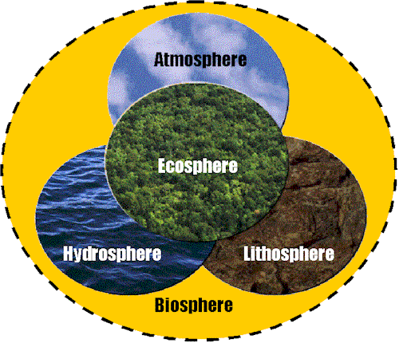
المجال الحيوي

Slide 2
The atmosphere
It is a mixture of N₂ (78%), O₂ (21%) and traces (remaining 1%) of CO₂, Argon, water vapor and other components
Although the atmosphere is approximately 1,100 km high, the stratosphere (10 to 50 km) and the troposphere (less than 10 km) are the main atmospheric interactors of the biosphere.
The atmosphere is a prime mean for the spatial diffusion of pollutants and a temporary mean of their accumulation.

Slide 3
The hydrosphere
It covers around 71% of the total earth's surface and is an important accumulator of pollutants.
It is the accumulation of water in all its states (solid, liquid and gas) and the elements dissolved it in (sodium, magnesium, calcium, chloride & sulphate).
97% of the water forms the oceans, 2% is ice (north and south poles) and 1% forms rivers, lakes, ground water and atmospheric vapor.

Slide 4
The lithosphere
The thin crust between the mantle and the atmosphere.
Although the lithosphere is around 100 km thick, only 1 km of it can be considered in interaction with the biosphere.
Main constituents are oxygen (47%), silicon (28%), aluminum (8%), iron (5%), calcium (4%), sodium (3%), potassium (3%) and magnesium (2%) in a crystalline state.

Slide 5
The Ecosphere
(The Biota)
all forms of living organisms, including fauna (wild & domesticated animals) & flora (higher & lower plants forms).
It is found in the atmosphere, hydrosphere & lithosphere.

Slide 6
What is ecology?
Eco = Oikos = Home
Ology = science or study
Why pants are not uniform on the earth?

Slide 7
Habitat:
The specific place or environment that meets the needs of an organism.

Slide 8
Species
Biological units with individuals of high genetic compatibility. The individuals of one species can mate together and produce fertile offspring.

Slide 9
Autecology
Study individual species and their environment

Slide 10
Synecology
Study plant communities and their environment

Slide 11
Environmental factors
-Climatic
-Edaphic
-Biotic
-Physiographic

