Slide 1
Soil Factor

Slide 2
Definition
Soil is the inconstant outer layer of earth's crust.
The thickness ranging between few mm up to more than 100 meters.
It is usually underlined by the parent material
The true soil is generally made of the same parent material which it covers.

Slide 3
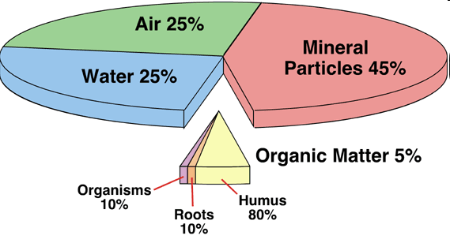
Soil Origin and Components
A true soil has five components:
1 - The mineral particles of various sizes and in different stages of chemical decomposition.
2 - Organic matter in various stages of decomposition ranging from raw litter to well decomposed humus.

Slide 4
3 - Soil solution of various inorganic salts
4 - Microorganisms both plants and animals
5- Soil air occupying interspaces not filled with soil solution.

Slide 5
Why Soil is important to plants?
1- Seed's germination
2- Seedling's growth
3- Root's branching
4-Depth of plants
5- Vigour of plants
6-Number of leaves/plant
7 - Number of flowers
8 -Yield of fruits
9 - Yield Quality.

Slide 6
Soil Parent Material
a) Residual and /or b) Transported

Slide 7
I) Residual soil parent materials
It is formed and deposited in the same place of formation.

Slide 8
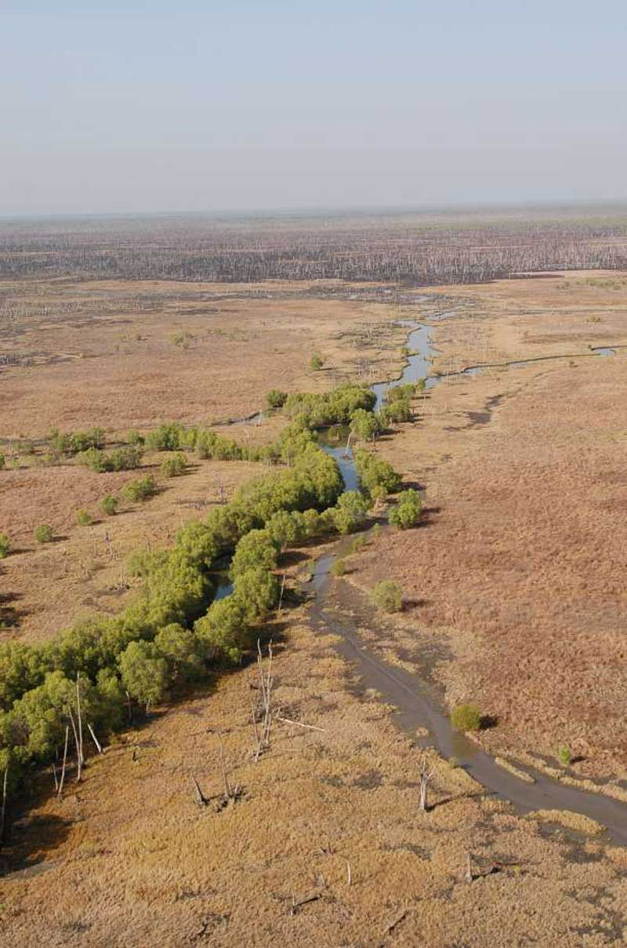
II) Transported Soil parent material
It is formed in one place and deposited in another place.
Soil transportation may be carried out through:
1- Soil transported by water are called alluvial soil
A-
Flood plains

Slide 9
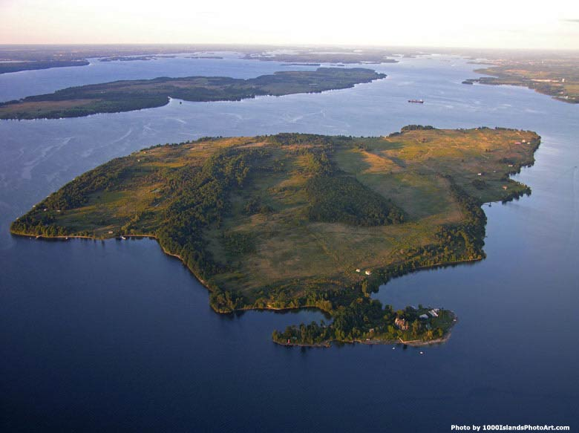
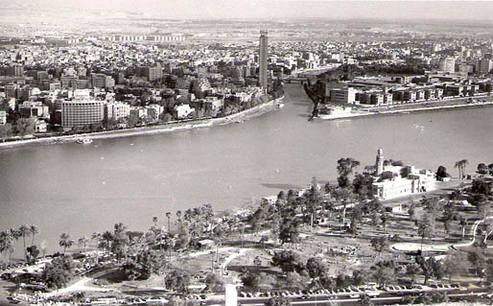
B-
Islands:

Slide 10
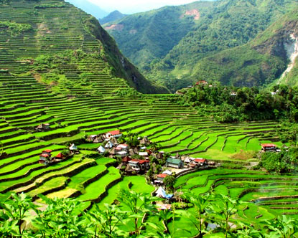
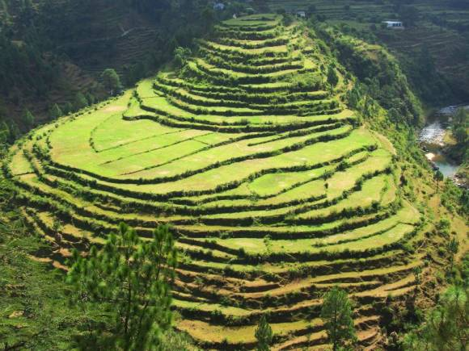
C-
Terraces

Slide 11
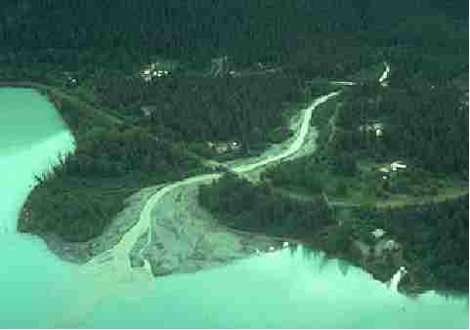
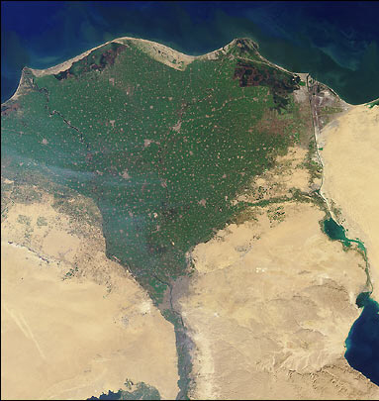
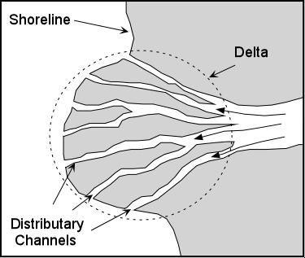
D-
delta

Slide 12
2-Soil transported by gravity are called colluvial soil

Slide 13
3- Soil transported by Ice balls (glaciers), are called glacial soil

Slide 14
4-Sandy soil transported by wind in the form of Plain dunes are called aeolian soil

Slide 15
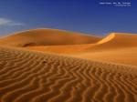
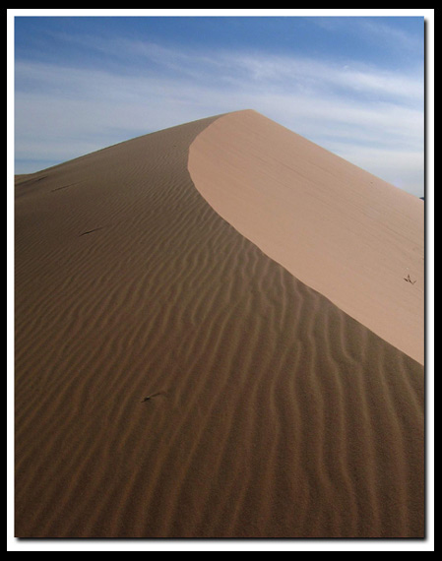
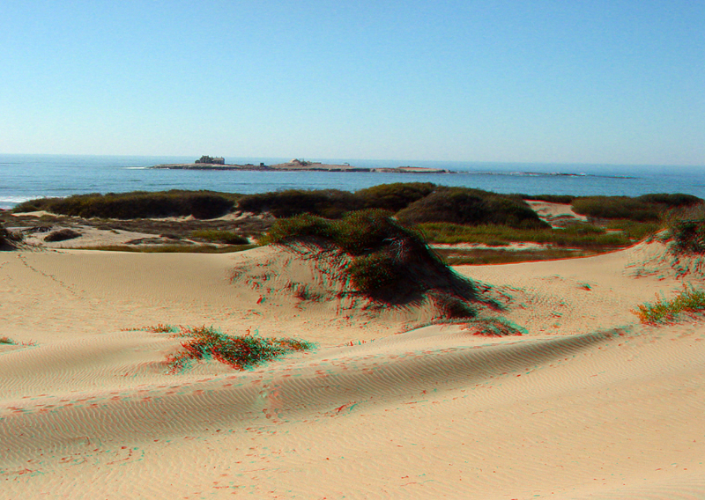
Transported by wind (aeolian soil
A- sand dunes

Slide 16
B- Loess
It is formed of finer particles usually silt and they have a yellowish- buff color carrying large amount of humus. Therefore, loess are fertile and cultivated

