Slide 1
Soil Physical properties

Slide 2
The American system for soil texture classification
Soil Particles | Diameter (mm)
Gravel | 2.00 mm
Pine gravel (very coarse sand) | 200-1.00 mm
Coarse sand | 1.00-0.500 mm
Medium sand | 0.5-0.25 mm
Fine sand | 0.25-0.10 mm
Very fine sand | 0.1-0.05 mm
Silt | 0.05-O.OO2 mm
Clay | 0.002 mm

Slide 3
Soil Properties
Distribution of particle size
1- Gravel
The larger soil particle which is not active
2- Sand
With large particle size and is not chemically active
3- Silt
(like fine sand) is inactive but with little physical activity
4- Clay
Clay is made of Colloidal particles (organic) & minerals (inorganic). It is the base of all chemical and physical activities of the soil.

Slide 4
Soil texture:
It is the proportion of soil fractions
Sandy soil:
Sand is the major component in light soil
sand is above 80 %.
Clay soil:
Clay is the major component in heavy soil
clay is above 30 % it is clay soil.

Slide 5
We have sandy soil, loamy soil, silty soil, clay soil.
-If there are almost equal proportions of sand (35%) silt (.45%) and clay (20%) the soil is loamy (e.g. 35 % sand + 45% silt + 20% clay: = loamy soil).
-The soil is silty when the silt is above 60% and clay less than 20%

Slide 6
Soil temperature
Soil temperature affects all the biological, chemical and physical processes in soil.
1-It affects the rate of water & solutes absorption,
2- seed's germination,
3-rate of underground plant parts growth
as well as
4-the activities of microorganisms.

Slide 7
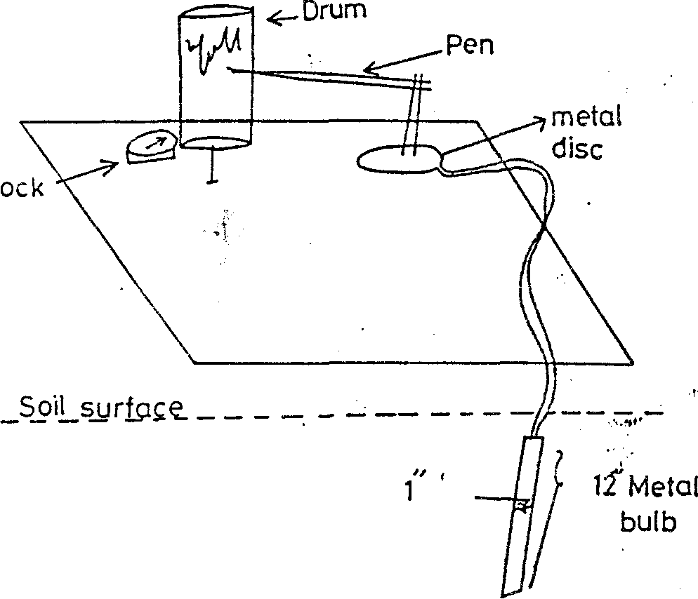
Measurement of soil temperature
Soil Thermograph

Slide 8
Factors affecting soil temperature
Soil Color
Structure,
Texture,
Organic matter content,
Water content,
Slope of soil surface and exposure to sun rays
Presence or absence of Vegetation

Slide 9
Soil water (moisture)
Required for plant growth Solvent for nutrients
Types of soil water
1 – Gravitational water:
Amount of water move under the effect of gravity – not used by plants
2- Capillary water:
Amount of water held in capillary pores and forms thin film around soil particles -- Used by plants – main source
3- Hygroscopic water:
Amount of water held by soil particles not in pores and forms thin film around soil particles (air dry soil) -- not in used by plants
4- Water vapour:
Amount of water in air pores– not used by plants
5- Combined water:
Amount of water combined in some soil minerals – not used by plants

Slide 10
Soil moisture constants
1- Maximum water holding capacity:
Water hold by a saturated soil
2 - Field capacity:
It this is the amount of soil water that remains after all gravitational water is drained away in the field.
This value may be reached after a heavy irrigation for a few hours to 3 days.
3- Permanent wilting point:
The percentage of water that remains in a soil when permanent wilting is attained is called the-permanent wilting percentage or wilting coefficient.
It varies between 1-15 % depending upon the texture of soil and includes all the hygroscopic water plus a portion of the capillary water.

Slide 11
4 - Available water:
This the range of moisture content between field capacity and the permanent wilting point.
It is small in coarse-grained soil (sand), sometimes less than 1% but higher in silt, loam or clay soils and may amount to 20 % or more.
5 - Unavailable water:
The water holds in soil at permanent wilting point is unavailable to plants. Such water (moisture) includes hygroscopic water and the portion of capillary water which is removed too slowly by plants to prevent wilting.

