Slide 1
Classification of Soil Parent Materials

Slide 2
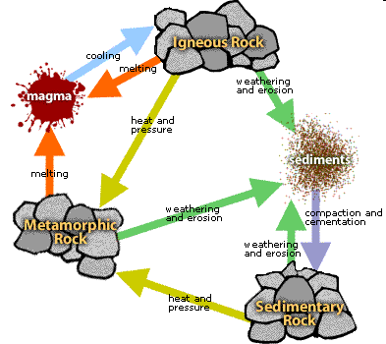

Slide 3
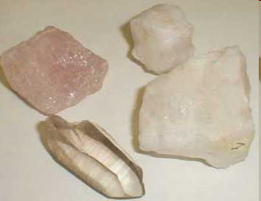
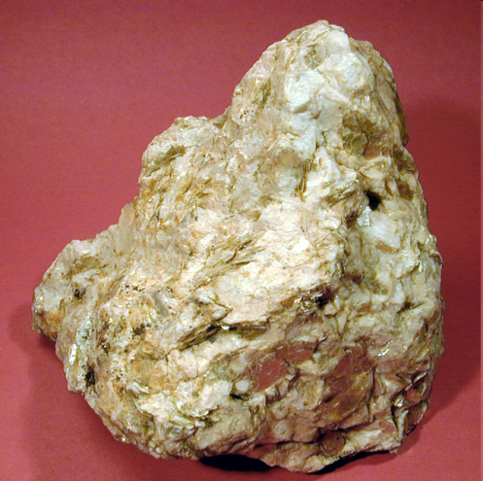
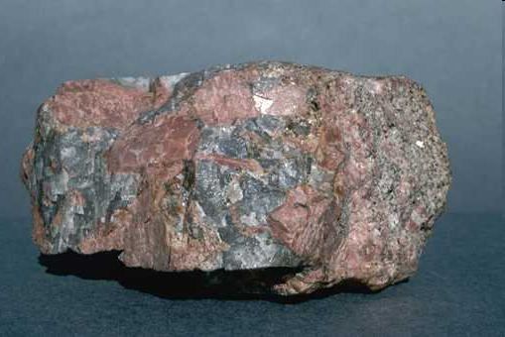
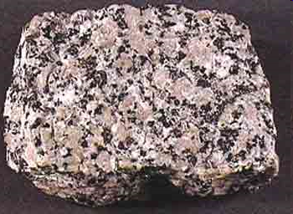
Igneous rocks

Slide 4
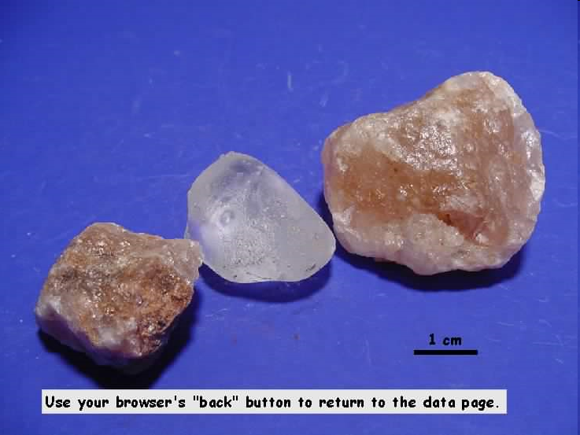
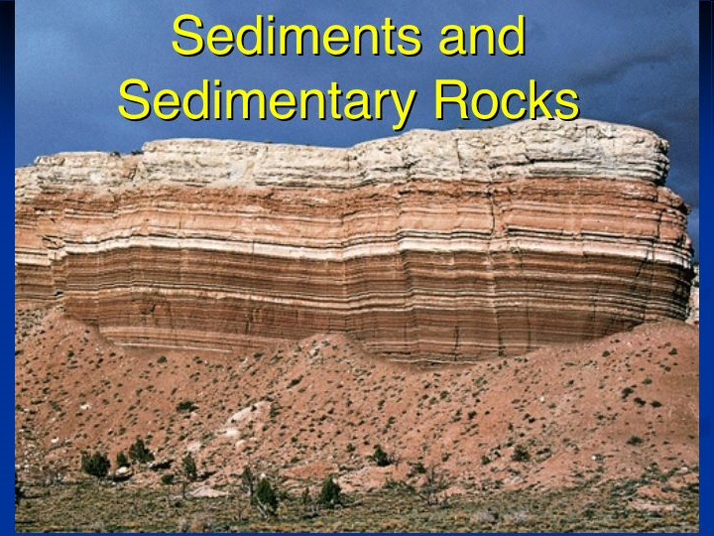
Sedimentary Rocks

Slide 5
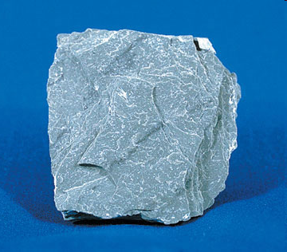
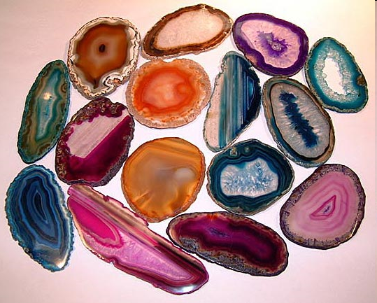
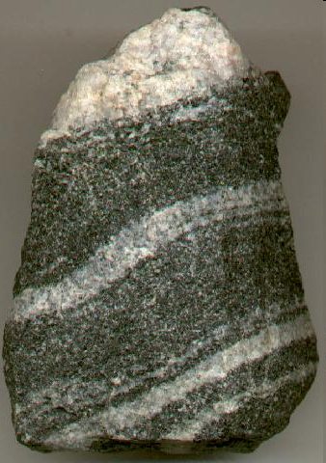
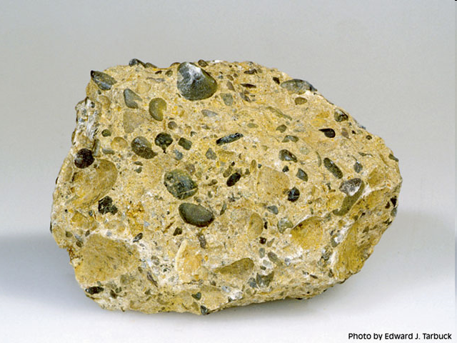
Metamorphic

Slide 6
Soil Development by 3 processes
1- Mechanical disintegration (weathering or erosion)
Temperature
water
Wind
2- Chemical decomposing
(a) Oxidation
(b) Reduction
(c) Hydration
(d) Hydrolysis
(e) Carbonation
(F) Solution
3- Biological activity decomposing
Soil animals
Soil Microorganisms

Slide 7
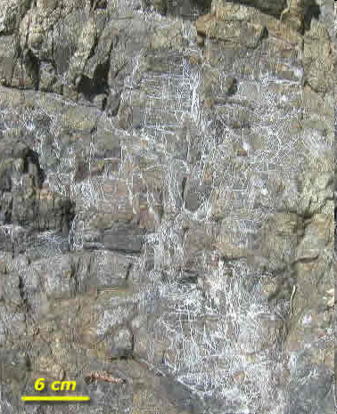
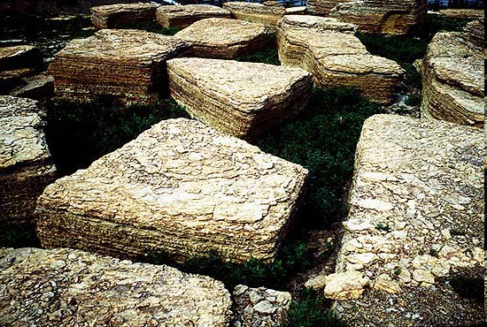
Soil Formation
1- Mechanical (disintegration) processes

Slide 8

1) Oxidations:
Sulfur compounds are oxidized in soils to sulfuric acid
SO3 + H2O H2SO4,
Fe++ Fe+++
2) Reduction:
In water logged soil, ferric irons are reduced to ferrous form
Fe+++ Fe++
3) Hydration
Hydration causes physical disintegrate of rock because the hydrated compounds occupy more space and play an active role in weathering 2Fe2O3+ 3H2O 2Fe2O3.3H2O

Slide 9
4) Hydrolysis
This process goes on extensively with minerals containing strongly basic elements parts of which are exchanged for Hydrogen
CaSiO3 + 2H2O Ca(OH)2 + H2SiO3
5) Carbonation
The decomposition of organic mater in the soil and the respiration of plant roots liberate large quantities of CO2 in the soil air. This gas readily combines with bases, producing carbonates or bicarbonates. Carbonic acid is also formed and acts on rocks.
Ca(OH)2 + CO2 Ca(HCO3)2
6) Solutions
Solutions occur in soil in the form of acids e.g. HNO2; H2SO4; HCO3 etc
These acids are developed in soil through chemical and biological agencies

Slide 10
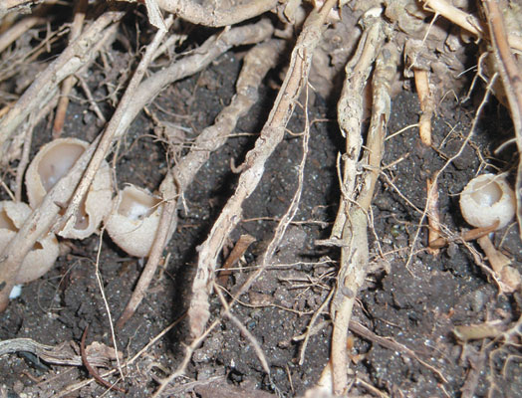
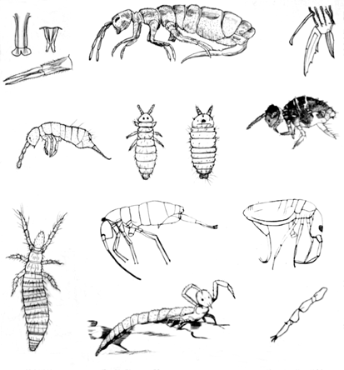
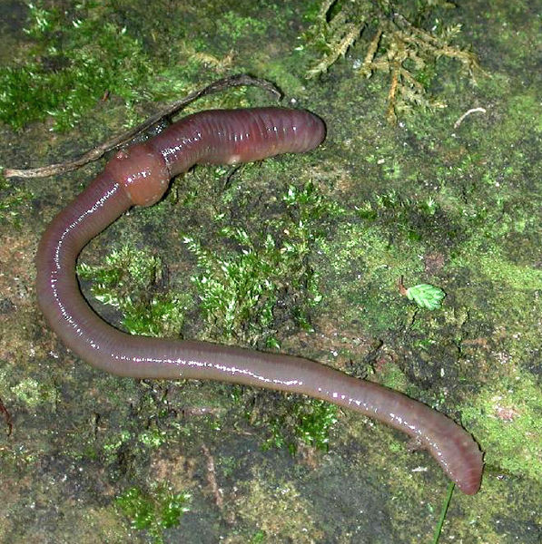


Slide 11
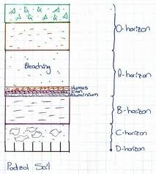
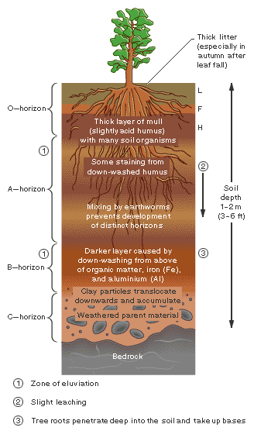
Soil Profile
- Downward section in soil
- 3 layers result from weathering

