Slide 1
Soil Microbiology
Third year botany
307B
Lecture 7(2)
Dr. Mahmoud Nour El-Dein

Slide 2
3. Nitrification
Ammonia released during ammonification are oxidized to nitrates and the process is called “nitrification”.
Soil conditions such as well aerated soils rich in calcium carbonate, a temperature below 30 °C, neutral pH and less organic matter are favorable for nitrification in soil.

Slide 3
Nitrification is a two- stage process and each stage is performed by a different group of bacteria as follows
Stage I:
Oxidation of ammonia of nitrite is brought about by ammonia oxidizing bacteria viz. Nitrosomonas europaea, Nitrosococcus nitrosun, Nitrosospira briensis, Nitrosovibrio and Nitrocystis and the process is known as nitrosification. The reaction is presented as follows
2 NH₃ + ½ O₂ NO₂ + 2 H + H₂ O Ammonia Nitrite

Slide 4
Stage II:
In the second step nitrite is oxidized to nitrate by nitrite-oxidizing bacteria such as Nitrobacter winogradsky, Nitrospira gracilis, Nitrosococcus mobilis and several fungi (e.g. Penicillium, Aspergillus) and actinomycetes (e.g. Streptomyces, Nocardia).
NO₂ (-) + ½ O₂ NO₃ Nitrite ions Nitrate ions

Slide 5
The nitrate thus, formed may be utilized by the microorganisms, assimilated by plants, reduced to nitrite and ammonia or nitrogen gas or lost through leaching depending on soil conditions.
The nitrifying bacteria (ammonia oxidizer and nitrite oxidizer) are aerobic gram-negative and chemoautotrophic and are the common inhabitants of soil, sewage and aquatic environment.

Slide 6
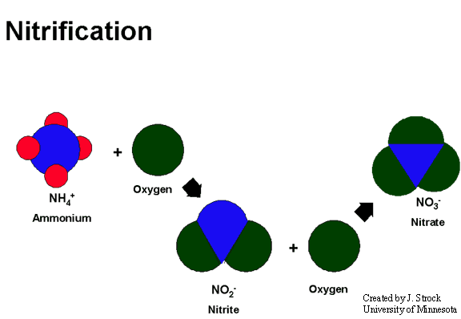
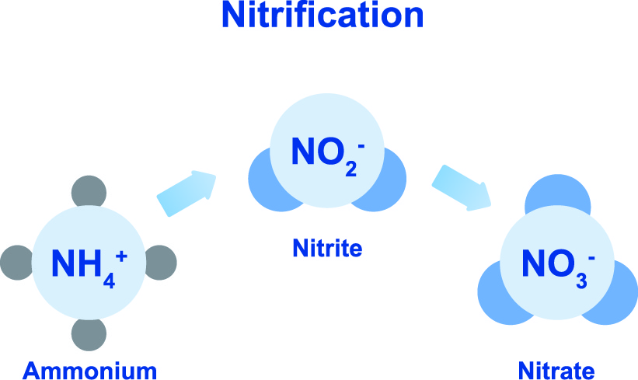

Slide 7
4. Nitrate Reduction:
Several heterotrophic bacteria (E. coli, Azospirillum) are capable of converting nitrates to nitrites and nitrites to ammonia. Thus, the process of nitrification is reversed completely which is known as nitrate reduction Nitrate reduction normally occurs under anaerobic soil conditions (water logged soils) and the overall process is as follows

Slide 8
Nitrate HNO₃ + 4 H₂ NH₄ + 3 H₂0 Nitrate Reductase ammonium
Nitrate reduction leading to production of ammonia is called "dissimilatory nitrate reduction" as some of the microorganisms assimilate ammonium for synthesis of proteins and amino acid.

Slide 9
5. Denitrification
This is the reverse process of nitrification. During denitrification nitrates are reduced to nitrites and then to nitrogen gas and ammonia. Thus, reduction of nitrates to gaseous nitrogen by microorganisms in a series of biochemical reactions is called “denitrification". The process is wasteful as available nitrogen in soil is lost to atmosphere. The overall process of denitrification is as follows
NaR NiR NOR NOR Nitrate Nitrite Nitric Oxide Nitrous Oxide Nitrogen gas

Slide 10
This process also called dissimilatory nitrate reduction as nitrate nitrogen is completely lost into atmospheric air. In the soils with high organic matter and anaerobic soil conditions (waterlogged or ill-drained) rate of denitrification is more. Thus, rice / paddy fields are more prone to denitrification
The most important denitrifying bacteria are Thiobacillus denitrificans, Micrococcus denitrificans, and species of Pseudomonas, Bacillus, Achromobacter, Serratia paracoccus etc.
Denitrification leads to the loss of nitrogen (nitrate nitrogen) from the soil which results into the depletion of an essential nutrient for plant growth and therefore, it is an undesirable process from the soil fertility and agricultural productivity.

Slide 11
Although, denitrification is an undesirable reaction from agricultural productivity, but it is of major ecological importance since, without denitrification the supply of nitrogen including N2 of the atmosphere, would have not got depleted and NO3 (which are toxic) would have accumulated in the soil and water.

Slide 12
Phosphorus Cycle or Transformation
Phosphorus is only second to nitrogen as a mineral nutrient required for plants, animals and microorganisms.
It is a major constituent of nucleic acids in all living systems essential in the accumulation and release of energy during cellular metabolism
This element is added to the soil in the form of chemical fertilizers, or in the form of organic phosphates present in plant and animal residues.
In cultivated soils it is present in abundance (i.e. 1100 kg/ha), but most of which is not available to plants, only 15 % of total soil phosphorus is in available form

Slide 13
Both inorganic and organic phosphates exist in soil and occupy a critical position both in plant growth and in the biology of soil.
Microorganisms are known to bring a number of transformations of phosphorus, these include
(i) Altering the solubility of inorganic compounds of phosphorus
(ii) Mineralization of organic phosphate compounds into inorganic phosphates
(iii) Conversion of inorganic, available anion into cell components i.e. an
(iv) Oxidation or reduction of inorganic phosphorus compounds. Of these mineralization and immobilization are the most important processes in phosphorus cycle

Slide 14
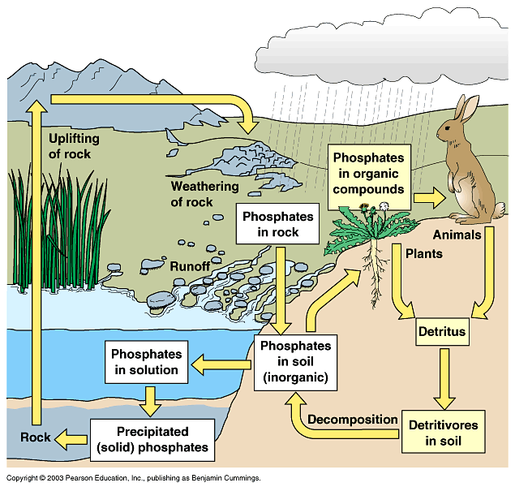

Slide 15
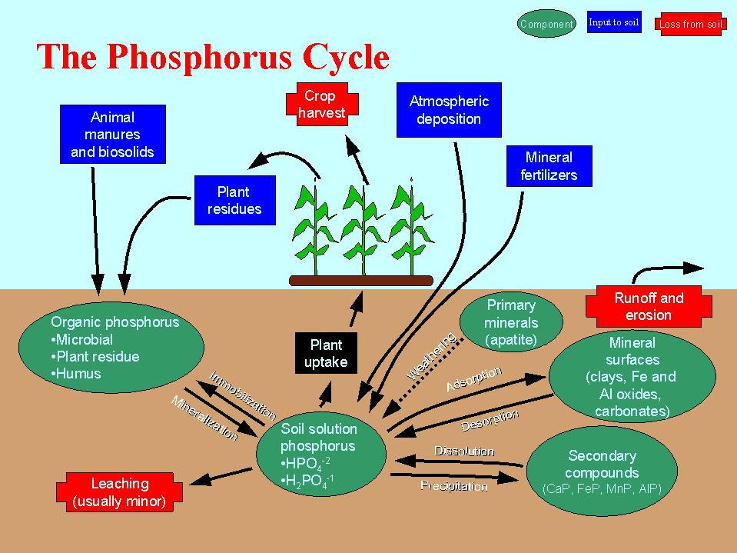

Slide 16
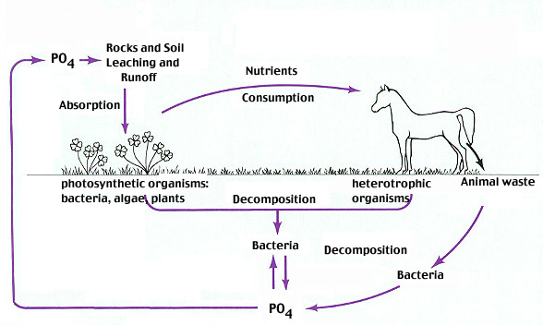

Slide 17
Insoluble inorganic compounds of phosphorus are unavailable to plants, but many microorganisms can bring the phosphate into solution
Soil phosphates are rendered available either by plant roots or by soil microorganisms through secretion of organic acids (e.g. lactic, acetic, formic, fumaric, succinic acids etc)

Slide 18
phosphate-dissolving soil microorganisms
(e.g. species of Pseudomonas, Bacillus, Micrococcus, Mycobacterium, Flavobacterium, Penicillium, Aspergillus, Fusarium.)
plays important role in correcting phosphorus deficiency of crop plants
They may also release soluble inorganic phosphate (H₂PO₄), into soil through decomposition of phosphate-rich organic compounds

Slide 19
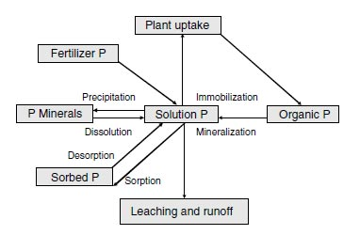
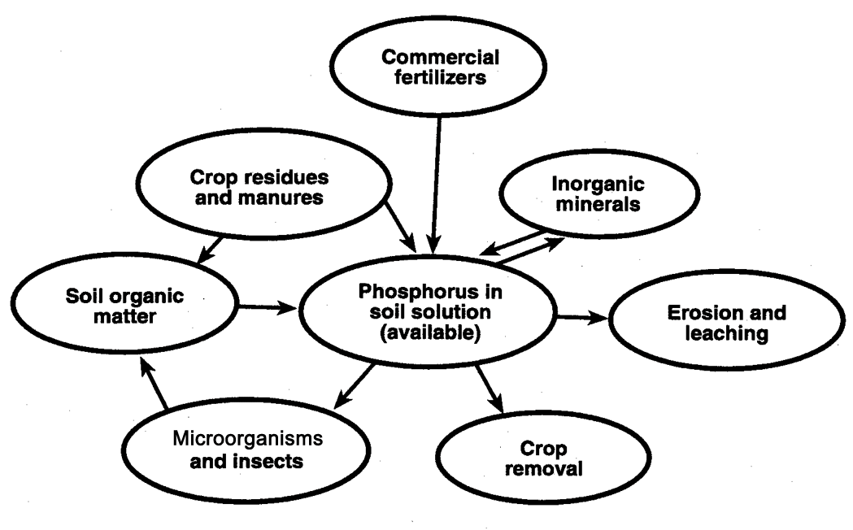

Slide 20
Solubilization of phosphate by plant roots and soil microorganisms is substantially influenced by various soil factors, such as pH, moisture and aeration
In neutral or alkaline soils solubilization of phosphate is more as compared to acidic soils.
Many phosphates solubilizing microorganisms are found in close proximity of root surfaces and may appreciably enhance phosphate assimilation by higher plants
By their action, fungi, bacteria and actinomycetes make available the organically bound phosphorus in soil and organic matter and the process is known as mineralization

Slide 21
On the other hand, certain microorganisms especially bacteria assimilate soluble phosphate and use for cell synthesis and on the death of bacteria, the phosphate is made available to plants
A fraction of phosphate is also lost in soil due to leaching. One of the ways to correct deficiency of phosphorus in plants is to inoculate seed or soil with commercial preparations (e.g. Phosphobacterin) containing phosphate - solubilizing microorganisms along with phosphatic fertilizers

Slide 22
Mineralization of phosphate is generally rapid and more in virgin soils than cultivated land. Mineralization is favored by high temperatures (thermophilic range) and more in acidic to neutral soils with high organic phosphorus content
The enzyme involved in mineralization (cleavage) of phosphate from organic phosphorus compound is collectively called as “Phosphatases".
The commercially used species of phosphate solubilizing bacteria and fungi are: Bacillus polymyxa, Bacillus megatherium. Pseudomonas striata, Aspergillus, Penicillium awamori and Mycorrhiza

Slide 23
Iron Cycle or Transformation
Iron exists in nature either as ferrous (Fe++) or ferric (Fe+++) ions. Ferrous iron is oxidized spontaneously to ferric state, forming highly insoluble ferric hydroxide
Plants as well as microorganisms require traces of iron, manganese copper, zinc, molybdenum, calcium boron, cobalt etc. Iron is always abundant in terrestrial habitats, and it is oftenly in an unavailable form for utilization by plants and leads to the serious deficiency in] plants

Slide 24
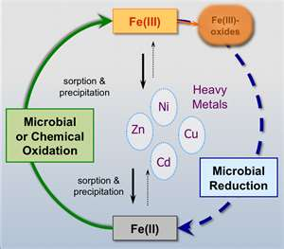

Slide 25
Soil microorganisms play important role in the transformations of iron in a number of distinctly different ways such as
A. Certain bacteria oxidize ferrous iron to ferric state which precipitate as ferric hydroxide around cells
B. Many heterotrophic species attack on in soluble organic iron salts and convert into inorganic salts
C. Oxidation-reduction potential decreases with microbial growth and which leads to the formation of more soluble ferrous iron from highly insoluble ferric ions
D. Number of bacteria and fungi produce acids such as carbonic, nitric, Sulphuric and organic acids which brings iron into solution
E. Under anaerobic conditions, the sulfides formed from sulphate and organic sulphur compounds remove the iron from solution as ferrous sulfide
F. As microbes liberate organic acids and other carbonaceous products of metabolism which results in the formation of soluble organic iron complex

Slide 26
Thus, iron may be precipitated in nature and immobilized by iron oxidizing bacteria under alkaline soil reaction and on the other hand solubilization of iron may occur through acid formation
Some bacteria are capable of reducing ferric iron to ferrous which lowers the oxidation-reduction potential of the environment (e.g. Bacillus, Clostridium, Klebsiella)
However, some chemoautotrophic iron and sulphur bacteria such as Thiobacillus ferooxidans and can oxidize ferrous iron to ferric hydroxide which accumulates around the cells

Slide 27
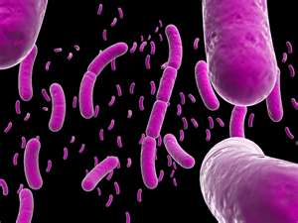
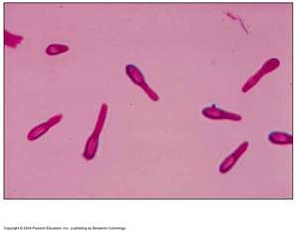
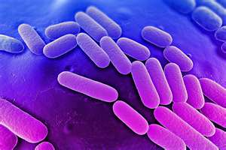
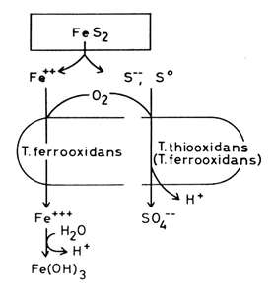

Slide 28
Most of the aerobic microorganisms live in an environment where iron exists in the oxidized, insoluble ferric hydroxide form.
They produce iron-binding compounds in order to take up ferric iron. The iron-binding or chelating compounds produced by microorganisms are called "Siderophores"

Slide 29
Bacterial siderophores may act as virulence factors in pathogenic bacteria and thus, bacteria that secrete siderophores are more virulent than non- siderophores producers. Therefore, siderophore producing bacteria can be used as biocontrol agent's e.g. Fluorescent pseudomonads used to control Pythium, causing damping-off diseases in seedlings.
Recently Vascular - Arbuscular – Mycorrhiza (VAM) has been reported to increase uptake of iron.

