Slide 1
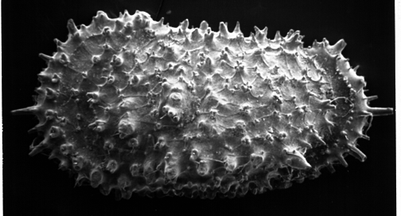
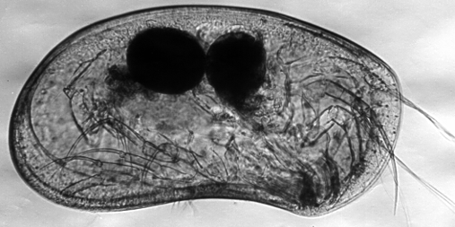
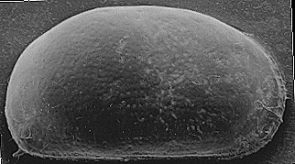
OSTRACODA
It belongs to phylum crustacea and class ostracoda.
Known as seed shrimps
Live in various niches: ocean platform, on sea floor, fresh water ponds, humid forest soils, mostly common among the shallow marine benthos).
Used as:
1- Tools for biozonation of marine strata, as they occur from Cambrian to the Present.
2- Indicators of ancient marine shorelines salinity, relative sea-floor depth

Slide 2
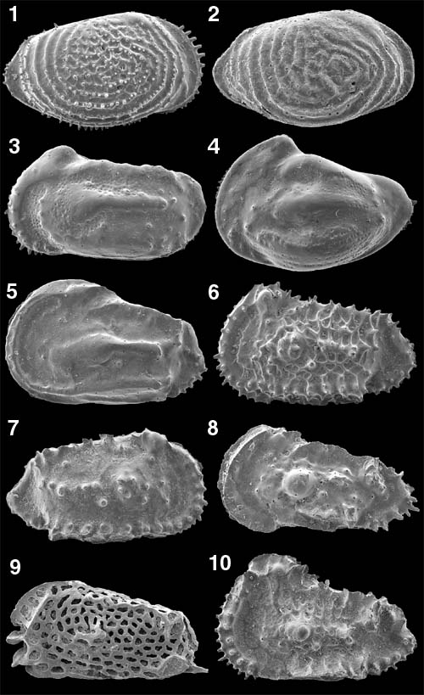
1) Neocythere denticulata
2) Neocythere vanveenae
3) Mandocythere harrisiana
4) Protocythere albae
5) Cornicytereis larivourensis
6) Cythereis reticulata
7) Cythereis folkestonensis
8) Isocythereis fortinodis
9) Platycythereis gaultina
10) Rehacythereis luermannae

Slide 3
MORPHOLOGY OF THE OSTRACOD CARAPACE
Composition of carapace: Chitinous (rarely fossilized) and calcareous (fossilized).
Size: range from 0.3-30 mm long (average size is typically about 1mm long).
Shape: ovate, kidney, or bean-shaped.
Carapace consists of two valves (right and left). These two valves are connected at the dorsum by a hinge and separate at the ventral.
Valves of a shell are not commonly the same size, so one overlaps the other.

Slide 4
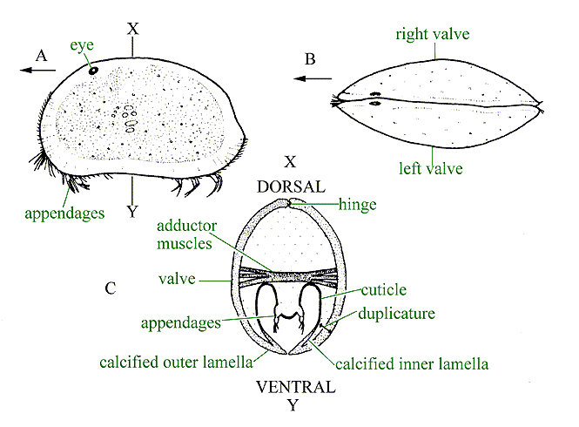

Slide 5
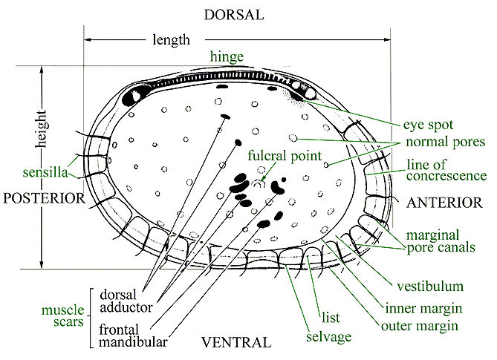

Slide 6
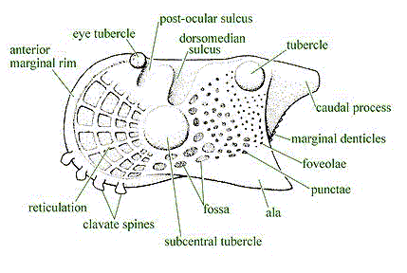
TACTILE FEATURES (feeling by the surrounding environment):
-- Setae (from pore canals and marginal pore canals)
-- Eyes (near eye spot/eye tubercle, specially for shallow water forms, deep water forms are blind).
Ornamentation:
The outer surfaces of the ostracod valves can be smooth or ornamented with pits, striations, reticulations, spines, sulci, tubercles, wings-shaped (alae).

Slide 7
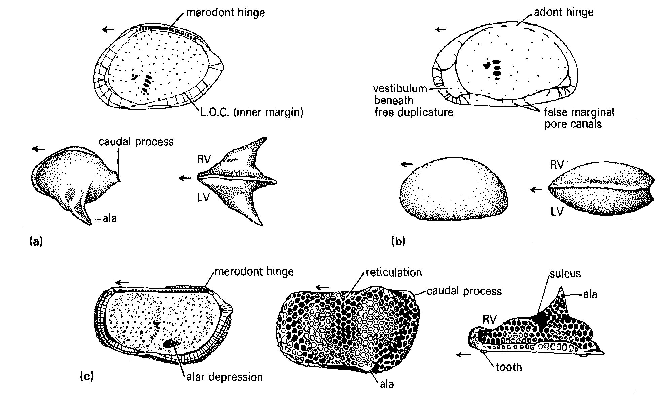
Common ornamentations in ostracods

Slide 8
ORIENTATION OF THE SHELL
From side view:
-Rounded end (the highest) )is anterior and pointed end is posterior.
-Dorsal outline is convex (often straight), while the ventral outline is straight, concave or sometimes with less convexity.
- eye-spot (if present) occur in an anterodorsal position.
From dorsal/ventral view:
- Broadest region occurs near the posterior
From the interior: adductor muscle scars occur near the anterior end.
Spines and alae (wings) are generally directed towards the posterior.
Ornamentation is heavier at the posterior than is at the anterior.

Slide 10
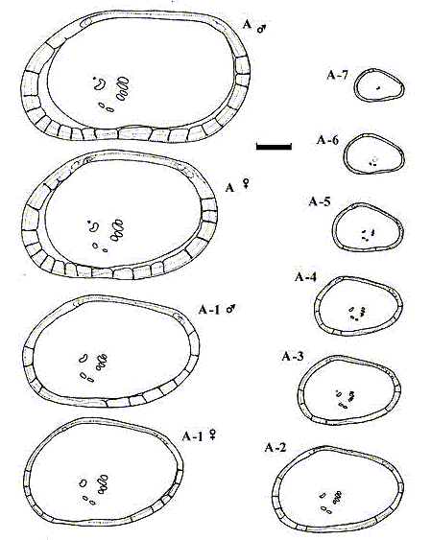
ONTOGENY
Ostracods grow by moulting. There are usually eight moults between the egg and the adult.
What is the dimorphism?
Dimorphic two shells are typically similar in everything but not in size. Male-shell is generally longer than the female-shell.

Slide 11
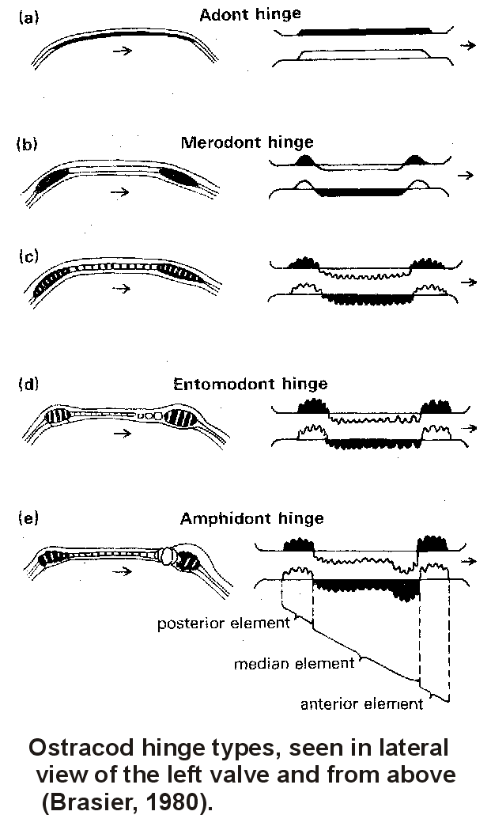
ARTICULATION
Can be done by the following:
Ligament (chitinous material,
unfossilized)
Hinge (teeth, sockets, ridges and
grooves)
- Adont hinge
- Merodont hinge
- Entomodont hinge
- Amphidont hinge
3. Ridges on the duplicature
Adductor muscles (leave muscle
scars inside and a subcentral tubercle/sulcus outside).

