Slide 1
208M
Molecular Biology (1)
Dr. Heba Ebeed
2020

Slide 2
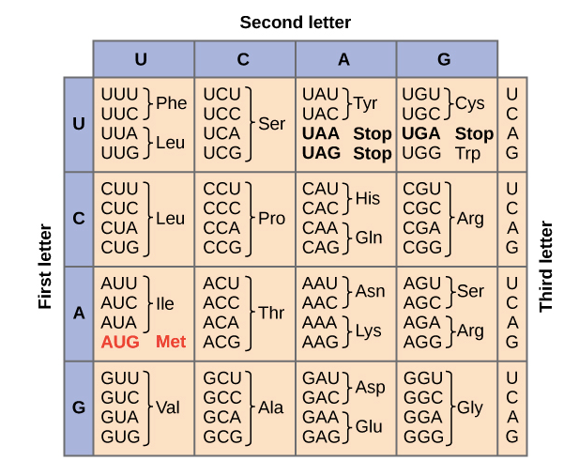
Translation
Genetic code

Slide 4
Ribosomes

Slide 5
Transfer RNAs (tRNAs)

Slide 6
Some tRNAs bind to multiple codons ("wobble")

Slide 7
The 3D structure of a tRNA

Slide 8
Loading a tRNA with an amino acid

Slide 9
Steps of translation
Initiation
Elongation
Termination

Slide 10
Initiation
In order for translation to start, we need a few key ingredients. These include:
A ribosome (which comes in two pieces, large and small)
An mRNA with instructions for the protein we'll build
An "initiator" tRNA carrying the first amino acid in the protein, which is almost always methionine (Met)
During initiation, these pieces must come together in just the right way. Together, they form the initiation complex, the molecular setup needed to start making a new protein.

Slide 11
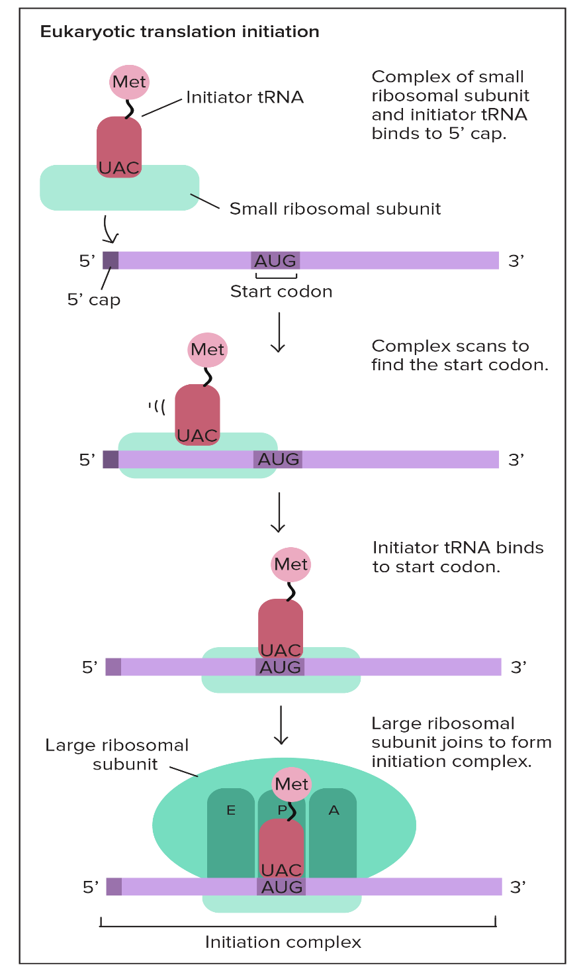

Slide 14
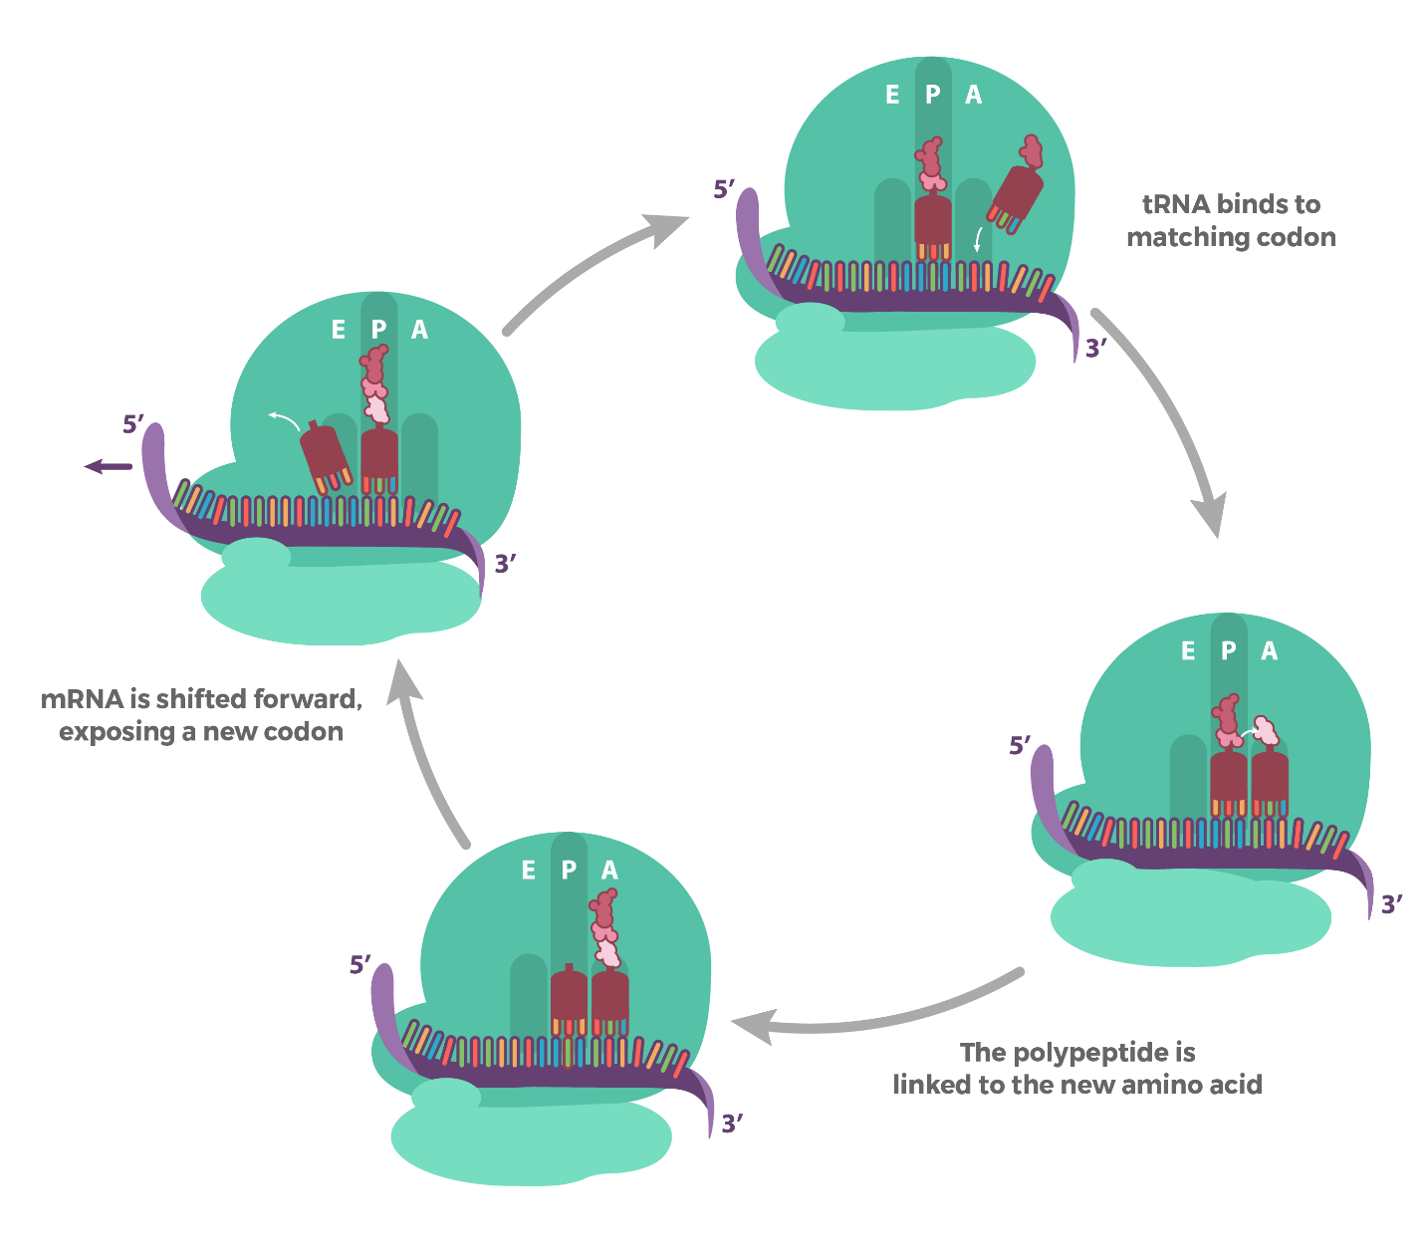
Elongation
Elongation is the stage where the amino acid chain gets longer. In elongation, the mRNA is read one codon at a time, and the amino acid matching each codon is added to a growing protein chain.

Slide 16
Termination
Termination happens when a stop codon in the mRNA (UAA, UAG, or UGA) enters the A site.

Slide 17
Protein targeting

Slide 18
The endomembrane system and secretory pathway

Slide 19
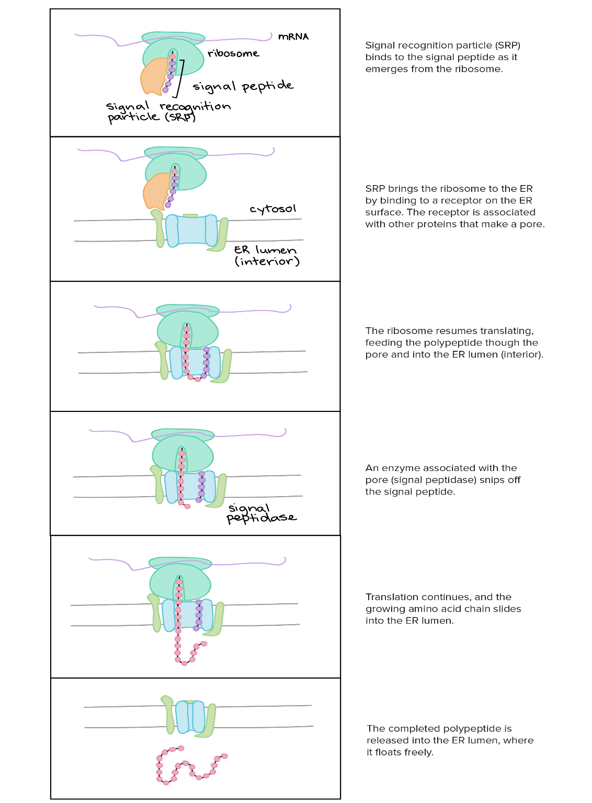
Signal peptides

Slide 20
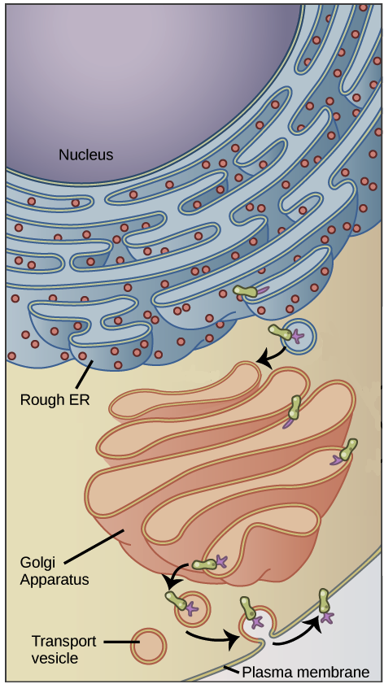
Transport through the endomembrane system

Slide 21
Targeting to non-endomembrane organelles

