Slide 1
208M
Molecular Biology (1)
Dr. Heba Ebeed
2020

Slide 2
Protein targeting

Slide 3
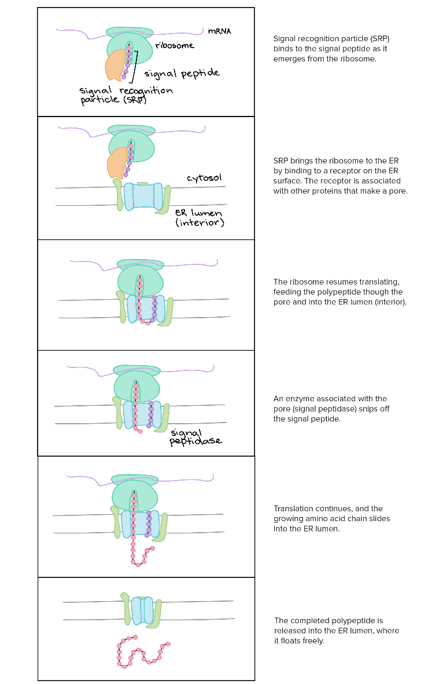
The endomembrane system and secretory pathway
Signal peptides

Slide 4
Transport through the endomembrane system

Slide 5
Targeting to non-endomembrane organelles

