Slide 1
208M
Molecular Biology (1)
Dr. Heba Ebeed
2020

Slide 2
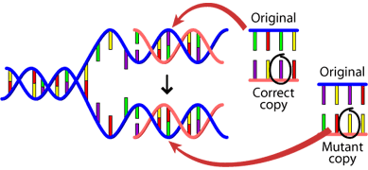
Damage, Repair and Mutation
DNA Damage: Causes and Effects
Mutations happen for several reasons.
1. DNA fails to copy accurately
2. External influences can create mutations

Slide 3
Mechanism of DNA repair

Slide 4
Mismatch repair

Slide 5
DNA damage repair mechanisms
Reversal of damage

Slide 6
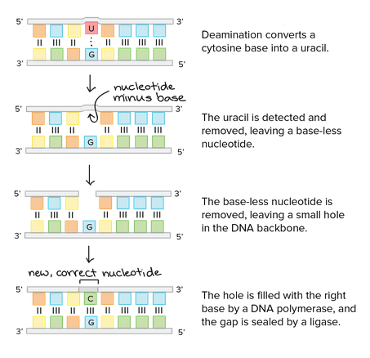
DNA damage repair mechanisms
Base excision repair

Slide 7
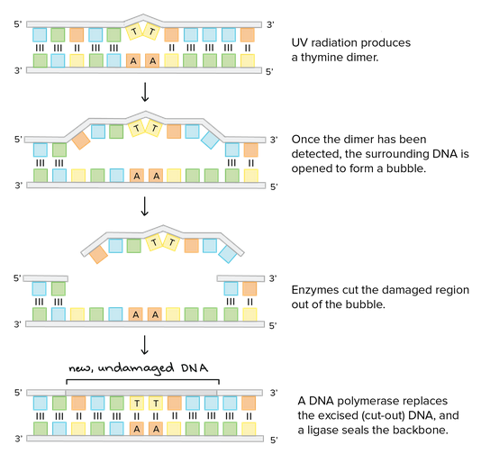
DNA damage repair mechanisms
Nucleotide excision repair

Slide 8
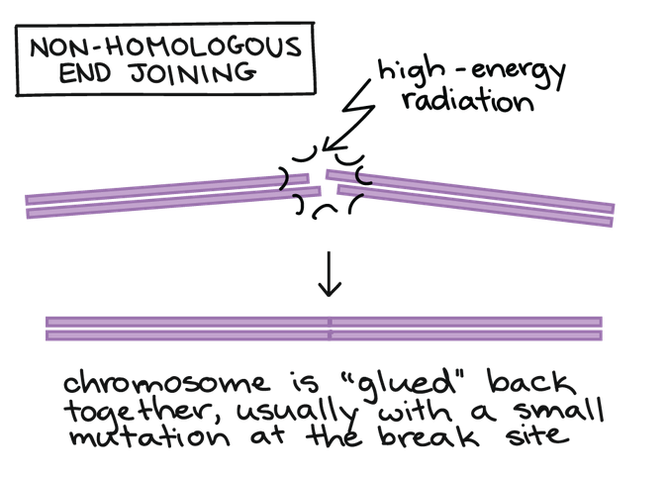
DNA damage repair mechanisms
Double-stranded break repair

