Slide 1
Microbial Enzymes
Final
Lectures 5-12

Slide 2
Enzyme Kinetics
Two-substrate kinetics
One-substrate kinetics

Slide 3
Two-substrate kinetics
  1- Ternary Enzyme-substrate complexes
a- Random order mechanism
b- Compulsory order mechanism
2- Binary Enzyme-substrate complexes

Slide 4
Random order mechanism
ES2
+S1
S1
+
ES1S2
E
+
ES1
+S2
S2

Slide 5
Compulsory order mechanism
S1 + E ES1
Leader substance
ES1 + S2 ES1S2

Slide 6
Binary Enzyme-substrate complexes
E + S1 ES1 P1 + F
F + S2 FS2 P2 + E
Example: Transaminases
Aspartate
E
E-aspartate
F-Oxaloacetate
Oxaloacetate
α-Ketoglutaric acid
F- α-Ketoglutaric acid
F
E-Glutamic acid
E + Glutamic acid

Slide 7
Enzyme Kinetics
One-substrate kinetics
S + E
SE
P + E
+I
ESI
EI
K1
K3
S + E
SE
P + E
K2

Slide 8
(Km) = (K2+K3)/K1
K2>>>K3 K3 is negligible
(Km) = K2/K1
K1
K3
S + E
SE
P + E
K2
[SE]K2
[S][E]K1 = [SE]K2
[E]=
[S]K1

Slide 9
[SE]Km
(Km) = K2/K1
[E]=
[S]
v depends on the [tot E] (free and bound)
[SE]Km
[tot E]= [SE]+[E]
[tot E]= [SE]+
[S]
v depends on dissociation of [SE] (K3)
v α [SE]
v= K3 [SE]

Slide 10
v [SE]K3
=
[SE]Km
[tot E] [SE]+
[S]
v [SE]K3
=
Km
[tot E] [SE](1+ )
[S]
v K3
v K3
=
=
Km
[S]+Km
[tot E] ( )
[tot E] (1+ )
[S]
[S]

Slide 11
v [S]K3
[tot E]K3[S]
=
v
=
[tot E]
[S]+Km
[S]+Km
[tot E]K3 determines the maximum reaction velocity (Vmax)
Vmax[S]
v
Michaelis-Menten equation
=
↔
[S]+Km

Slide 12
Vmax[S]
v
=
[S]+Km
At [S]>>>Km
v = Vmax [S] / [S]
v = Vmax
At [S] = Km
v = Vmax [S] / [S] + [S]
v = Vmax / 2

Slide 13
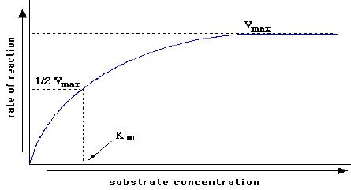
Michaelis-Menten plot

Slide 14
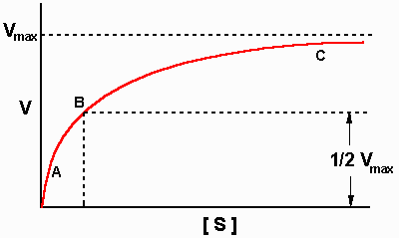
Determination of kinetic constants (Vmax and Km)
Inaccurate
Michaelis-Menten equation
Michaelis-Menten plot

Slide 15
Accurate
1- Lineweaver-Burk equation
v = Vmax [S] / (Km + [S])
1/v = (Km / Vmax [S]) + ([S] / Vmax [S])
= (Km / Vmax [S]) + (1 / Vmax)
1/v =(Km / Vmax)(1/[S]) + (1 / Vmax)
y= ax+b

Slide 16
Lineweaver-Burk plot
1/v
Slop = Km/Vmax
1/Vmax
-1/Km
1/ [S]

Slide 17
Effects of inhibitors on kinetic parameters
1- Competitive inhibitors
Vmax unchanged
Km increased
Michaelis-Menten plot
Vmax
-I
v
+I
Vmax/2
Km1
Km2
[S]

Slide 18
Lineweaver-Burk plot
+I
-I
1/v
Slop = Km/Vmax
1/Vmax
-1/Km1
-1/Km2
1/[S]

Slide 19
2- Non-competitive inhibitors
Vmax decreased
Km unchanged
Michaelis-Menten plot
v
Vmax1
-I
Vmax2
+I
Vmax1/2
Vmax2/2
Km
[S]

Slide 20
Lineweaver-Burk plot
1/v
+I
-I
1/Vmax2
Slop = Km/Vmax
1/Vmax1
-1/Km
1/[S]

Slide 21
Km | Vmax
increased | unchanged | Competitive inhibitors
unchanged | decreased | Non-competitive inhibitors

Slide 22
Classification of Enzymes
depends on the reaction nature that catalyzes
6 groups
    Hydrolases
    Oxidoreductases
    Lyases
    Isomerases
    Transferases
    Ligases (Synthetases)

Slide 23
A- Carbohydrases
B- Esterases
1- Hydrolases
C- Amidases
D- Proteolytic enzymes
AB + H₂O AH + BOH

Slide 24
Glycosidases
  Hydrolyze oligosaccharides
  α-glucosidase (Maltase)
  β-glucosidase
  β-fructosidase (Invertase)
A- Carbohydrases
Polysaccharases
Hydrolyze polysaccharides
Amylase
Cellulase

Slide 25
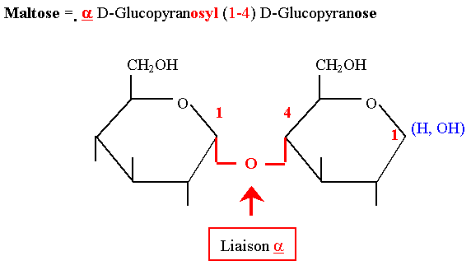
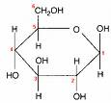
  = α-glucosidase (Maltase)
Maltase
Maltose 2 glucose units
H₂O

Slide 26
  = β-glucosidase
  Emulsin (Amigdalase + Pronase + Mandilonitrilase)
Amigdalase
Amigdaline glucose + pronasine
H₂O
Pronase
pronasine glucose + mandilonitile
H₂O
Mandilonitrilase
mandilonitile benzaldehyde + HCN
H₂O

Slide 27
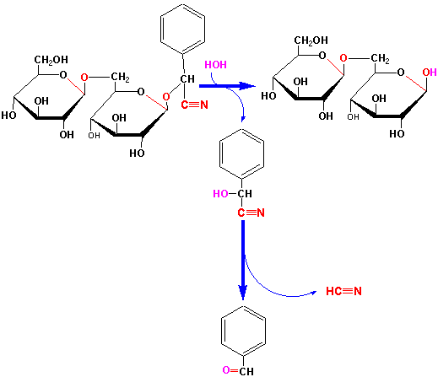

Slide 28
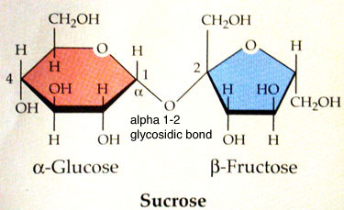

  iii- β-fructosidase (Invertase)
Invertase
Sucrose glucose + fructose
H₂O

Slide 29
  2- Polysaccharases
  Hydrolyze polysaccharides into simple sugars
  i.e. amylase, Cellulase, Cellobiase
  Amylase hydrolyzes starch into maltose

Slide 30
  2- Polysaccharases
  Amylase hydrolyzes starch into maltose
  amylose amylopectin

Slide 31
  2- Polysaccharases
  Amylase hydrolyzes starch into maltose
  amylose amylopectin
  α-amylase
  (dextrinogenic amylase
  endoamylase)
  Q enzyme
α-amylase
Starch
α-dextrins
  R enzyme
  β-amylase
  maltogenic amylase
  saccharogenic amylase
  exoamylase)
β-amylase
Starch
β-dextrins+ maltose
β-amylase
α-dextrins
maltose
R- and Q
Abnormal dextrins
α-dextrins

Slide 32
α-amylase
Starch α-dextrins
β-amylase
Starch β-dextrins + maltose
β-amylase
α-dextrins maltose
R- and Q
Abnormal dextrins α-dextrins

Slide 33
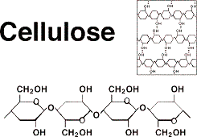
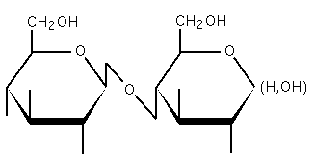
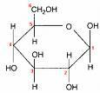
Cellulase and Cellobiase:
They hydrolyze Cellulose to simple Sugars.
Cellulose is composed of sugar units held together by β-1,4-Glucosidic Linkage.
  Cellulase
  n (C₁₂H₂₂O₁₁)
H₂O
Cellobiose
Cellobiase
H₂O

Slide 34
B- Esterases
(Lipases
Esterase
R–O-CO–R” + HOH ROH + HO–OC–R”
Ester Alcohol Acid
Triacyl Glycerol
Lipases
  CH₂OOCR₁ CH₂OH
  CHOOCR₂ CHOOCR₂ + R₁COOH
  CH₂OOCR₃ CH₂OOCR₃
  CH₂OH CH₂OH
  CHOH +R₃COOH CHOH + R₂COOH
  CH₂OH CH₂OOCR₃
H₂O
H₂O
Glycerol + 3 Fatty Acids
H₂O
H₂O

Slide 35
  C- Amidases
  (asparaginase, glutaminase, urease)
Asparaginase
Asparagine Aspartic Acid + NH₃
H₂O
Glutaminase
Glutamine Glutamic Acid + NH₃
H₂O
Urease
Urea CO₂+ NH₃
H₂O

Slide 36
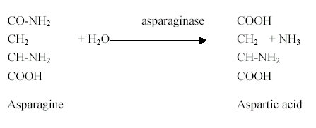
  asparaginase

Slide 37
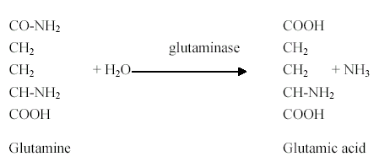
glutaminase

Slide 38

urease

Slide 39
D- Proteolytic enzymes
COOH–CH–NH---AAAAAAAAAAAAAAAAA---CO–CH–NH₂ R R
H₂O
Protease
peptidase
COOH–CH–NH–CO–CH–NH₂
R R
2 COOH–CH–NH₂
R
H₂O

Slide 40

2. Oxidoreductases
a- Oxidation state, electron
(Reductases)
b- Oxygen addition
(Oxidases,
Peroxidases,
Oxygenases)
c- Hydrogen transfer
(Dehydrogenases)

Slide 41
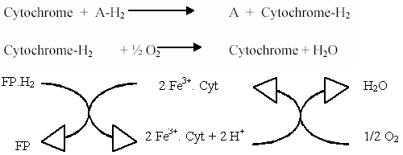
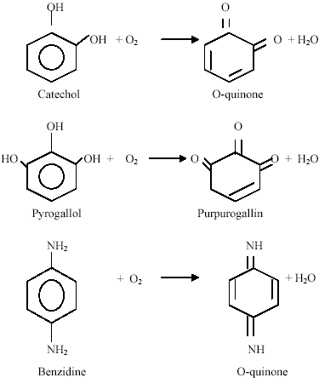
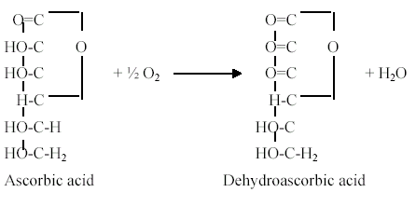
Oxidases

Slide 42
Peroxidases

Slide 43
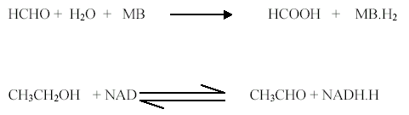
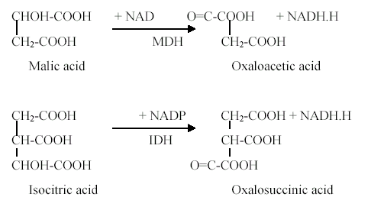
Dehydrogenases

Slide 44
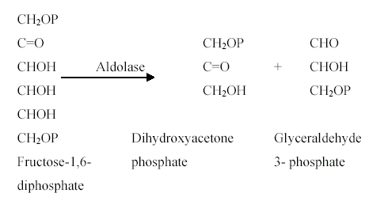
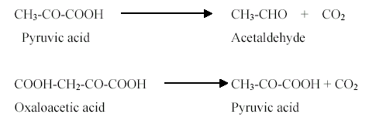
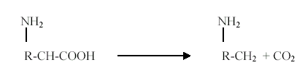
3. Lyases
A + B
A + B
Aldolase,
Carboxylase,
AA carboxylase
Ammonia lyase , Aspartase
Carbonic anhydrase,
Hydratase, aconitase, fumarase
C
C + D

Slide 45



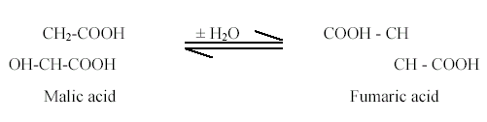
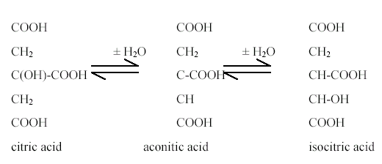
3. Lyases
A + B
A + B
Aldolase,
Carboxylase,
AA carboxylase
Ammonia lyase , Aspartase
Carbonic anhydrase,
Hydratase, aconitase, fumarase
C
C + D

Slide 46
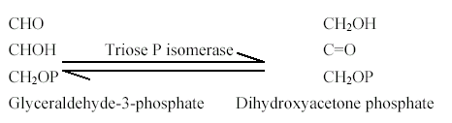
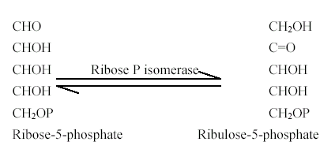
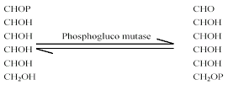
4. Isomerases
Rearrangement
a- Isomerization
(Isomerases)
b- Epimerization
(Epimerases)
c- mutation
(Mutases)

Slide 47

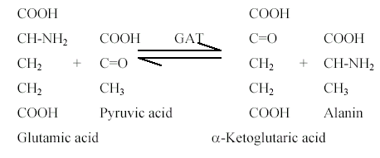
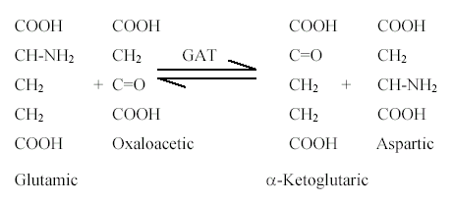
5. Transferases
transfer a group
Transaminases,
Adenylate Kinase,
Sucrose transglucosylase,
Starch transglucosylase
Methyl transferase
Acetyl transferase

Slide 48
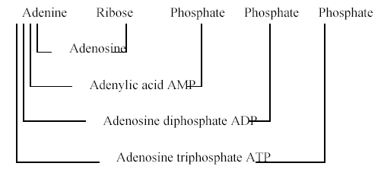
5. Transferases
transfer a group
Transaminases,
Adenylate Kinase,
Sucrose transglucosylase,
Starch transglucosylase
Methyl transferase
Acetyl transferase

Slide 49
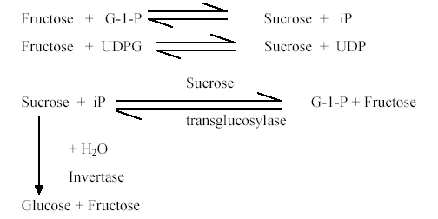

5. Transferases
transfer a group
Transaminases,
Adenylate Kinase,
Sucrose transglucosylase,
Starch transglucosylase
Methyl transferase
Acetyl transferase

Slide 50

5. Transferases
transfer a group
Transaminases,
Adenylate Kinase,
Sucrose transglucosylase,
Starch transglucosylase
Methyl transferase
Acetyl transferase

Slide 51

6. Ligases (Synthetases)
Activate synthesis on the expense of ATP consumption.
Glutamine synthetase, GS
Asparagine synthetase, AS
Acetyl Coenzyme A synthetase (Acetothiokinase)

Slide 52
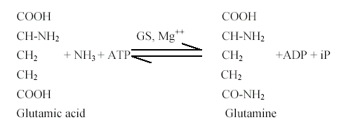
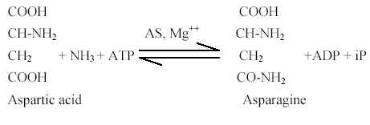

6. Ligases (Synthetases)

Slide 53
Extracellular microbial enzymes
Microorganisms (heterotrophic organisms) have the ability to produce the extracellular enzymes.
They are needed for the bioremediation of organic waste.
The decomposition process of the organic material consists of proteolytic, cellulolytic, amylolytic, nitrification and denitrification.
Proteins, carbohydrates, and fats are the main components.

Slide 54
Extracellular microbial enzymes
Biologically active enzymes may be extracted from any living organism.
A very wide range of sources are used for commercial enzyme production.

Slide 55
Extracellular microbial enzymes
Microbes are preferred to plants and animals as sources of enzymes because:
1. are cheaper to produce,
2. are more predictable and controllable,
3. reliable supplies of raw material are easily arranged,
4. plant and animal tissues contain more potentially harmful materials than microbes, including phenolic compounds.

Slide 56
Extracellular microbial enzymes
In practice, the great majority of microbial enzymes come from a very limited number of genera, of which Aspergillus species, Bacillus species and Saccharomyces species predominate.

Slide 57
Some important industrial microbial
enzymes and their sources
Source | Source | Intra/extra -cellular | Scale of production | Industrial use
Bacterial enzymes
α-Amylase | Bacillus | E | +++ | Starch
β-Amylase | Bacillus | E | + | Starch
Asparaginase | Escherichia coli | I | - | Health
Glucose isomerase | Bacillus | I | ++ | Fructose syrup
Penicillin amidase | Bacillus | I | - | Pharmaceutical
Protease | Bacillus | E | +++ | Detergent
Pullulanase | Klebsiella | E | - | Starch

Slide 58
Some important industrial microbial
enzymes and their sources
Source | Source | Intra/extra -cellular | Scale of production | Industrial use
Fungal enzymes
α-Amylase | Aspergillus | E | ++ | Baking
Glucoamylase | Aspergillus | E | +++ | Starch
Catalase | Aspergillus | I | - | Food
Cellulase | Trichoderma | E | - | Waste
Dextranase | Penicillium | E | - | Food
Glucose oxidase | Aspergillus | I | - | Food
Lactase | Aspergillus | E | - | Dairy
Lipase | Rhizopus | E | - | Food
Pectinase | Aspergillus | E | ++ | Drinks
Pectin lyase | Aspergillus | E | - | Drinks
Protease | Aspergillus | E | + | Baking

Slide 59
Some important industrial microbial
enzymes and their sources
Source | Source | Intra/extra -cellular | Scale of production | Industrial use
Yeast enzymes
Invertase | Saccharomyces | I/E | - | Confectionery
Lactase | Kluyveromyces | I/E | - | Dairy
Lipase | Candida | E | - | Food
Raffinase | Saccharomyces | I | - | Food

Slide 60
Various Important Microbial Enzymes
Carbohydrases
They hydrolyze polysaccharides or oligosaccharides.
They have industrial importance.
The various starch-splitting enzymes are known as amylases.
Amylases are liquefying and saccharifying of starch.

Slide 61
Various Important Microbial Enzymes
α-amylases have good liquefying ability.
β-amylase is a true saccharifying enzyme, forming maltose directly from starch by cleaving disaccharide units from the open ends of chains.

Slide 62
Various Important Microbial Enzymes
Bacterial amylases are used in the continuous process for sizing and desizing of textile fabrics.
Bacterial amylase is uses for preparing cold water dispersible laundry starches and in removing wall paper.

Slide 63
Various Important Microbial Enzymes
Fungal amylase is used
as a saccharifying agent for alcohol fermentation mashes.
in conversion of partially hydrolyzed starch to sweet syrups.
in baking.
for improving sugar production.
for starch removal for flavoring extracts
for fruit extracts and juices
in preparing clear, starch-free pectin.
for modifying starch in vegetable purees, and
in treating vegetables for canning.

Slide 64
Various Important Microbial Enzymes
Fungal and bacterial amylases are utilized in processing cereal products for food dextrin and sugar mixtures and for breakfast foods, for preparation of chocolate and licorice syrups to keep them from congealing, and for recovering sugars from scrap candy of high starch content.

Slide 65
Various Important Microbial Enzymes
Proteases
Industrially proteolytic enzymes are endo and exo proteinases
Proteins are complex so proteolysis is extremely complicated.
Limited proteolysis or complete hydrolysis of proteins is related with appropriate conditions of time, temperature, and pH.

Slide 66
Various Important Microbial Enzymes
Most fungal proteases tolerate and act effectively over a wide pH range (about 4 to 8), while most bacterial proteases generally work best over a narrow range of about pH 7 to 8.
Fungal protease is used
for the production of soy sauce
in breakfast food
in baking bread.

Slide 67
Various Important Microbial Enzymes
Cereal foods are treated with proteolytic enzymes to modify their proteins, resulting in better processing.
Protease reduces mixing time and increases extensibility of doughs, and improves texture, and loaf volume.
However, excess protease must be carefully controlled, unmanageable doughs will result.

Slide 68
Applications of microbial enzymes
in industries
Detergents
Bacterial proteinases are the most important detergent enzymes.
Bacterial and fungal amylases are used in detergents to remove starch based stains.

Slide 69
Applications of microbial enzymes
in industries
Alkaline cellulases are produced by Bacillus strains
Neutral and acidic cellulases are produced by by Trichoderma and Humicola fungi.
Cellulases are capable of degrading crystalline cellulose to glucose.
In textile washing cellulases remove cellulose microfibrils, which are formed during washing and the use of cotton based cloths causing brightening and softening of the material.

Slide 70
Cellulase
Enzymatic degradation of cellulose is an important topic due to its potential for efficient utilization of the energy and carbon content of these polymers.
Cellulose is highly abundant and natural polymers of D-glucose.

Slide 71
Cellulase
Cellulases are:
Exo (are active on both ends of the polymer chain)
End (attack easily accessible glycosidic bonds or amorphous regions in the polymer chain)
dimer hydrolases (hydrolyze oligosaccharides)
A final mixture of monomeric, dimeric and oligomeric carbohydrate units is produced.

Slide 72
Cellulase and Cellobiase:
They hydrolyze Cellulose to simple Sugars.
Cellulose is composed of sugar units held together by β-1,4-Glucosidic Linkage.
  Cellulase
  n (C₁₂H₂₂O₁₁)
H₂O
Cellobiose
Cellobiase
H₂O

Slide 73
Uses of Cellulase
In Textiles for treating cotton
In Feeding to assist in the digestibility of animal feeds
In Fruit juices to clarify fruit juices
In Paper industry to degrade starch for the aid in sizing, decolorizing, and softening the paper
In Biofuel industry for the production of ethanol and biodiesel
In Detergent industry to remove starch, protein and lipid stains and as fabric conditioner

Slide 74
Chitinases
Chitin (C₈H₁₃O₅N)n, an insoluble, most abundant polysaccharide is composed of linear chains of β1,4-N-acetylglucosamine (GlcNAc) residues that are highly cross-linked by hydrogen bonds.
Chitin is the main structural component of the protective covers, viz. cell wall and cuticle, of the fungi and insects, respectively.

Slide 75
Chitinases
Chitin is widely distributed in nature and it is the principle structural component of outer skeleton (50% of the cuticle made up of chitin), foregut, hindgut and midgut lining of peritrophic membrane and essential for structural integrity of many insects, nematodes and most of the fungi.

Slide 76
Chitinases
Chitinases can catalyze the hydrolysis of chitin to its monomer N-acetyl-d-glucosamine.
Chitinases are widely distributed in bacteria and fungi

Slide 77
Chitinases
Endochitinases randomly split chitin at internal sites of the chitin microfibril, forming soluble, low molecular mass multimer products.
Exochitinases releases the di-acetylchitobiose dimer one by one from the chitin chain.
Therefore, there is no release of monosaccharides or oligosaccharides in this reaction.

Slide 78
Chitinases
Function
Like cellulose, chitin is relatively resistant to degradation.
It is typically not digested by animals.
It is assumed that chitin digestion by animals requires bacterial symbionts and lengthy fermentations.

Slide 79
Chitinases
The chitin metabolism is important for fungal cell wall synthesis in insects.
Microorganism requires prolonged time to decompose chitin and produce chitinase due to its higher molecular weight.
Chitinase degrade chitin into its monomeric or oligomeric components.

Slide 80
Chitinases
Chitinase act as both contact and systemic molecule to kill insects, so its specificity against pests is very effective and economical than the inorganic chemicals.
It has received attentions in applications in the biocontrol of fungal pathogens, because chitin is the major structural component of fungal cell walls (biological control), since it neither causes environmental pollution nor induces pathogen resistance, which is usually a side effect of synthetic antifungal agents.

Slide 81
Applications of microbial enzymes
in industries
Food industry
Amylases carry out conversion of starch to glucose.
α-amylase cuts the large α-1,4-linked glucose polymers into shorter oligomers in high temperature (liquefaction).
Glucoamylase (fungal enzyme) hydrolyses the oligomers into glucose (saccharification).

Slide 82
Applications of microbial enzymes
in industries
Milk product industry
Chymosin is used in cheese making to coagulate milk protein.
Lactase splits milk-sugar lactose into glucose and galactose.
This process is used for milk products.

Slide 83
The use of lactases in the dairy industry
Lactase is formed by Aspergillus and yeast.
Lactose is present at concentrations of about 4-5% in milk.
Its presence makes it unsuitable for some people (lactose intolerant). Lactose intolerance is due to lactase deficiency while lactose tolerance is due to lactase persistence.

Slide 84
The use of lactases in the dairy industry
Severe dehydration, diarrhea and even death may result from feeding lactose containing milk to lactose-intolerant children.
Lactose may cause a problem due to its low solubility resulting in crystal formation (11 %) causing sandy texture and becomes prone to microbiological spoilage.
Hydrolysis of lactose to glucose and galactose would prevent the severe digestive problems.

Slide 85
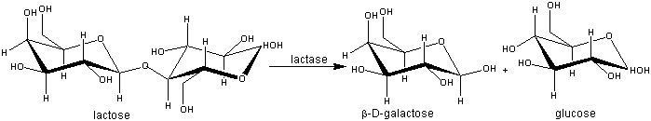
The use of lactases in the dairy industry
Lactose is hydrolyzed by lactase to glucose and galactose. It is inhibited by galactose.

Slide 86
The use of lactases in the dairy industry
It is used in the production of ice cream and sweetened flavoured and condensed milks.
When added to milk or liquid whey and left for about a day at 5C about 50% of the lactose is hydrolysed, giving a sweeter product which will not crystallise if condensed or frozen.
It improves the creaminess of the product.

Slide 87
Applications of microbial enzymes
in industries
Drinks and brewing industries
Brewing is an enzymatic process.
Enzymes are used in fruit juice manufacturing.
Fruit cell wall needs to be broken down to improve juice liberation.

Slide 88
Applications of microbial enzymes
in industries
Pectins are polymeric substances in fruit lamella and cell walls closely related to polysaccharides.
The cell wall contains also hemicelluloses and cellulose.
Pectinase, xylanase and cellulase improve the liberation of the juice from the pulp.
Pectinases and amylases are used in juice clarification.

Slide 89
Applications of microbial enzymes
in industries
Additional amylases can be used to help the starch hydrolysis.
β-glucanases solves filtration problems caused by β-glucans.
Proteinase hydrolyses proteins
Papain, α-amylase and β-glucanase control haze during maturation, filtration and storage.

Slide 90
Applications of microbial enzymes
in industries
Textiles industries
Starch is used as a protective glue of fibers in weaving of fabrics (sizing).
Enzymes are used to remove the starch (desizing).
Amylases are used in this process since they do not harm the textile fibers .

Slide 91
Applications of microbial enzymes
in industries
The same effect can be obtained with cellulase enzymes.
The effect is a result of alternating cycles of desizing and bleaching enzymes and chemicals in washing machines.
Laccases that are produced by white-rot fungi, degrade lignin.
They are copper-containing enzymes, can oxidatively degrade many different types of molecules like dye pigments.

Slide 92
Applications of microbial enzymes
in industries
Pulp and paper industry
Xylanases are used in pulp bleaching.
Xylanases liberate lignin fragments by hydrolyzing residual xylan and so reduces the need for bleaching chemicals.
Starch improves the strength, stiffness and erasability of paper.
The starch suspension must have a certain viscosity, which is achieved by adding amylase enzymes in a controlled process.

Slide 93
Applications of microbial enzymes
in industries
Softwoods contain lipids which cause problems in paper machines and can be removed by lipases.
Lipases hydrolyze lipids (triacylglycerol) into glycerol and fatty acids

Slide 94
Applications of microbial enzymes
in industries
Baking industry
Amylases are used to improved bread quality and increased shelf life.
Both fungal and bacterial amylases are used.
Overdosage may lead to sticky dough so the added amount needs to be carefully controlled.

Slide 95
Applications of microbial enzymes
in industries
In addition to starch, flour contains minor amounts of cellulose, glucans and hemicelluloses like arabinoxylan and arabinogalactan.
Xylanases decrease the water absorption and thus reduces the amount of added water needed in baking.
This leads to more stable dough.

Slide 96
Applications of microbial enzymes
in industries
Proteinases improve dough-handling properties.
Glucose oxidase is used to replace chemical oxidants.
Lipases are used to strengthen gluten, which leads to more stable dough and better bread quality.

