Slide 1
Plant tIssue culture
Prof.Dr. Nemat Mohamed Hassan, Department of Botany and Microbiology, Faculty of Science, University of Damietta
Lecture 22.03.2020

Slide 2
Plant Tissue Culturing (micropropagating steps)
Stage 0 – Selection & preparation of the mother plant
sterilization of the plant tissue takes place
Stage I - Initiation of culture
explant placed into growth media
Stage II - Multiplication
explant transferred to shoot media; shoots can be constantly divided
Stage III - Rooting
explant transferred to root media
Stage IV - Aclimatization
Transfer to soil explant returned to soil; hardened off

Slide 3
Stage I:
Establishment of axenic cultures – Introduction of the surface disinfected
explants into culture, followed by initiation of shoot growth. The objective of this stage is to place selected explants into culture, avoiding contamination and providing an environment that promotes shoot production .
Depending on the type of explant, shoot formation may be initiated from apical and axillary buds.

Slide 4
Stage II:
Multiplication – shoot proliferation and multiple shoot production.
At this stage, each explant has expanded into a cluster of small shoots. Multiple shoots are separated and transplanted to new culture medium. Shoots are subcultured every 2–8 weeks.
Material may be subcultured several times to new medium to maximise the quantity of shoots produced.

Slide 5
Stage III:
Root formation – shoot elongation and rooting. The rooting stage prepares the regenerated plants for transplanting from in vitro to vivo conditions in controlled environment rooms, in the glasshouse and, later, to their ultimate loca-
tion.
This stage may involve not only rooting of shoots, but also conditioning of the plants to increase their potential for acclimatization and survival during transplanting.

Slide 6
The induction of adventitious roots may be achieved either in vitro or ex vitro in the presence of auxins.
The main advantage of ex vitro compared
to in vitro rooting is that root damage during transfer to soil is less likely to occur.
The rates of root production are often greater and root quality is optimized when
rooting occurs ex vitro .

Slide 7
Stage IV:
Acclimatization – transfer of regenerated plants to soil under natural
environmental conditions [16]. Transplantation of in vitro-derived plants to soil is
often characterized by lower survival rates. Before transfer of soil-rooted plants
to their ﬁnal environment, they must be acclimatized in a controlled environment room or in the glasshouse.

Slide 8
Plants transferred from in vitro to ex vitro conditions, undergo gradual modiﬁcation of leaf anatomy and morphology, and their stomata begin to function (the stomata are usually open when the plants are in culture). Plants also form a protective epicuticular wax layer over the surface of their leaves.
Regenerated plants gradually become adapted to survival in their new environment.

Slide 9
Plant Regeneration Pathways
Existing Meristems (Microcutting)
Uses meristematic cells to regenerate whole plant.
Organogenesis
Relies on the production of organs either directly from an explant or callus structure
Somatic Embryogenesis
Embryo-like structures which can develop into whole plants in a way that is similar to zygotic embryos are formed from somatic cells
(Source:Victor. et al., 2004)
Notes:
9

Slide 10
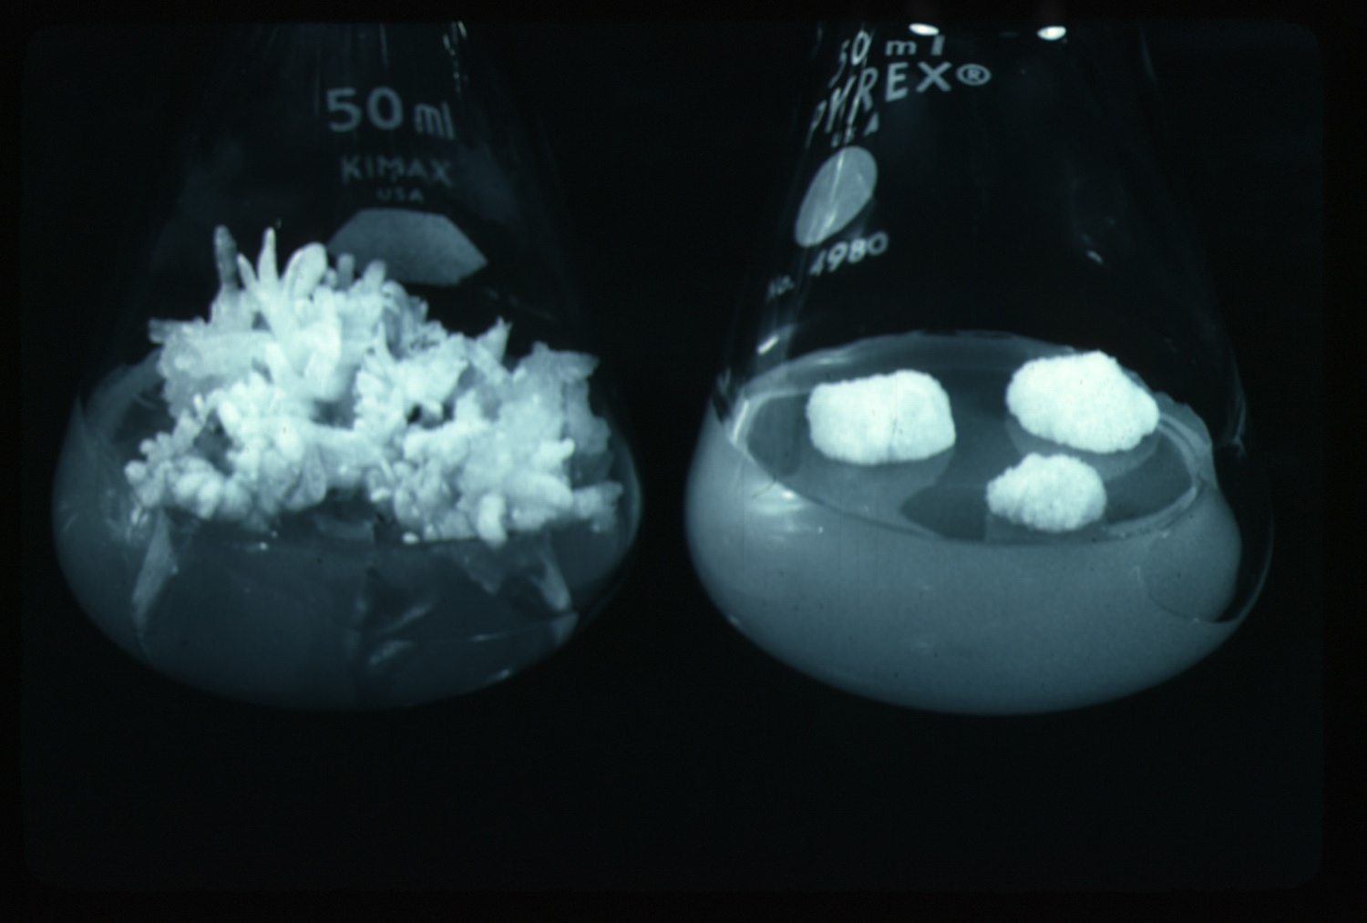
II-Organogenesis

Slide 11
The ability of non-meristematic plant tissues to form various organs de novo.
The formation of adventitious organs
The production of roots, shoots or leaves
These organs may arise out of pre-existing meristems or out of differentiated cells
This may involve a callus intermediate but often occurs without callus.

Slide 12
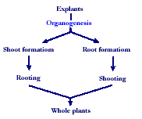

Slide 13
Indirect organogenesis
Explant
Callus
Meristemoid
Primordium

Slide 14
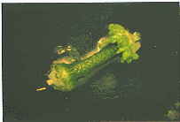
Direct Organogenesis
Direct shoot/root formation from the explant

Slide 15
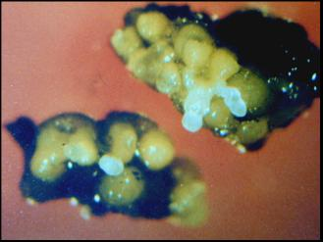
III-Somatic Embryogenesis

Slide 16
The formation of adventitious embryos
The production of embryos from somatic or “non-germ” cells.
It usually involves a callus intermediate stage which can result in variation among seedlings

Slide 17
Types of embryogenic cells
Pre-embryogenic determined cells, PEDCs
The cells are committed to embryonic development and need only to be released. Such cells are found in embryonic tissue.
Induced embryogenic determined cells, IEDCs
In majority of cases embryogenesis is through indirect method.
Specific growth regulator concentrations and/or cultural conditions are required for initiation of callus and then redetermination of these cells into the embryogenic pattern of development.

Slide 18
Various terms for non-zygotic embryos
Adventious embryos
Somatic embryos arising directly from other organs or embryos.
Parthenogenetic embryos (apomixis)
Somatic embryos are formed by the unfertilized egg.
Androgenetic embryos
Somatic embryos are formed by the male gametophyte.

Slide 19
Somatic Embryogenesis and Organogenesis
Both of these technologies can be used as methods of micropropagation.
It is not always desirable because they may not always result in populations of identical plants.
The most beneficial use of somatic embryogenesis and organogenesis is in the production of whole plants from a single cell (or a few cells).

Slide 20
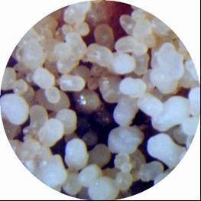
Somatic embryogenesis differs from organogenesis

Slide 21
Bipolar structure with a closed radicular end rather than a monopolar structure.
The embryo arises from a single cell and has no vascular connection with the mother tissue.

Slide 22
Two routes to somatic embryogenesis (Sharp et al., 1980)
Direct embryogenesis
Embryos initiate directly from explant in the absence of callus formation.
Indirect embryogenesis
Callus from explant takes place from which embryos are developed.

Slide 23
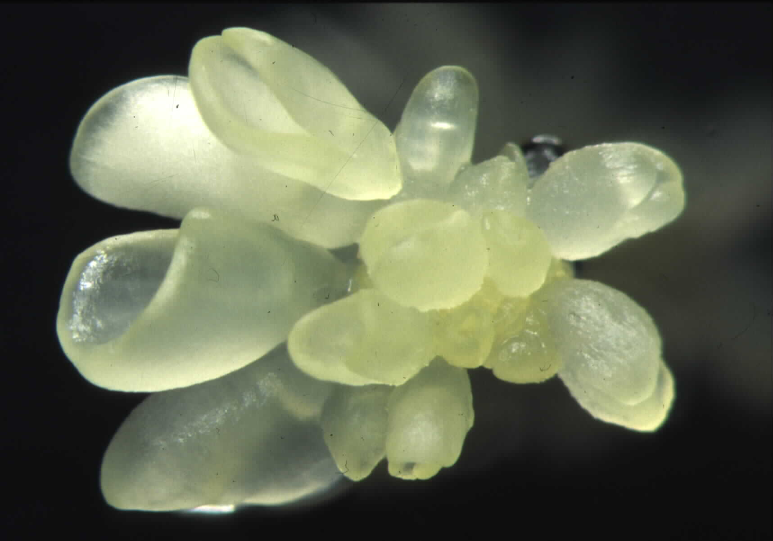
Direct somatic embryogenesis
Direct embryo formation from an explant

Slide 24
Indirect Somatic Embryogenesis
Explant → Callus Embryogenic → Maturation → Germination
Calus induction
Callus embryogenic development
Multiplication
Maturation
Germination

Slide 25
Induction
Auxins required for induction
Proembryogenic masses form
2,4-D most used
NAA, dicamba also used

Slide 26
Development
Auxin must be removed for embryo development
Continued use of auxin inhibits embryogenesis
Stages are similar to those of zygotic embryogenesis
Globular
Heart
Torpedo
Cotyledonary
Germination (conversion)

Slide 27
Maturation
Require complete maturation with apical meristem, radicle, and cotyledons
Often obtain repetitive embryony
Storage protein production necessary
Often require ABA for complete maturation
ABA often required for normal embryo morphology
Fasciation
Precocious germination

Slide 28
Germination
May only obtain 3-5% germination
Sucrose (10%), mannitol (4%) may be required
Drying (desiccation)
ABA levels decrease
Woody plants
Final moisture content 10-40%
Chilling
Decreases ABA levels
Woody plants

Slide 29
Somatic embryogenesis as a means of propagation is seldom used
High probability of mutations
The method is usually rather difficult.
Losing regenerative capacity become greater with repeated subculture
Induction of embryogenesis is very difficult with many plant species.
A deep dormancy often occurs with somatic embryogenesis

Slide 30
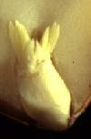
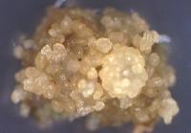
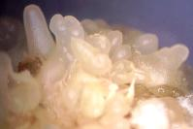
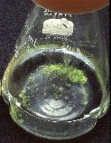
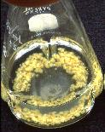
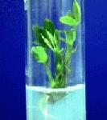
Peanut somatic embryogenesis

Slide 31
Callus
During callus formation there is some degree of dedifferentiation both in morphology and metabolism, resulting in the lose the ability to photosynthesis.
Callus cultures may be compact or friable.
Compact callus shows densely aggregated cells
Friable callus shows loosely associated cells and the callus becomes soft and breaks apart easily.
Habituation:
The lose of the requirement for auxin and/or cytokinin by the culture during long-term culture.

Slide 32
Cell-suspension cultures
When friable callus is placed into the appropriate liquid medium and agitated, single cells and/or small clumps of cells are released into the medium and continue to grow and divide, producing a cell-suspension culture.
The inoculum used to initiate cell suspension culture should neither be too small to affect cells numbers nor too large too allow the build up of toxic products or stressed cells to lethal levels.
When callus pieces are agitated in a liquid medium, they tend to break up.

Slide 33
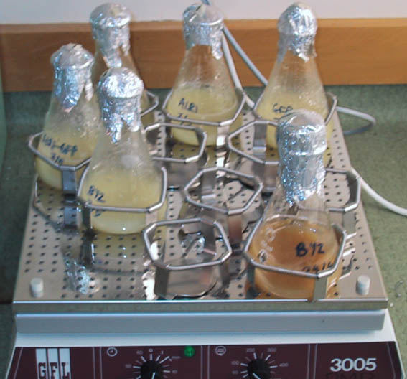
Cell suspension culture

Slide 34
Suspensions are much easier to bulk up than callus since there is no manual transfer or solid support
Cell suspension culture techniques are very important for plant biotransformation and plant genetic engineering.

Slide 35
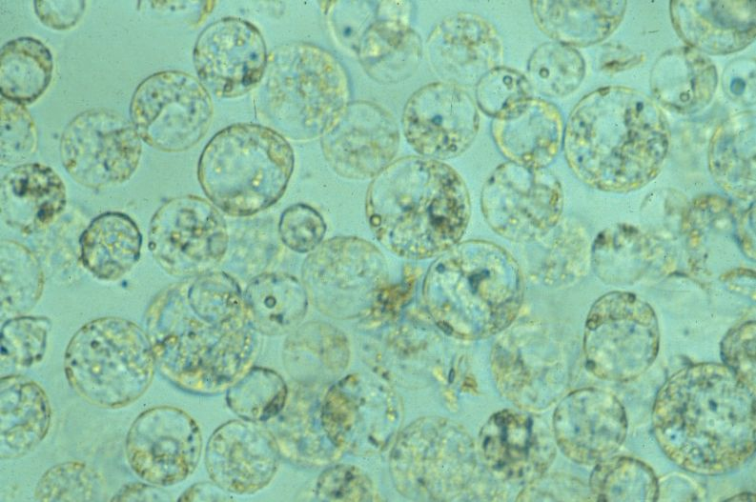
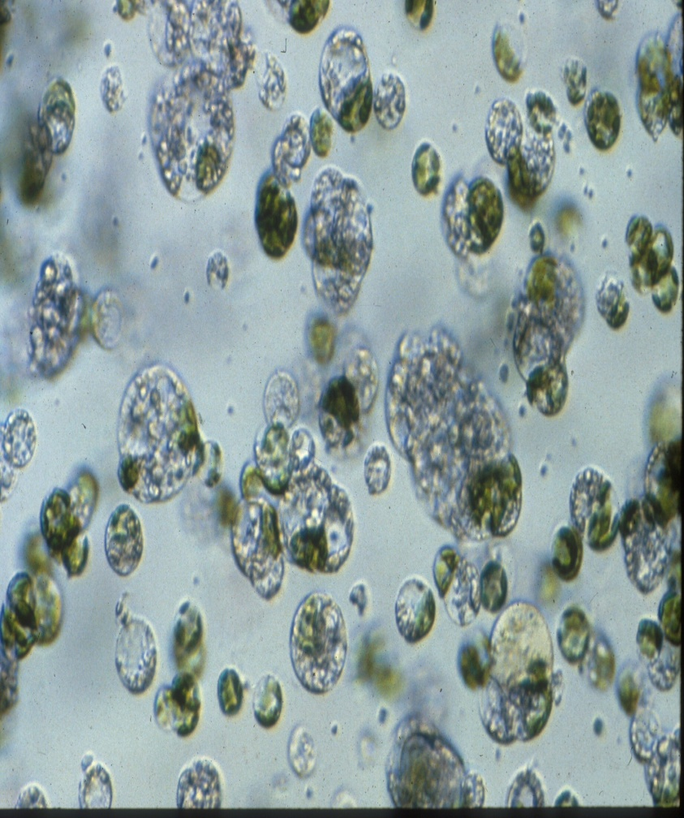
Protoplast culture
The isolation and culture of plant protoplasts in vitro

Slide 36
Protoplast
The living material of a plant or bacterial cell, including the protoplasm and plasma membrane after the cell wall has been removed.

Slide 37
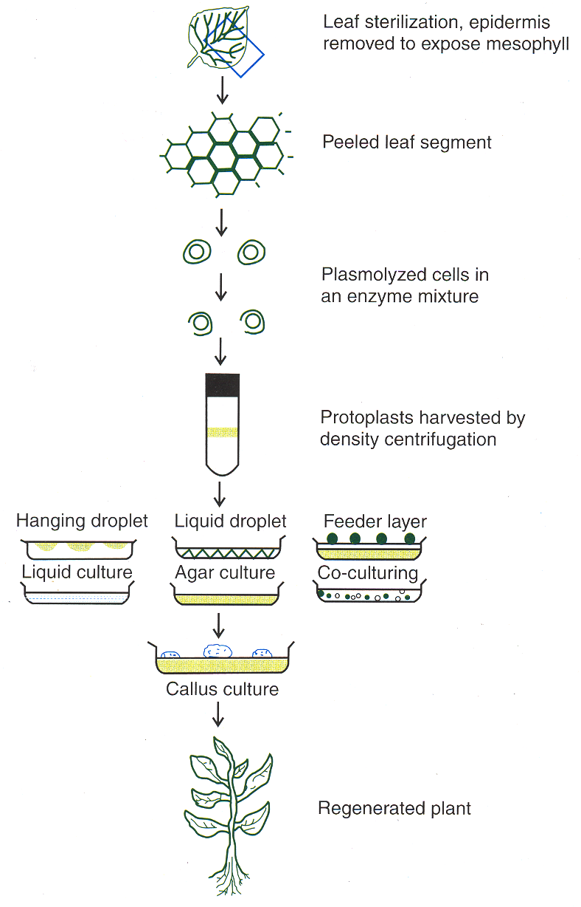

Slide 38
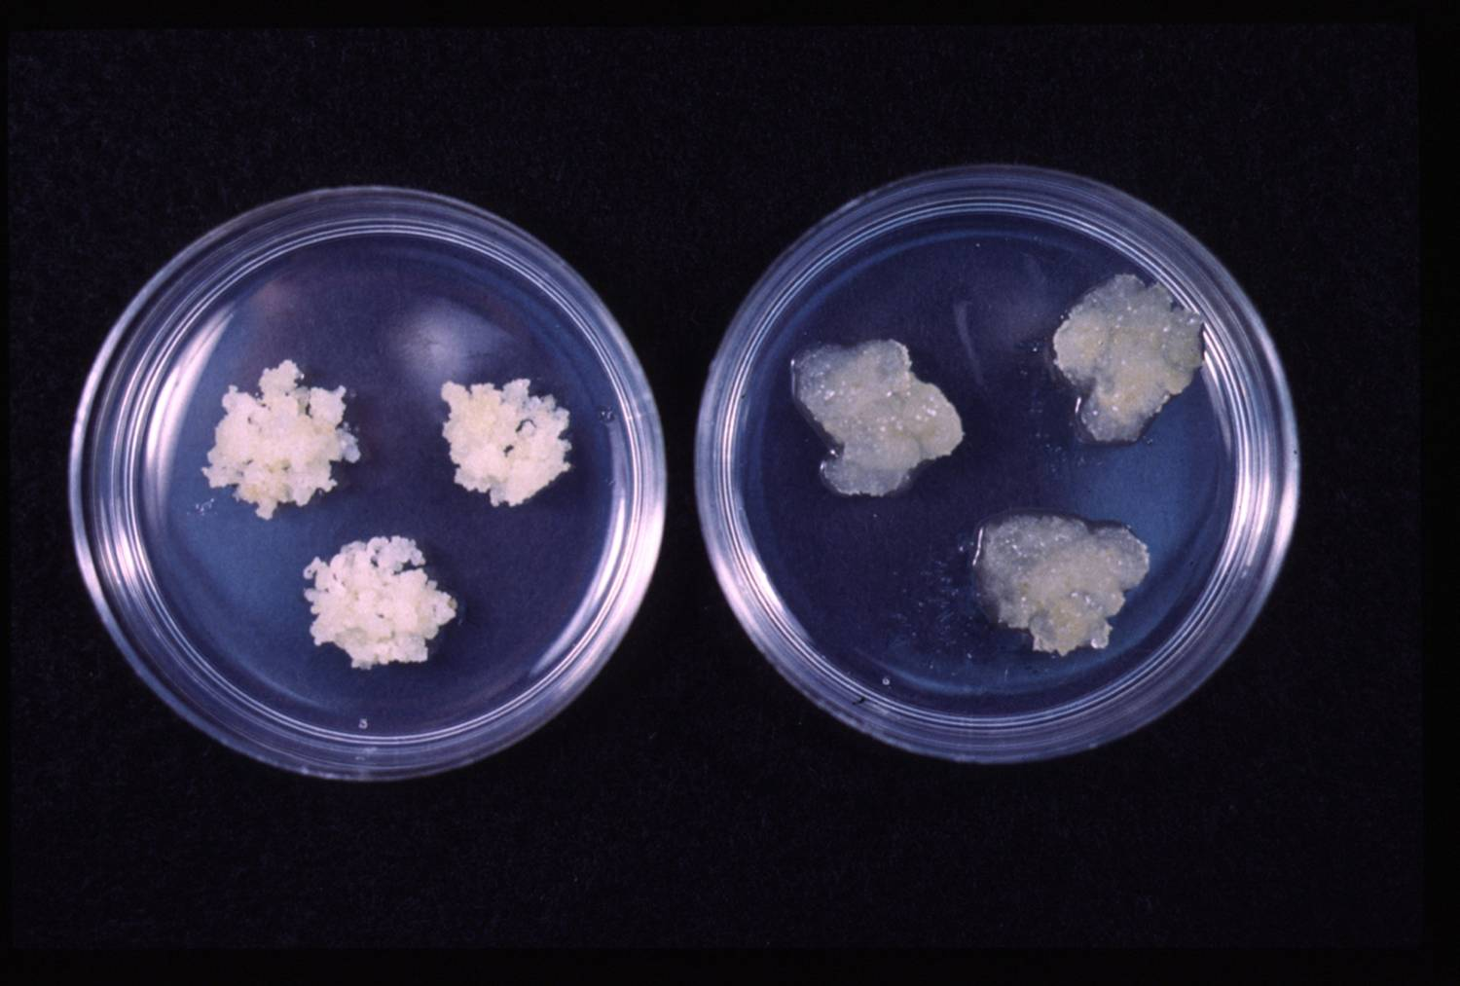
Callus Culture
Callus:
An un-organised mass of cells, produced when explants are cultured on the appropriate solid medium, with both an auxin and a cytokinin and correct conditions.
A tissue that develops in response to injury caused by physical or chemical means
Most cells of which are differentiated although may be and are often highly unorganized within the tissue

Slide 39
Callus formation
1. Meristems
2. Leaf sections
3. Bulb sections
4. Embryos
5. Anthers
6. Nucellus
De-differentiation
Re-differentiation
Explants Callus
Protoplasts
Development
Suspension cells
Organs
(leaves, roots, shoots, flowers,...)
?

Slide 40
Cloning
Using the somatic cells of a multicellular organism to generate a new organism
Each clone is genetically identical to the parent plant.

Slide 41

THANK YOU！

