Slide 1
Advanced Microbial Ecology Code no. 618B
Pre-MSc. Students
Lecture no. 7 (29-3-2020)
Dr. Mahmoud Nour El-Dein

Slide 2
Role of microbes in organic carbon decomposition and maintenance of soil ecosystem
Organic matter is mainly present in the top 20–30 cm of most soil profiles and is essentially an array of organic macromolecules consisting principally of combinations of C, O, H, N, P and S.
Almost all organic matter in soil is directly and indirectly derived from plants via photosynthesis.

Slide 3
Thus, atmospheric CO₂ is transformed by reduction into simple and complex organic carbon compounds,
which in combination with key nutrients enable the plant to function and grow.

Slide 4
The most important pathways by which the fixed carbon is retained and ultimately transferred to the soil ecosystem are the direct addition of senescent material as above-ground and below-ground detritus,
return of ingested plant matter in animal faeces, and exudation of soluble organic compounds from roots.

Slide 5
Plant and animal detritus and root exudates represent essential sources of energy and nutrients for soil microbial and faunal communities.
Bacteria and fungi represent 95%+ of the biomass present in most soils, where they interact with a combination of micro-fauna (nematodes, protozoa), and macro-fauna (earthworms, termites, molluscs) in complex soil food-web systems that determine the turnover of organic matter and associated nutrients in the soil environment.

Slide 6
Soil Organic Carbon
Soil organic carbon is organic component of soil, consisting of three primary parts including
small (fresh) plant residues and small living soil organisms, decomposing (active) organic matter, and stable organic matter (humus) and Soil organic carbon (SOC) is the carbon (C) stored in soil organic matter (SOM).

Slide 7
Organic carbon (OC) enters the soil through the decomposition of plant and animal residues, root exudates, living and dead microorganisms, and soil biota.
It is the main source of energy for soil microorganisms.
The soil organic matter (SOM) is a complex combination of living organisms, fresh organic residues, actively decomposing material, and stabilized organic matter (otherwise known as humus). Generally, samples containing 50% or more of carbon are referred as soil organic carbon (SOC).

Slide 8
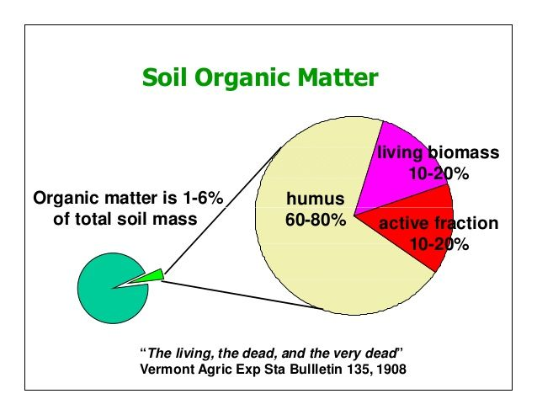

Slide 9
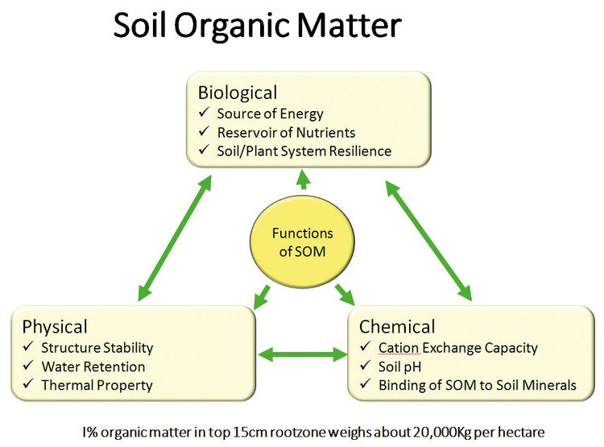

Slide 10
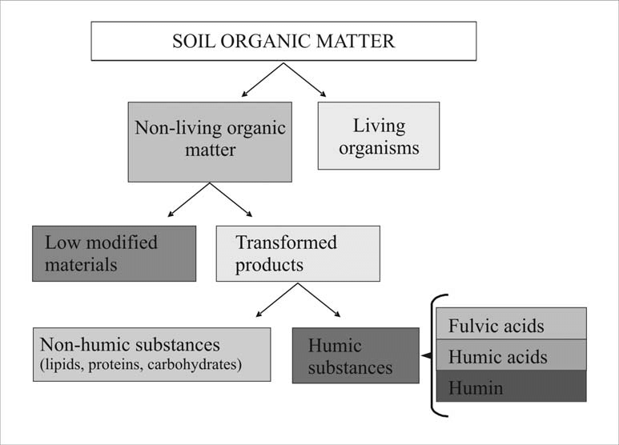

Slide 11
Soil organic matter (SOM) is mainly composed of carbon, hydrogen and oxygen but also has small amounts of nutrients such as nitrogen, phosphorous, sulfur, potassium, calcium and magnesium contained within organic residues.
Soil organic matter also exists as four distinct fractions which vary widely in them in size, composition and turnover times in the soil (Table 1).

Slide 12
Fraction | Size micrometers (µm) & millimeters (mm) | Turnover time | Composition
Dissolved organic matter | <45 (µm) (in solution) | Minutes to days | Soluble root exudates, simple sugars and decomposition by-products. It generally makes up less than 5% of total soil organic matter.
Particulate organic matter | 53µm–2mm | 2-50 years | Fresh or decomposing plant and animal matter with identifiable cell structure. Makes up between 2-25% of total soil organic matter.
Humus | <53µm | Decadal (0s-00s years) | Older, decayed organic compounds that have resisted decomposition. Can make up more than 50% of total soil organic matter.
Resistant organic matter | <53µm <2mm | 00s-000s years | Relatively inert material such as chemically resistant materials or organic remnants (for example, charcoal). Can be up to 10% of soil organic matter.

Slide 13
Soil organic matter decomposition
When plant residues are returned to the soil, various organic compounds undergo decomposition. Decomposition is a biological process that includes the physical breakdown and biochemical transformation of complex organic molecules of dead material into simpler organic and inorganic molecules.
Carbon cycling is the continuous transformation of organic and inorganic carbon compounds by plants and micro- and macro-organisms between the soil, plants and the atmosphere.

Slide 14
Decomposition of organic matter is largely a biological process that occurs naturally.
Its speed is determined by three major factors: soil organisms, the physical environment and the quality of the organic matter.
In the decomposition process, different products are released: carbon dioxide (CO₂), energy, water, plant nutrients and resynthesized organic carbon compounds. Successive decomposition of dead material and modified organic matter results in the formation of a more complex organic matter called humus.

Slide 15
Humus affects soil properties. As it slowly decomposes, it colors the soil darker, increases soil aggregation and aggregate stability, increases the ability to attract and retain nutrients and contributes N, P and other nutrients.

Slide 17
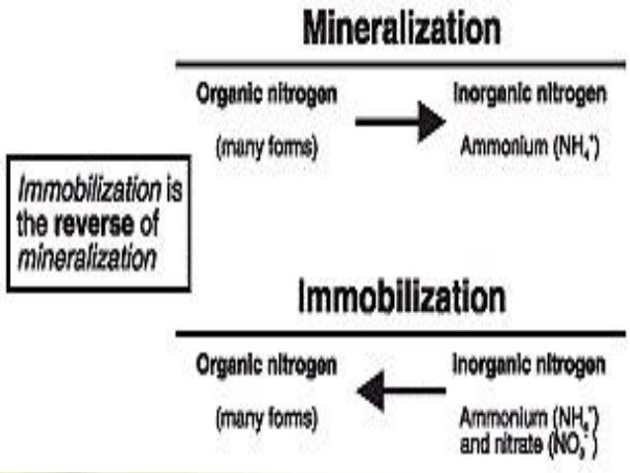

Slide 19
Enzymes for Organic matter decomposition
Organic matter decomposition is largely an enzymatic process. Constitutional enzymes are produced by microbial cells, irrespective of the substrate in the environment; inducible enzymes are formed in the presence of a specific substrate.
Further, an enzyme may metabolize its substrate within or outside the cell.
Accordingly, they are known as intracellular or extracellular enzymes.

Slide 20
Extracellular enzymes are essential for the decomposition of polysaccharides because the microbial cell is impenetrable to the large polysaccharide molecules.
Monosaccharides, such as glucose, are metabolized by intracellular enzymes. Organic residues added to the soil are first broken down into their basic components by extracellular enzymes; and the basic components are subsequently utilized by intracellular enzymes.

