Slide 1
foraminifera can be used as ecological indicators

Slide 2
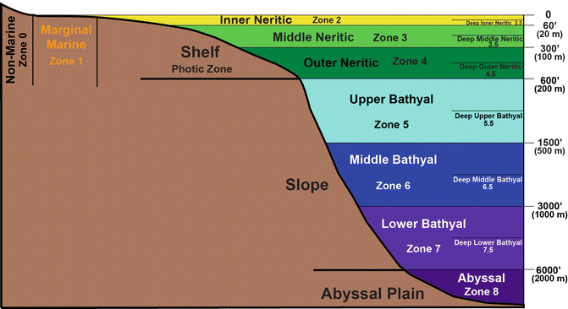
1-Palaeobathymetry

Slide 3
a-Planktonic / benthic (P/B ratio). As is documented by recent studies, the high occurrence of planktonic foraminifera suggests at least an outer neritic environment, with water depths exceeding 150 m.

Slide 4
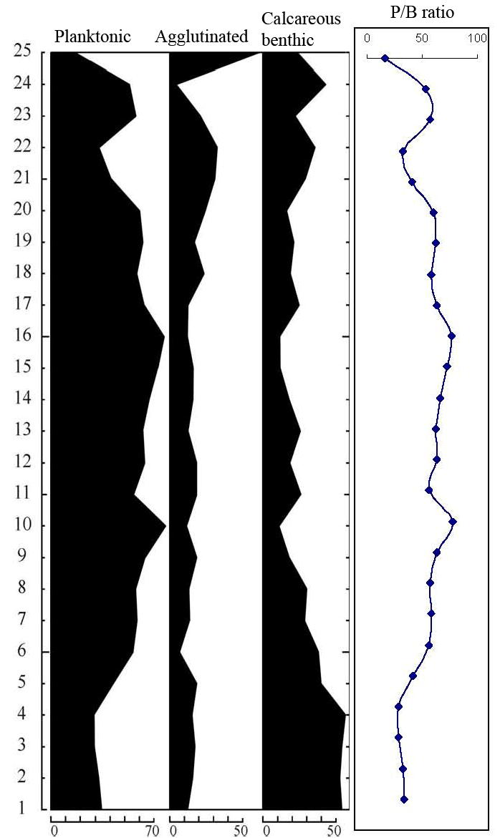
sHALLOW
Deep,
bathyal environment
(about 200-600 m depth

Slide 5
The increase in abundance of planktonic foraminifera (up to 70 %) proves the presence of deeper environments, which produced a sharp decrease in the level of oxygenation of the substrate.
B-Benthic foraminifera dominated by calcareous taxa are indicative of a deposition floor above the calcite compensation depth (CCD).
-larger foraminifer occur in the inner neritic environment.

Slide 6
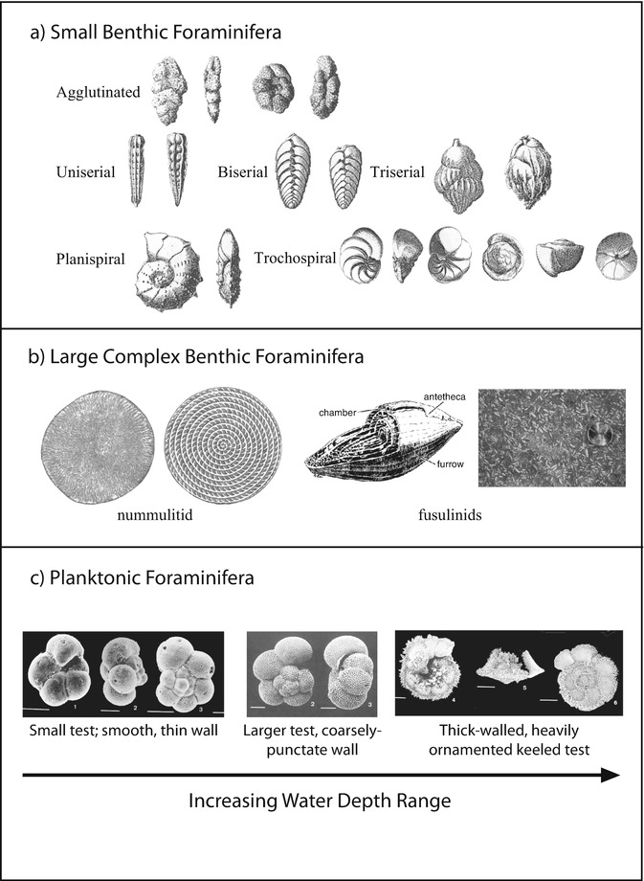

Slide 8
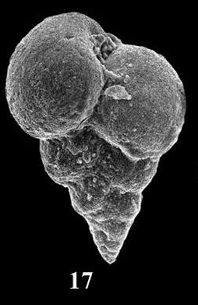
2-Oxygen content
Heterohelix
HEterohelix spp. characterise the oxygen
minimum zone of a water column.

Slide 9
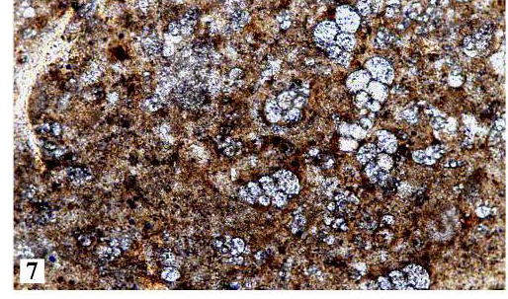

Slide 10
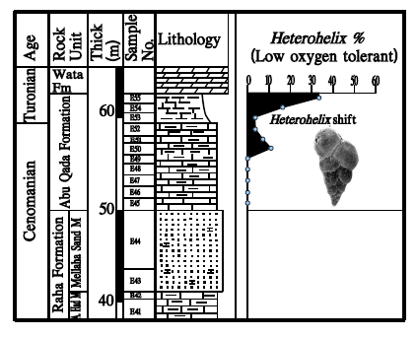

Slide 11
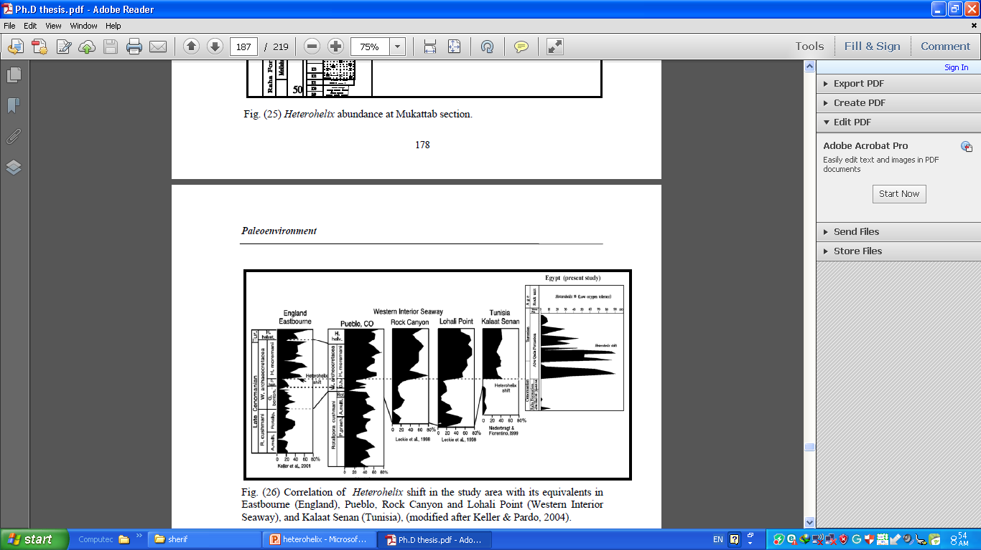

Slide 12
3-Temperature
* Coiling direction in some species may be to the right (dextral) or to the left (sinistral). In Neogloboquadrina pachyderma coiling is sinistral when T< 9°c and is dextral when T> 15°c.

Slide 13
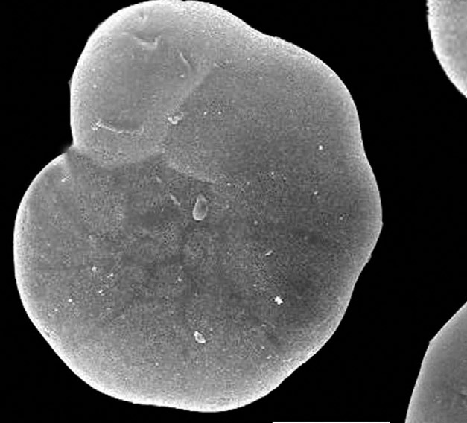
Ammonia spp.
Life style: worldwide widespread in marginal marine environments, lives infaunal, free, at depth of 0-50m, common in sediments with mud and organ carbon. Tolerates salinities of up to 50‰, low oxygen for several days and low and high temperatures (0°C-35°C).

Slide 14
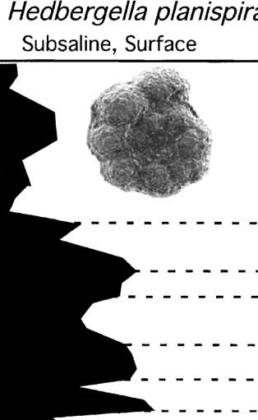
Hedbergella planispira
subsaline 0.5–3 ‰
hyposaline 3–20 ‰
mesosaline 20–50 ‰
hypersaline greater than 50 ‰

Slide 15
Deformities in benthic foraminifera

Slide 16
Test Abnormalities
Majority of the foraminifera follow a well defined
pattern to add chambers during its growth till it reaches maturity.
This normal course of addition of chambers for any species, can be assessed by looking at the general population of that particular species in a region.
Any deviation from this normal course of addition of chambers is termed as abnormality.

Slide 17
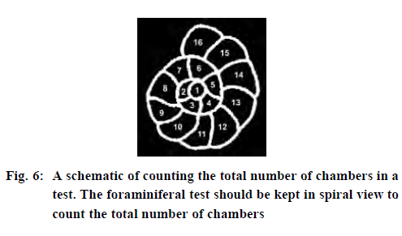

Slide 18
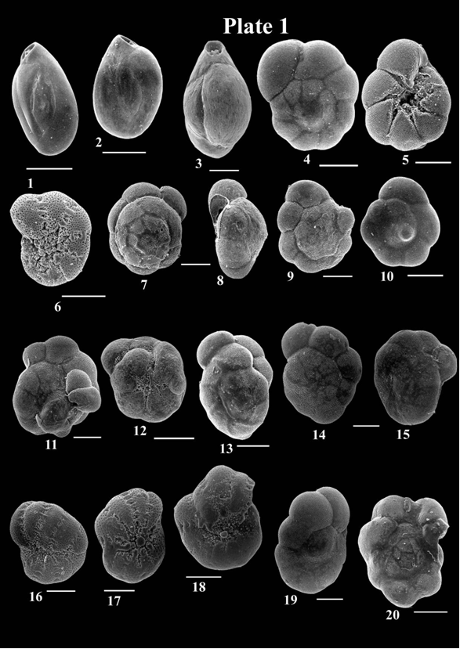
Normal tests

Slide 19
Additional chambers

Slide 20
spiroconvex test

Slide 21
Twisted test

Slide 22
Reduced chambers

Slide 23
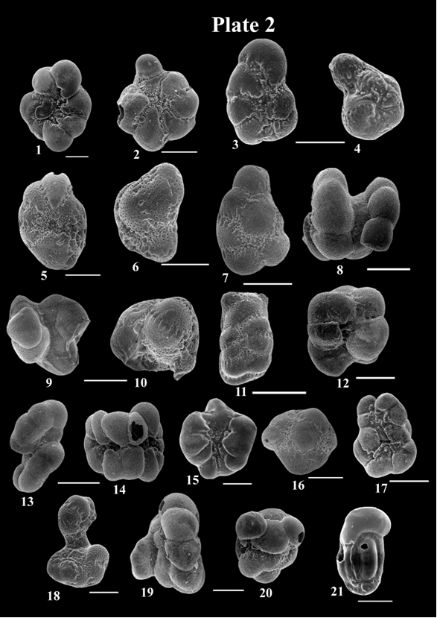
Deformed tests aberrant chamber size and shape

Slide 24
Twinning

Slide 25
Twinning

Slide 26
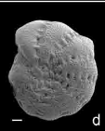
Protruding chamber

Slide 27
-Alve (1991) noted that the normal rate of abnormal tests in a non-stressed population is about 1%.
-Thus a low percentage of abnormalities cannot be considered as an indicator of abnormal environmental conditions.
-The morphological abnormalities include high spire giving spiroconvex test, additional chamber , twisted tests, reduced chambers , aberrant chamber shape and size, twinning , and complex deformities.

Slide 28
Deformities have been related to a number of environmental factors:
(1) changes in temperature, reduced or elevated salinity, which also affects the size
of foraminifera;
(2) the lack of food, which causes aberrant growth and affects the size of foraminifera
3) the type of substrate, which affects the outline and shape of foraminiferal tests;
(4) low DO content, which may create dwarfed, thin-walled, less ornamented and aberrant forms;
(5) insufficient light, which may affect the size of foraminifers;
(6) and pollution in marine environments

Slide 29
Complex forms

Slide 30
Heavy metals
are generally defined as metals with relatively high densities, atomic weights, or atomic numbers.
Heavy metals are found naturally in the earth. They become concentrated as a result of human caused activities and can enter plant, animal, and human tissues via inhalation, diet

Slide 31
Heavy metals in sediment
Pollution of the environment with toxic metals has
attracted considerable public attention over the past
few decades.
Heavy metals released into aquatic systems are generally bound to particulate matter, which settle down and become incorporated into sediments. Surface sediment therefore is the most important reservoir or sink of metals and other pollutants
in aquatic environments .
Under favorable conditions, sediment can release pollutants causing detrimental effects to aquatic biota
long after the initial input of pollution has ceased.

Slide 32
ASSESSMENT OF SEDIMENT CONTAMINATION

Slide 33
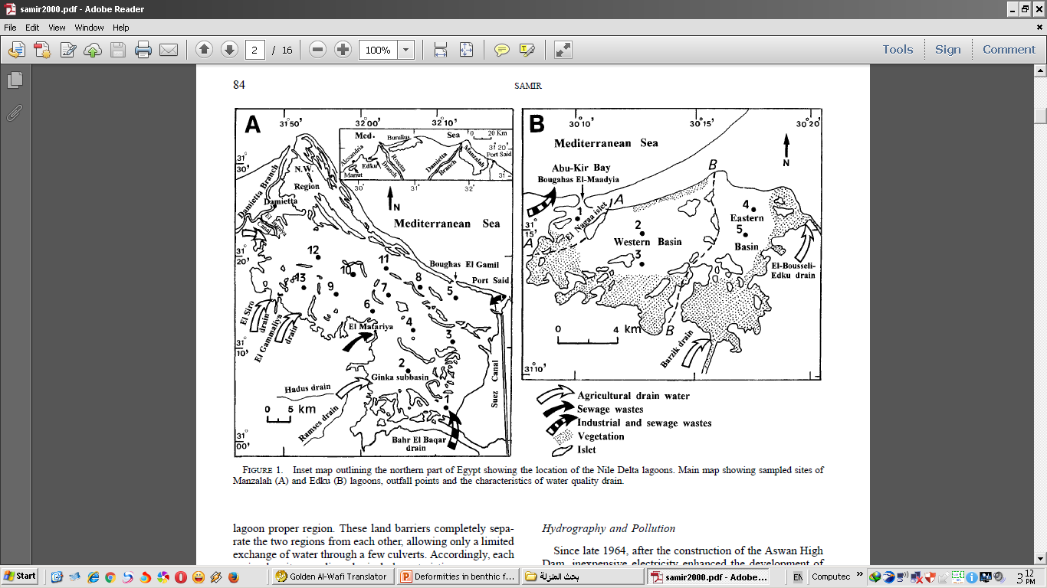
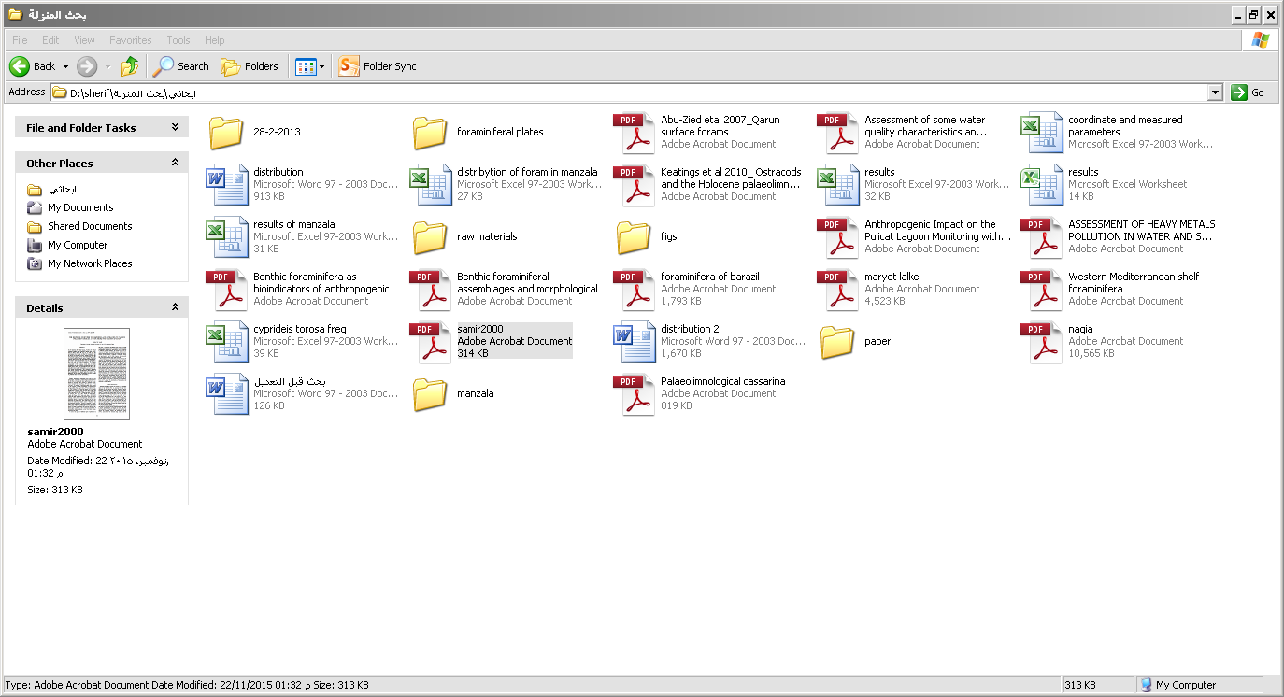

Slide 34
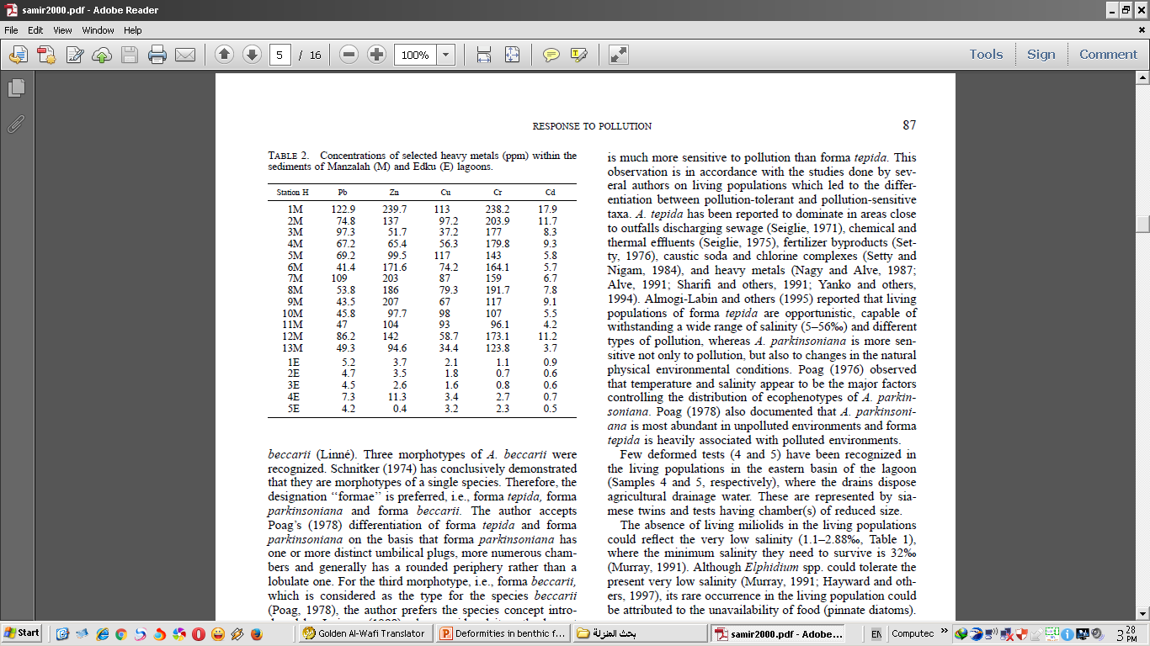

Slide 35
1-Contamination factors (CF)
The level of contamination can be expressed by the contamination factor (CF); It was calculated as follows:
Cf = (Metal content in the sediment) / (Metal content in natural reference sediment)

Slide 36
factor was classified into four groups:
Cf < 1 refers to the low contamination factor;
1≤ Cf < 3 refers to the moderate contamination factor;
3≤ Cf < 6 refers to the considerable contamination factors;
6≤ Cf refers to the very high contamination factor.

Slide 37
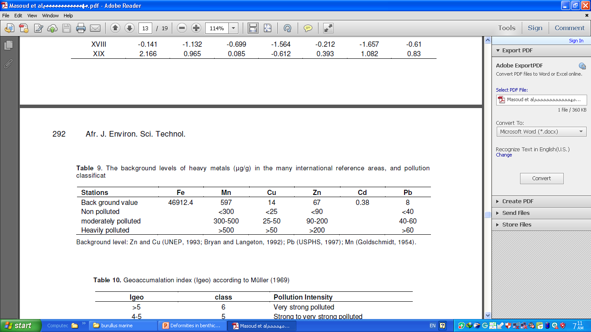
ASSESSMENT OF SEDIMENT CONTAMINATION
(Contamination indices)
Back ground values

Slide 38
3-Degree of contamination (Dc)
Degree of contamination (Dc) defined as the sum of all contamination factors for a given basin.
For the description of the degree of contamination
the following terminologies have been used:
Dc < 7 low degree of contamination;
7<Dc<14 moderate degree of contamination;
14≤Dc<28 considerable degree of contamination;
Dc > 28 very high degree of contamination.

