Slide 1
Paleoclimate

Slide 2
What do we mean by "paleoclimate"?
What evidence exists for ancient climate change?
What causes the climate to change?

Slide 3
Paleoclimatology is the study of past climates. It is multidisciplinary field, combining history, anthropology, chemistry, physics, geology, atmospheric, and ocean sciences.

Slide 4
Paleoclimatologists employ a wide variety of techniques to deduce ancient climates.
1- Ice
Air trapped within fallen snow becomes encased in tiny bubbles as the snow is compressed into ice in the glacier under the weight of later years' snow. The trapped air has proven a tremendously valuable source for direct measurement of the composition of air from the time the ice was formed.

Slide 5
Ice in glaciers has less ¹⁸O than the seawater, but the proportion of heavy oxygen also changes with temperature. To understand why this might be so, we need to think about the process of glacier formation. The water-ice in glaciers originally came from the oceans as vapor, later falling as snow and becoming compacted in ice. When water evaporates, the heavy water (H₂O¹⁸) is left behind and the water vapor is enriched in light water (H₂O¹⁶). This is simply because it is harder for the heavier molecules to overcome the barriers to evaporation. Thus, glaciers are relatively enhanced in O¹⁶, while the oceans are relatively enriched in O¹⁸. This imbalance is more marked for colder climates than for warmer climates.

Slide 6
2- Dendroclimatology is the science of determining past climates from trees(primarily properties of the annual tree rings). Tree rings are wider when conditions favor growth, narrower when times are difficult.
-Using tree rings, scientists have estimated many local climates for hundreds to thousands of years previous

Slide 7
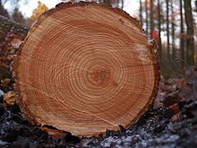

Slide 8
Each year, a tree adds to its girth, the new growth being called a tree ring. Tree growth depends upon local conditions such as water availability. Because the amount of water available to the tree varies from year to year, scientists can.
A tree ring consists of two layers:
A light colored layer which grows in the spring
A dark colored layer which forms in late summer
During wet, cool years, most trees grow more than during hot, dry years and the rings are wider.
If the rings are a consistent width throughout the tree, the climate was the same year after year. By counting the rings of a tree, we can pretty accurately determine the age and health of the tree and the growing season of each year.

Slide 9
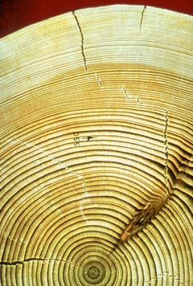

Slide 10
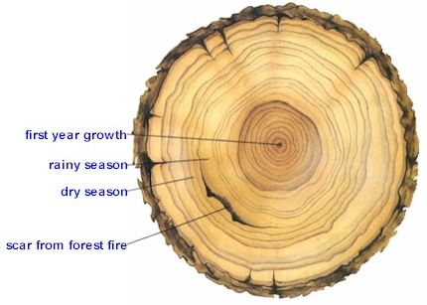

Slide 11
3-Pollen
Pollen grains are well preserved in lake and ocean sediment.
The analysis of each of these sediment layers provides information on the vegetation present at that time. Scientists can infer past climates (warm or cold) based on the distribution and changes in plant species.
The study of prehistoric pollen is palynology
Notes:
All flowering plants produce pollen.
Pollen grains have distinct shapes that can be used to identify which plant they came from.
Changes in the type of vegetation over a long time period can help scientists to determine whether a certain time period was warm or cold. Pollen analysis is often performed with radio carbon dating so that years can be assigned to the data set.
Plants have adapted to live in various conditions throughout evolutionary history. Some plants prefer to grow in colder regions, while others have adapted to survive in warmer regions. Changes in the type of vegetation (pollen) can help us to understand how climate has changed in the past.

Slide 12
4-Varve
A varve is a pair of thin layers of sediment. Typically, one band of the varve is light and composed of sand, pollen, and spores, while the second layer is dark and composed of very fine clay particles.
Varves are formed by seasonal variations in sedimentary deposition. The lighter band is laid down during the summer when a greater flow of water in nearby rivers and streams brings coarse, sandy material into the lake. The larger particles settle rather quickly, but the winds that constantly agitate the surface of the lake keep the fine clay in suspension. In winter, when the lake freezes over, the effect of the winds is not felt, and the clay particles slowly settle to the bottom. When the lake thaws, the cycle begins anew. Each varve, therefore, typically represents one year. One can determine the age of a varve formation by counting the number of couplets, just as one can determine the age of a tree by counting its rings.

Slide 13
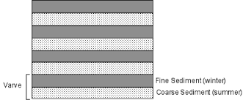

Slide 14
