Slide 1
Advanced Microbial Ecology
Code no. 618B
Pre-MSc. Students
Lecture no. 7 (2)
Dr. Mahmoud Nour El-Dein

Slide 2
Decomposition of Organic Matter and the Microbes Involved
The insoluble plant residues constitute the part of humus and soil organic matter complex. The final product of aerobic decomposition is CO₂ and that of anaerobic decomposition are Hydrogen, ethyl alcohol (CH₄), various organic acids and carbon dioxide (CO₂).
Soil organisms use organic matter as a source of energy and food. The process of decomposition is initially fast, but slows down considerably as the supply of readily decomposable organic matter gets exhausted.

Slide 3
Sugars, water-soluble nitrogenous compounds, amino acids, lipids, starches and some of the hemicellulases are decomposed first at rapid rate, while insoluble compounds such as cellulose, hemicellulose, lignin, proteins etc. which forms the major portion of organic matter are decomposed later slowly. Thus, the organic matter added to the soil is converted by oxidative decomposition to simpler substances which are made available in stages for plant growth and the residue is transformed into humus.
The microbiology of decomposition/degradation of some of the major constituents of soil organic matter/plant residues are discussed in brief in the following paragraphs:

Slide 4
Cellulose decomposition
Cellulose is the most abundant carbohydrate present in plant residues/organic matter in nature. When cellulose is associated with pentosans (e.g. xylans & mannans) it undergoes rapid decomposition, but when associated with lignin, the rate of decomposition is very slow.
The decomposition of cellulose occurs in two stages:
(i) in the first stage the long chain of cellulase is broken down into cellobiase and then into glucose by the process of hydrolysis in the presence of enzymes cellulase and cellobiase, and (ii) in second stage glucose is oxidized and converted CO₂ and water.

Slide 5
Cellulose is a structural polysaccharide that contains glucose. In order to access this glucose for catabolism, the cellulose must be decomposed by extracellular enzymes. These pieces are then transported into the cell for energy generation (catabolism) or production of biomass (anabolism).
Fungi such as Penicillium and Aspergillus and bacteria such as Streptomyces and Pseudomonas are important participants in the extracellular cleavage of cellulose.
The most extensively studied sources of cellulolytic enzymes have been the fungi Trichoderma and Phanerochaete and the bacteria Cellulomonas (anaerobe) and Clostridium thermocellum (an anaerobe).
Fungi produces three types of cellulolytic enzymes that cooperate in the degradation of cellulose: endoglucanases (EG I to EG V), cellobiohydrolases (CBH I and CBH II), and β-glucosidases (BGL I and BGL II).

Slide 6
Hemicellulose decomposition
Hemicelluloses are water-soluble polysaccharides and consists of hexoses, pentoses, and uronic acids and are the major plant constituents second only in quantity of cellulose, and sources of energy and nutrients for soil microflora.
The hydrolysis is brought about by number of hemicellulolytic enzymes known as "hemicellulases" excreted by the microorganisms.
On hydrolysis hemicelluloses are converted into soluble monosaccharide/sugars (e.g. xylose, arabinose, galactose and mannose) which are further convened to organic acids, alcohols, CO₂ and H₂O and uronic acids are broken down to pentoses and CO₂.

Slide 7
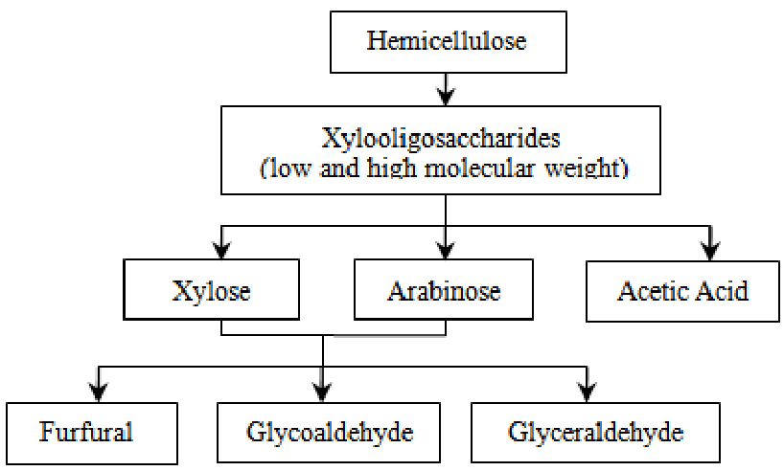

Slide 8
Various microorganisms including fungi, bacteria and actinomycetes both aerobic and anaerobic are involved in the decomposition of hemicelluloses.
Even though hemicelluloses decomposition is much quicker than cellulose decomposition, cells will utilize simple as substrates before hemicelluloses
Enzymes:
Hemicellulases are xylanases, mannanases, arabinofuranosides, and pectin lyases.

Slide 9
Chitin decomposition
Chitin is a special compound which can be found in the integument of arthropods and cell wall of fungi. The polymer is not easily degraded, and requires a variety of enzymes to do so. The dominant chitin degrades are the actinomycetes Streptomyces and Nocardia, and (less importantly) fungi as Trichoderma and Verticillium.
Enzymes
Microbes produced Chitinase enzymes for chitin degradation and Chitosanase for chitosan degradation.

Slide 10
Lignin decomposition
Lignin is the third most abundant constituent of plant tissues, and accounts about 10-30 percent of the dry matter of mature plant materials.
Lignin content of young plants is low and gradually increases as the plant grows old.
It is one of the most resistant organic substances for the microorganisms to degrade however certain Basidiomycetous fungi are known to degrade lignin at slow rates.
The final cleavages of these aromatic compounds yield organic acids, carbon dioxide, methane and water.

Slide 11
Lignin is the main component of wood in trees. Lignin has a varied, unique, and complicated chemical structure which contains many aromatics. These aromatics can be released from the lignin structure by fungal enzymes such as peroxidases and oxidases.
The enzymes utilize H₂O₂ and OH radicals to break the bonds in the lignin. Common types of fungi which degrade lignin are white rot (Phanerochaete chrysosporium), brown rot, and soft rot.
Once the aromatics are released from the original lignin structure they are incorporated into the metabolic pathway as pyruvate, acetyl CoA, and into the TCA cycle.

Slide 12
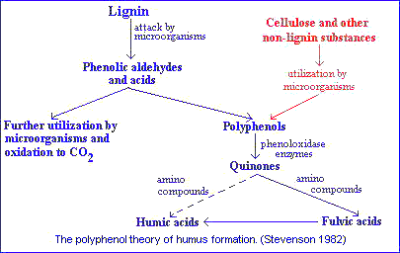
Enzymes
Lignin peroxidase, Mn (II)-Dependent Peroxidases, Quinone Reductases are produced by microbes for lignin degradation.

Slide 13
Lipids decomposition
Soil lipids, a complex series of 500 different fatty acids, are mostly derived from plants and microorganisms. The lipid content of soil organic matter ranges from 2% to 20%. Phospholipids are the primary lipids composing cellular membranes.
Enzymes
Phospholipases are enzymes that degrade phospholipids through hydrolytic cleavage of carboxy- and phosphodiester bonds. Phospholipases A, B lipases fatty acid esters and Phospholipases of the C, D types cleave phosphate ester bonds.

Slide 14
Protein Decomposition
Proteins are complex organic substances containing nitrogen, sulfur, and sometimes phosphorus in addition to carbon, hydrogen and oxygen. During the course of decomposition of organic matter, proteins are first hydrolyzed to a number of intermediate products e.g. Proteases, peptides etc. collectively
known as polypeptides. The intermediate products so formed are then hydrolyzed and broken down ultimately to individual amino acids, or ammonia and amides.

Slide 15
The process of hydrolysis of proteins to amino acids is known as “ammonification”, which is brought about by certain enzymes, collectively known as “proteases” or “proteolytic” enzymes secreted by various microorganisms.
Amino acids and amines are further decomposed and converted into ammonia.
During the course of ammonification, various organic acids, alcohols, aldehydes etc. are produced which are further decomposed finally to produce carbon dioxide and water.

