Slide 1
Lecture 6
Molecular biology and genetic engineering
For master students:
1- Cytology and genetics program
And
2- Plant taxonomy program
By
Dr. Reham M. Nada
Associate professor of Plant molecular biology

Slide 2
Methods used in protein estimation
1- Lowry
2- Bradford
Standard Curve

Slide 3
Protein Electrophoresis
SDS PAGE versus Native PAGE
Continuous versus discontinuous PAGE

Slide 4
Western blotting
https://www.youtube.com/watch?v=VgAuZ6dBOfs
Definition of primary antibody and secondary antibody

Slide 5
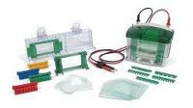

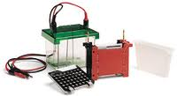
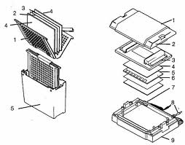
Western blotting
chemiluminescence, or autoradiography
Secondary antibody
Primary antibody

Slide 6
Antibodies to most proteins can be created by injecting small amounts of the protein into an animal such as a mouse, rabbit, sheep, or donkey (polyclonal antibodies) or produced in cell culture (monoclonal antibodies).
western blotting, proteins are first separated by size,
The proteins in the gel are then transferred to a PVDF, nitrocellulose, nylon or other support membrane.
This membrane can then be probed with solutions of antibodies.
Antibodies that specifically bind to the protein of interest can then be visualized by a variety of techniques, including colored products, chemiluminescence, or autoradiography.

Slide 7
RNA extraction
Using TRI reagent method
Using commercial kits
Advantage and disadvantage for each one

Slide 8
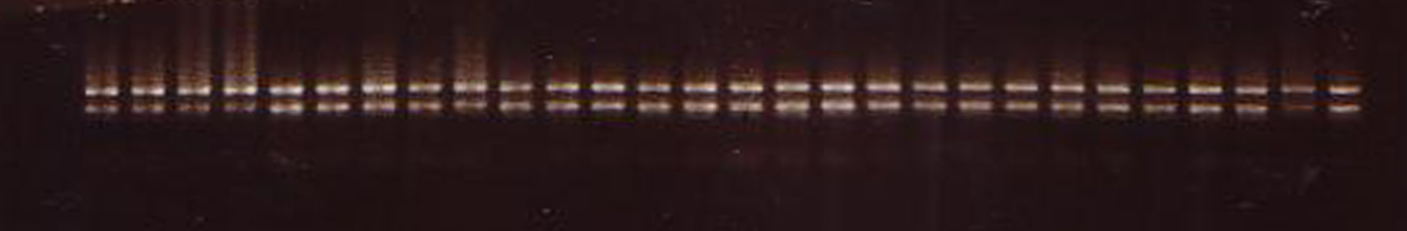
Estimation of RNA quality and quantity

Slide 9
The quantity and quality of RNA by using spectrophotometer at 260 and 280 nm

Slide 10
DNA extraction
Manual methods versus commercial kits

