Slide 1
Soil Microbiology
Third year botany
307B
Lecture 9
Dr. Mahmoud Nour El-Dein

Slide 2
Microbiology of decomposition of various constituents in organic matter
When plant and animal residues are added to the soil, the various constituents of the soil organic matter are decomposed simultaneously by the activity of microorganisms and carbon is released as CO₂, and nitrogen as NH₄ —>NO₃ for the use by plants.
Other nutrients are also converted into plant usable forms. This process of release of nutrients from organic matter is called mineralization.
The insoluble plant residues constitute the part of humus and soil organic matter complex.

Slide 3
The final product of aerobic decomposition is CO₂ and that of anaerobic decomposition are hydrogen, ethyl alcohol, (CH₄), various organic acids and carbon dioxide (CO₂). Soil organisms use organic matter as a source of energy and food.
The process of decomposition is initially fast, but slows down considerably as the supply of readily decomposable organic matter gets exhausted.

Slide 4
Sugars, water-soluble nitrogenous compounds, amino acids, lipids, starches and some of the hemicellulases are decomposed first at rapid rate, while insoluble compounds such as cellulose, hemicellulose, lignin, proteins etc. which forms the major portion of organic matter are decomposed later slowly.

Slide 5
Thus, the organic matter added to the soil is converted by oxidative decomposition to simpler substances which are made available in stages for plant growth and the residue is transformed into humus.
The microbiology of decomposition/degradation of some of the major constituents ( Cellulose, Hemicellulose, Lignin, Proteins) of soil organic matter are discussed in brief in the following paragraphs.

Slide 6
Decomposition of Cellulose:
Cellulose is the most abundant carbohydrate present in organic matter in nature. When cellulose is associated with pentosans (e.g. xylans & mannans) it undergoes rapid decomposition, but when associated with lignin, the rate of decomposition is very slow. The decomposition of cellulose occurs in two stages:
Cellulase Cellobiase
1. Cellulose ----------> Cellobiose ------------> Glucose
Hydrolysis hydrolysis
Oxidation Oxidation
2. Glucose ------------> Organic Acids ----------> CO₂ + H₂O

Slide 7
The intermediate products formed during enzymatic hydrolysis of cellulose (e.g. cellobiose and glucose) are utilized by the cellulose-decomposing organisms or by other organisms as source of energy for biosynthetic processes.
The cellulolytic microorganisms responsible for degradation of cellulose through the excretion of enzymes (cellulase & Cellobiase) are fungi, bacteria and actinomycetes.

Slide 8
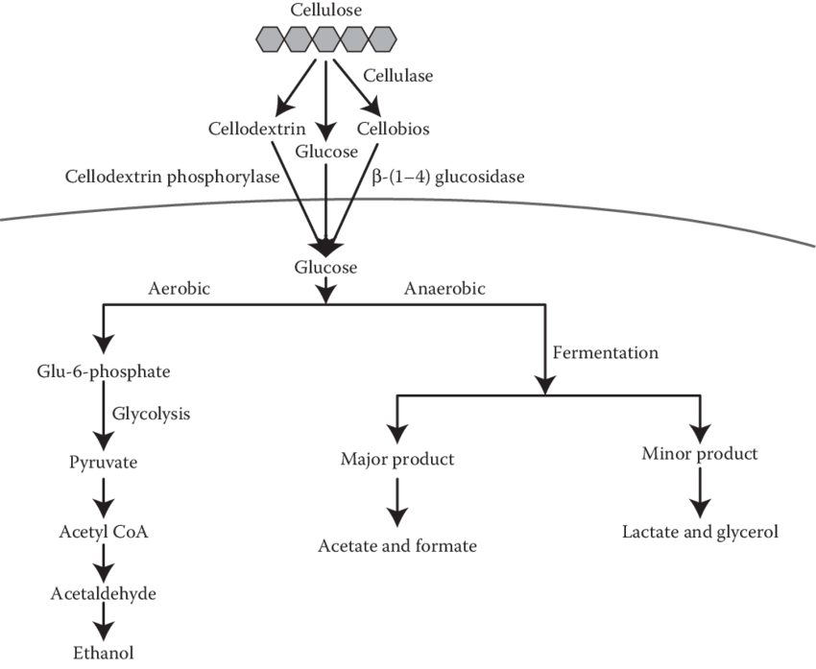

Slide 9
b) Decomposition of Hemicelluloses:
Hemicelluloses are water-soluble polysaccharides and consists of hexoses, pentose's, and uronic acids and are the major plant constituents second only in quantity of cellulose, and sources of energy and nutrients for soil micro flora.
When subjected to microbial decomposition, hemicelluloses degrade initially at faster rate and are first hydrolyzed to their component sugars and uronic acids. The hydrolysis is brought about by number of hemicellulolytic enzymes known as "hemicellulases" excreted by the microorganisms.

Slide 10
On hydrolysis hemicelluloses are converted into soluble monosaccharide (e.g. xylose, arabinose, galactose and mannose) which are further convened to organic acids, alcohols, CO₂ and H₂O and uronic acids are broken down to pentose's and CO₂.
Various microorganisms including fungi, bacteria and actinomycetes both aerobic and anaerobic are involved in the decomposition of hemicelluloses.

Slide 11
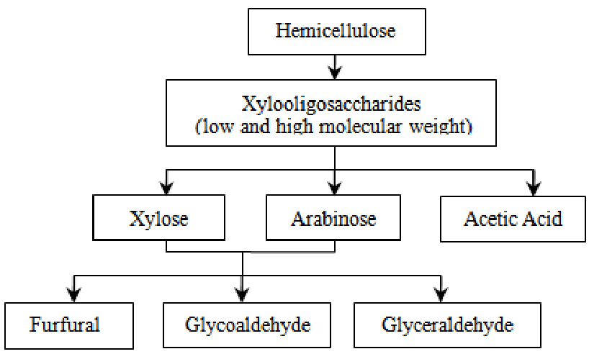

Slide 12
c) Lignin Decomposition:
Lignin is the third most abundant constituent of plant tissues, and accounts about 10-30 % of the dry matter of mature plant materials. Lignin content of young plants is low and gradually increases as the plant grows old. It is one of the most resistant organic substances for the microorganisms to degrade however certain Basidiomycetous fungi are known to degrade lignin at slow rates.
Complete oxidation of lignin result in the formation of aromatic compounds such as syringaldehydes, vanillin and ferulic acid. The final cleavages of these aromatic compounds yield organic acids, carbon dioxide, methane and water.

Slide 13
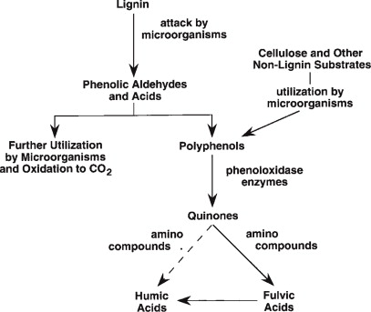

Slide 14
d) Protein Decomposition:
Proteins are complex organic substances containing nitrogen, sulphur, and sometimes phosphorus in addition to carbon, hydrogen and oxygen. During the course of decomposition of organic matter, proteins are first hydrolyzed to a number of intermediate products e.g. Proteases, peptides etc. collectively known as polypeptides
The intermediate products so formed are then hydrolyzed and broken down ultimately to individual amino acids, or ammonia and amides.

Slide 15
The process of hydrolysis of proteins to amino acids is known as “aminization or ammonification”, which is brought about by certain enzymes, collectively known as “proteases” or “proteolytic” enzymes secreted by various microorganisms. Amino acids and amines are further decomposed and converted into ammonia. During the course of ammonification, various organic acids, alcohols, aldehydes etc. are produced which are further decomposed finally to produce CO₂ and water.
All types of microorganisms, bacteria, fungi, and actinomycetes are able to bring about decomposition of proteins. In acid soils, fungi are pre-dominant, while in neutral and alkaline soils bacteria are dominant decomposers of proteins.

