Slide 1
Lecture Eight Metamorphism of Ultramafic rocks (Metaultramafics)

Slide 2
What is the Metaultramafics?
Metaultramafics, are metamorphosed ultramafic igneous rocks.
Ultramafic rocks are generated in the upper mantle and composed of <90% mafic minerals, which include:
Olivine (Ol) (Mg,Fe)₂SiO₄,
Orthopyroxene (Opx) (Mg,Fe)SiO₃ and
Clinopyroxene (Cpx) Ca(Mg,Fe)Si₂O₆
and comprises rocks such as:
- Dunite (Ol), Pyroxenite (Cpx+Opx), Peridotite (Cpx+Opx+Ol) include harzburgite (Ol+Opx) and lherzolite (Ol+Cpx).
Chemically, the Utramafic chemical system of the ultramafic is simple (SiO₂, MgO, FeO, CaO)

Slide 3
Mineralogy of Metaultramafics
Metaultramafics contain the following mineral assemblage:
Talc
Serpentine
Olivine + H₂O = serpentine
Mg₂SiO4 + H₂O = Mg₃Si2O₅(OH)₄
Anthophyllite
Olivine
Pyroxene

Slide 4
1- Rock types of the metamorphosed ultramafic rocks
The rock types of the metamorphosed ultramafic rocks are usually mono-mineralic and include:
- Serpentintes: a massive to schistose rock with abundant serpentine minerals.
- Talc fels / talc schist: Talc rich foliated/non-foliated rocks
- Ophicalcites: serpentine + carbonate calcite
- Anthophyllite schist.
- Peridotites: Olivine bearing ultrmafics

Slide 5
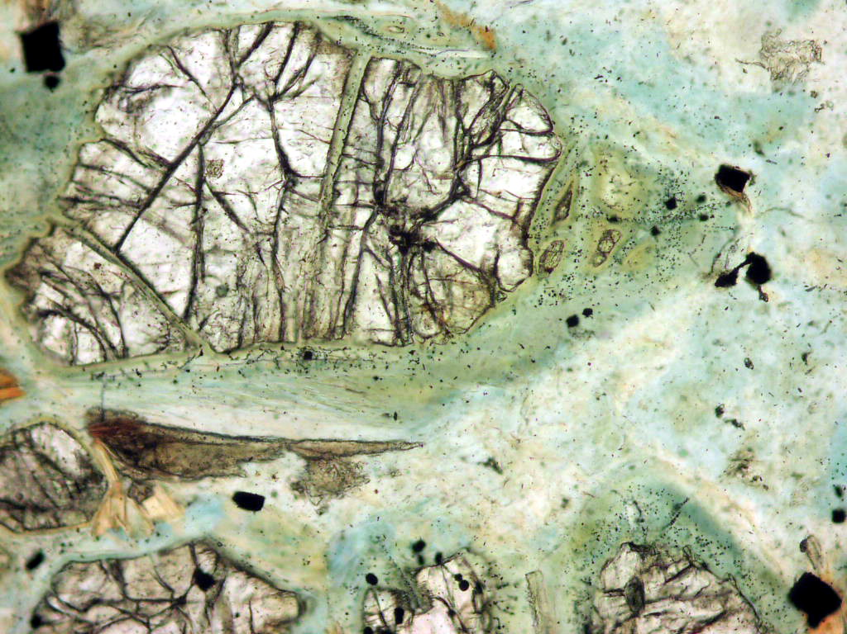
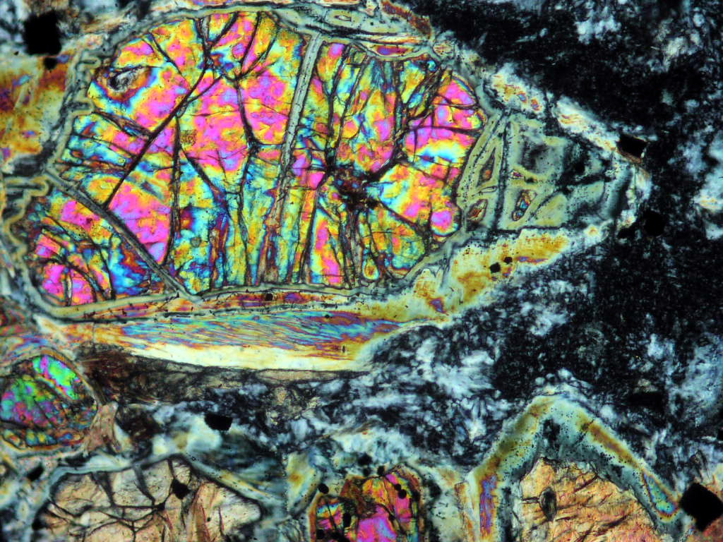

Slide 6
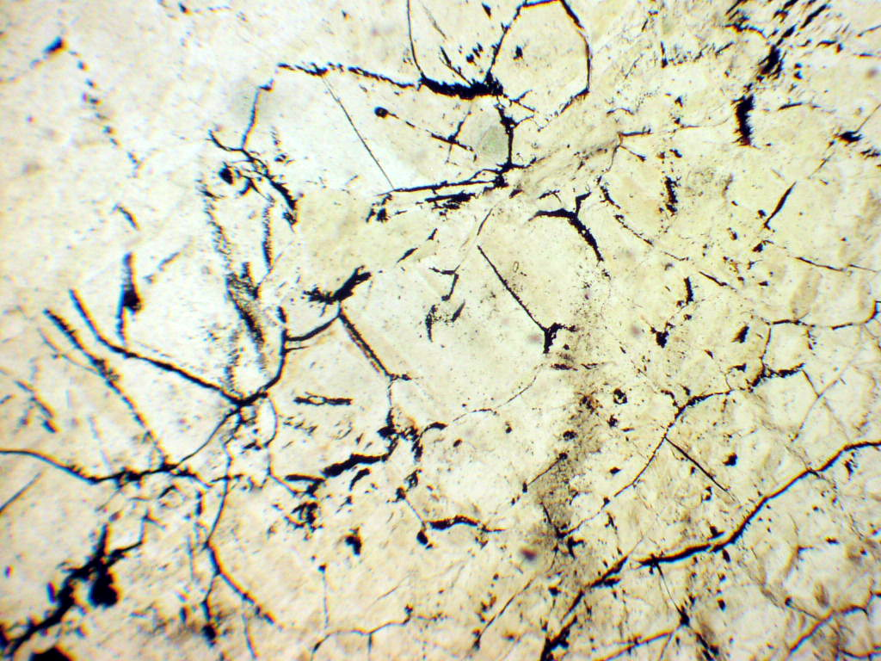
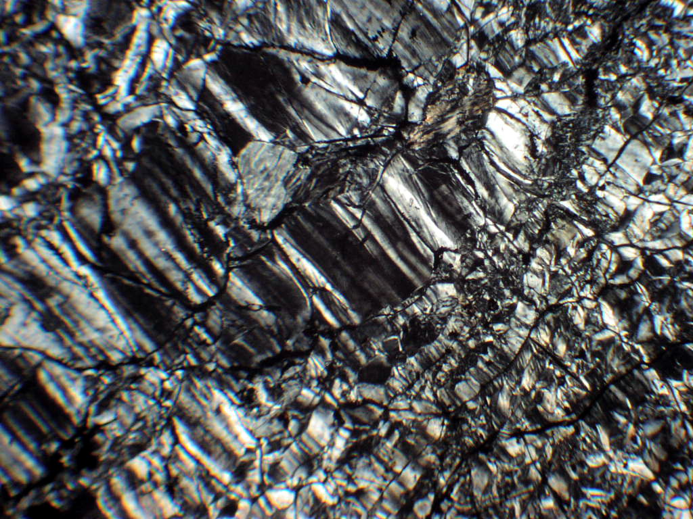
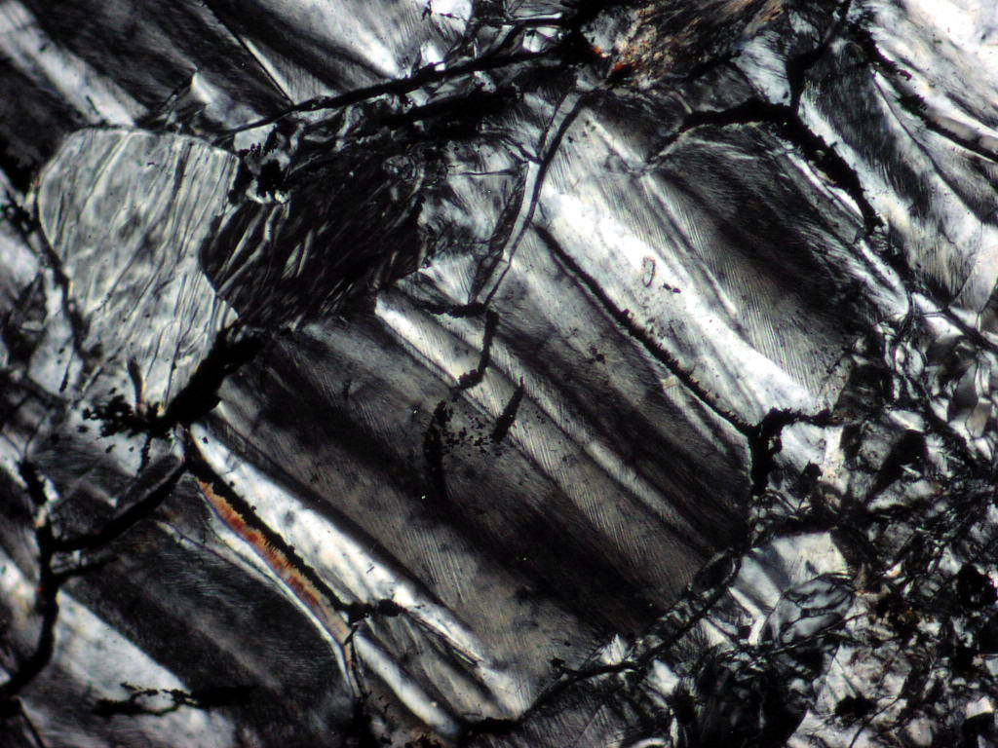

Slide 7
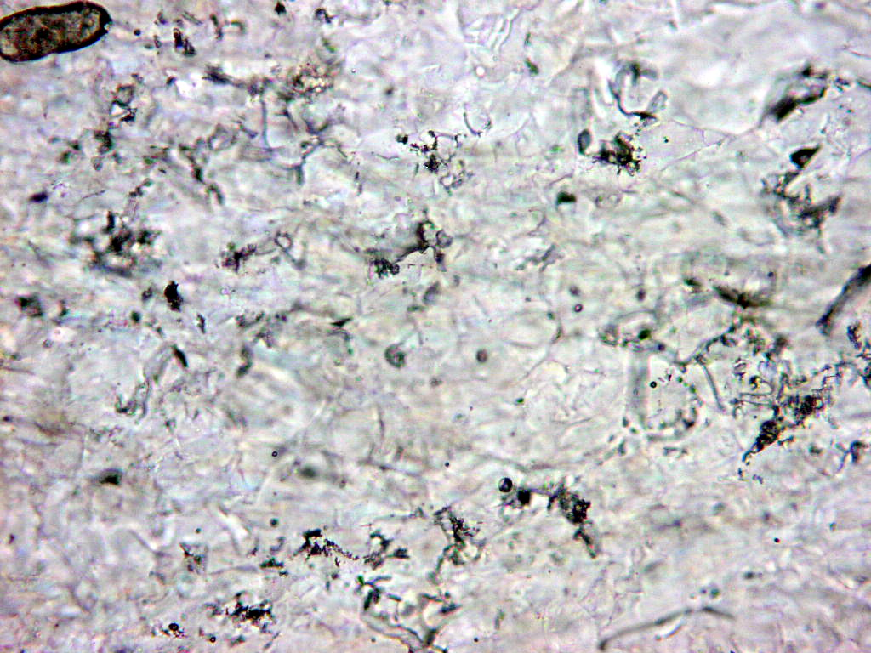
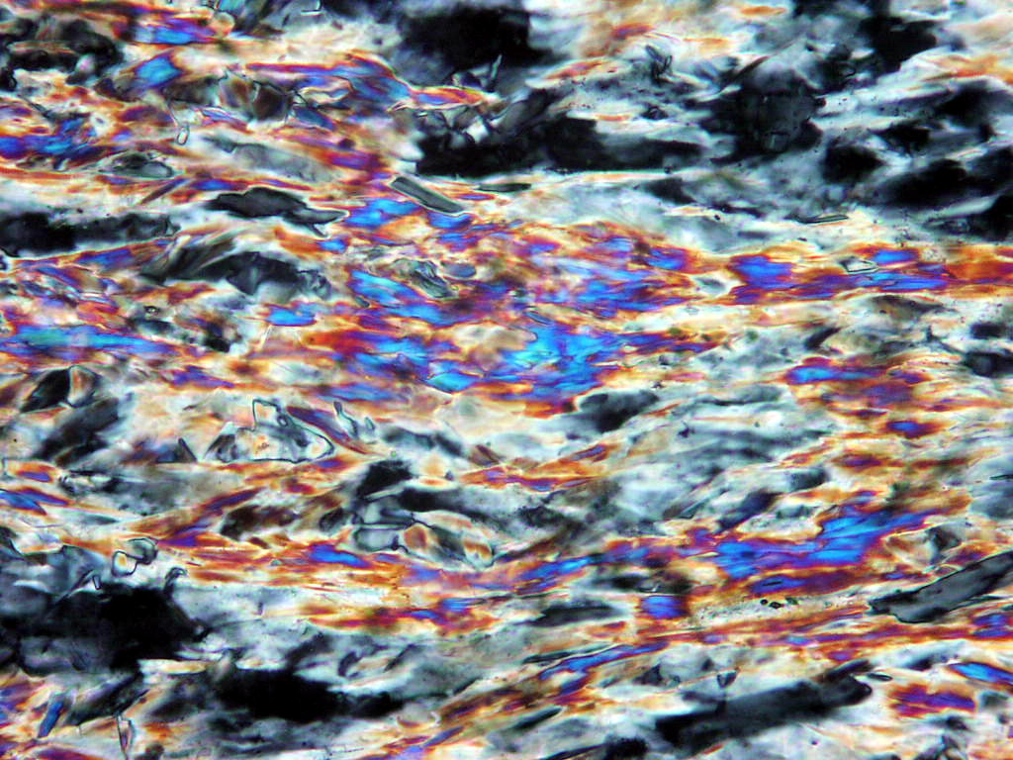

Slide 8
