Slide 1
Lecture Nine Metamorphism of carbonate rocks (Metcarbonates)

Slide 2
What is the Metacarbonates?
Metacarbonates, are metamorphosed calcareous (limestone and dolomite) rocks in which the carbonate component is predominant, with granoblastic polygonal texture
Metacarbonates include:
i) Marbles are nearly pure carbonate (carbonate >50%)
ii) Calc-silicate rocks: carbonate is subordinate (carbonate <50%) and may be composed of Ca-Mg-Fe-Al silicate minerals, such as diopside, grossular, Ca-amphiboles, vesuvianite, epidote, wollastonite, plagioclase, talc, anthophyllite, etc.
iii) Skarn: calc-silicate rock formed by metasomatism between carbonates and silicate-rich rocks or fluids
Carbonate rocks are predominantly carbonate minerals, usually limestone or dolostone. They may be pure carbonate, or they may contain variable amounts of other precipitates (such as chert or hematite) or detrital material (sand, clays, etc.)
Chemically, the carbonate rocks are rich in CaO, CO₂, MgO, and mad may SiO₂, Al₂O₃, FeO, and other subordinate oxides if the carbonate are impure.

Slide 3
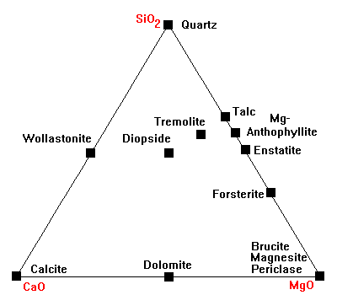
Mineralogy of Metacarbonates
Metacarbonate contain the following mineral assemblage:
Carbonate minerals (Calcite and dolomite),
Amphibole (anthophyllite Enstatite, Tremolite)
Pyroxene (Diopside)
Olivine
talc,
wollastonite
quartz

Slide 4
The metacrbonates will discussed for metamorphism in the following conditions:
Pure limestone and dolomite
Impure limestone and dolomite

Slide 5
-1- Pure Metacarbonates Calcite and dolomite marbles

Slide 6
1- Pure Carbonates (Limestone and dolomite)
Metamorphism of pure carbonate rocks yielded calcite and/or dolomite marbles. Many marbles are composed only of calcite and/or dolomite with minor quartz and phyllosilicates, originally of detrital origin.
A- Calcite marble
The grade of metamorphism is function in grain size, where grain size increases with grade increase.
At very HP, the polymorph aragonite becomes stable and aragonite marble is known from high pressure terrains.
At HT/LP (>600°C) calcite and quartz react to produce wollasonite and CO₂. The reaction occurs only at high temperature thermal aureole, and is inhibited by high fluid pressures of CO₂.
CaCO₃ +SiO₂ ➔ CaSiO₃ + CO₂

Slide 7
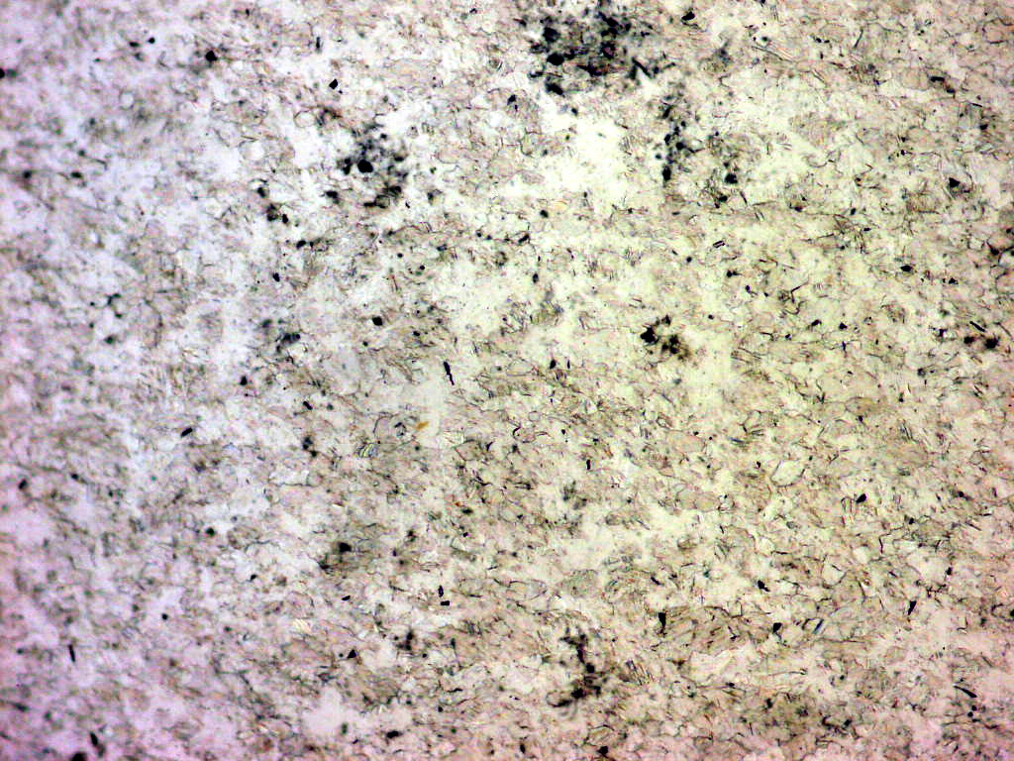
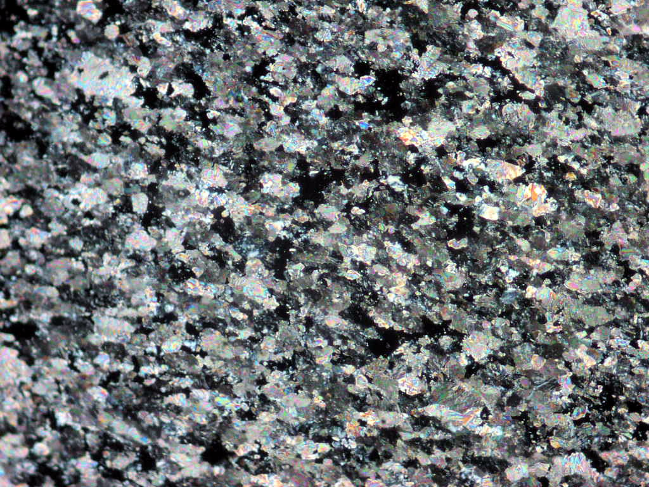

Slide 8
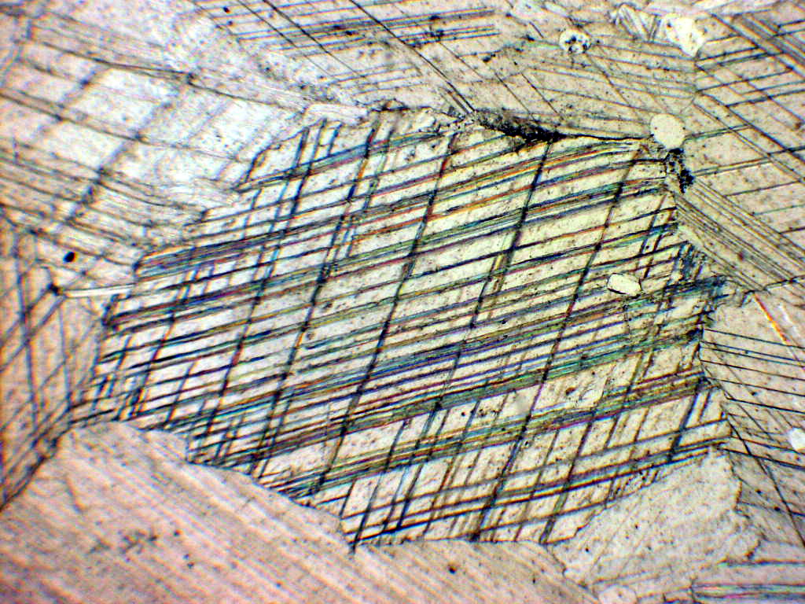
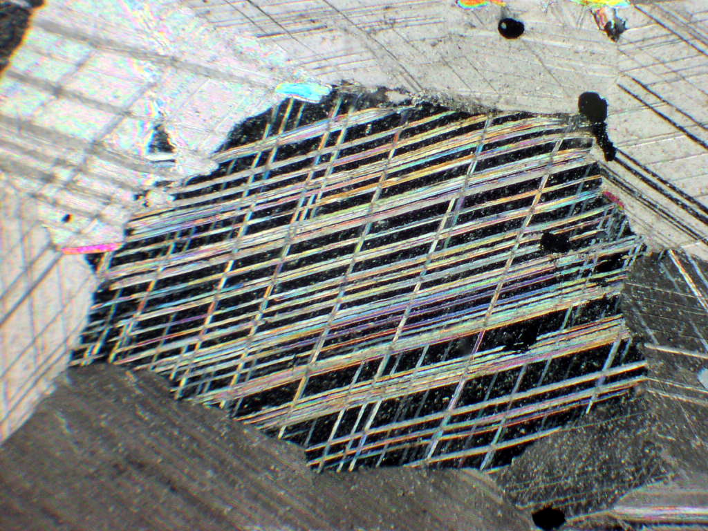

Slide 9
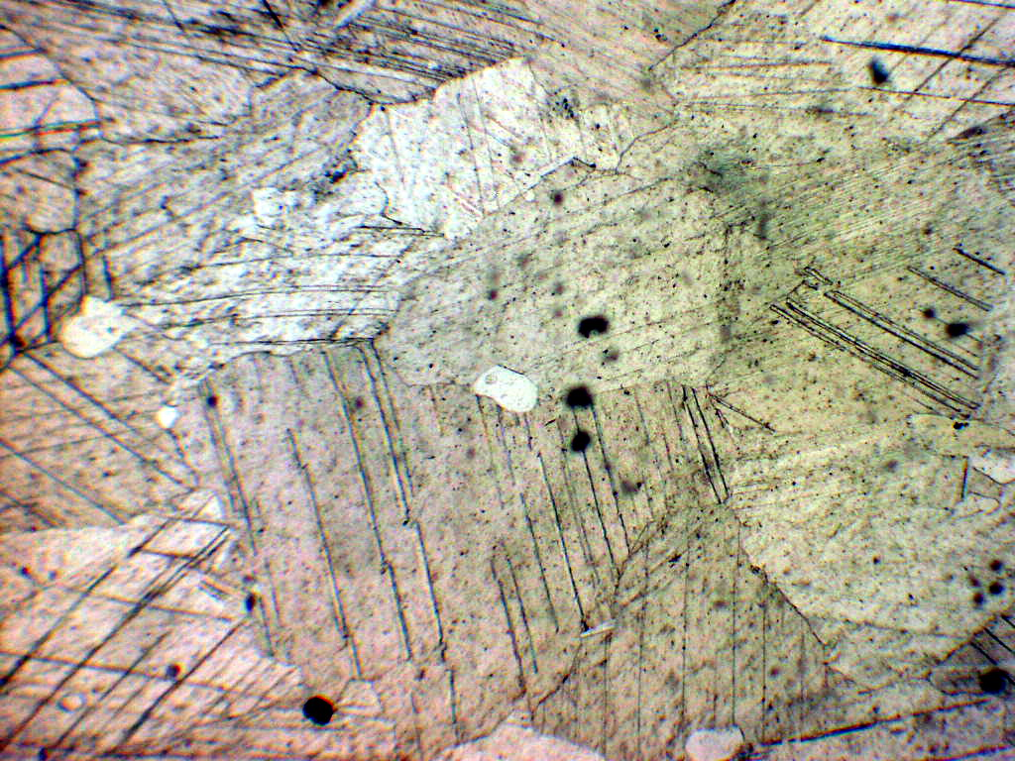
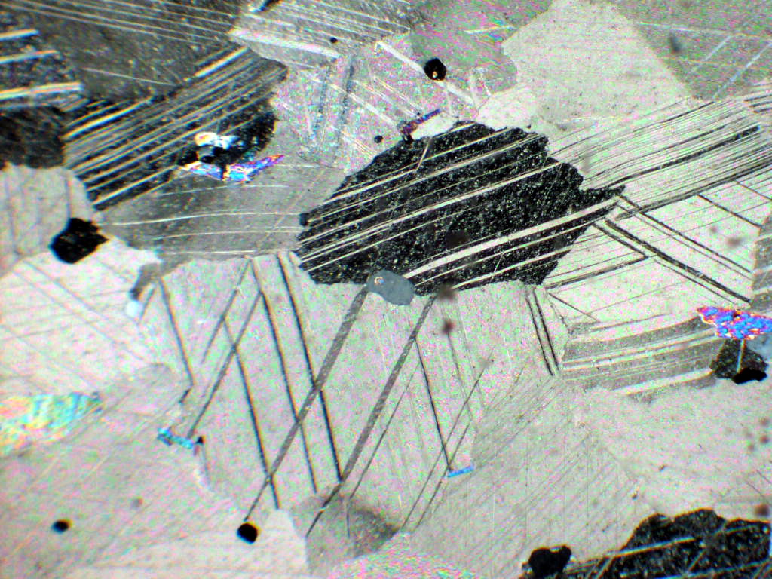

Slide 10
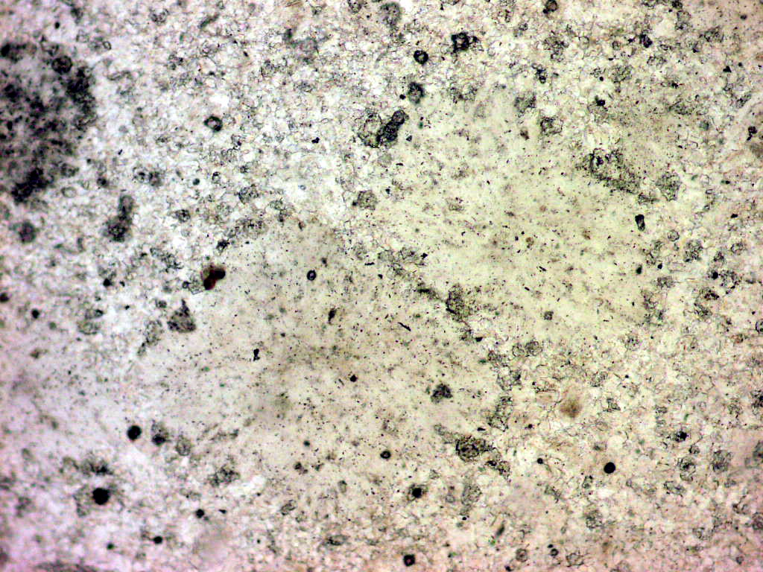
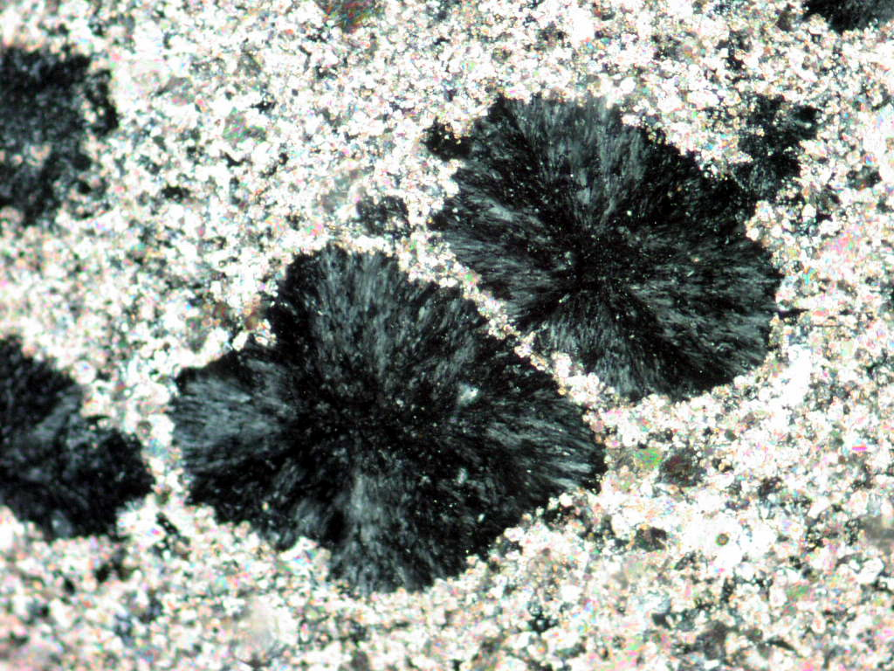
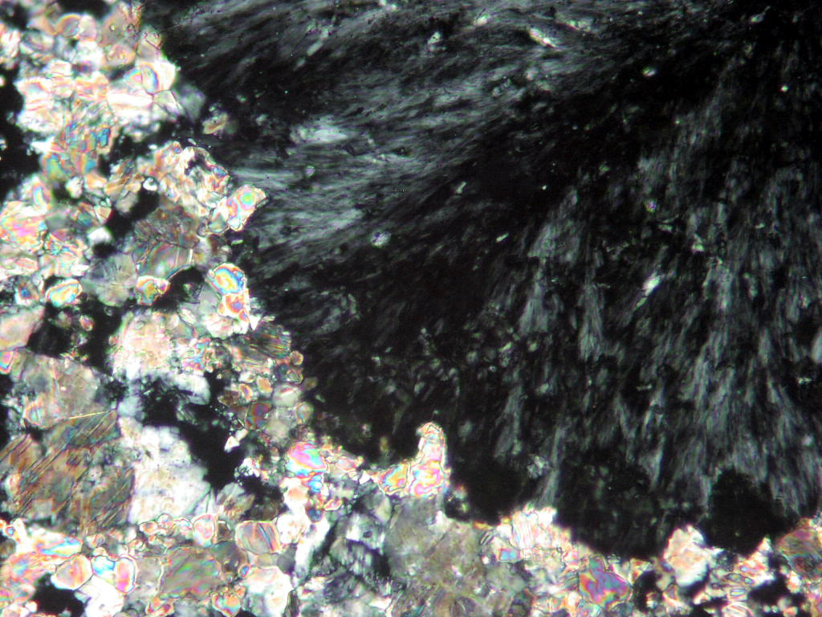

Slide 11
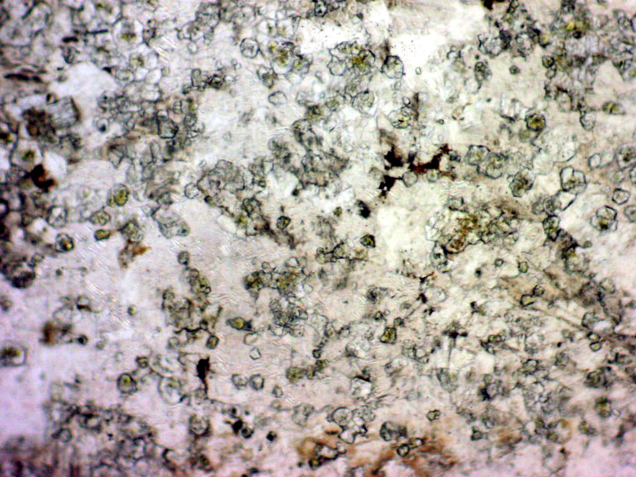
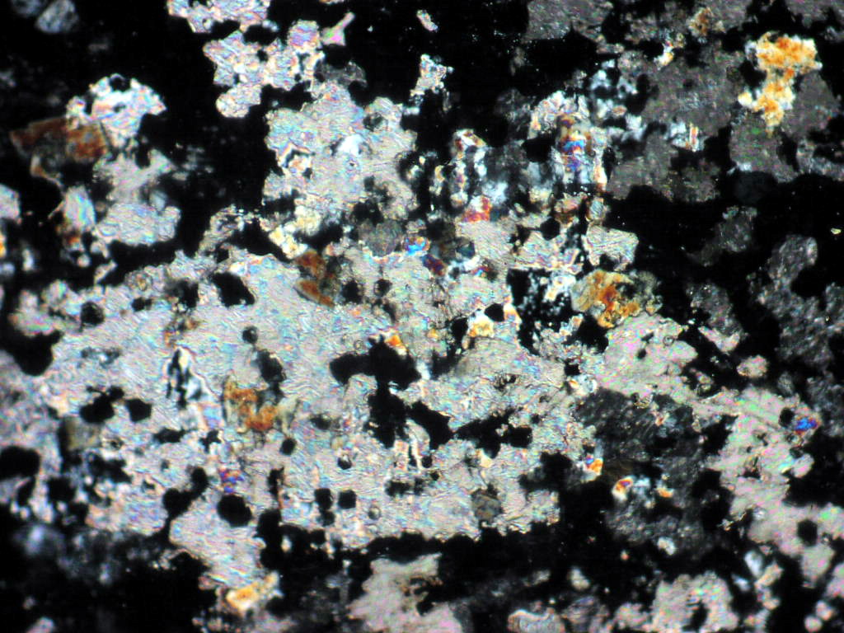
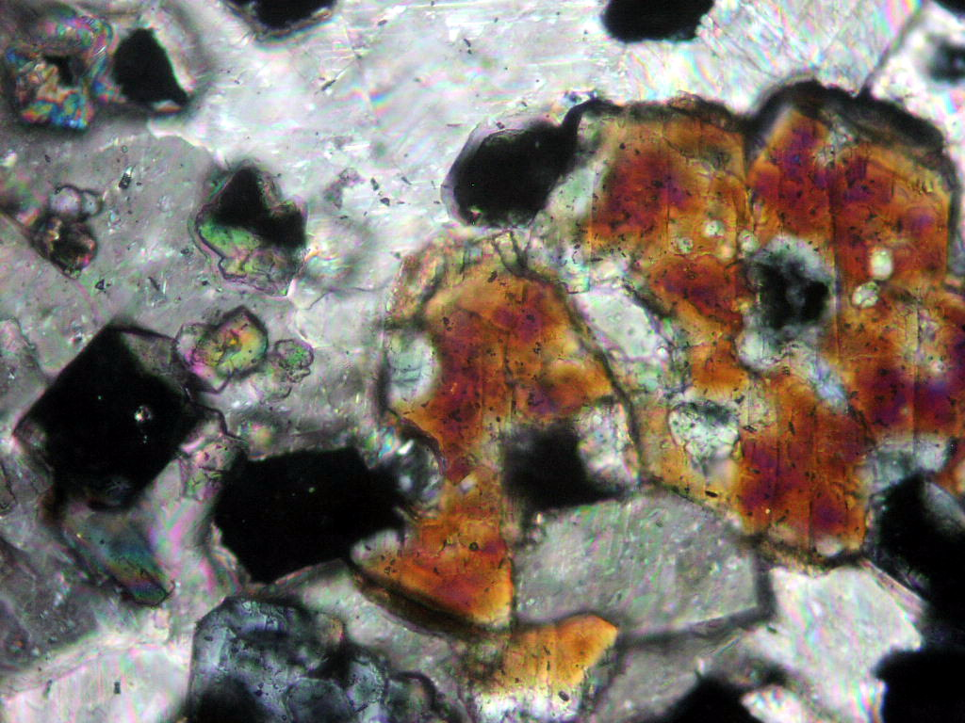

Slide 12
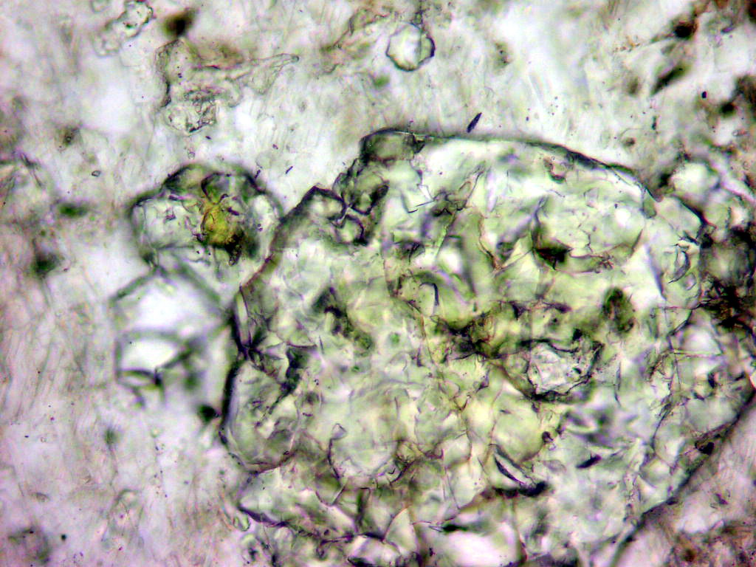
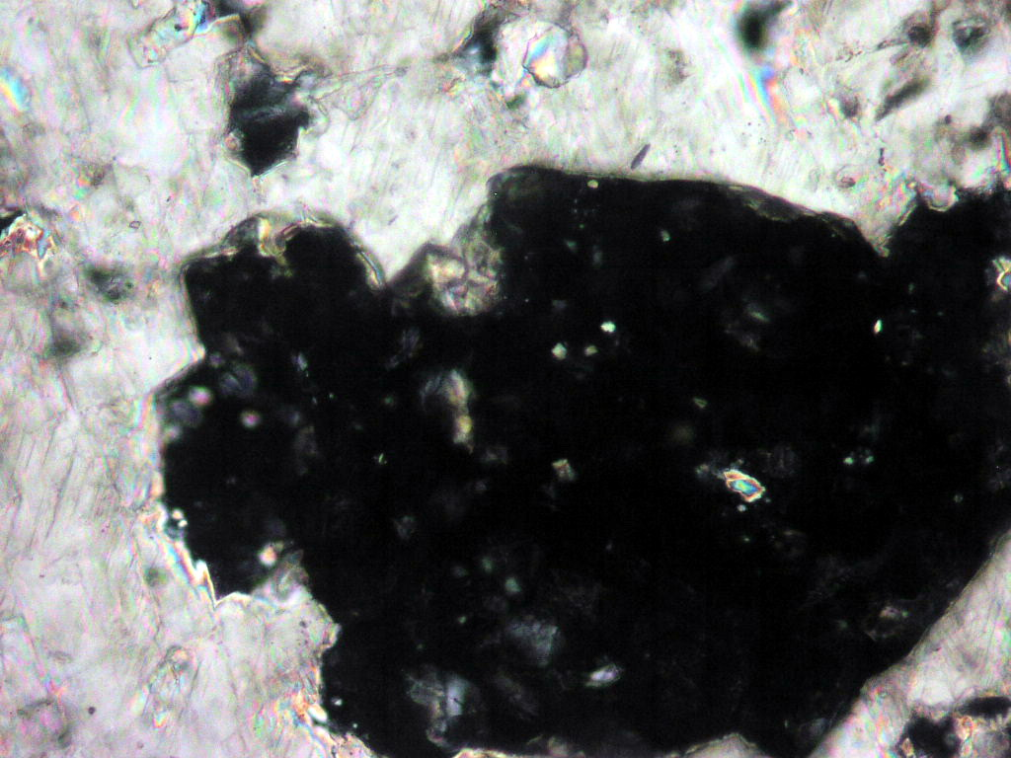

Slide 13
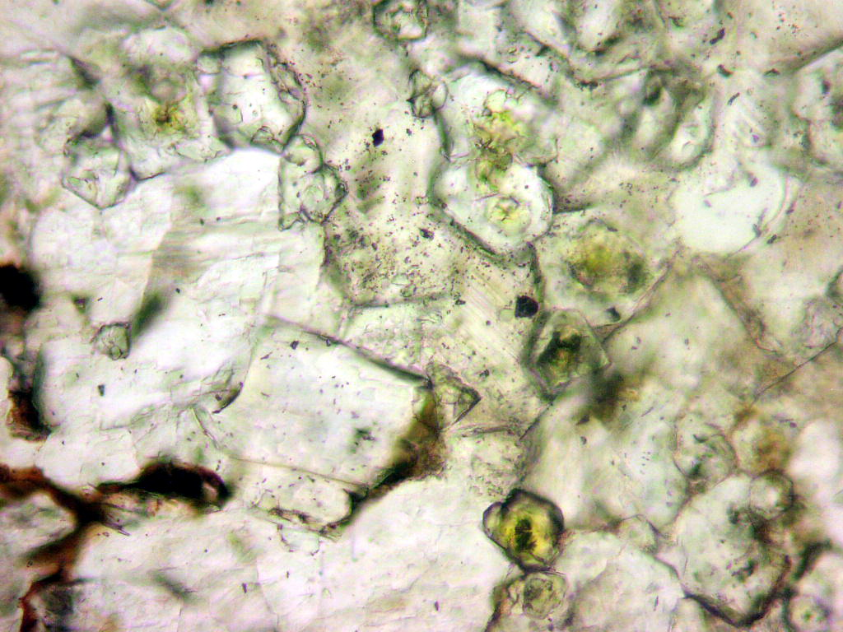
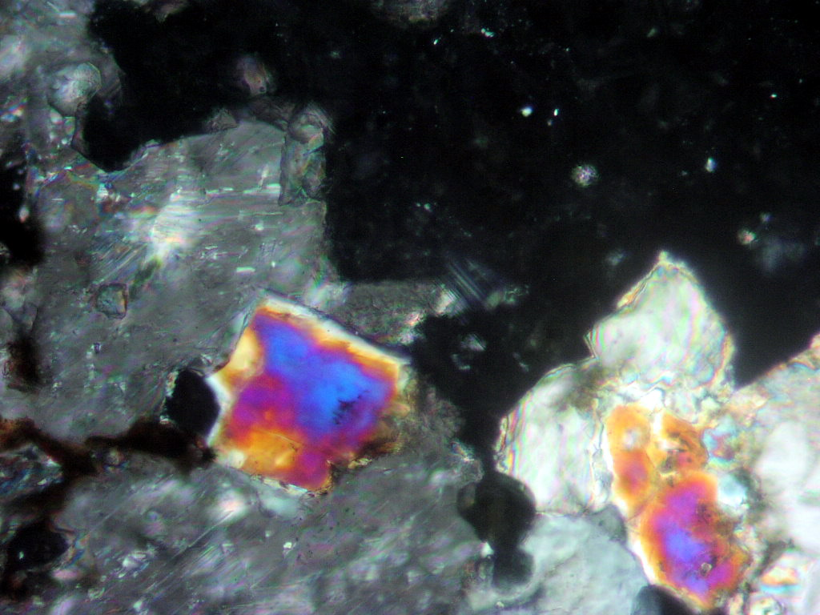

Slide 14
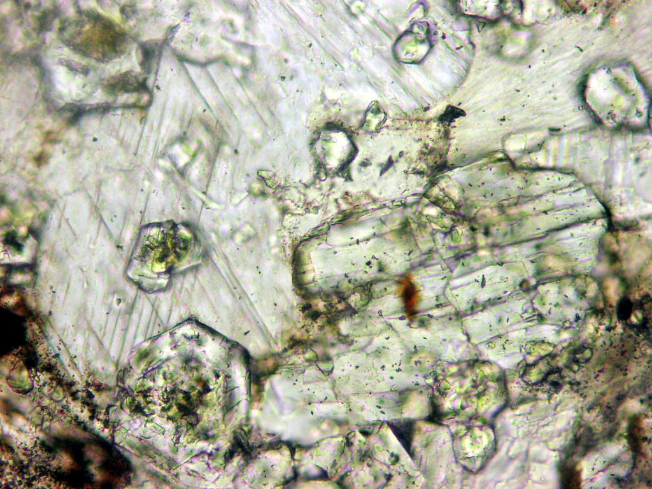
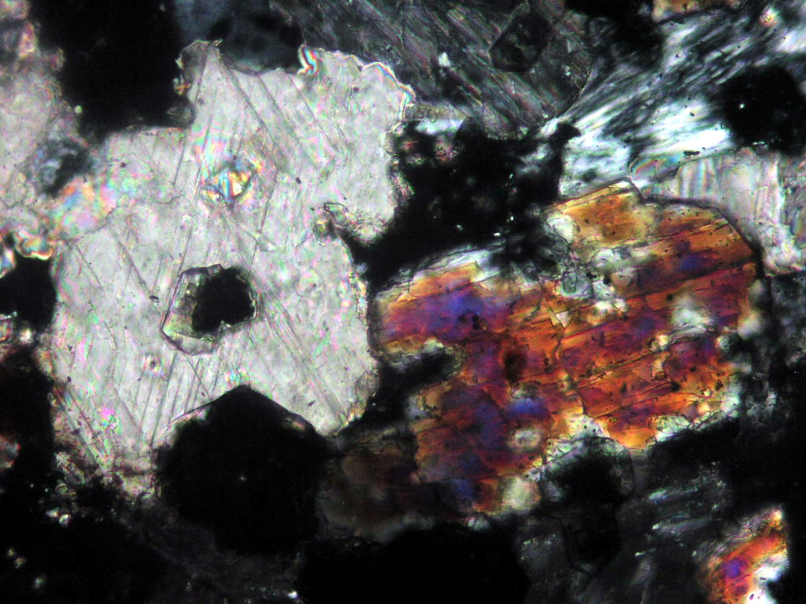

Slide 15
1- Pure Carbonates (Limestone and dolomite)
A- Dolomite marble
At HT/LP, dolomite marble loses CO₂ to form periclase (MgO) in condition <900 °C, and consequently reacts with water to form brucite (MgO(OH)₂). Therefore, the common result of decarbonation of dolomite or dolomitic marble is a mixture of brucite and calcite.
Quartz bearing dolomitic marbles (calcite + dolomite + quartz) develop a characteristic sequence of Ca- and/or Mg-silicate as follows:
(i) talc
dolomite + qurtz + H₂O = talc + calcite + CO₂
(ii) tremolite in the greenschist facies,
talc + calcite + quartz = tremolite + H₂O + CO₂ (quartz rich)
talc+calcite = tremolite + dolomite + CO₂ + H₂O (quartz poor)

Slide 16
1- Pure Carbonates (Limestone and dolomite)
A- Dolomite marble, cont.
(iii) diopside and/or forsterite in the amphibolite facies
tremolite+calcite+quartz = diopside+H₂O +CO₂
tremolite + dolomite = forsterite + calcite + H₂O + CO₂
And,
(iv) diopside + forsterite at higher grade.
tremolite + calcite = diopside + forsterite + H₂O+CO₂
Sheet-silicate impurity in calcite and dolomite marble adds variety by the following Al-bearing minerals to feature in the assemblage: typically they include zoisite, epidote and Ca-rich garnet in the greenschist facies and anorthite in the amphibolite facies.

Slide 17
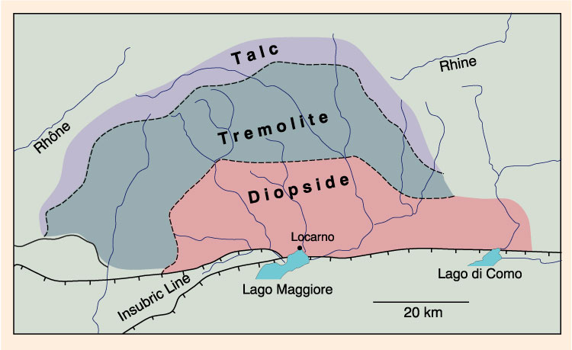
Metamorphic zones developed in regionally metamorphosed dolomitic rocks of the Lepontine Alps

