Slide 1
Lecture Ten Metamorphism of pelitic rocks

Slide 2
What is the Metapelites?
Metapelites, are metamorphic rocks, which derived from contact or regional metamorphism of shale or mudstones (clay rich sediments).
Metapelites are the most distinguished family in metamorphic rocks because the clays are very sensitive to variations in temperature and pressure, undergoing extensive changes in mineralogy during progressive metamorphism.
Pelitic sediments are mineralogy dominated by fine Al-K-rich phyllosilicates (50 vol%), such as clays (montmorillonite, kaolinite, or smectite), fine white micas (sericite, paragonite, or phengite) and chlorite, all of which may occur as detrital or authigenic grains (10-30%).
Chemically, the pelitic rocks are rich in Al₂O₃ and SiO₂, Na₂O, K₂O, and poor in CaO, therefore, the yielded metamorphic minerals during progressive metamorphism will be rich in Al₂O₃.

Slide 3
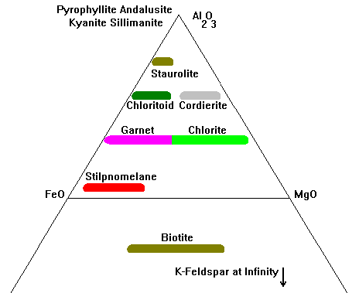
Mineralogy of metapelites
Metapelites contain the following mineral assemblage:
Mica (Muscovite, biotite), pyrophyllite, chlorite, chloritoid,
Feldspars (plagioclase and K-feldspars)
Garnet, staurolite, cordierite
Al-silicate (andalusite, Kyanite, and sillimanite)
Quartz, orthopyroxene, spinel
+Qtz +Pl
+ Ms

Slide 4
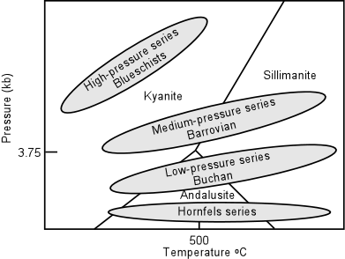
The metapelites will discuss their metamorphism in the following connditions:
Pre-metamorphic – low-grade metamorphic conditions
In Middle Pressure metamorphism (Barrovian zonal scheme)
In the low pressure metamorphism (Buchan zonal scheme)
In the high temperature conditions

Slide 5
-1- Pre-metamorphic – low grade metamorphic changes

Slide 6
1- Pre-metamorphic – low grade metamorphic changes
During compaction and diagenesis, changes in mudstones and shale include:
Reducing of porosity (> 50 Vol.%) during burial & compaction
Original clay, smectite, are replaced by mixture of chlorite and illite (sericitic muscovite)
With progress increase of P-T condition the following assemblage could be formed
chlorite + illite + kaolinite
chlorite + sericite + pyrophyllite + illite + koalinite
Illite crystallinity, as deined from XRD, used to measure the degree of diagenetic and very-low metamorphism.
There is no sharp contact between diagenesis and low-Temperature metamorphism

Slide 7
-2- Medium Pressures metamorphism (Barrovian Zonal scheme)

Slide 8
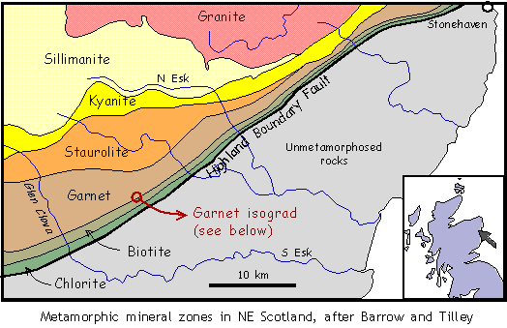
2- Barrovian Zonal Scheme (MP metamorphism)
The classical zones of metamorphism in the Scottish Highlands and many other parts of the world include six distinct mineral assemblages that occur in the metapelites.

Slide 9
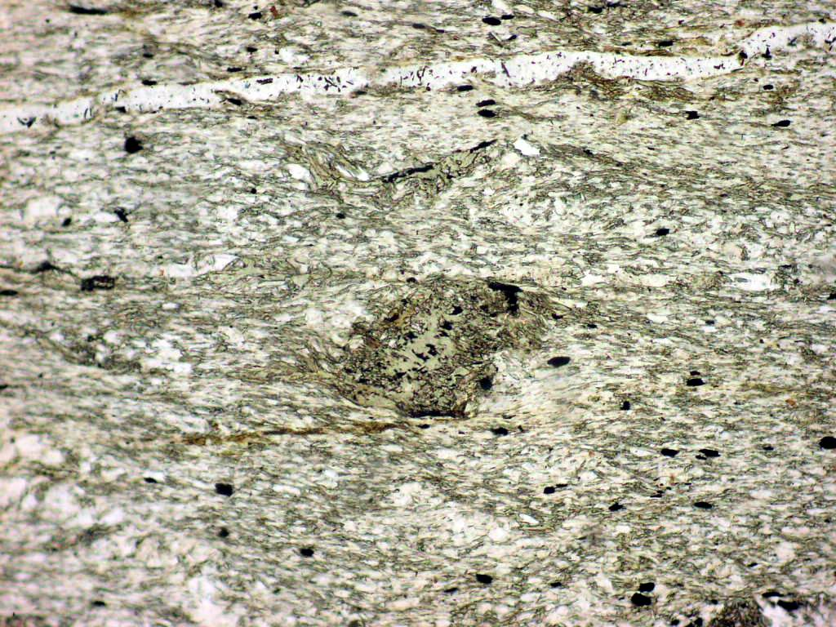
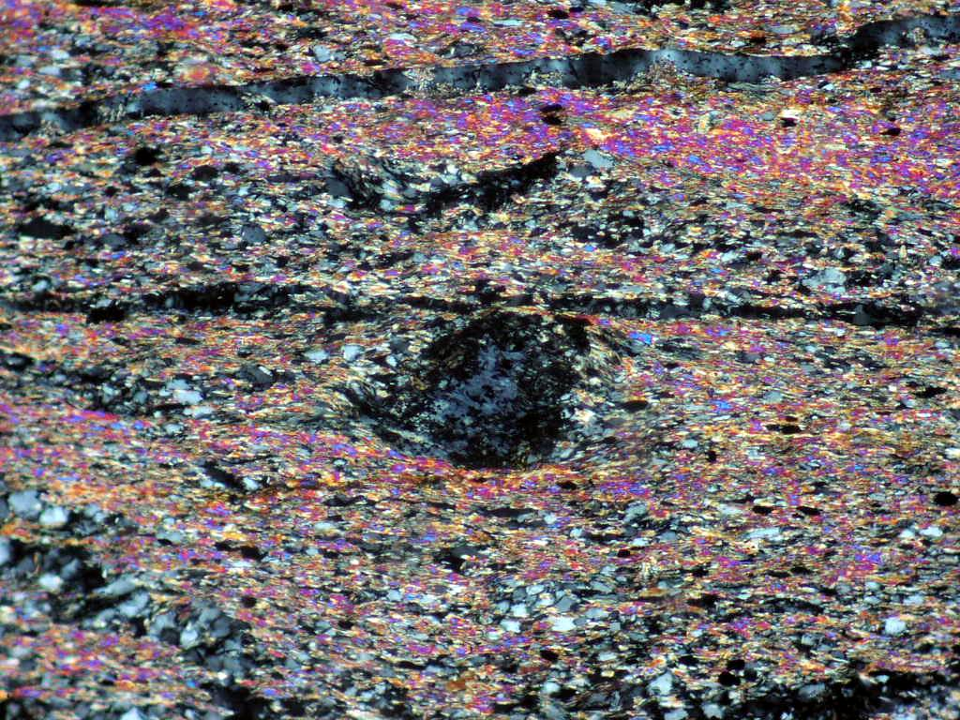
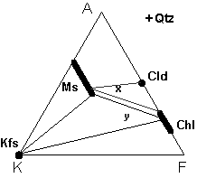
I- Chlorite zone
Metapelites of the chlorite zone are very fine-grained slates, so it makes difficult to investigate under the microscope,
They tyically contain mineral assemblage: chlorite + Mg-Fe-bearing muscovite (phengitic) + quartz + Na-plagioclase (albite) ± K-feldspars ± stilpnomelane ± calcite.

Slide 10
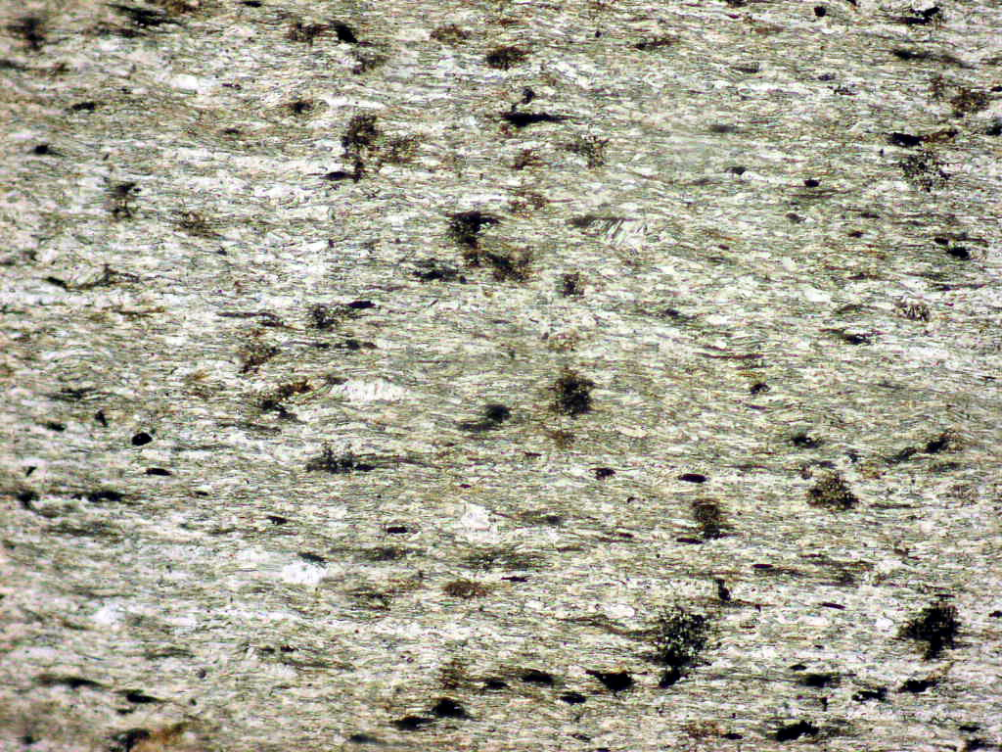
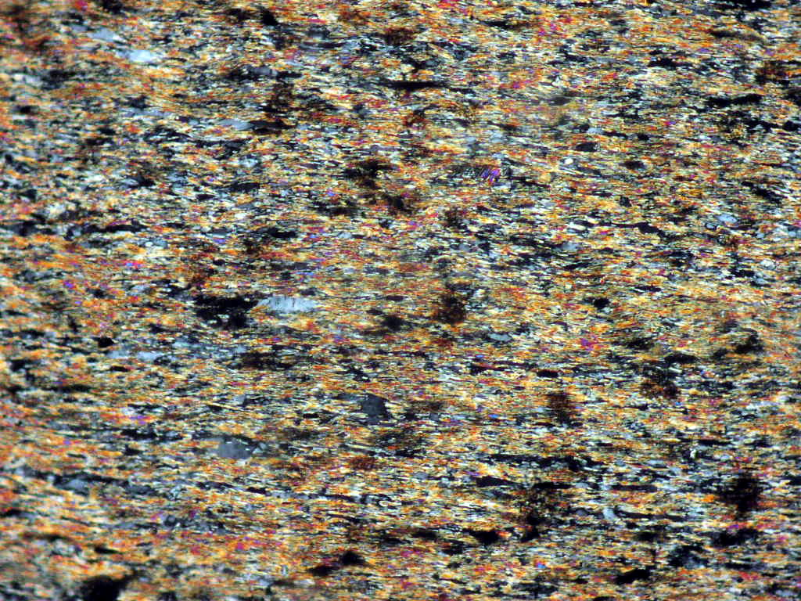

Slide 11
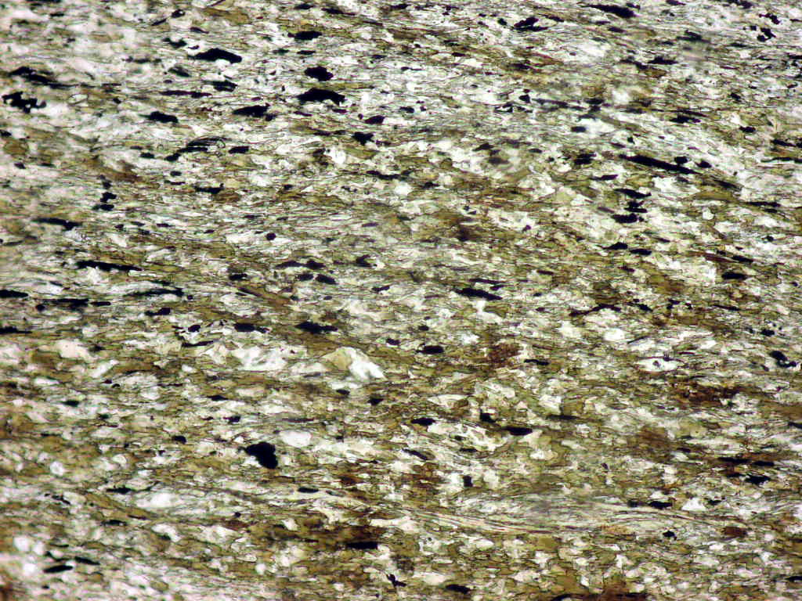
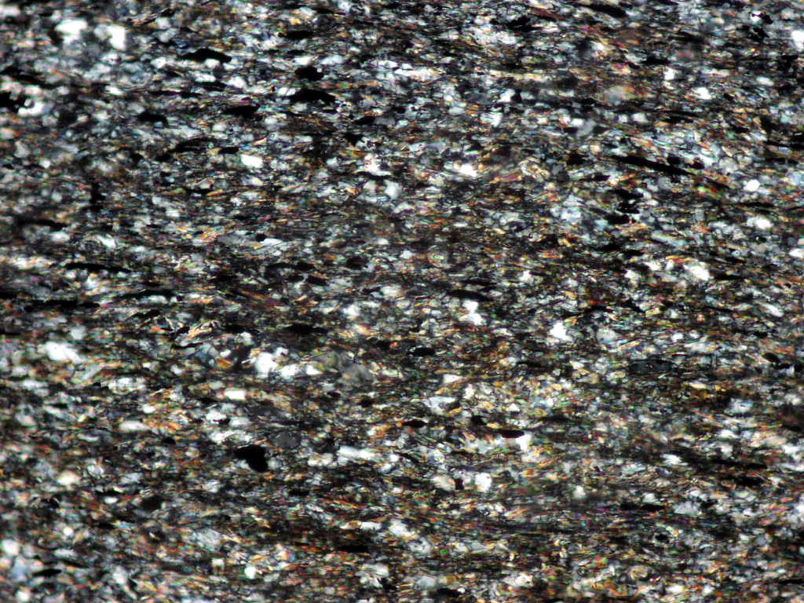
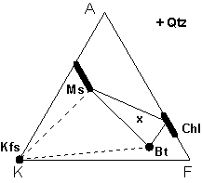
II- Biotite zone
Metapelites of the biotite zone are defined by first appearance of biotite through one of two mineral reactions (depending upon the presence or absence of K –feldspar):
K-feldspar + chlorite ➔ biotite + muscovite + quartz + H₂O
Phengitic Ms + chlorite ➔ biotite + phengitic-poor Ms + quartz + H₂O
They are typically Phyllite and contain mineral assemblage: chlorite + muscovite + biotite + quartz + Na-plagioclase (albite) ± calcite.

Slide 12
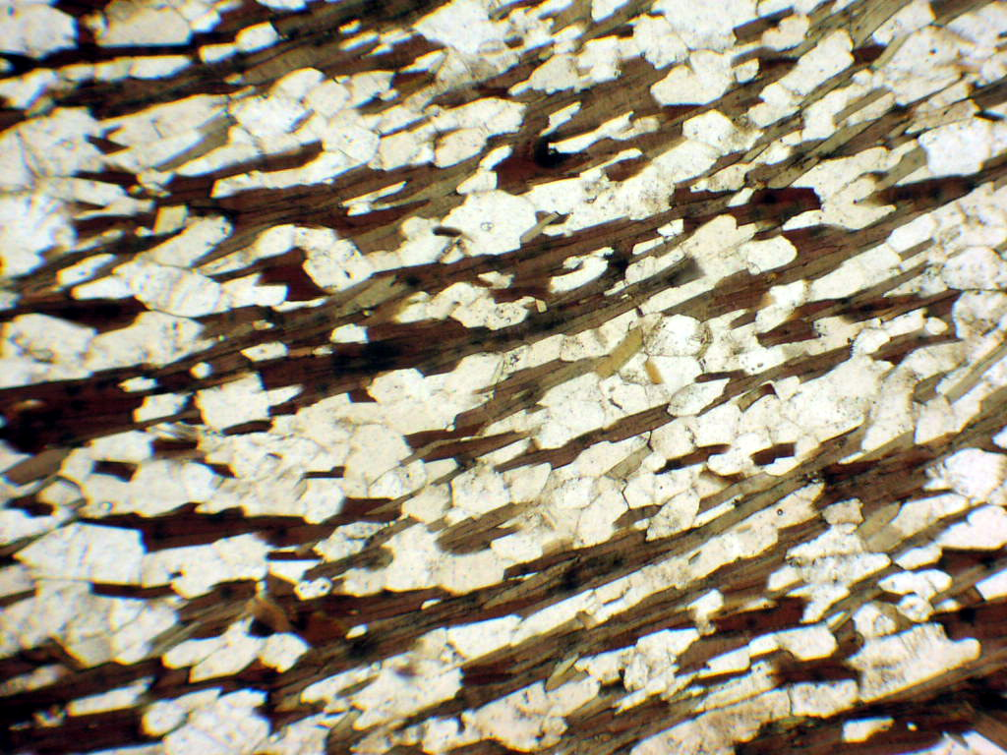
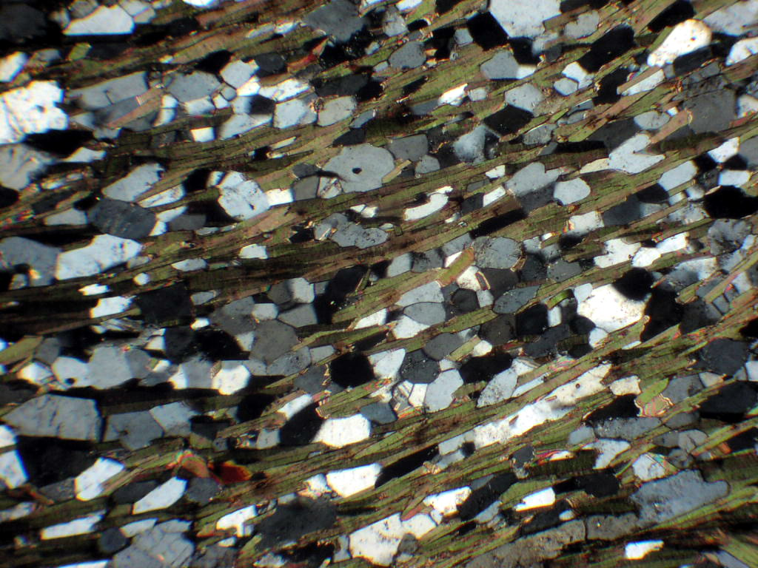

Slide 13
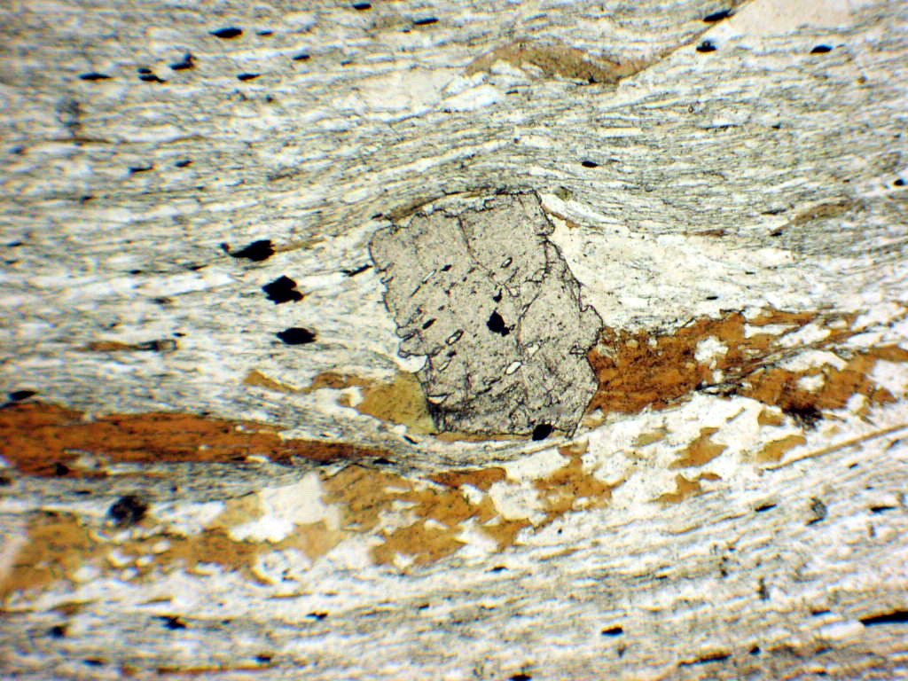
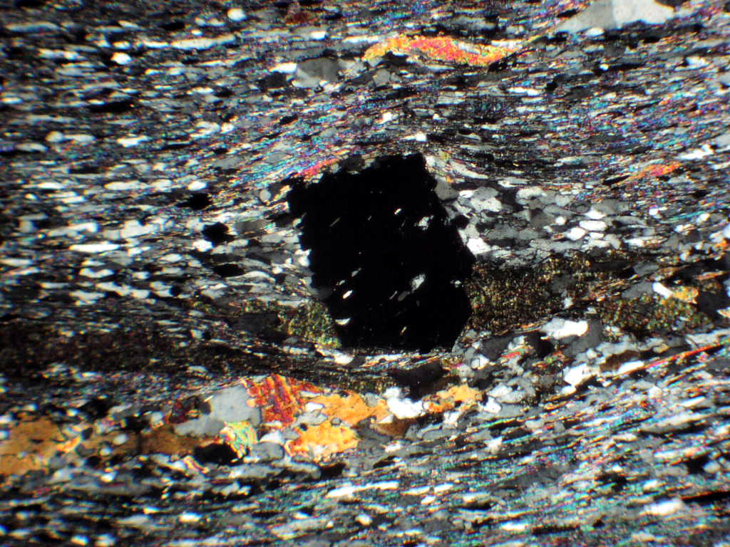
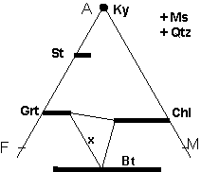
III- Garnet zone
Metapelites of the garnet zone are defined by first appearance of garnet porphyroblasts (Fe-rich almandine) through the following mineral reaction:
Chlorite + muscovite ➔ garnet + biotite + quartz + H₂O
They are typically medium to coarse grained schists and contain mineral assemblage: garnet + biotite + chlorite + quartz + Na-plagioclase (albite) ± epidote.

Slide 14
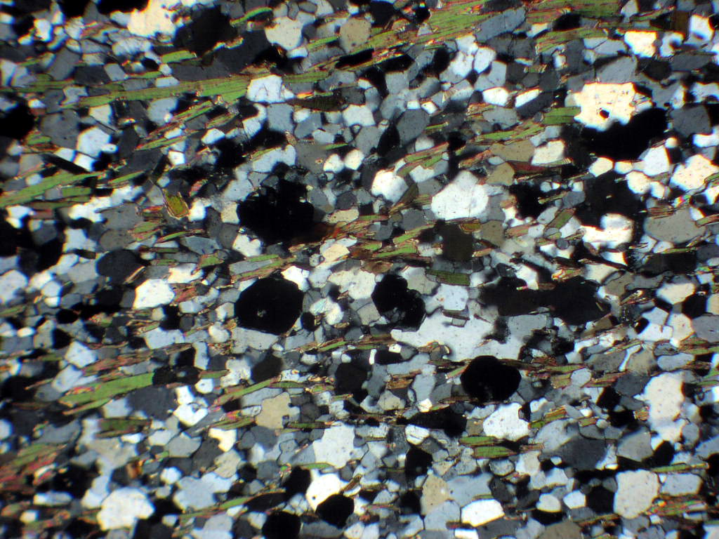
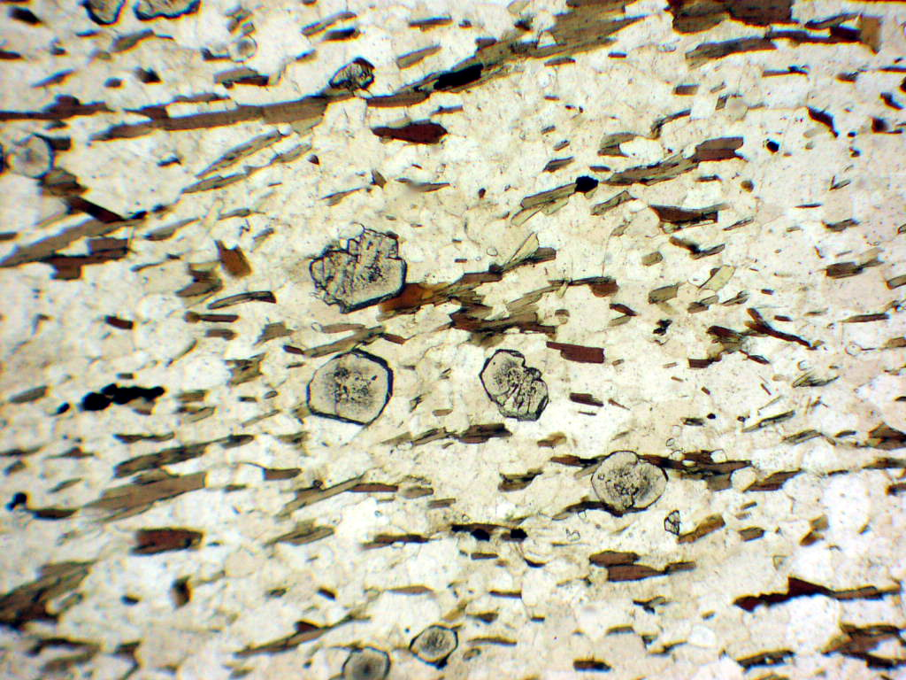

Slide 15
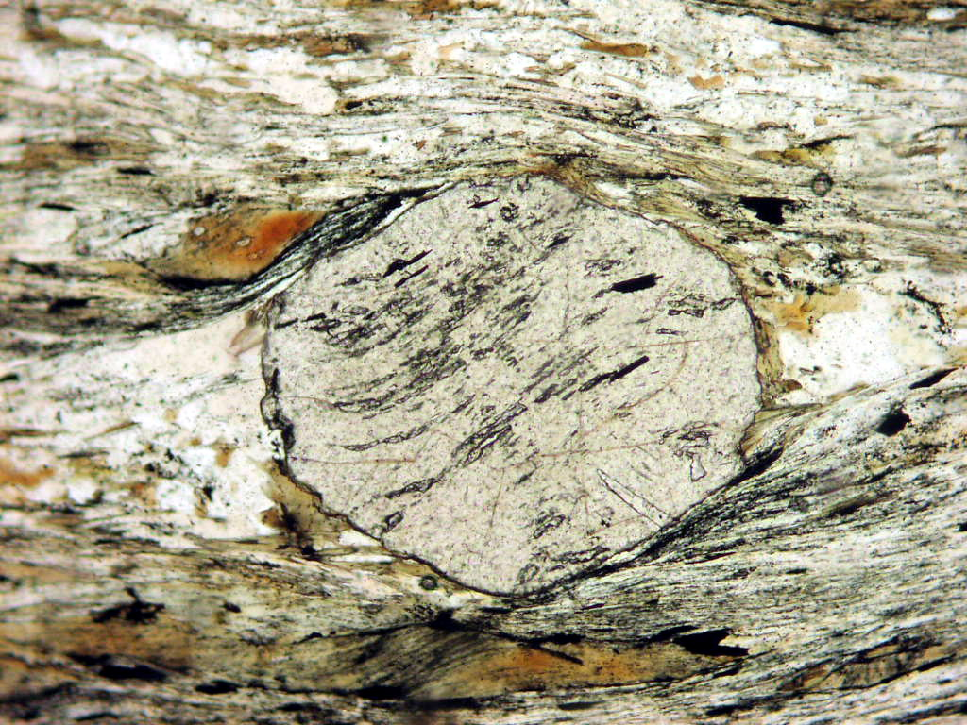
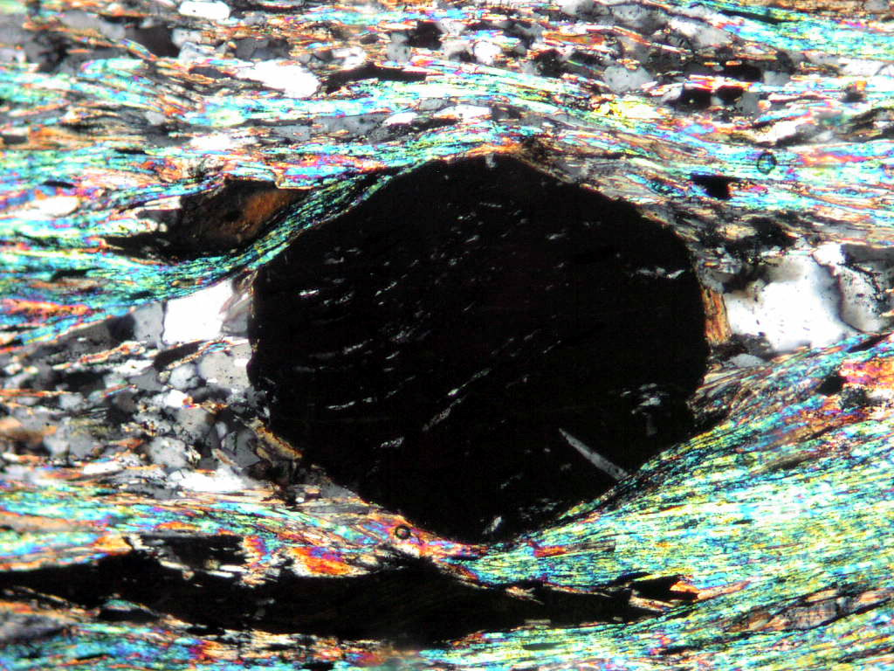

Slide 16
IV- Staurolite zone
Staurolite is only form in Al-rich, Ca-poor pelites. This will depend on the stability of plagioclase, which allow available Ca to combined Al. Therefore, Al is reduced and other Al-silicate minerals does not form.
staurolite forming through the following mineral reaction:
Chld + Qtz ➔ St + Grt + H₂O
Grt + Ms + Chl ➔ St + Bt + Qtz + H₂O (Grt consuming reaction)
Ms + Chl ➔ St + Bt + Qtz + H₂O
They are typically medium to coarse grained schists and contain mineral assemblage: staurolite + garnet + biotite + muscovite + quartz + plagioclase ± chlorite (retrograde).

Slide 17
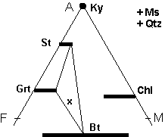
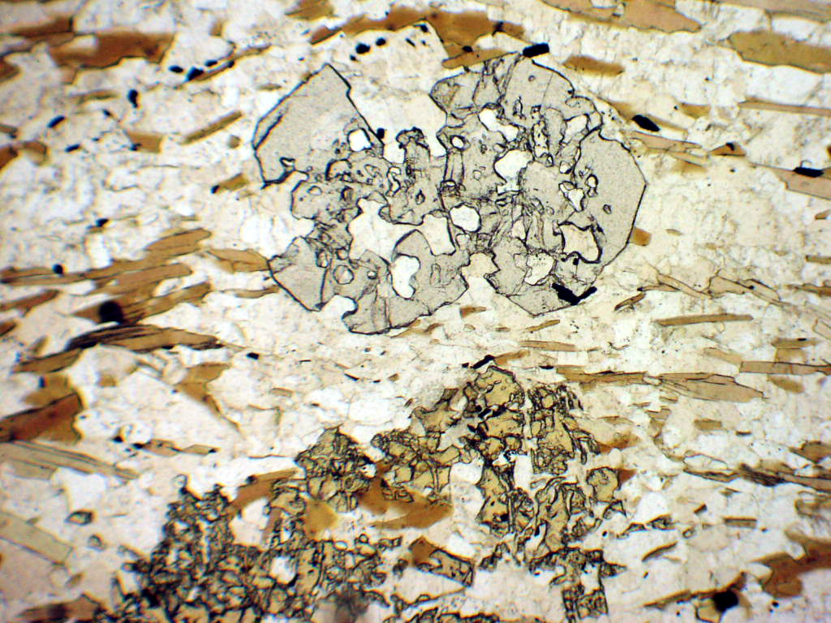
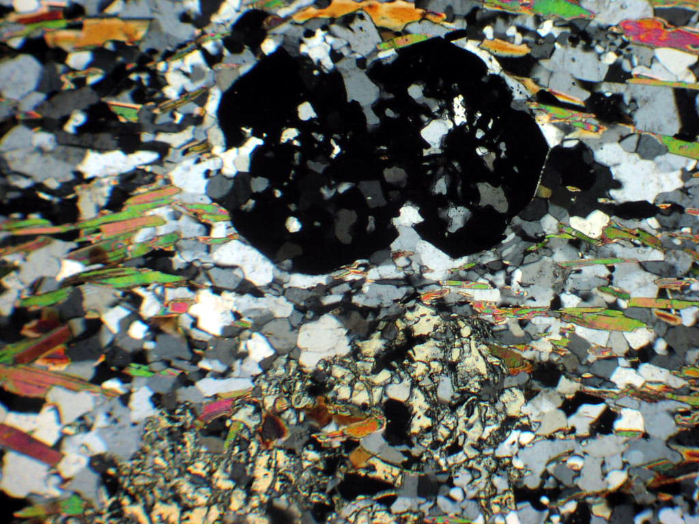

Slide 18
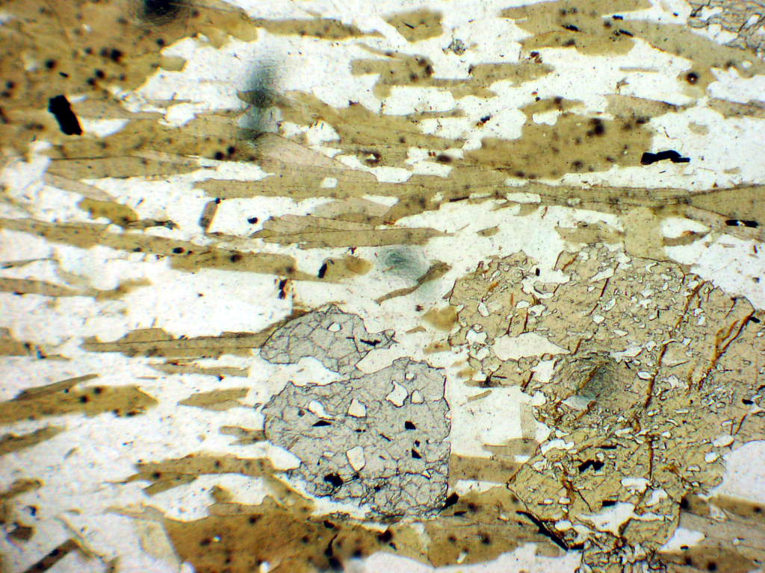
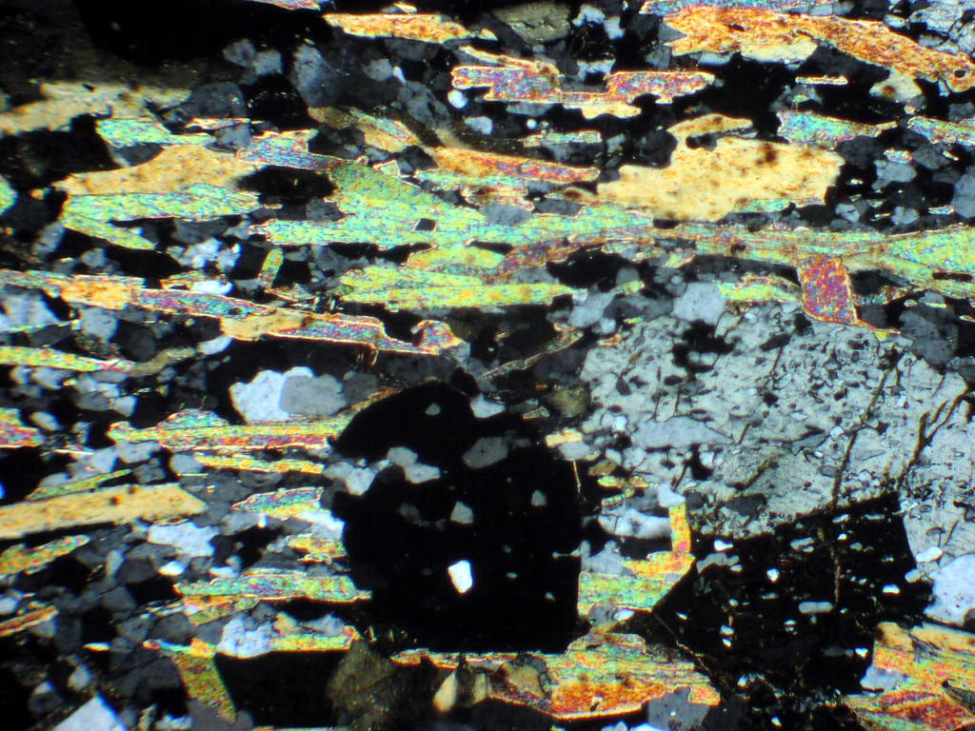

Slide 19
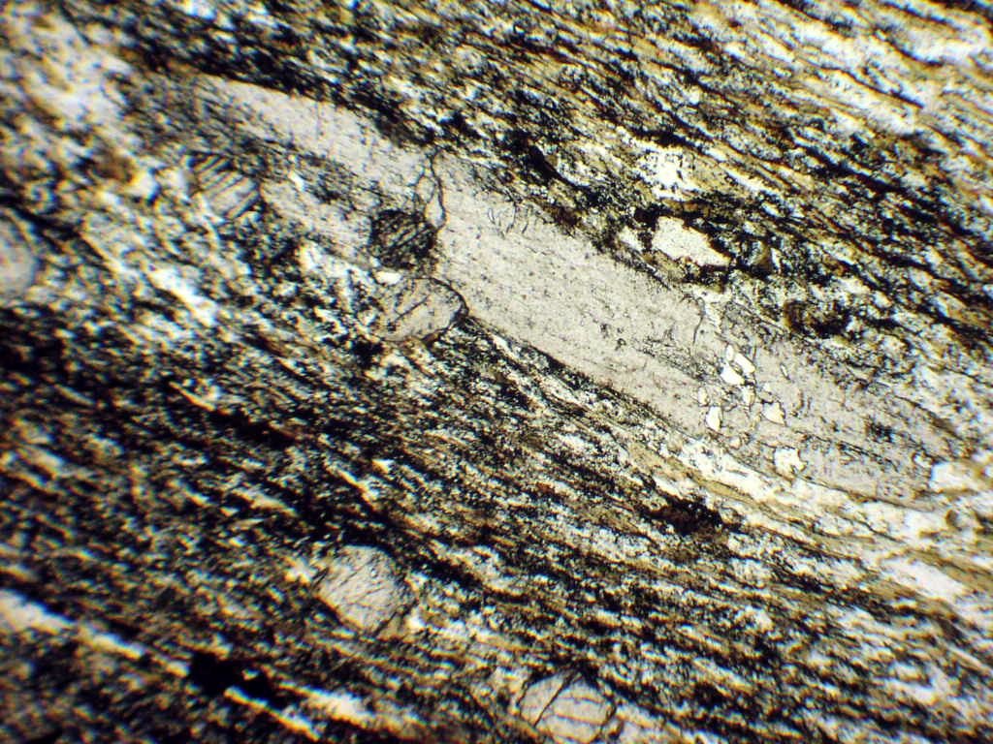
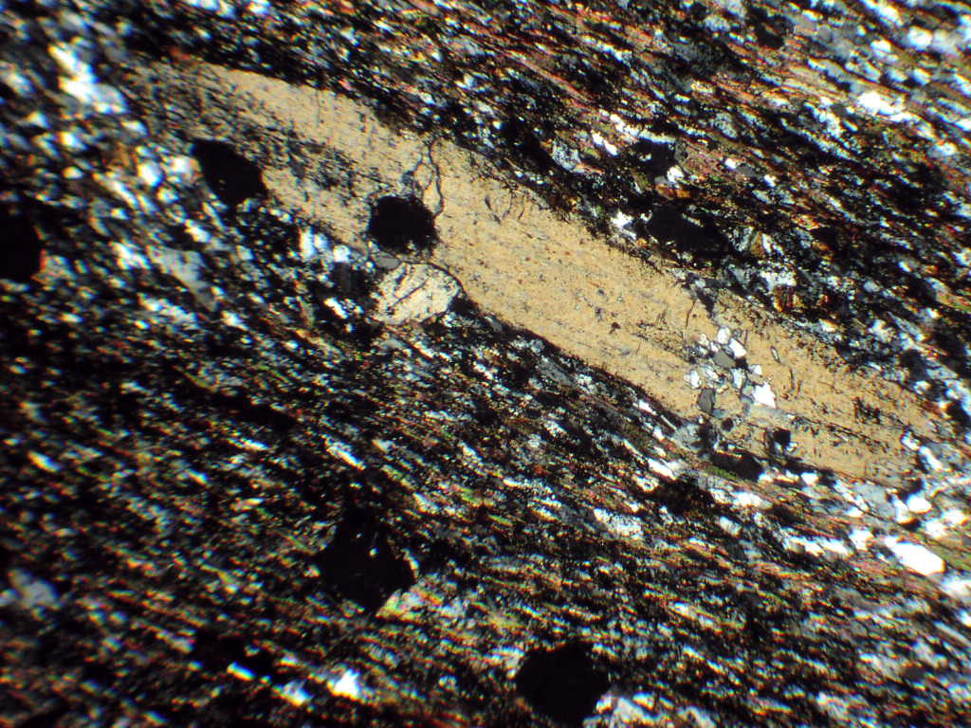
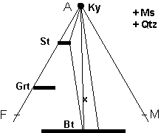
V- Kyanite zone
Kyanite zone is typified by the range of the assemblages:
Ky + St + Bt + Ms + Qtz, Ky + Grt + Bt + Ms + Qtz,
Ky + Grt + St + Bt + Ms + Qtz, Ky + Bt + Ms + Qtz
- Kyanite formed through the reaction:
Ms + St + Chl ➔ Ky + Bt + Qtz + H₂O
Ms + St + Qtz ➔ Ky + Bt + H₂O
They are typically coarse grained schists and contain above mentioned diagnostic mineral assemblage.

Slide 20
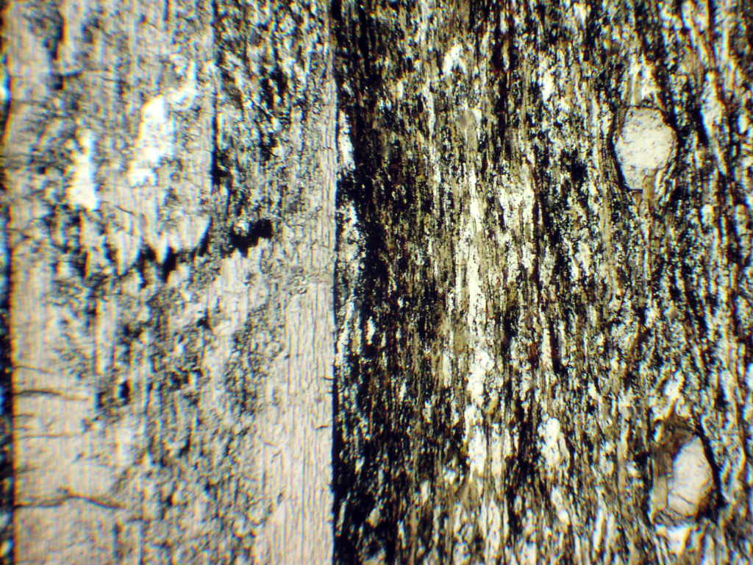
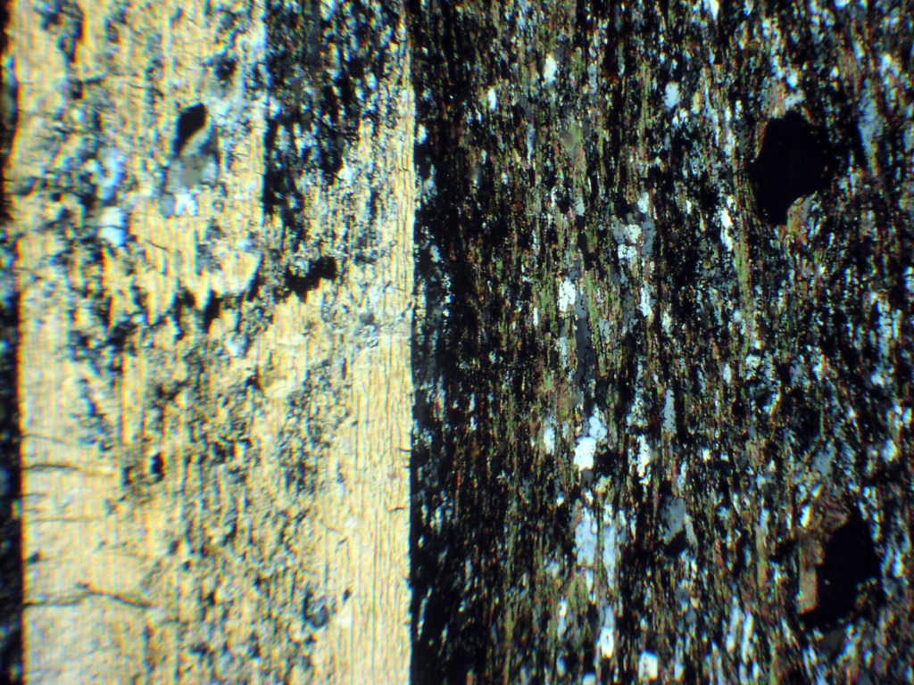

Slide 21
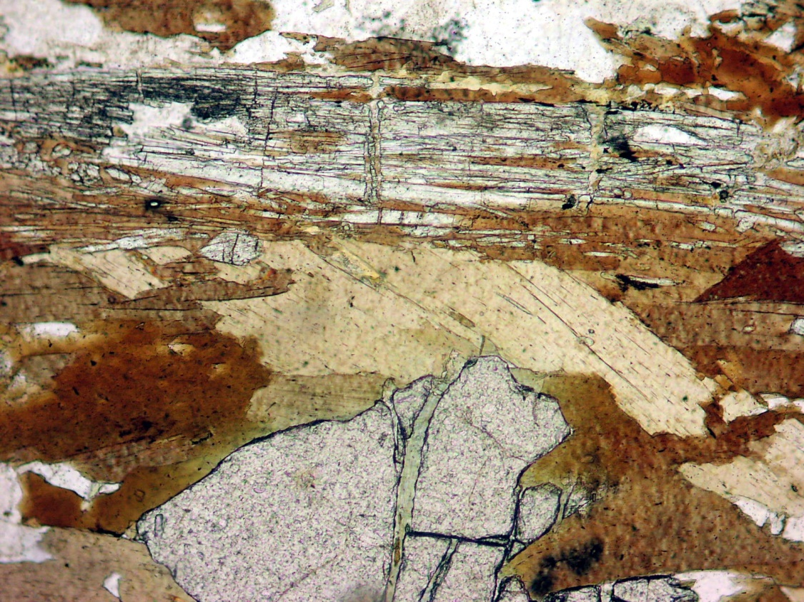
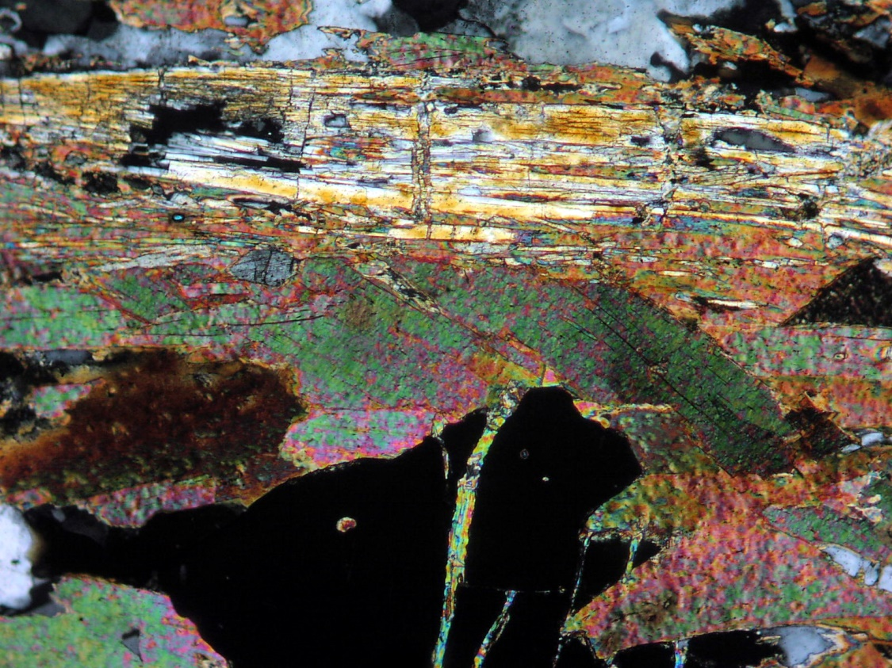
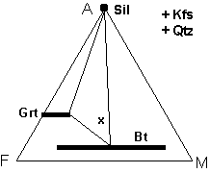
V- Sillimanite zone
this zone is the highest zone in the Barrovian series
It characterize by presence of Sillimanite in the form of fibrolite, and/or coarse prismatic crystals. It could form as Psedudomorph of andalusite via solid-solid reaction And↑↓Sill
Sillimanite coud also formed as a result of the following reaction:
St + Ms + Qtz ➔ Grt + Bt + Sill+ H₂O
Ms + St + Chl ➔ Bt + Sill+ H₂O
They are typically coarse grained schists/gneisses and contain mineral assemblage of Sill ± St + Grt + Bt + Ms + Qtz + Pl ± Ky.

Slide 22
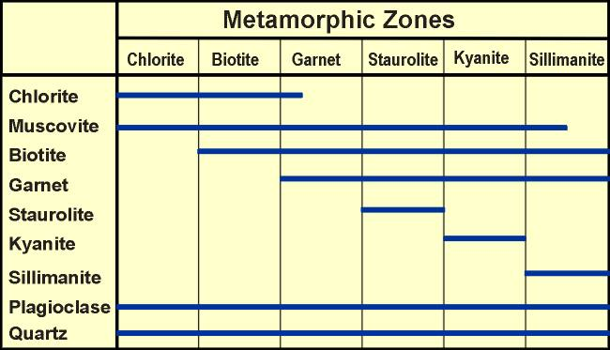
Stability of metamorphic minerals

Slide 23
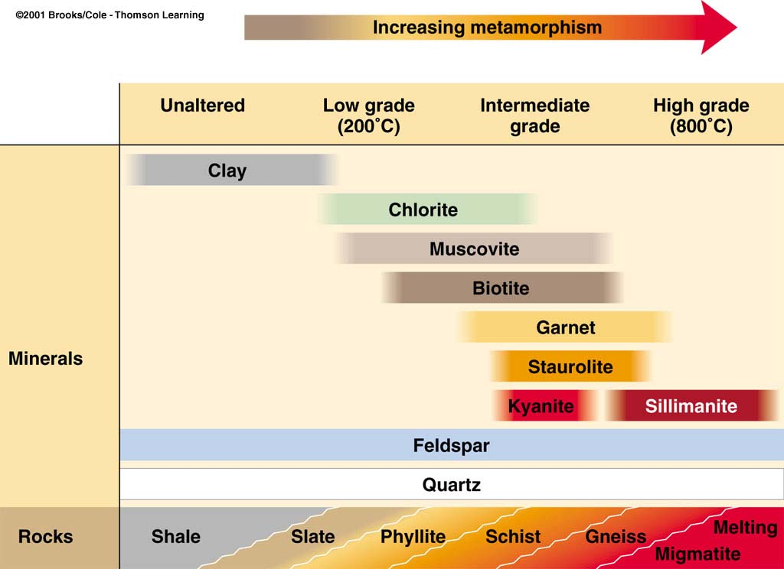

Slide 24
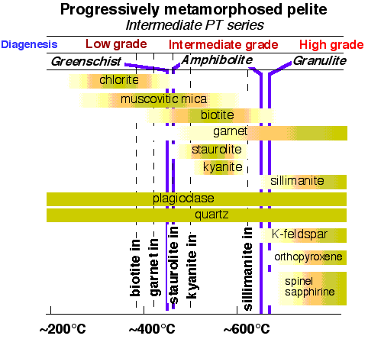
Stability of metamorphic minerals

