Slide 1
Advanced Microbial Ecology
Code no. 618B
Pre-MSc. Students
Lecture no. 8
Dr. Mahmoud Nour El-Dein

Slide 2
Microbial Degradation of Petroleum Hydrocarbon Contaminants
Biodegradation of petroleum hydrocarbons is a complex process that depends on the nature and on the amount of the hydrocarbons present. Petroleum hydrocarbons can be divided into four classes:
pyridines
carbazoles
1- the saturates
2- the aromatics
3- the asphaltenes
4- the resins
phenols
quinolines
amides
fatty acids
ketones
esters
porphyrins
sulfoxides

Slide 3
One of the important factors that limit biodegradation of oil pollutants in the environment is their limited availability to microorganisms.
Petroleum hydrocarbon compounds bind to soil components, and they are difﬁcult to be removed or degraded.
Hydrocarbons diﬀer in their susceptibility to microbial attack. The susceptibility of hydrocarbons to microbial degradation can be generally ranked as follows: linear alkanes > branched alkanes > small aromatics > cyclic alkanes.

Slide 4
Some compounds, such as the high molecular weight polycyclic aromatic hydrocarbons (PAHs), may not be degraded at all.
Microbial degradation is the major and ultimate natural mechanism by which one can clean up the petroleum hydrocarbon pollutants from the environment.

Slide 5
the extensive biodegradation of alkyl aromatics in marine sediments which occurred prior to detectable biodegradation of n-alkane proﬁle of the crude oil and the microorganisms, namely, Arthrobacter, Mycobacterium, Pseudomonas, and Rhodococcus were found to be involved for alkyl aromatic degradation.
Some bacterial strains, namely, Pseudomonas ﬂuorescens, P. aeruginosa, Bacillus subtilis, Alcaligenes sp., Flavobacterium sp., and Corynebacterium sp. were isolated from the polluted stream which could degrade crude oil.

Slide 6
Hydrocarbons in the environment are biodegraded primarily by bacteria, yeast, and fungi. The reported eﬃciency of biodegradation ranged from 6% to 82% for soil fungi, 0.13% to 50% for soil bacteria, and 0.003% to 100% for marine bacteria. Many scientists reported that mixed populations with overall broad enzymatic capacities are required to degrade complex mixtures of hydrocarbons such as crude oil in soil, fresh water, and marine environments.

Slide 7
Bacteria are the most active agents in petroleum degradation, and they work as primary degraders of spilled oil in environment. Acinetobacter sp. was found to be capable of utilizing n-alkanes of chain length C10–C40 as a sole source of carbon.
Fungal genera, namely, Amorphoteca, Neosartorya, Talaromyces, and Graphium and

Slide 8
yeast genera, namely, Candida, Yarrowia, and Pichia were isolated from petroleum contaminated soil and proved to be the potential organisms for hydrocarbon degradation, a group of terrestrial fungi, namely, Aspergillus, Cephalosporium, and Penicillium which were also found to be the potential degrader of crude oil hydrocarbons.
The yeast species, namely, Candida lipolytica, Rhodotorula mucilaginosa, Geotrichum sp., and Trichosporon mucoides isolated from contaminated water were noted to degrade petroleum compounds.

Slide 9
Factors Inﬂuencing Petroleum Hydrocarbon Degradation
The composition and inherent biodegradability of the petroleum hydrocarbon pollutant is the ﬁrst.
Among physical factors, temperature plays an important role in biodegradation of hydrocarbons by directly affecting the chemistry of the pollutants as well as aﬀecting the physiology and diversity of the microbial ﬂora.
At low temperatures, the viscosity of the oil increased, while the volatility of the toxic low molecular weight hydrocarbons was reduced, delaying the onset of biodegradation. Temperature also aﬀects the solubility of hydrocarbons.

Slide 10
Although hydrocarbon biodegradation can occur over a wide range of temperatures, the rate of biodegradation generally decreases with the decreasing temperature.
highest degradation rates that generally occur in the range 30–40◦C in soil environments,
20–30◦C in some freshwater environments and 15–20◦C in marine environments.
Signiﬁcant biodegradation of hydrocarbons have been reported in psychrophilic environments in temperate regions.

Slide 11
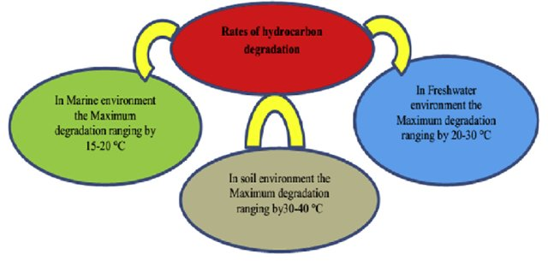

Slide 12
Nutrients are very important ingredients for successful biodegradation of hydrocarbon pollutants especially nitrogen, phosphorus, and in some cases iron.
When a major oil spill occurred in marine and freshwater environments, the supply of carbon was signiﬁcantly increased and the availability of nitrogen and phosphorus generally became the limiting factor for oil degradation.

Slide 13
In marine environments, it was found to be more pronounced due to low levels of nitrogen and phosphorous in seawater. Freshwater wetlands are typically considered to be nutrient deﬁcient due to heavy demands of nutrients by the plants.
Therefore, additions of nutrients were necessary to enhance the biodegradation of oil pollutant.

Slide 14
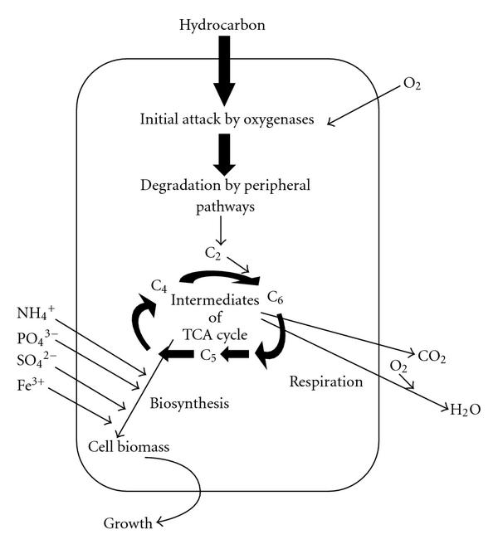
Mechanism of Petroleum Hydrocarbon Degradation

Slide 15
Biodegradation of Petroleum Hydrocarbons by Immobilized Cells
Immobilized cells (Cell immobilization is defined as the physical confinement or localization of intact cells to a certain defined region of space with the preservation of some desired activity) have been used and studied for the bioremediation of numerous toxic chemicals. Immobilization not only simpliﬁes separation and recovery of immobilized cells but also makes the application reusable which reduces the overall cost. Free suspension and immobilized Pseudomonas sp. degrade petrol in an aqueous system.

Slide 16
The study indicated that immobilization resulted in a combination of increased contact between cell and hydrocarbon droplets and enhanced level of rhamnolipids production.
Rhamnolipids caused greater dispersion of water-insoluble n-alkanes in the aqueous phase due to their amphipathic properties and the molecules consist of hydrophilic and hydrophobic moieties reduced the interfacial tension of oil-water systems.
This resulted in higher interaction of cells with solubilized hydrocarbon droplets much smaller than the cells and rapid uptake of hydrocarbon in to the cells.

Slide 17
Immobilization of bacterial cells enhanced the biodegradation rate of crude oil compared to free living cells in a wide range of culture salinity. Immobilization can be done in batch mode as well as continuous mode.

