Slide 1
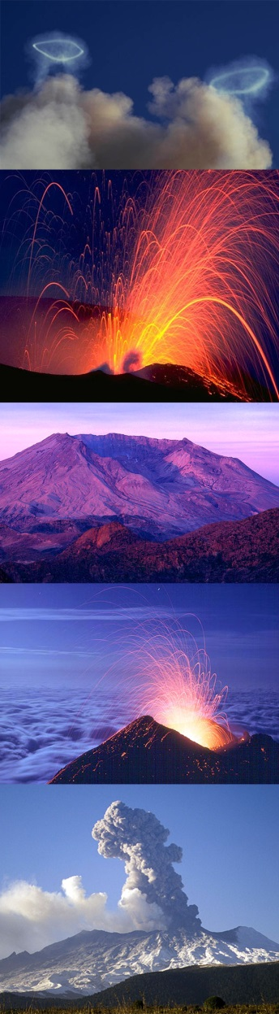
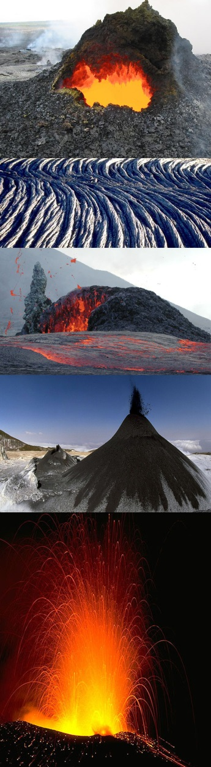
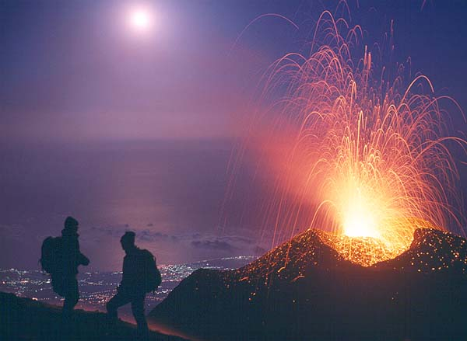
Volcanic Eruptions and Hazards

Slide 2
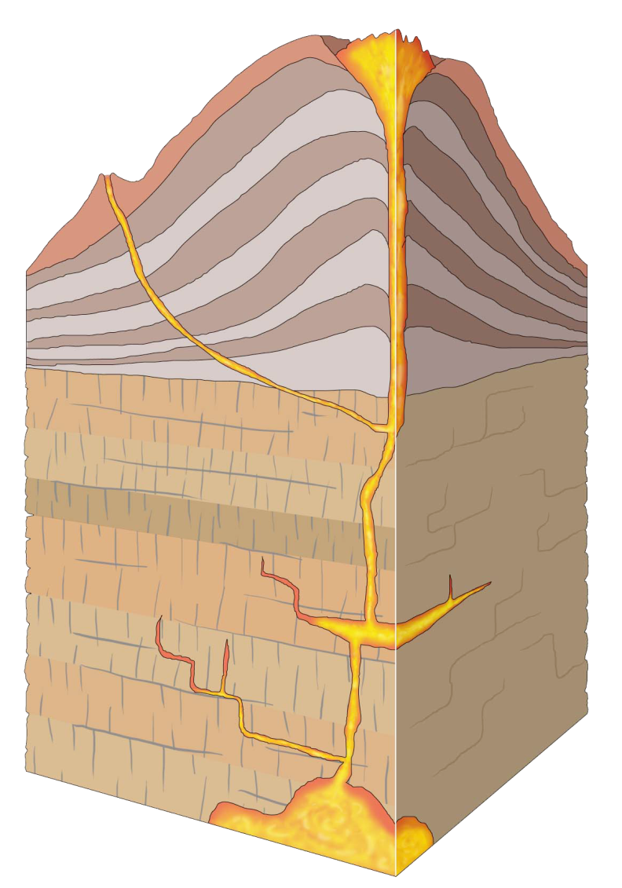
What is a volcano?
vent
A volcano is a vent or 'chimney' that connects molten rock (magma) from within the Earth’s crust to the Earth's surface.
The volcano includes the surrounding cone of erupted material.
cone
conduit
magma chamber
Notes:
A volcano is a place on the Earth’s surface where hot, molten rock (called magma) breaks through. As we will see there are many different types of volcanoes and material that is erupted.
However, in general a volcano is classed as “active” if it erupts lava, rock, gas or ash, or if it shows seismic (earthquake) activity.
A volcano is dormant if it hasn't erupted for a long time (less than 1 million years) but could again one day.
An extinct volcano will never erupt again.
Presenters; go through the different parts of a volcano:
Magma: Molten rock beneath the surface of the earth.
Magma chamber: The subterranean cavity containing the gas-rich liquid magma which feeds a volcano.
Conduit: A passage followed by magma in a volcano.
Vent: The opening at the earth's surface through which volcanic materials issue forth.
Cone: A volcanic cone built entirely of loose fragmented material (pyroclastics) and (or) lava flows erupted from the vent. Erupted material builds up with each eruption forming the cone.

Slide 3
How and why do volcanoes erupt?
Hot, molten rock (magma) is buoyant (has a lower density than the surrounding rocks) and will rise up through the crust to erupt on the surface.
  Same principle as hot air rising, e.g. how a hot air balloon works
When magma reaches the surface it depends on how easily it flows (viscosity) and the amount of gas (H₂O, CO₂, S) it has in it as to how it erupts.
Large amounts of gas and a high viscosity (sticky) magma will form an explosive eruption!
  Think about shaking a carbonated drink and then releasing the cap.
Small amounts of gas and (or) low viscosity (runny) magma will form an effusive eruption
  Where the magma just trickles out of the volcano (lava flow).
Notes:
Why Do Volcanic Eruptions Occur?
High temperature of the Earth’s interior
Melting of lower crust and mantle = molten rock = magma
At depths > 20 km the temperature = 800-1,600 degrees Celsius
The density of the magma is less than the crustal rock, therefore it rises to the surface
Source of this heat?
Residual from the cooling of the Earth (& solar system)
Radioactive decay
Convection in the mantle
- Brings hot rock up from near the interior of the Earth and returns cooler material towards the centre of the Earth for reheating.
Shock/impact melting
E.g. meteorite impacts produce instantaneous heat and melting from high energy collisions
Two styles of volcanic eruption: Explosive and Effusive (see next slides for further descriptions of each)
Explosive: where rapidly escaping gas bubbles (= vesicles) rip apart the magma, fragmenting it.
Effusive: where the magma leaks out onto the surface passively as lava flows.
- NOTE: Some effusive eruptions involving highly viscous lava may turn into explosive eruptions. If the magma is too viscous (sticky) it can block up the volcanic vent, trapping gas inside the volcano. If this gas builds up enough to break through the blockage an extremely dangerous explosive eruption may form.
- Some of the most explosive eruptions have formed this way, e.g. Pinatubo 1991

Slide 4
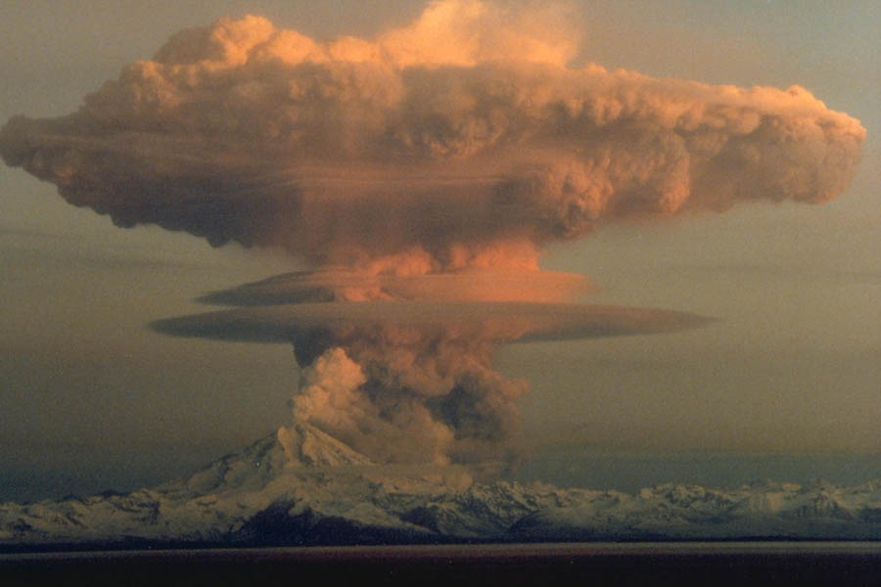
Explosive Eruptions
Explosive volcanic eruptions can be catastrophic
Erupt 10’s-1000’s km³ of magma
Send ash clouds >25 km into the stratosphere
Have severe environmental and climatic effects
Hazardous!!!
Mt. Redoubt
Above: Large eruption column and ash cloud from an explosive eruption at Mt Redoubt, Alaska
Notes:
If you release the pressure of a magma chamber (by cracking the surrounding rock or breaking through to the surface) the gas dissolved in the magma will start to exsolve (separate from the melt forming bubbles). These bubbles, called vesicles, rapidly expand and rise through the magma. (Think about shaking up a bottle of carbonated drink to build up the pressure and then taking the top off the bottle to quickly release the pressure - what happens?)
The rapid escape of gas (volatiles) causes magma to fragment and erupt explosively.
Presenter: read through the facts about explosive eruptions. Give examples of the volumes and distances. For example, the local swimming pool might be approximately 25km from the school. So get the children to think about how far that is to drive from the school to the pool and then imagine that distance going straight up into the air!

Slide 5
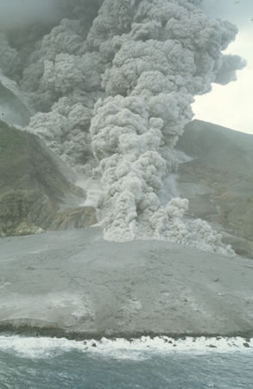
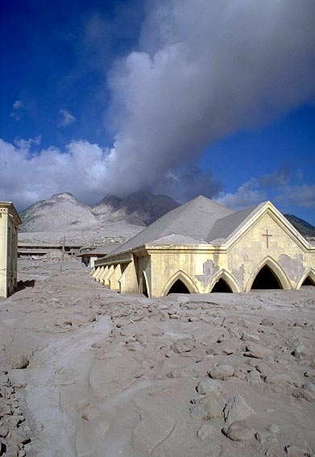
Explosive Eruptions
Three products from an explosive eruption
  Ash fall
  Pyroclastic flow
  Pyroclastic surge
Pyroclastic flows on Montserrat, buried the capital city.
Notes:
Ash fall: The fallout of rock, debris and ash from an explosive eruption column.
An explosive volcanic eruption will propel large volumes of volcanic rock, ash and gas into the atmosphere. The larger (most dense) particles will fall out of the air quickly and close to the volcanic vent. The smaller particles (ash) can be suspended in the atmosphere for days to weeks before they fall back to Earth. Whilst in the atmosphere the wind can transport the ash particles large distances. For example when Mt Pinatubo (Philippines) erupted in 1991 ash was blown all the way around the entire globe!
Pyroclastic flow: Pyroclastic flows are hot, turbulent, fast-moving, high particle concentration clouds of rock, ash and gas.
Pyroclastic flows can reach > 100 km from a volcano.
They can travel 100s km/h and are commonly >400°C.
They will destroy everything in their path including buildings, agriculture and forests. Although because they contain a high concentration of particles and a low concentration of gas, they are dense and usually are confined to, and flow along, topographic lows (valleys).
It is extremely important to understand them as they are often the most hazardous component of an explosive eruption.
Pyroclastic surge: Pyroclastic surges are low particle concentration (low density) flows of volcanic material. The reason they are low density flows is because they don’t have a high concentration of particles and contain a lot of gas.
Pyroclastic surges are very turbulent and fast (up to 300 km per hour).
They overtop high topographic features, and therefore are not confined to valleys.
Pyroclastic surges usually do not travel as far as pyroclastic flows, but pyroclastic surges can travel up to at least 10 kilometers from the source.

Slide 6
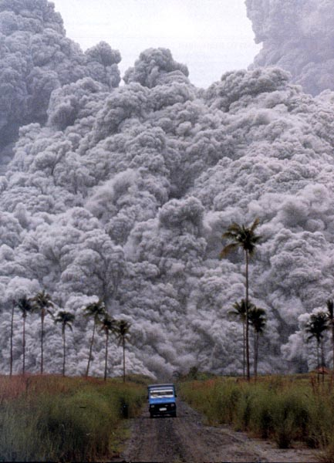
Direct measurements of pyroclastic flows are extremely dangerous!!!
Notes:
A truck carrying volcanologists and a film crew attempting to out run a pyroclastic flow in Indonesia….the pyroclastic flow was traveling at about 25-30 meters per second…..they made it….just!

Slide 7
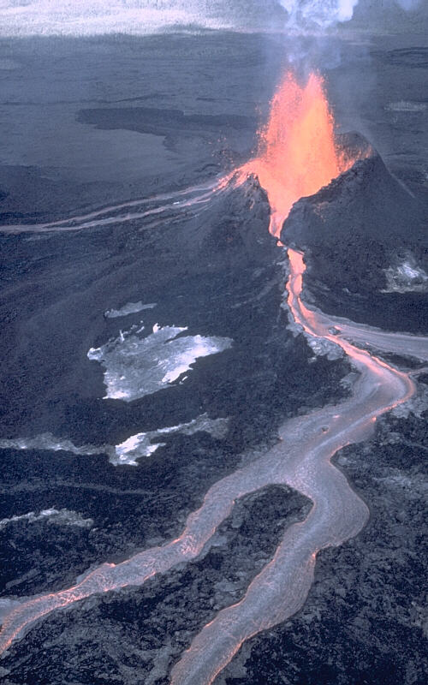
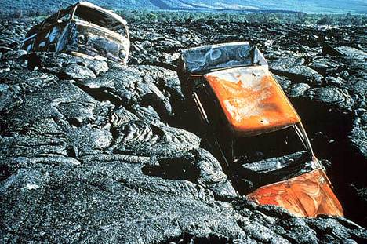
Effusive Eruptions
Effusive eruptions are characterised by outpourings of lava on to the ground.
Hawaii
Courtesy of www.swisseduc.ch
Notes:
A volcanic eruption dominated by the passive outpouring of lava onto the Earth’s surface is called an effusive eruption.
This happens either because there is not enough gas (volatiles) in the magma to break it apart upon escaping, or the magma is too viscous (sticky) to allow the volatiles to escape quickly.
Remember: molten rock is called “magma” when it is underneath the ground. It is called “lava” once it has been erupted onto the surface.
Lava flows generated by effusive eruptions vary in shape, thickness, length, and width depending on the type of lava erupted, discharge rate (how fast it comes out of the vent), slope of the ground over which the lava travels, and duration of eruption.
Although not generally as hazardous as explosive eruptions, lava flows can burn and bury buildings and forests and do pose a danger to people living on or near an active volcano.

Slide 8
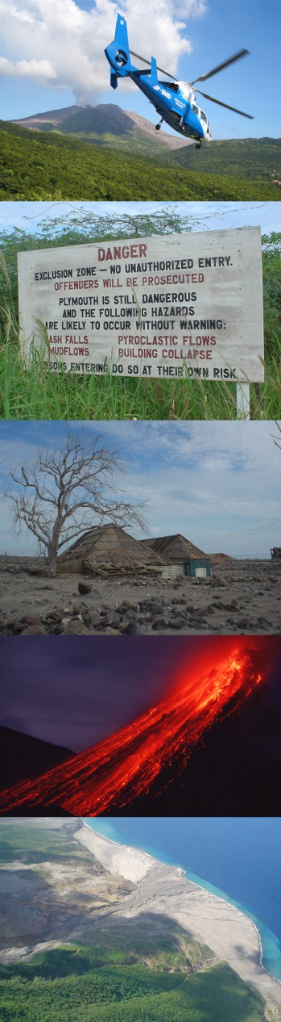
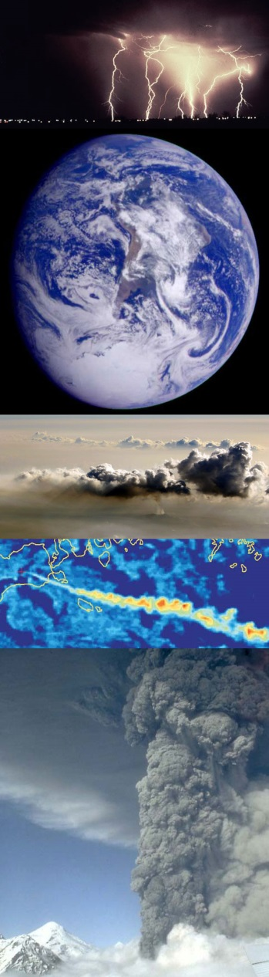
Practical Exercise 1.
What controls the violence of an eruption?
How fast is magma ejected out of the volcano?
Notes:
See worksheet: Volcanoes, Exercise 1.

Slide 9
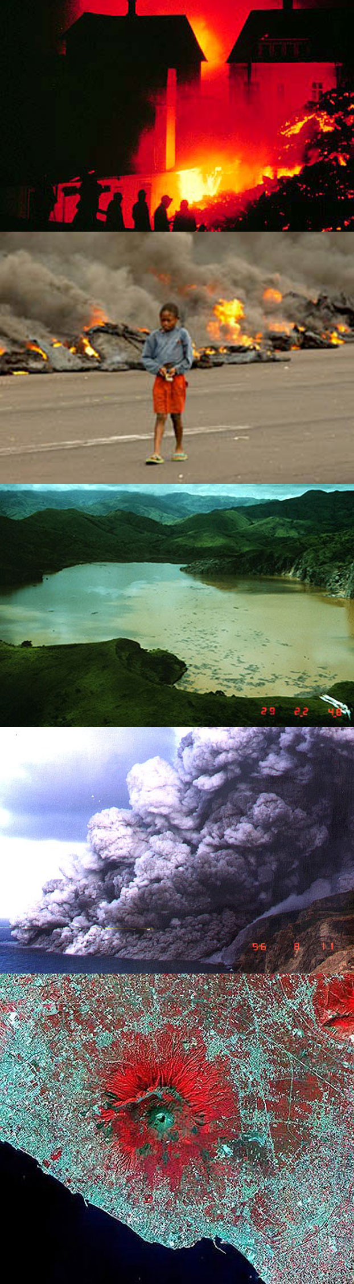
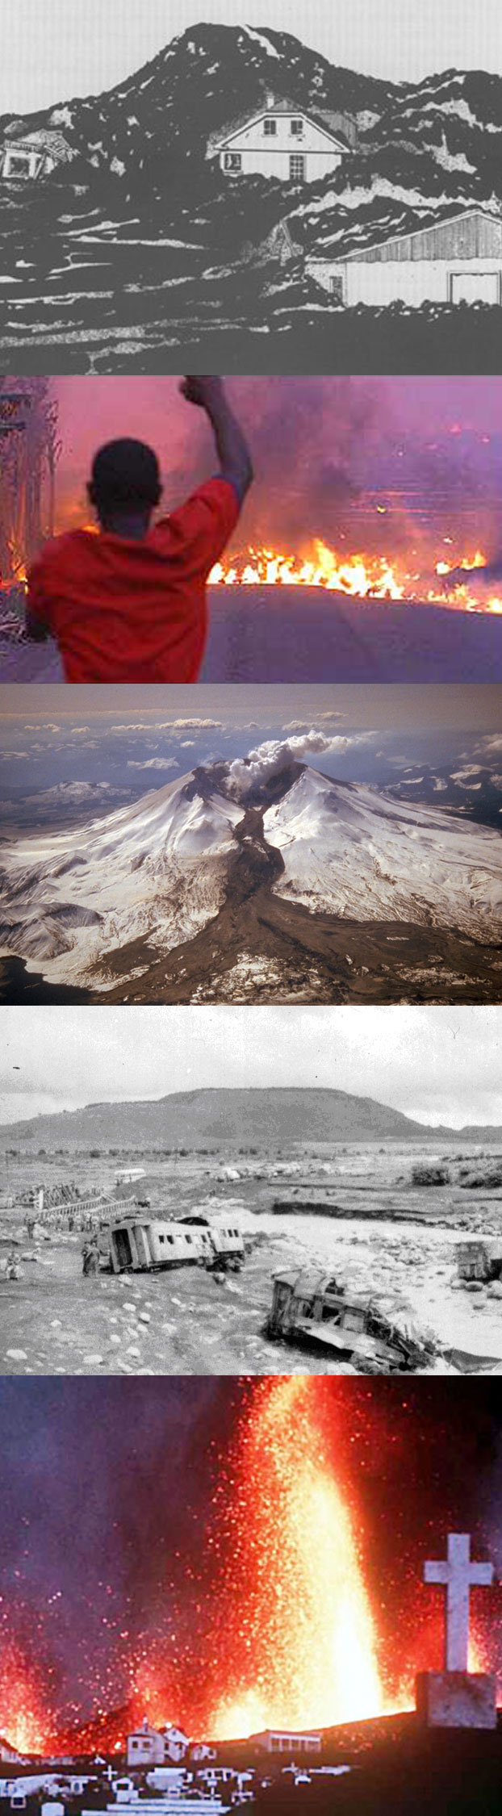
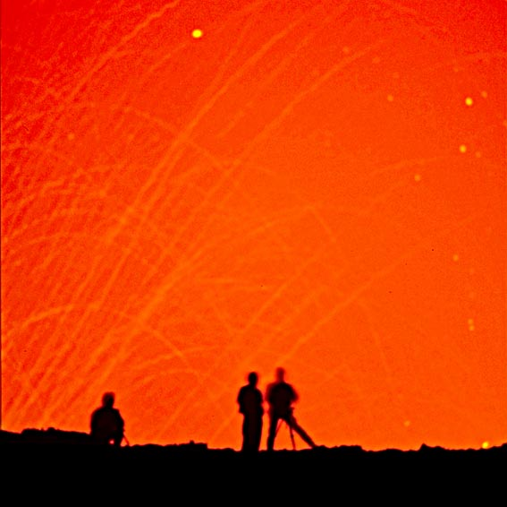
Volcano Monitoring and Hazard Mitigation
Notes:
Volcanoes can be extremely hazardous natural phenomena. That is why it is important to understand as much as possible about them, in an attempt to understand the processes involved in eruptions and try to minimize the risk to life and property.

Slide 10
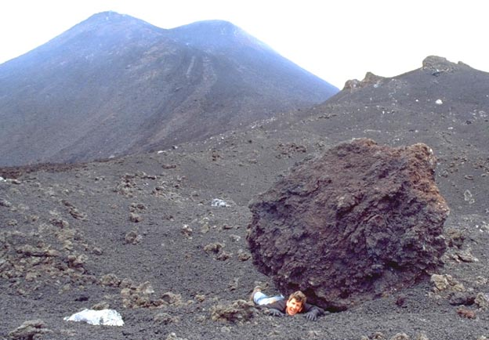
Volcanic Fatalities
92,000 Tambora, Indonesia 1815
36,000 Krakatau, Indonesia 1883
29,000 Mt Pelee, Martinique 1902
15,000 Mt Unzen, Japan 1792
Courtesy of www.swisseduc.ch
But, volcanoes cause fewer fatalities than earthquakes, hurricanes and famine.
Notes:
Many volcanoes are found in heavily populated areas. Volcanic soil is very fertile and rich in minerals so people move on to the sides of volcanoes to plant crops and graze livestock.
This puts them in great danger if there is an eruption.
Large individual volcanic eruptions can causes numerous fatalities. **CLICK FOR POP-UP** However, such large, catastrophic eruptions occur relatively infrequently so volcanoes causes less fatalities than earthquakes, hurricanes and famine.
Note: there are many small-scale eruptions occurring all over the world every day. But most are either in remote locations, are too small to cause too much damage or are well-managed and only a minimal risk to humans.

Slide 11
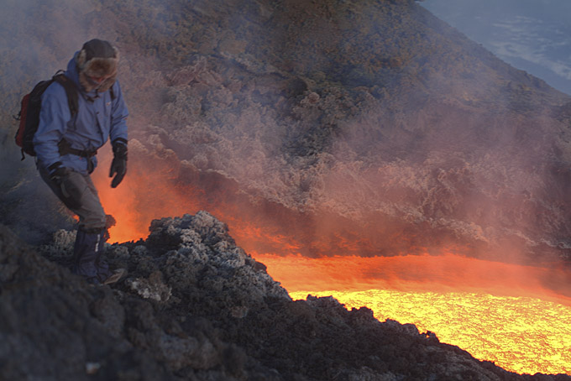
Volcanic Hazards
Pyroclastic flow
Lahars/Mud flows
Pyroclastic fall
Lava flow
Noxious Gas
Earthquakes
Courtesy of www.swisseduc.ch
Notes:
There are many hazards associated with volcanic eruptions: see list. (these are presented in turn in following slides)

Slide 12
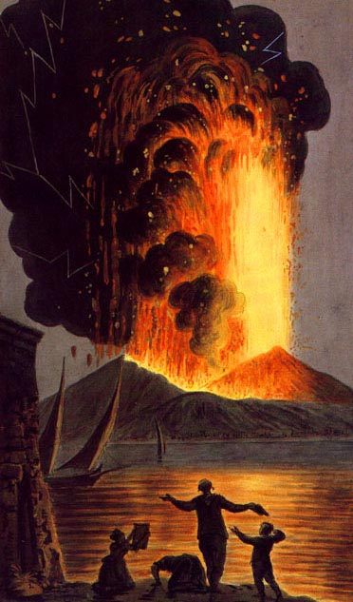
Pyroclastic Flow
For example, eruption of Vesuvius in 79 AD destroyed the city of Pompeii
Notes:
Perhaps the biggest hazard are pyroclastic flows. As mentioned earlier these are hot, fast moving, high particles concentration flows of gas, rock and ash (something you don’t want to get in the way of!).
A famous historic example of an explosive eruption that produced devastating pyroclastic flows was the 79AD eruption of Mt Vesuvius in Italy that buried the ancient Roman city of Pompeii…

Slide 13
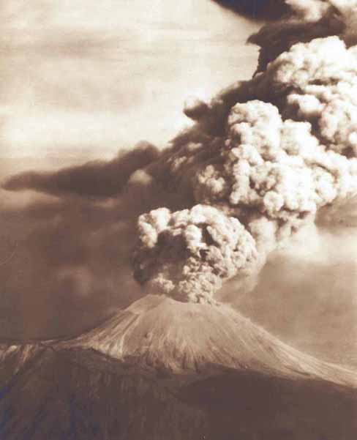
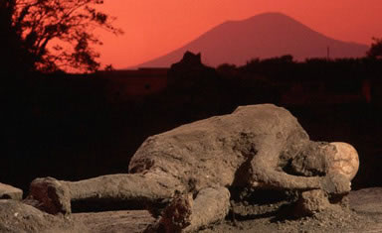
Pompeii (79AD)
On August 24, 79AD Mount Vesuvius literally blew its top, erupting tonnes of molten ash, pumice and sulfuric gas miles into the atmosphere. Pyroclastic flows flowed over the city of Pompeii and surrounding areas.
Notes:
On August 24, 79AD Mount Vesuvius literally blew its top, erupting tonnes of molten ash, pumice (volcanic rock that contains many vesicles/bubbles) and sulfuric gas miles into the atmosphere.
The photo on the left shows a more recent eruption of Vesuvius, but this is the kind of thing people living in Pompeii would have seen at the time. The photo on the right shows the remains of an inhabitant of Pompeii with the Vesuvius volcano in the background.
Pyroclastic flows reached the city of Pompeii and surrounding areas, devastating everything in it’s path…

Slide 14
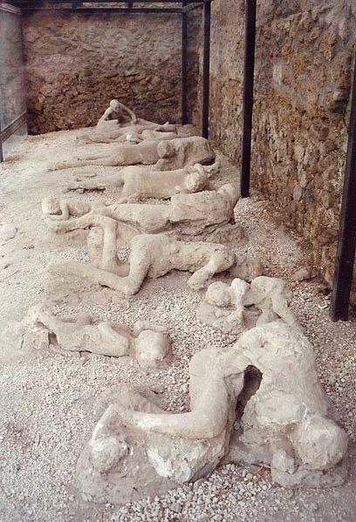
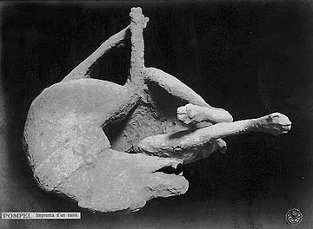
Pompeii (79AD)
Pyroclastic flows of poisonous gas and hot volcanic debris engulfed the cities of Pompeii, Herculaneum and Stabiae suffocating the inhabitants and burying the buildings.
Notes:
Pyroclastic flows of poisonous gas and hot volcanic debris engulfed the cities of Pompeii, Herculaneum and Stabiae suffocating the inhabitants and burying the buildings.
The people and animals of Pompeii died in their sleep or trying to evacuate the town. If you visit Pompeii today you can see their remains…

Slide 15
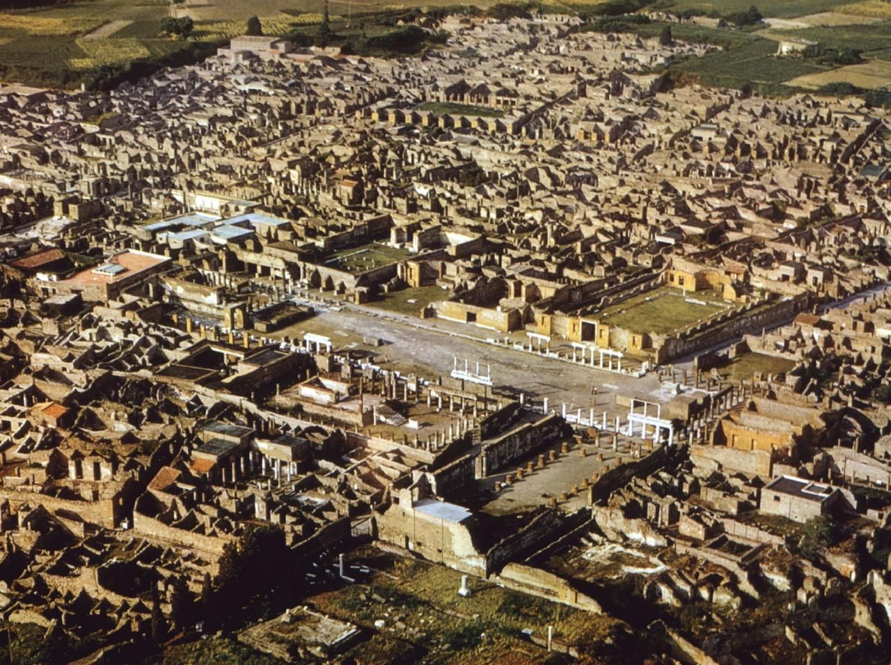
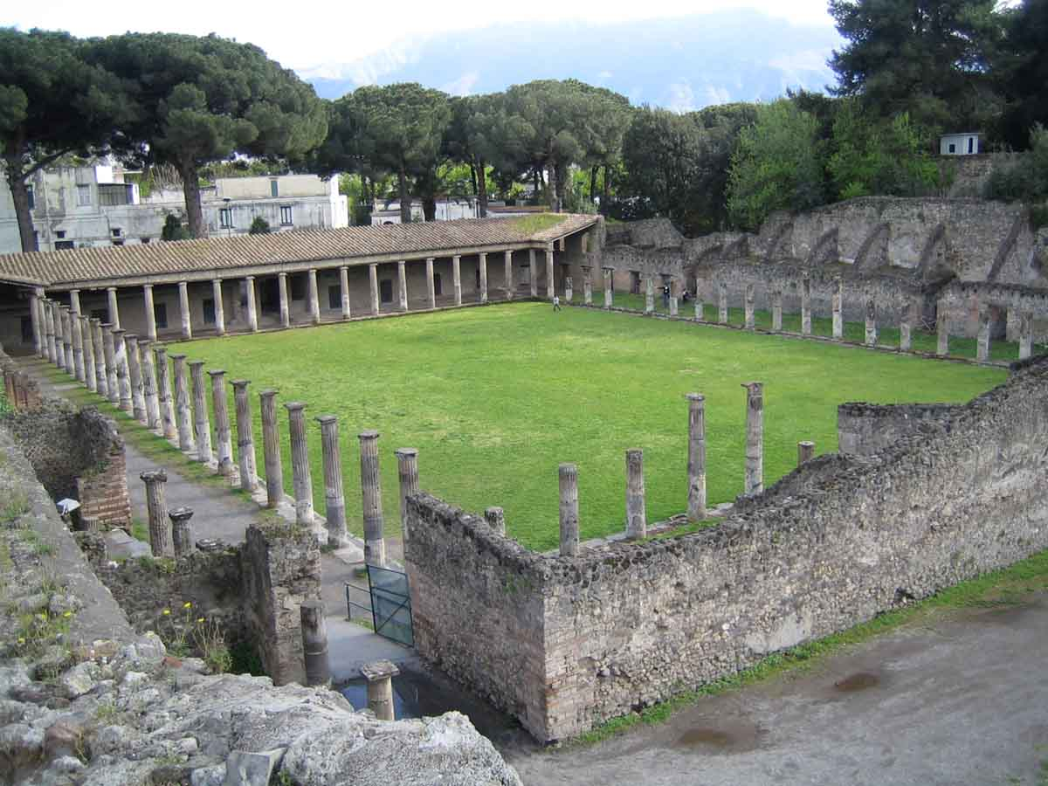
Pompeii (79AD)
The cities remained buried and undiscovered for almost 1700 years until excavation began in 1748. These excavations continue today and provide insight into life during the Roman Empire.
Notes:
These ancient cities remained buried and undiscovered for almost 1700 years until excavation began in 1748. These excavations continue today and as entire cities are preserved as they were on the day in 79AD when they were hit by the pyroclastic flows from Vesuvius, they provide a uniquely preserved snapshot of Roman life and culture.

Slide 16
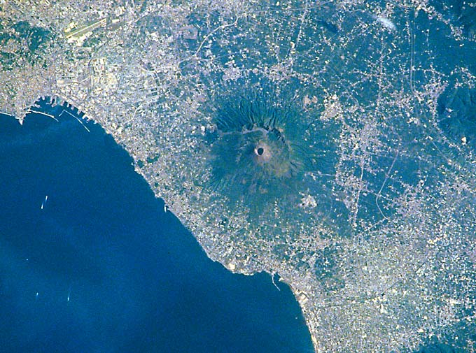
Vesuvius today
Vesuvius remains a hazardous volcano with heavily populated flanks:
  around 1.5 million people live in the city of Naples alone
  Naples is situated approx. 30 km from Vesuvius
  Pyroclastic flows can flow up to 100 km from source!
Naples
Vesuvius
Bay of Naples
Courtesy of www.swisseduc.ch
Notes:
Mt Vesuvius is still classed as an Active Volcano.
The major Italian city of Naples lies approximately 30 km from the volcano vent. 1.5 million people live in Naples and as pyroclastic flows can travel as far as 100km from source, the city is built well within the danger zone!
Will there be a repeat of what happened to Pompeii in 79AD?

Slide 17
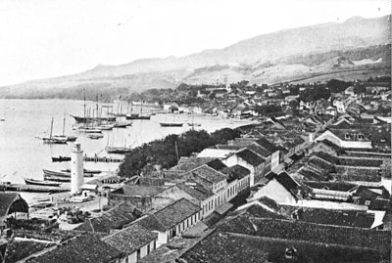
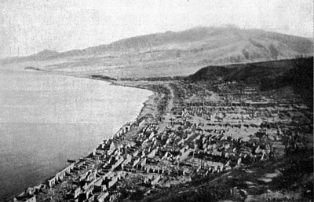
Mt Peleé, Martinique (1902)
An eruption of Mt Peleé in 1902 produced a pyroclastic flow that destroyed the city of St. Pierre.
before
after
Notes:
Another example of the destructive power of pyroclastic flows occurred on the island of Martinique in the West Indies, when an eruption of Mt Pelee produced a pyroclastic flow that completely destroyed the city of St Pierre (see the before and after photos).
The force of the pyroclastic flow swept all the buildings, inhabitants and anything else in it’s path into the ocean. Some portion of the pyroclastic flow actually traveled over the ocean surface for several kilometres to burn ships that were moored in the harbor.

Slide 18
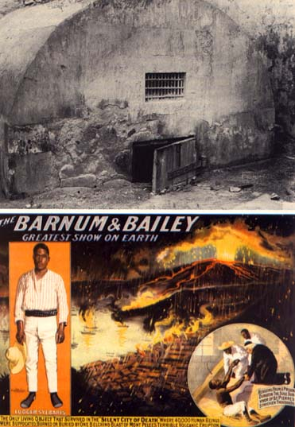
29,000 people died….
Only 2 survived! Why?
Notes:
Presenter: Ask the audience where they think the safest place to survive a pyroclastic flow might be….? Consider the fact that everything above ground was flattened and transported into the ocean.
Answer: Prison (read the story below).
The only other known survivor in St. Pierre became a minor celebrity. He was a husky 25-year-old roustabout named Louis-Auguste Cyparis, locally known simply as "Samson". In early April, Samson was put in jail for wounding one of his friends with a cutlass. Towards the end of his sentence, he escaped from a labouring job in town, danced all night, and then turned himself into the authorities the following morning. For this, he was sentenced to solitary confinement for a week in the prison's dungeon. On May 8, he was alone in his dungeon with only a small grated opening cut into the wall above the door. While waiting for his breakfast, his cell became dark and he was overcome by intense gusts of hot air mixed with ash that had entered through the grated opening. He held his breathe while experiencing intense pain. After a few moments, the heat subsided. He was severally burned, but managed to survive for four days before he was rescued by people exploring the ruins of St. Pierre. After he recovered, he received a pardon and eventually joined the Barnum & Bailey Circus, where he toured the world billed as the "Lone Survivor of St. Pierre.” **CLICK TO VIEW CIRCUS ADVERTISEMENT AND PHOTO OF PRISON CELL**
Another man (a local shoe maker) believed to have been in an elevated position on the outskirts of town when the pyroclastic flow hit. He therefore missed the full force of the eruption and somehow made his way through the burning wreckage to safety.
There were other survivors on the outskirts of the town and in some of the ships moored in the harbor. Mercifully, death came quickly to those that died. Some may have died by the sheer force of the blast, but most died within a few seconds after inhaling the burning fumes and ash of the pyroclastic flow. The throats and lungs of most of the dead were seared and their bodies badly burned.
The most common cause of death in people hit by a pyroclastic flow is drowning…fluid in lungs after burns.

Slide 19
How do pyroclastic flows cause devastation?
Notes:
We have seen the effect of pyroclastic flows entering a town. But what are the exact processes that cause the damage?

Slide 20
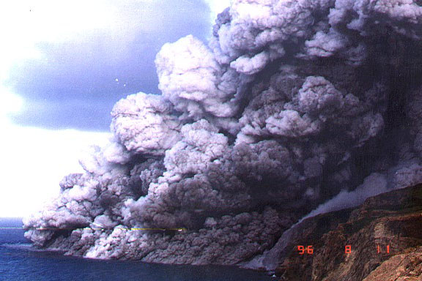
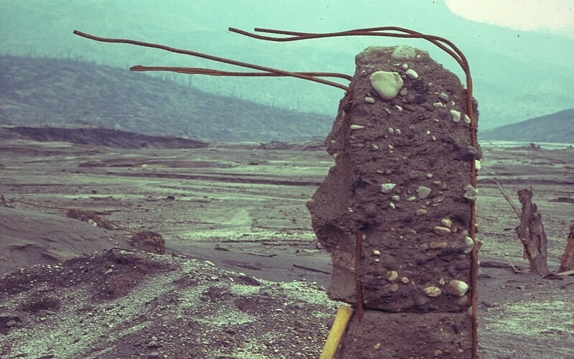
Pyroclastic Flow - direct impact
Courtesy of www.swisseduc.ch
Notes:
The direct force of a pyroclastic flow traveling at 10’s of metres per second and carrying boulders as large as houses is extremely damaging.
On the volcanic island of Montserrat in the West Indies (top photos), metre-scale blocks of volcanic rock when embedded 10’s of centimetres into concrete walls by the force of the passing pyroclastic flow. The top right hand photograph shows steel reinforcement bars that were once in the wall of a house bent in the direction of the passing flow (from right to left of screen).
As we previously saw, the entire city of St Pierre in Martinique was swept into the ocean.

Slide 21
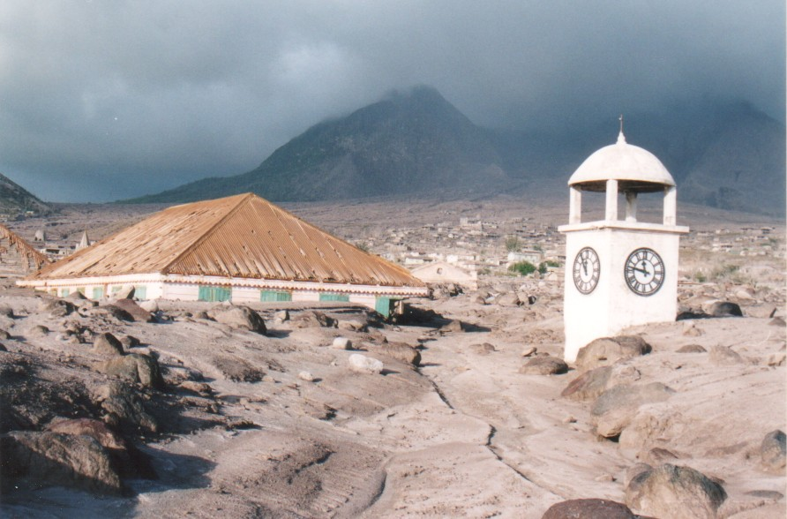
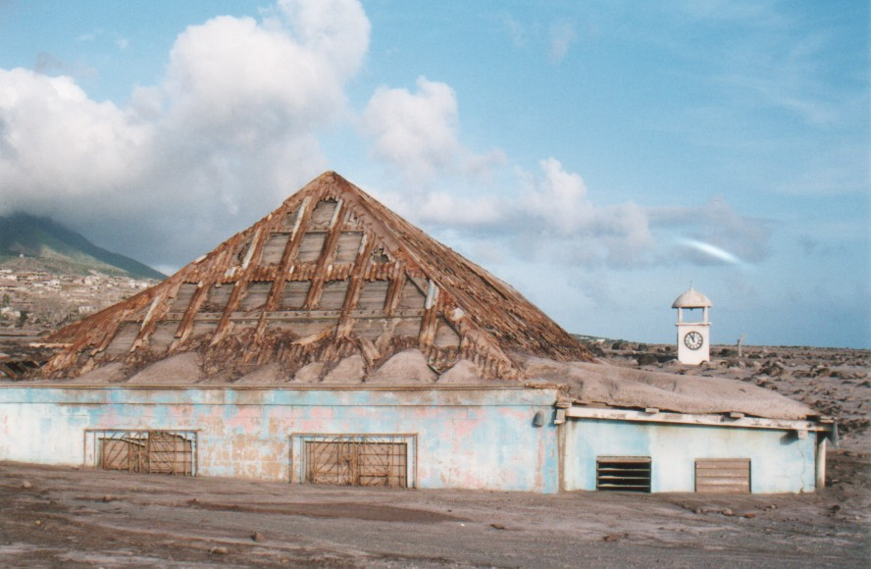
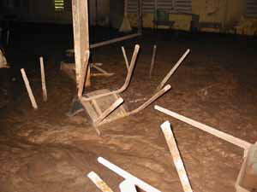
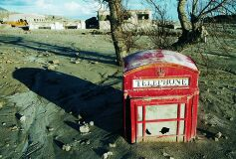
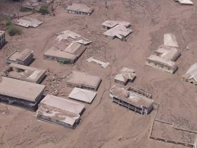
Pyroclastic Flow - burial
Notes:
The debris left behind from a passing pyroclastic flow can bury structures.
These example are from a 1997 eruption of the Soufrière Hills volcano on Montserrat. The pyroclastic flows produced buried the capital city of Plymouth. The white clock tower in the top photo was on the top of the town hall, which used to stand several storeys above street level.

Slide 22
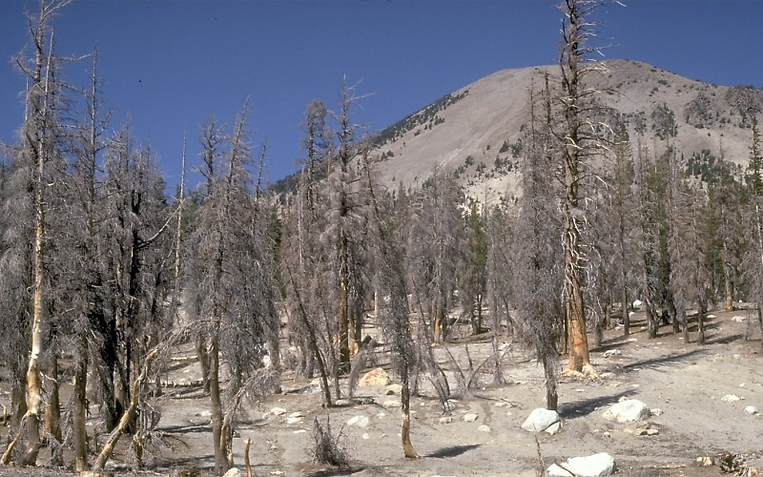
Pyroclastic Flow - burns
Notes:
Pyroclastic flows have temperatures commonly in excess of 400 degrees Celsius. Hot enough to burn forests and wooden structures.
Here we see burnt trees after an eruption from Mt St Helens in the USA.

Slide 23
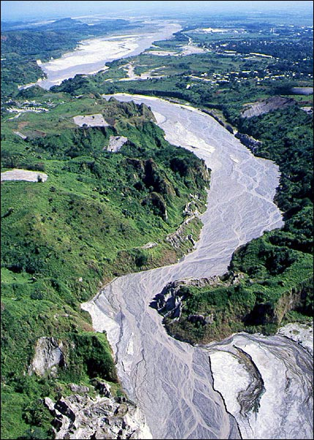
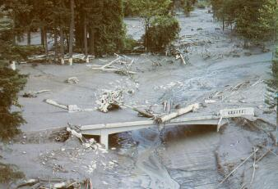
Pyroclastic Flow - lahars
Hot volcanic activity can melt snow and ice
Melt water picks up rock and debris
Forms fast flowing, high energy torrents
Destroys all in its path
Notes:
What is a Lahar?
‘Lahar’ is an Indonesian term that describes a hot or cold mixture of water and rock fragments flowing down the slopes of a volcano and (or) river valleys.
Heavy rain after an eruption or hot volcanic activity melting snow and ice will provide a large volume of water that will flow down the sides of the volcano. This water picks up the newly erupted material forming fast flowing torrents of water, mud, ash, rock and debris.
Lahars can flow great distances and be very destructive. The bottom photo shows a lahar knocking down a concrete bridge.

Slide 24
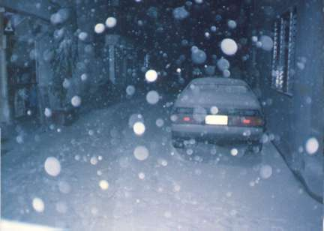
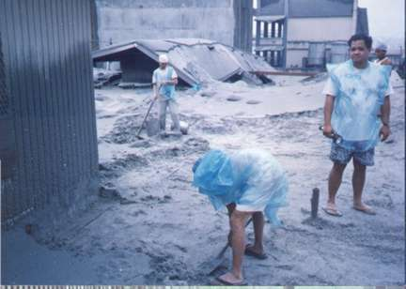
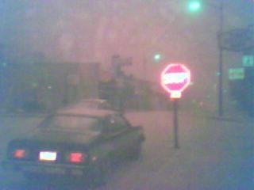
Pyroclastic Fall
Ash load
  Collapses roofs
  Brings down power lines
  Kills plants
  Contaminates water supplies
  Respiratory hazard for humans and animals
Notes:
Moving on from pyroclastic flows, there are other hazards associated with volcanic eruptions. Such as Pyroclastic Fall:
An explosive eruption will produce an eruption column of hot gas, ash and debris ejected kilometres into the air. As this debris falls back down to the ground it can cause a lot of damage.
Like too much snow on a roof, too much ash raining down from an eruption column can cause the roof to collapse.
Ash loading on power lines will cause them to fall.
As little as 1 centimetre of ash accumulated on the leaves of a plant will stop it from being able to photosynthesize and therefore the plant will die.
Lots of fine ash falling in lakes, rivers and water reservoirs will cause contamination making it unfit to drink, or to live in if you are a fish etc.
Very fine ash particles, if inhaled by humans, can cause extensive damage to the lungs causing a respiratory disease called silicosis.

Slide 25
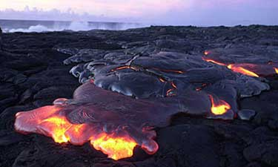
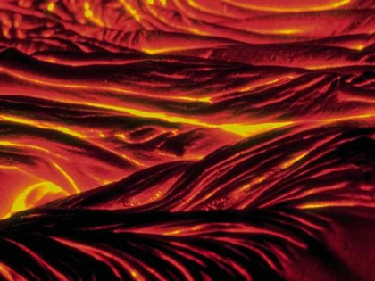
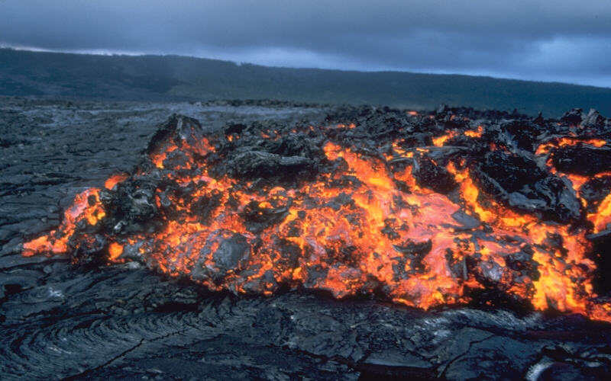
Lava Flow
It is not just explosive volcanic activity that can be hazardous. Effusive (lava) activity is also dangerous.
Notes:
Lava flows although generally slower moving and less catastrophic than pyroclastic flows still remain dangerous.
Lava flows have temperatures in excess of 200 degrees Celsius. Therefore will burn any flamable material it contacts with.
Thick lava flows will bury all in it’s path including infrastructure (buildings, roads, waterways etc.) and agricultural land…

Slide 26
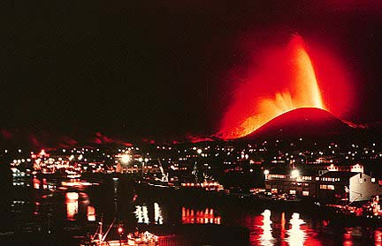
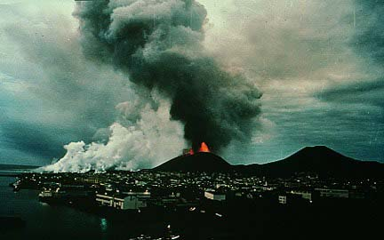
Lava Flow - Heimaey, Iceland
Iceland, January 23,1973.
Large fissure eruption threatened the town of Vestmannaeyjar.
Notes:
An example of a hazardous effusive eruption comes from the town of Vestmannaeyjar in Iceland.
In 1973 a large fissure crack opened up on the outskirts of the town and lava began to flow towards the buildings….

Slide 27
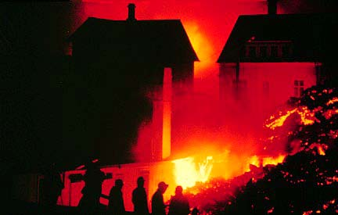
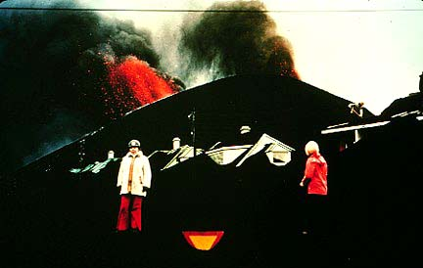
Lava Flow - Heimaey, Iceland
The lava flows caught the inhabitants by surprise
Before the eruption was over, approximately one-third of the town of Vestmannaeyjer had been destroyed
Notes:
The eruption happened at night and consequently caught the town’s inhabitants by surprise. No one was killed by the lava flows but around 1/3 of the town was destroyed……

Slide 28
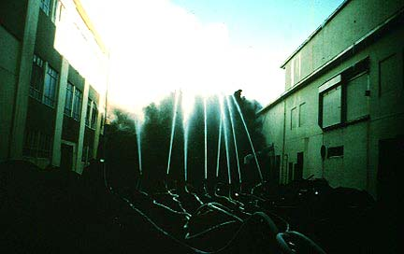
Lava Flow - Heimaey, Iceland
However, the potential damage was reduced by spraying seawater onto the advancing lava flows.
This caused them to slow and/or stop, or diverted them away from the undamaged part of the town.
Notes:
The people eventually stopped the advance of the lava flows by pumping seawater from the nearby harbor and spraying it on to the lava flows. This caused the front of the lava flow to cool quickly and stop moving. This formed a barrier for the lava behind it.
The residents of the town were able to stop and (or) divert the lava from the rest of the town.

Slide 29


Practical Exercise 2.
Assessing Volcanic Hazards
Notes:
See Volcanoes Exercise 2.

Slide 30
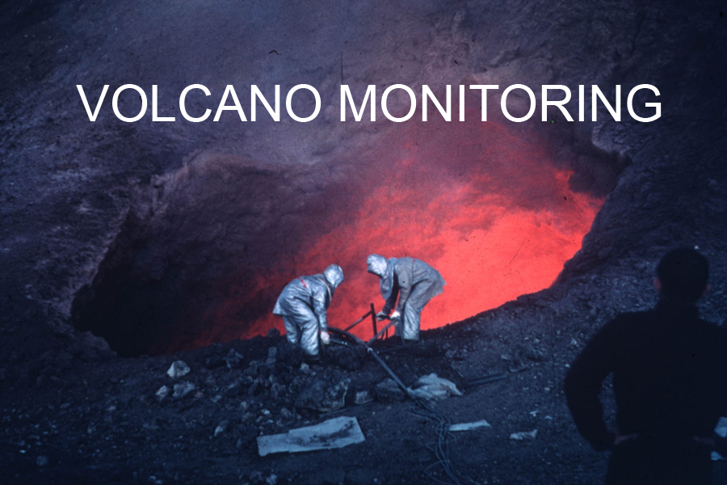
So….
How do we minimize the risk of active volcanoes?
Notes:
We have learned about the dangers and risks involved with eruptions. But, what can we do about it?How can we understand more about a volcano so that we might forecast a future eruption?
Answer: **CLICK TO SHOW** Volcano monitoring…..

Slide 31

Volcano Monitoring
Volcano Observatories are set up on all active volcanoes that threaten the human population. These are designed to monitor and potentially to predict the eruptive behaviour of the volcano in question.
Notes:
What is volcano monitoring?
Scientists set up “laboratories” or “volcano observatories” on the sides of active volcanoes to look for signs that the volcano is active and may have an eruption soon.
What are they looking for?
As magma moves through the Earth’s crust it can alter it’s environment producing sign’s that it is on its way to the surface…these signs are called “precursors” to an eruption.
Precursors include:
Increased earthquakes in the area (increased seismicity)
Swelling and cracking of the ground (deformation)
Change in the amount of or chemistry of the gas coming out of the volcano
Change in the groundwater levels or chemistry.

Slide 32
Volcano Monitoring
Seismicity
Deformation
Gas Output
  (on volcano and remote sensing techniques)
These three things are the most important precursors to an eruption.
Notes:
Seismicity (earthquake activity), ground deformation and gas output are the 3 most important precursors to an eruption….
For example, the Montserrat volcano observatory in the West Indies will increase its alert level and warn the population if two out of these three precursors occur. This warning and increase in alert level may involve relocation of people and livestock to safer areas and (or) a ban on boats sailing within 4 km of the volcano.

Slide 33

Seismic Activity
Earthquake activity commonly precedes an eruption
  Result of magma pushing up towards the surface
  Increase volume of material in the volcano shatters the rock
  This causes earthquakes
Notes:
Volcanoes and seismic activity (earthquakes) - what’s the link?
Many erupts are preceded by increased levels of seismic activity. The earthquakes are caused by fracturing and brittle failure of the subsurface rocks as new magma pushes it’s way up towards the surface.

Slide 34



Seismic Activity
Earthquake activity is measured by Seismographs
  Seismographs are stationed on the flanks of the volcano
  These record the frequency, duration and intensity of the earthquakes and report it back to the volcano observatory.
Notes:
Earthquake activity is measured by Seismographs
Seismographs are stationed on the flanks of the volcano
These record the frequency, duration and intensity of the earthquakes and report it back to the volcano observatory.
Changes in the seismic activity (especially an increase) may forecast an eruption.

Slide 35


Deformation Monitoring
“Tiltmeters” are used to measure the deformation of the volcano
  The tiltmeters measure changes in slope as small as one part per million. A slope change of one part per million is equivalent to raising the end of a board one kilometer long only one millimeter!
Notes:
Any deformation on a volcano can be measured by GPS surveys or “tiltmeters”.
Tiltmeters can measure tiny changes in slope angle…. as small as one part per million. A slope change of one part per million is equivalent to raising the end of a board one kilometer long only one millimeter!

Slide 36

Deformation Monitoring
Tilltmeters can tell you when new material enters the magma chamber.
A
Note the presence of earthquakes in relation to the deformation. Often it is a combination of events that fore-warns of an eruption.
B
Notes:
Why is measuring ground deformation on a volcano important?
Tiltmeters can tell the scientists when new magma has entered a magma chamber in the volcano.
Figure A shows a volcano in a dormant (resting) stage. Titlmeters on the sides of the volcano meassure a shallow slope angle.
When new magma enters the magma chamber (Figure B) the chamber swells to accommodate the larger volume. This causes the sides of the volcano to bulge out. It’s like blowing up a balloon: the more air you put into the middle the bigger the out skin of the balloon gets. The tiltmeters will now record a new steeper slope angle on the outside of the volcano.
If fresh magma enters the magma chamber, this again may be a precursor to an eruption. New magma will increase the pressure in the magma chamber causing more fracturing of the surrounding rock (this will produce earthquakes) and potentially the formation of a conduit to the surface. It is common for ground deformation and seismic activity to occur at the same time before an eruption occurs.

Slide 37


Gas Monitoring
Commonly gas output from a volcano increases or changes composition before an eruption.
  As magma rises to the surface it releases (exsolves) much of its gas content.
  This can be measured
Notes:
When magma rises towards the surface the decrease in pressure causes it to lose some of its gas content. As gas is released from the magma it often vents at the surface, leaking out of small cracks in the ground or from the large volcanic vent.
A dormant volcano will commonly vent gas even when there is no eruption going on. This is because the magma is deep down in the crust, still releasing gas but not in the position to erupt at the surface.
A change in the amount of gas or the chemistry of the gas being released is another precursor to an eruption. An increase in the amount of magma in the chamber will produce an increase in the amount of gas. Also, the new magma may have a slightly different chemical composition to the old magma and therefore release different abundances of gas types (CO₂, SO₂, H₂O). For example, an increase in the ratio of carbon to sulfur can be used to indicate the arrival of a new batch of magma at the summit reservoir.

Slide 38





Gas Monitoring
Gas samples are collected from fumaroles and active vents.
Gas levels may also be monitored by remote sensing techniques
Notes:
Gas (volatile) composition and abundance can be measured directly from the volcano by gathering samples from the vents and fumeroles.
Or, using remote sensing techniques. For example, the amount of sulfur dioxide (SO₂) released by a volcano can be measured indirectly by a correlation spectrometer or COSPEC. The spectrometer compares the light coming through the volcanic plume to a known spectra of sulfur dioxide, thereby measuring the SO₂ levels in the plume.

Slide 39
In Summary..
Volcanoes are extremely hazardous.
However, the volcano can be studied, monitored and understood.
Each volcano is different, and offers a unique set of dangers
Plans may be emplaced to help control potential damage.

Slide 40
Post-lecture Question:
What should geologists do about volcanic eruptions in the future?
Study volcanoes to find out more about how and why they erupt
Monitor the volcanoes
Develop hazard mitigation plans
Understand the population around volcanoes, i.e. why do people choose to live near volcanoes?
Education
Notes:
Presenters: Ask the students this question. Get them to list 5 things geologists can do to help understand and mitigate the hazards of future volcanic eruptions.
See if they can come up with the same answers as provided (or perhaps they can think of more!).

Slide 41
Additional (Optional) Material

Slide 42
Are there other volcano related hazards?

Slide 43


Noxious Gas
1,700 people living in the valley below Lake Nyos in northwestern Cameroon mysteriously died on the evening of August 26, 1986.

Slide 44


Noxious Gas
Lake Nyos is a crater lake inside a dormant volcano.
The lake had become laden with carbon dioxide gas.
This gas had suddenly bubbled out of the lake and asphyxiated nearly every living being in the surrounding valley.

Slide 45

Noxious Gas
A management plan has been developed to remove gas from the lake to prevent a further tragedy.
An artificial vent to the lake surface was created with pipe.
Water is pumped from the bottom of the lake to the surface through the pipe, where it can degas.

Slide 46

Noxious Gas

Slide 47


Noxious Gas

Slide 48
Noxious Gas
The Lake Nyos incident was not unique.
Two years earlier, Lake Monoun, 60 miles to the southeast, released a heavy cloud of toxic gas, killing 37 people.
A third lake, Lake Kivu, on the Congo-Rwanda border in Central Africa, is also known to act as a reservoir of carbon dioxide and methane, which is a valuable natural gas that is gathered from the lake and used locally.

Slide 49
Earthquakes
Large volumes of magma moving through the shallow crust can cause large earthquakes.
This can lead to building collapse, slope failure and avalanches

Slide 50


Earthquakes
Destruction after a volcanic induced earthquake in Japan

