Slide 1
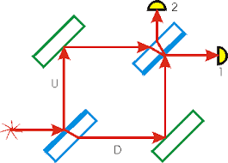
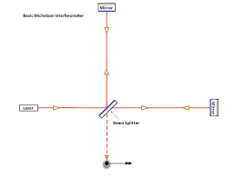
Michelson & Mach–Zehnder interferometers
(division of amplitude)
Michelson interferometer
Mach-Zehnder interferometer

Slide 2
In physics, the Mach–Zehnder interferometer is a device used to determine the relative phase shift variations between two collimated beams derived by splitting light from a single source.
The interferometer has been used, among other things, to measure phase shifts between the two beams caused by a sample or a change in length of one of the paths.
Applications
The versatility of the Mach–Zehnder configuration has led to its being used in a wide range of fundamental research topics in quantum mechanics, including studies on counterfactual definiteness, quantum entanglement, quantum computation, quantum cryptography, quantum logic, Elitzur–Vaidman bomb tester, the quantum eraser experiment, the quantum Zeno effect, and neutron diffraction. In optical telecommunications it is used as an electro-optic modulator for phase and amplitude modulation of light.

Slide 3
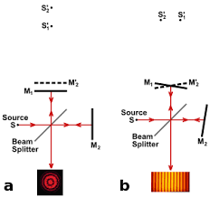
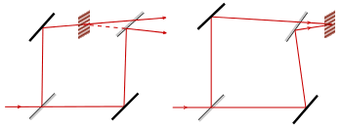
Localized fringes

Slide 4
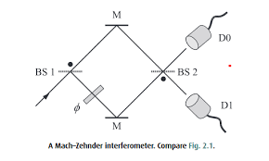
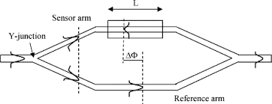
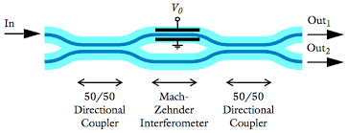
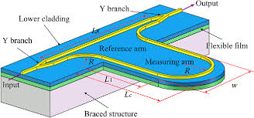
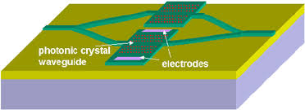
Other forms of MZ interferometer

Slide 5
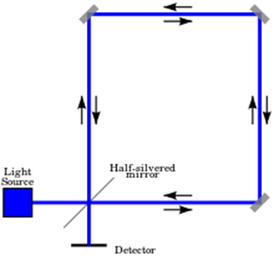
Sagnac interferometer

Slide 6
wave 1
wave 2
Two waves in phase
Two waves 180° out of phase
combined
waveform
$$I∝A^{2}=2a^{2}\left(1+\cos{δ}\right)=4a^{2}\cos^{2}{\frac{δ}{2}}$$
$$δ=α_{1}−α_{2}$$
$$a_{1}=a_{2}=a$$
$$I_{max}=4a^{2}$$
$$I_{min}=0$$
$$δ=0, 2π, 4π,……, 2nπ$$
$$δ=π, 3π, 5π,……, (2n+1)π$$

Slide 7
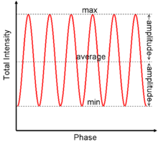
Visibility
$$V=\frac{I_{max}−I_{min}}{I_{max}+I_{min}}$$

Slide 8
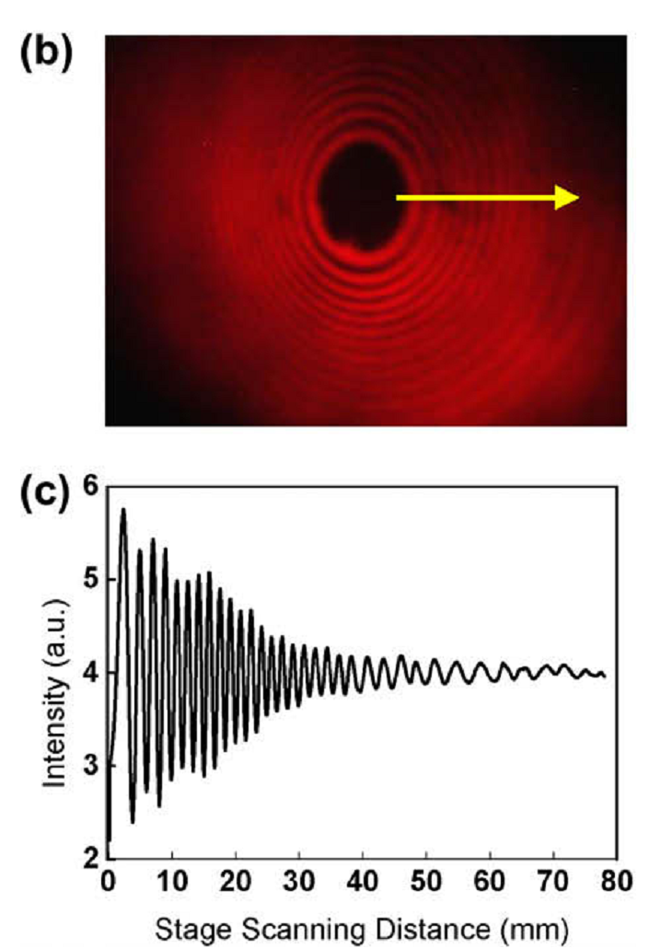

Slide 9
https://www.youtube.com/watch?v=j-u3IEgcTiQ
https://www.youtube.com/watch?v=UA1qG7Fjc2A
https://www.youtube.com/watch?v=lzBKlY4f1XA
https://www.youtube.com/watch?v=M6y_igUpyCg

