Slide 2
Prof. Maie El-Gammal
Environmental Sciences Department
AIR POLLUTION

Slide 3
Pollution
Introduction and Some Definitions:
Environment: All conditions and influence affecting life and development of organism, including air, water and soil.
Environmental Pollution:
Unfavorable alteration of our surroundings as by-products of man's action, through effects of changes in energy, radiation, chemical and physical constitutions, they may affect many directly or his supplies of water and agriculture.
Undesirable physical, chemical or biological that affect naturally or artificial on living organisms in the surrounding environment air, water.

Slide 4
Introduction and Some Definitions
Environment: All conditions and influence affecting life and development of organism, including air, water and soil.
Environmental Pollution:
Unfavorable alteration of our surroundings as by-products of man's action, through effects of changes in energy, radiation, chemical and physical constitutions, they may affect many directly or his supplies of water and agriculture.
Undesirable physical, chemical or biological that affect naturally or artificial on living organisms in the surrounding environment air, water.

Slide 5
Natural processes cause pollution, but all pollution troubles are anthropogenic, increasing with:
Migration of people from contusive into cities.
Development of industry.
Use of energy sources (coal, fossil fuels, oil, and natural gas) to power of their technology.
Types of Pollution:
Every human society rural, urban, industrial and technologically society dispose of by-products and waste products into biosphere in quantities, so greater than that of normal functioning of ecosystems and effect on plants, animals and man.

Slide 6
Nondegradable Pollutants | Degradable Pollutants
Not broken by natural process | Broken down by natural process
As plastic, mercury, lead, aluminum, phenolic, DDt. | As Substances are rapidly biodegradable "Human Sewage“ Substances are non-biodegradable "radioactive
They combine with other components to produce additional toxins | They become problem when the environment faster than the natural process break them down

Slide 7
According to Environment: Air, water and Soil.
According to Pollutants: Lead, mercury, CO₂, Solid Waste and Noise.
According to Categories: Natural Pollutants from natural process, Artificial Pollutants from Activities.
According to Environment: (Air, water and Soil).

Slide 8
1- Water Pollution:
Physical, chemical or biological change in water quality that adversely affects living organisms or makes water unsuitable for use.

Slide 9
Water pollution
Causes due to the introduction of chemical, biological and all sort of physical matter into large bodies of water that degrade the quality of life that lives in it and consumes it.
We can blame fertilizers, pesticides, or petroleum derivatives for water pollution.
In addition to that waste treatment facilities, mining, pesticides, herbicides and fertilizers, oil spills, refiners, factories, oil and antifreeze leaking from cars, animal waste, soap from washing your car, house hold chemicals and many more to count.

Slide 10
some common of water pollution
Industrial Waste:
Manufacturing has always been a great tool for the economy of any country but slack regulations have allowed companies to severely pollute our air and water, & output makes a lot of difference to the environment.
In general practice, all most all the manufacturing unit dump waste directly into rivers and lakes, and some of them dump waste on the ground are polluting the ground water.
As a result of which the water source has been found to be contaminated with hundreds of toxic chemicals from industrial waste.

Slide 11
Agricultural Chemicals
Chemical has been used extensively in the agriculture sector. Due to which large quantities of pesticides and herbicides have drained off into the main source of water. As a result of which it pollute water
Home waste
Whatever we put down your drains eventually ends up in our water sources. It may be home cleaning products, prescription drugs or whatever eventually it causes water pollution.

Slide 12
Sewage Waste:
Sewage wastes generally originate from homes and businesses
It is dumped directly into the ocean by many water side cities and towns.
Millions of tons of sewage waste are pumped into oceans on a daily basis
It is a massive source of water pollution.

Slide 13
Top causes of water pollution
Radioactive & Industrial Wastes
:Mainly these pollutants come from the industries and nuclear power plants and they are, washed out to the rivers, lakes, and ocean at a high rate proportion, which leads to severe water pollution.
Toxic chemicals like mercury, sulfuric acid, lead, and used oil are the major constituents of those pollutants, which leads to several health problem and may cause death if taken in great proportion.

Slide 14
Eutrophication:
Continuous use of inorganic chemical fertilizer & pesticides for crop production leads to eutrophication.
Due to eutrophication algae produces some toxic substances that effects higher life forms and food chain and causes polluting of water source.

Slide 15
Mining:
Mining industry always poses a high threat to water pollution.
Mining industry dispose heavy metals and sulfuric compounds previously stocked underground the soil profile to environment triggering water pollution.
Hence all effort has to be made to nullify water pollution.

Slide 16
2- Soil pollution
Solid wastes have a lion’s share among total pollution.
Mainly it is composed of municipal solid waste (MSW), hazardous waste, plastic waste and E-waste.
MSW also called as trash or garbage which is mainly composed of everyday items that are discarded by the public

Slide 17
MSW is of two types, biodegradable or recyclable and non biodegradable.
Non biodegradable is more harmful in nature as it can’t be degraded.
Hazardous wastes always pose a great threat to an environment. They are classified into 4 categories viz. ignitability, reactivity, corrosively and toxicity

Slide 18
Types of Water Pollution:
1-Pathogens
Microorganisms cause disease
Source: human sewage, animal manure
2-Nutrients and biodegradable organic matter
as remains of animal and plants "Feces, leaves and wood …"
They are broken down by organisms into minerals nutrients pollute water.

Slide 19
3-Physical Agents: as Heat and suspended solids (Soil).
4- Toxic Chemicals:
as any chemicals are poisonous to organisms.
Metals: (Lead, Mercury …).
Organic Components: (Pesticides, petrochemical industry...).
Radioactive Waste.

Slide 20
Types of Soil Pollution
It is caused by: solid wastes and chemicals.
1-Solid Wastes:
Disposal of solid wastes material "animal manure"
2. Agriculture wastes.
Industrial wastes as chemical, flyash and cinders "residues of fuels, paper, plastics, rubber, cloth, rubbish, sand metal and glass (resulting from demolition of buildings)".
Dead animals "Cattle's, dogs, cats, birds and containers".
Manufactures products as "Old refrigerators, washing machines".

Slide 21
3-Chemicals:
Radioactive minerals sulphur & lead.
Many pesticides and herbicides are applied by aerosol spray.
These chemicals effect on plants and animals.
They inhibit processes of soil formation & reduce the capacity of the forest to maintain fertility of the soil.

Slide 22
Air Pollution
Clean Air
A colorless, odorless, tasteless, gaseous mixture, mainly nitrogen (approximately 78 percent) and oxygen (approximately 21 percent) with lesser amounts of argon, carbon dioxide, hydrogen, neon, helium, and other gases.
This mixture with varying amounts of moisture and particulate matter, enveloping the earth; the atmosphere

Slide 23
Air contaminants:
Any things added to the environment that cause a deviation from the geochemical mean composition, as, dust, fumes, mist, smoke, vapor, gas or any combination of them.

Slide 24
Air Pollution
The presence in the atmosphere, one or more contaminants in a sufficient quantity, injurious to human, plant, animal life and interfere with the comfortable enjoyment of life.
If there are particles or gases in the air that are not part of its normal composition, we call this "air pollution" and the particles or gases are called "air pollutants."
Very small amounts of certain air pollutants can cause serious health and environmental problems.

Slide 25
Air pollution is not a new phenomenon:
- Smoke from heating and cooking.
- Odors from domestic wastes. Where man has been living.
*Today smoke and odors have been reduced and replaced by new air pollutants, resulting from mobile, industrial and urban society.

Slide 26
First step to understand air pollution and its control is understanding the composition and structure of atmosphere.
Atmosphere Zones of Air:
Atmosphere is a mixture of gases found in 4 zones of contrasting temperature due to different absorption of solar energy.
Energy transport mechanism "electromagnetic radiation, convection, evaporation, …" among atmosphere, ocean and earth's surface.
Temperature varies with altitude, season, time of day, cloud.
The 4 major layers of the atmosphere: Troposphere, Stratosphere, Mesosphere and Thermosphere.

Slide 27
Troposphere:
The region nearest the surface 16 Km over equator, 8 Km over poles, in with man lives.
The most weather events occur due to:
Force of gravity.
Compressibility of gasses "75% of total mass of atmosphere".
This layer contains most of the atmosphere's cloud and particulates "Acid rain".
Air temperature -50 to -80 ⁰C decreases with increasing of altitude at the top -60 ⁰C.
Tropopause: 10-20 Km above earth's surface.
Temperature curve changes suddenly in a narrow transition layer, that creates sharp boundary.

Slide 28
Stratosphere:
50 Km above Tropopuse
It has a similar composition of troposphere except for 2 important components: H₂O – O₃.
Ozone (O₃): (Conc. 1-5 ppm) is produced by:
Solar irradiation of O₂ molecules
Photosynthetic organisms.
Temperature increases with higher altitude, due to the absorption of solar ultraviolet radiation (U.V.) by O₃.
That protects life from exposure to U. V. rays, which cause skin cancer, genetic mutation, crop failures and disruption of biological communities.

Slide 29
The air is very dry, clouds and convection currents from troposphere do not penetrate easily into it.
Pressure and density 1/10-1/1000 of quantities near the surface of earth.
Stratopause: At the top of stratosphere, 50Km high It is warm and not much cooler than the earth's surface. It was refracting sound waves from the earth back to the surface.

Slide 30
Mesosphere:
Above the stratosphere.
Temperature again decreases with height to the very coldest temperature, about -80 ⁰C.
Mesopause: is region of the minimum temperature

Slide 31
Thermosphere:
Above the mesopause.
It is region of highly ionized gases. Temperature rise very rapidly.
Densities and pressure decrease gradually until become indistinguishable.
There is no sharp boundary that marks the end of atmosphere.
Ionosphere:
Located within thermosphere.
Contain high concentration of ions.
Northern lights appers when Solar energy cause ionized gases to emit visible lights.

Slide 32
The Earth's Natural Atmosphere
The earth's atmosphere has not always had its present composition, although the composition unchanged through most of geological time.
Ambient air composition has undergone several changes:
The primeval gaseous environment contained H₂ and He, no, O₂ or NO₂.
The earth's mass grew by accretion Cosmic dust.
It was bombarded by Meteorites that cause the surface to heat up with drove off most of atmosphere's original gases.

Slide 33
The earth becomes geologically active. Volcanoes→ huge quantities of lava, ash and gases CO₂, N₂, water vapour.
The breakdown of water vapour H₂O→ O₂.
Radioactive decay of an isotope of K in the earth's crust rock → Ar.
Volcanic activity subsided, the earth and its atmosphere gradually cooled.
The process of Cooling→ Water Vapour→ Clouds→ Rains→ 1st Rivers, lakes and Seas
Photosynthesis began, when the 1st marin plants appeared with contributed O₂ to air.

Slide 34
Major Constituents of Air
1. {Const. and Variables} Atmospheric Gas Concentration
i. Const. of Constituent of Earth's Atmosphere
 | Conc.% | Conc. ppmv
Nitrogen (N₂) Oxygen (O₂) Argon (A) Neon (Ne) Helium (He) Krypton (Kr) Hydrogen (H₂) Xenon (Xe) | 78.8 20.95 0.93 | 18.0 5.2 1.1 0.5 0.086

Slide 35
ii Variable Constituent of Earth's Atmosphere
a. Gases | Conc. ppmv | b- Aerosols
Water vapor Carbon dioxide(CO₂) Methane(CH₄) non methane HC Nitrous oxide (N₂O) Carbon monoxide(CO) Ozone (O₃) Ammonia (NH₃) Nitrogen dioxide(NO₂) Sulfur dioxide (SO2) Nitric Oxide (NO) Hydrogen sulfide (HS) | 0.1 – 30.000.00 0.036% 1.72 0.02 0.33 0.11 0.02 0.004 0.001 0.001 0.0005 0.00005 | Dust – Airborne-Soil Hydrogen Chloride Hydrogen Fluoride

Slide 36
2. {Principal and Trace} Air Pollutants
i) Principal Gases: N₂ , O₂ , Ar , CO₂
ii) Trace Gases
a. Non-reactive gases: Ne, Kr, Xe, He, H₂, N₂O
They do not react with other molecules under normal circumstances.
b. Reactive gases: CO, Hydrocarbons (methane – non-methane (NO, NO₂, NH_{3,} SO₂, O₃
They present in trace quantities, but interact with the biosphere, H₂ & each other.

Slide 37
This reactive gases, when produced by man in sufficient quantities for conc. {Pollutants}
Other reactive gases as Halogen gases "chlorine, fluorine, their acid derivatives" cause pollution problem at elevated concentration.
Pollution problems arise not as a result of man-made emission, but because emission is concentrated in the areas where people live and work.
Natural emissions are nearly concentrated in limited areas as in case of volcanoes. On other hand man's emissions are increasing as population & industry.

Slide 38
3. Main air pollutants are {Oxides, Volatile Comp, Particulates & Secondary pollutants }
Oxides: CO, CO₂, SO₂, SO₃, NO, NO₂, N2O
Volatile Comp. :
Hydrocarbons: methane, ethylene, benzene, benzo- pyrene.
Organic Comp: formaldehyde, carbon tetrachloride chloroform, methylene dichloride, Trichloroethylene, vinyl chloride, ethylene oxide.
Suspended particles & droplets:
Dust , soot , lead , cadmium , asbestos , chromium , arsenic , nitrate , sulfate salts , sulfuric acid , nitric acid , oil , pesticides.

Slide 39
4. { Primary and Secondary} Air Pollutants
1) Primary pollutants:
They are released directly into the air in a harmful from as soot is formed in fire.
2) Secondary pollutants:
They are formed when primary pollutant react with each other
Solar radiation provides the energy for this reaction as Photochemical Oxidants.
An atmospheric acid as SO₂ is a primary forms when fossil fuel is burned. It reacts with water vapor to form H₂SO₄ Acid rain.

Slide 40
5.Factors that contribute of Air pollution
1. Natural Factors
It includes meteorological & geographic conditions that restrict the normal dilution of contaminant emission.
Volcanoes: Ash, acid mists, hydrogen sulfide & other toxic gases.
Sea spray + Decay vegetation: Sulfur comp.
Forest fires: Clouds of smoke cause blanket trees. Volatile organic comp. terpenes – isoprenes.
Storms: raise dust clouds that transports soil.
Microorganisms "pollen, spores, viruses, bacteria": cause allergies – born infection.
Bacterial metabolism & ruminant animals: methane

Slide 41
2.Man – Made Factors
Heat & power generating "including nuclear power plants.
Solid-waste disposal.
Industrial processing.
Nuclear warhead explosions & other man-manipulated uses of radioactive isotopes.
Transportation sources include motor vehicles, aircraft ,Trains, Ships, boats & a variety of off-road vehicles.
50% of these pollutants (CO – pm1– Hc3 – Nox – Sox (& major source of Co- Nox
Major Stationary fuel combustion sources: fossil fuel-fired electrical generating plants, industrial & institutional boilers & home space heaters.

Slide 42
Major source of So₂, No_{x}
Industrial process losses include pollutants produced in abroad range of industrial activities "mineral ore smelting – petroleum refining – oil & gas production – marketing, chemical production, and paint application – industrial organic solvent, food processing, and mineral rook crushing.
PM – SOx
Solid waste disposal results from onsite & municipal incineration – open burning.
Miscellaneous sources: Forest fires – agricultural burning – coal refuses – structural firs – variety of organic solvent

Slide 43
(National Emission & pollutants (10⁶ short ton/year
 | Co | PM₁₀ | Hc_{s} | No_{x} | So_{x} | Total | Lead
Transportation Stationary fuel Industrial process Solidwaste Miscellaneous | 75.26 5.43 5.28 1.73 9.51 | 0.59 1.21 0.61 0.25 1.03 | 8.3 0.65 11.2 2.27 0.84 | 10.42 11.64 0.91 0.08 0.30 | 0.72 19.27 1.86 0.04 0.01 | 45.29 38.25 14.86 4.37 11.74 | 1.59 0.50 2.28 0.52 0.0

Slide 44
Man – mad air pollution is categorized as:
Industrial air pollution:
typical of big cities, where Coal & other fossil fuels are burned.
Photochemical air pollution:
When sun' rays combine w gaseous emission to produce secondary air pollutants related to weather inversions & high automobile density.
The natural factors are usually beyond mans,s sphere of control, whereas the man – made factors are more susceptible to control
Radiation from exposure to cosmic rays as from radioactive gases released from soil & rocks has been w man from beginning.
However in the past (70 – 80 year( , Man has added radioactive pollutants to a degree that has doubled the amount of radiation pollution in the atmosphere.
As more use Nuclear energy for power plants& propulsion Radioisotopes in medicine & scientific research the radiation pollution problem will increase.

Slide 45
Conc. of Atmospheric gases: PPm, PPb, PPt mg/m³, µg/m³
* A wide variety of gaseous pollutants are produced by pollutant sources.
* Hundreds may exist in the polluted air environment over some of our major cities.
* More than 400 different gaseous species have been identified in automobile exhaust alone.
* Many new pollutants are produced as a result of atmospheric chemistry.

Slide 46
Major gaseous pollutants identified as significant public health & welfare effects are discussed in their chemical properties , reaction , sources :-
a) Inorganic pollutants "carbon comp., Nitrogen comp, sulphur comp., Halogen comp & Oxidizing agents "

Slide 47
[1] Carbon Oxides
CO, CO2 are emitted to the atmosphere by both natural & anthropogenic.
i - Carbon Dioxide CO₂
All living matter on the earth is involved in the reactions of CO₂ in the atmosphere.
It is produced and emitted naturally & anthropogenic

Slide 48
1. Naturally Source:-
Biological decomposition, combustion & weathering of organic matter. Carbonates in rock, soil & water.
Lime stones – dolomites
Coal – petroleum
Volcanoes
Respiration 90%
2. Anthropogenic Source:-
Combustion of fossil fuels
Biomass burning, agriculture "indirect source"

Slide 49
CO₂ is nontoxic, it is major raw material in plant photosynthesis
Changes in Atmospheric Co₂ levels occurred through geological time due to human activities that cause global climate warming
It is removed from atmosphere by:
Plants "photosynthesis" & stored in the earth's crust as coal, oil & natural gas as energy sources, it is resulting in significant increase in atmospheric CO₂.

Slide 50
CO₂ is very soluble in water & earth's oceans removing 50% of anthropogenic emission.
World's forests served as major sinks for CO₂ , burning of high carbon density forests & replacement by low carbon density agricultural has significant decreased these biological sinks

Slide 51
ii - Carbon Oxide CO
It is a colorless, odorless, tasteless gas, non irritating but highly toxic gas.
*Source of CO Emissions :
1. Naturally Source:-
Photolytic decomposition of methane CH4 & biogenic HCs as terpenes from decaying vegetation.
Microbial processes in the Ocean & soils.
Forest fires & Incineration of biomass or solid waste.

Slide 52
2. Anthropogenic Source:-
2C + O₂ 2CO "intermediate product"
2CO + O₂ 2CO₂
Incomplete combustion of fossil fuels & motor vehicles
Industrial processes iron foundries, "incinerators & steel mills"
Photolytic Oxidation of anthropogenic HC_{s}
Transportation
Solid waste disposal & miscellaneous burning of things as leaves & brush

Slide 53
*Effect & Control
1) CO sink processes effect on:
Tropospheric conc. of OH & O₃ "thus oxidizing power of atm."
Oxidation of CO in the atmosphere
CO₂ + H CO + OH
H + O₂ + M HO₂ + M
In presence of NO_{x}
HO₂ + NO NO₂ + OH
NO₂ is photolysis to produce O₃
NO₂ ^{λν} O (³p) + NO
O (³p) + O₂ + M O₃ + M
O (³p) = ground – state atomic oxygen .
As a result of this reaction CO is oxidized to CO₂
CO + 2O2 + λν CO2 + O3

Slide 54
Tropospheric conc. of CH₄ , a major greenhouse gas , stratospheric conc. of H₂O vapor derived from CH₄ oxidation.
Major sink processes include atmospheric photochemical processes & uptake in the soil.
It can seriously effect human aerobic metabolism, owing to its high affinity for Hb .
The component of Blood responsible for transport of O₂ CO reacts with Hb of Blood Carboxy hemoglobin COHb thus reducing the capability of the Blood to carry O₂ .
It has little effect on plant or material .
..

Slide 55
[2] Sulfur Compounds
Gas + Sulfur Comp. included:-
A variety of reduced sulfur " Hydrogen sulfide H₂S -carbonyl sulfide COS , carbon disulfide CS₂ , dimethyl sulfide (CH₃)₂ S
(a) Gas
Sulfur Oxides SOX
6 gaseous compound SO, SO2 , SO3 , SO4 , S2O3 , S2O4

Slide 56
*Source of SO_{X} Emissions :
1. Naturally Source:-
Volcanoes & fumaroles fumes Evaporation of sea spray.
Atmospheric oxidation of reduced sulfur compounds.
Erosion of sulfate contain from arid soils.
2. Anthropogenic Sources:
Combustion of fuel "coal, oil, natural gas"
Industrial processes as melting & roasting of sulfide ores.
SO2 & SO3 are most interest in the study of pollution.

Slide 57
Sulfur Dioxide SO2
It is colorless gas - suffocating odor - nonexclusive - molecular weight 64.06 , is about twice as heavy as air , so , it remains airborne an average 2-4 days - it may be transported as far as 100 km ,
Thus SO₂ pollution become international
It may be primary or secondary pollutant.
It is highly soluble in water.

Slide 58
In stable atmosphere. It acts as reducing or oxidizing agent, reacting photo chemically or catalytically with other components.
S + O₂ SO₂ Sulfur dioxide
2 SO₂ + O₂ SO₃ Sulfur trioxide
SO₂ + H₂O H₂SO₃ Sulfurous acid
SO₃ + H₂O H₂SO₄ Sulfuric acid
SO₃ has a high affinity for H₂O to produce acid rain "H₂SO₄" falls in solid particles or liquid droplets with transport acid sulfate ion SO₄ for long distance.

Slide 59
ii Reduced Sulfur Compounds
These include: - Hydrogen sulfide H₂S, carbonyl sulfide COS, carbon disulfide CS₂ & dimethyl sulfide (CH₃)₂S
*Source of Sulfur Compounds Emissions :
1. Naturally Source:-
a- Carbonyl Sulfide COS
Is the most species in atmosphere
emitted from : biogenic sources - combustion processes
life time 44 years
Because of its limited reactively, it contributes little to pollution problems.

Slide 60
b- Carbon Disulfide CS2
Emitted from biogenic sources combustion processes.
It is more photo chemically reactive life time 12 days
Global conc. are variable
c- Dimethyl sulfide (CH3)2S
emitted from Oceans
has very short life time 0.6 days
rapidly oxidized to SO2
d- Hydrogen sulfide H2S
It is the reduced sulfur compound of major human concern produced by Anaerobic decomposition processes
It has relatively short lifetime 4.4 days

Slide 61
2. Anthropogenic Sources
Oil & gas extraction
Petroleum refining
Coke ovens
Kraft paper mills
Hydrogen sulfide 9H2S): It is "rotten egg" odor , toxic gas

Slide 62
iii Nitrogen Compounds
Gas + particulate nitrogen Comp. are found in atmosphere as:
a- Gas phase :
Nitrogen gas N2 , Nitrous oxide N2O , Nitric oxide NO , Nitrogen Dioxide NO2, Nitrate radical NO3, Di nitrogen pent oxide N2O5 , Nitrous acid HNO2 , Nitric acid HNO3 , Peroxyacyl Nitrate CH3COO2NO2 , Ammonia NH3 , Hydrogen Cyanide HCN.
b- Aqueous phase:
Ionic species NO₃ , NO₂ , NH₄
N₂ gas is the major gaseous: 78.l% of atmosphere's mass other nitrogen comp. is found in trace quantities.
NO_{x} (NO, NO₂), organic nitrates, gas & particulate nitrogen acids & ammonia NH₃ play significant role in the chemistry of polluted environments.

Slide 63
(a) Gas
[1] Nitrous Oxide N2O
It is colorless, slightly sweet, nontoxic gas.
used as an anesthetic in medicine & dentistry.
laughing gas because, elevated conc. produce a kind of hysteria.
Sources:
Natural: Microbiological processes in Oceans.
Anthropogenic: Nitrogen fertilizers - burning of fossil fuels.
It has no tendency to react w other substance, So, life time 150 years.
N2O is important chemical factor in stratospheric O3.
NO produced from N2O photolysis "by O* in the stratosphere is transported down into troposphere where it affect NOx level , especially in unpolluted area

Slide 64
Effect:
Stratospheric O3 depletion because of its thermal absorptivity.
Global warming.

Slide 65
[2] Nitric Oxide NO:
It is colorless, odorless, tasteless, nontoxic gas.
Sources:
1. Naturally Source:-
Anaerobic biological processes in soil & water.
Combustion processes.
Photochemical destruction of nitrogen comp. in stratosphere.
2. Anthropogenic Sources
Automobile exhaust.
Electric generation stations.
Industrial boilers
Incinerators
Home space heaters

Slide 66
NO is a product of high. Temp combustion.
N₂ + O₂ 2NO
Endothermic reaction, eq. moves to right at high temp & to left at lower temp.
It the cooling rate is rapid, eq. is not maintained & high NO emission result.
High NO emission:
High combustion temp
Rapid cooling
Instantaneous dilution.

Slide 67
[3] Nitrogen Dioxide NO2
colored gas " light – yellowish – orange to reddish – brown " at low & high conc.
pungent, irritating odor.
toxic & is extremely corrosive because of its high oxidation rate.
NO₂ is produced
a- by direct oxidation of NO
2NO + O₂ 2NO₂
b- by photochemical reactions involving O₃ , RO₂
NO + O₃ NO₂ + O₂
RO_{2.} + NO NO₂ + RO
HO₂. + NO NO₂ + OH

Slide 68
NO_{x} Sink Processes: NO & NO₂ are removed from atmosphere in chemical reaction.
a- Convert NO to NO₂ & NO₂ to HNO3
NO NO₂ HNO₃
NO₂ with OH radical
NO₂ + OH. + M HNO₃ + M " energy” absorbing species as O2 or N2 "
b- NO2 HNO3
by night time reactions involving O3
NO₂ + O₃ NO₃ + O₂
NO₂ + NO₃ N₂O₅ diNitrogen Pentoxide
N₂O₅ + H₂O 2H NO₃

Slide 69
c- HNO3 can be produced by hydrogen abstraction. R involving NO3 , Formaldehyde "HCHO" & Hydrocarbon radial RH
NO3 + HCHO HNO₃ + CHO
NO₃ + RH HNO₃ + R
d- Nitrate Radical produce organic comp. as isoprene & pinenes comp. which play a significant part in tropospheric O₃ chemistry.
It is rapidly photolyzed at daybreak, being depleted along with N₂O₅ by a shift in eq. by NO₂ , NO₃ & N₂O₅ ^{loward} NO₂
e- HNO3 tends to remain in gas phase. Some HNO₃ react with NH₃ & other alkalis to form salt as NH₄NO₃
NH3 + HNO3 NH4NO3
Nitrate aerosol particles can be removed from atmosphere by wet & dry deposition processes

Slide 70
[4] Ammonia NH3
NH₃ & its Particulate – phase anion ammonium "NH₄⁺" are important Nitrogen species in atmosphere
Sources
- Animals & their Soil - Biomass burning
- Coal combustion - Fertilizers
NH3 is rapidly converted to NH4 which is a major of prevalent aerosols in atmosphere : ammonium sulfate (NH4)2SO4 & amm. nitrate NH4NO3
So, NH3 plays a very important role in sink processes involving sulfur & nitrogen comp.
NH3 can be oxidized by chemical reactions initiated by OH
[5] Hydrogen cyanide : HCN
It oxidation comprises a small source of tropospheric NOx

Slide 71
(b) Organic Nitrate Comp :
Photochemical. Reaction involving NOx & HCs produce organic nitrate comp. including peroxyacyl nitrate PAN , peroxybutryl nitrate PBN, peroxyproponyl nitrate PPN ,
Peroxyacyl Nitrate (PAN)
Is eye irritant , cause smog injury on sensitive vegetation
CH3CHO + OH. CH3CO + H2O
CH3CO + O2 CH3COO2.
CH3C = OOO. + NO2 + M CH3C = OONO2 + M
Sink process for PAN is thermal degradation to reform
CH3C = OOO & NO2

Slide 72
PAN is removed when acetyl peroxy radical react with NO
It PAN is formed to upper troposphere , it may have lifetime served months so , it serve as important reservoir & carrier of NOx long – range transport because of its decomposition with temperature .
It can be formed in colder regions & decomposed to release NO2 in warmer regions.
Other nitrated organic Comp includes polyclic aromatic hydrocarbons as nitro-fluorothene identified in ambient particulate matter.

Slide 73
Halogens
Fluorine , chlorine , Bromine & Iodine
They are highly reactive , toxic in their elemental form
Halogen compounds:
It has recent interest because of several atmospheric phenomena:
Effects of chlorofluorocarbons on stratospheric Ozone.
Contributions of HCl to acidic intermediates.
Toxic pesticides.

Slide 74
Chlorofluorocarbons: CCl₂F₂
Vary in no. of C, H2 , CL2 & F atoms .
Used in:- spray propellants
refrigeration compressors
foam blowing
They release chlorine & fluorine which destroy O3 which protect from U.V.

Slide 75
Photochemical Smog:-
When atmosphere is loaded with large quantities of automobile exhausts during warm sunny days with gentle winds & low level inversion.
Then exhaust gases are trapped by the inversion layers with stagnant air masses & simultaneously exposed to intense sunlight.
Then, no of photo chemical reactors involving NO₂ , hydrocarbon & other organic comp. & free radicals take place in formation of O₃ , peroxides & photochemical oxidants.
This give the phenomena " photochemical smog "
It is characterized by:
formation of aerosols that reduce visibility
generation of brown hazy fumes that irritate eyes & lungs
cause extensive damage to vegetation & rubber goods

Slide 76
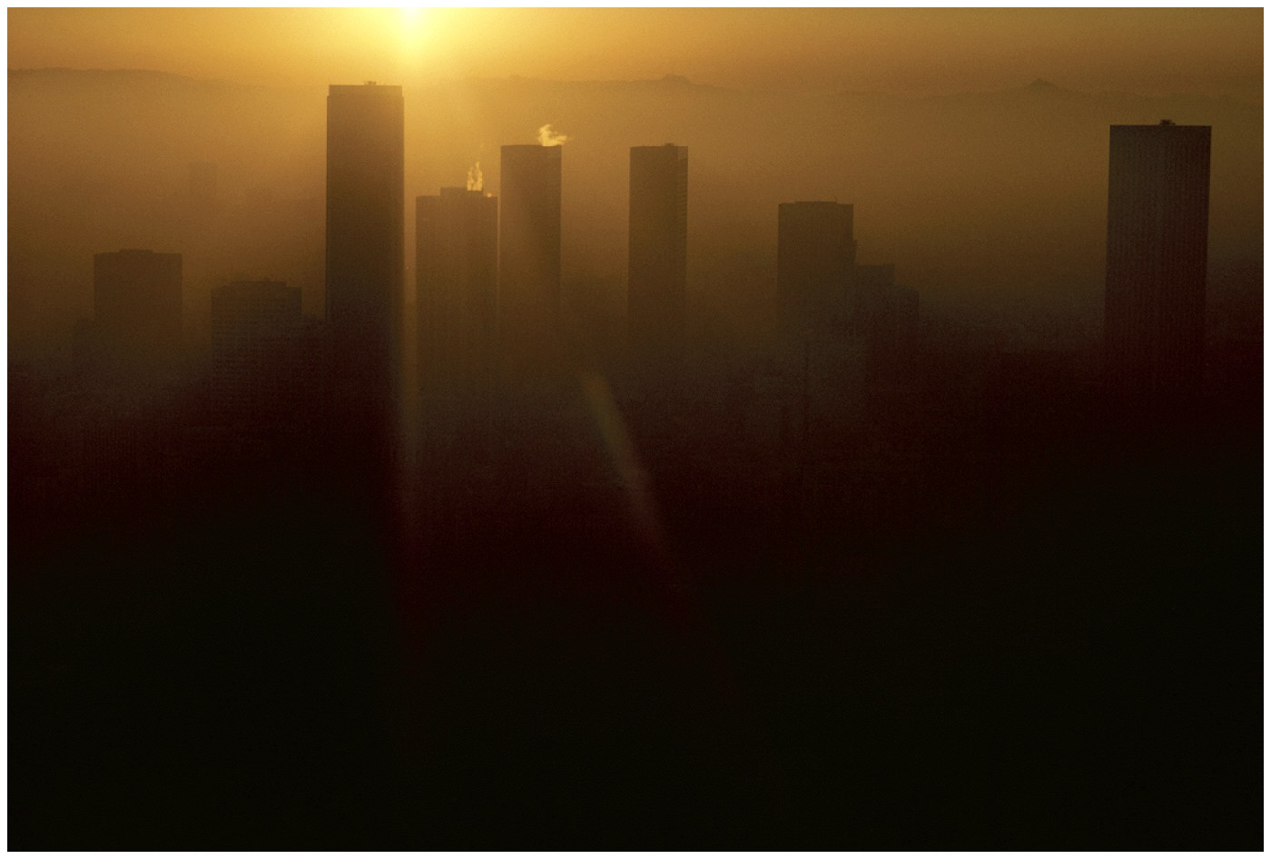
Urban Air Pollution
Photochemical Smog (ex: Los Angeles below)
Brownish-orange haze formed by chemical reactions involving sunlight, nitrogen oxide, and hydrocarbons

Slide 77
Photochemical Oxidants “ Photo Smog”
They are secondary pollutants, produced as result of chemical reactions involving sunlight, NO_{x} , O₂ & HCs.
Formation of Ozone
O₃ is formed in atmosphere, O₂ react with O(³p)
O(³p) : atomic oxygen " molecule free radical O*
Series of reaction initiated by absorption of photon by an atom produce molecule free radical O & [ O (³p) ] .
O2 O* + O* active free radical
O2 + O* O3
λν

Slide 78
Oxidation of NO to NO2
In troposphere , photo dissociation of NO2 (at λ 280 – 430 nm)
Source of atomic oxygen
NO2 + λν NO + O*
NO + O3 NO2 + O2
In atmosphere "urban & nonurban"
O₃ conc. are often higher, that occur from NO₂ photolysis, So , to elevate O3 , is chemical reactions that convert NO , to NO2 without consuming O consuming O3 .

Slide 79
Oxidation of Hydrocarbon
In polluted atmosphere such shifts in O₃ occur in presence of RO₂ " V.O.C" produced by oxidation of HC_{s.}
RO2. + NO NO2 + RO
NO2 + λν NO + O*
O* + O2 + M O3 + M
Net : RO2. + O2 + NO2 + λν RO. + O3+ NO
V.O.C + O2 + NO2 + λν Ald + O3 + NO
In very polluted, O₃ conc. "a function of intensity of sunlight".
NO₂ / NO , HCs & other pollutants , as aldehyde & CO react photo chemically to produce RO₂.
Increase in NO₂ / NO caused by atmospheric reactions involving RO₂ may result in significant increase in O₃ levels

Slide 80
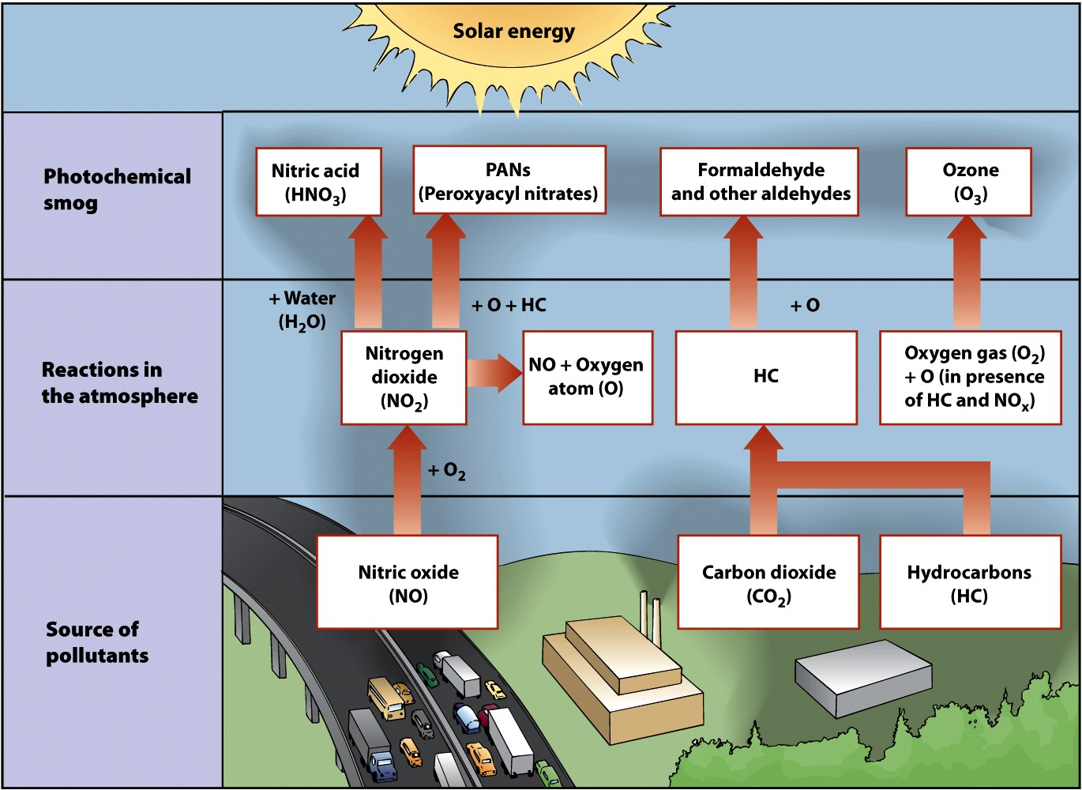
Formation of Photochemical Smog

Slide 81
v Ozone
O₃ conc. :- 0.02 - 0.05 ppm during warmer months of year
Source:
Tropospheric Ozone
Man- made pollutant in the lower atmosphere
Secondary air pollutant
Component of photochemical smog
Major: photochemical processes movement of stratospheric O₃ in the region of so-called "tropopause " into the lower atmosphere . " during spring "
Stratospheric Ozone
Essential component that screens out UV radiation in the upper atmosphere
Man- made pollutants (ex: CFCs) can destroy it

Slide 82
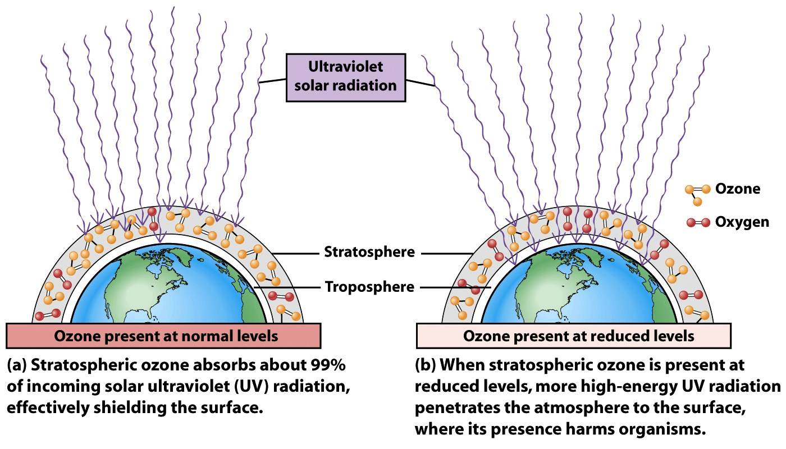
Ozone Depletion in Stratosphere
Ozone Protects earth from UV radiation
Part of the electromagnetic spectrum with wavelengths just shorter than visible light

Slide 83
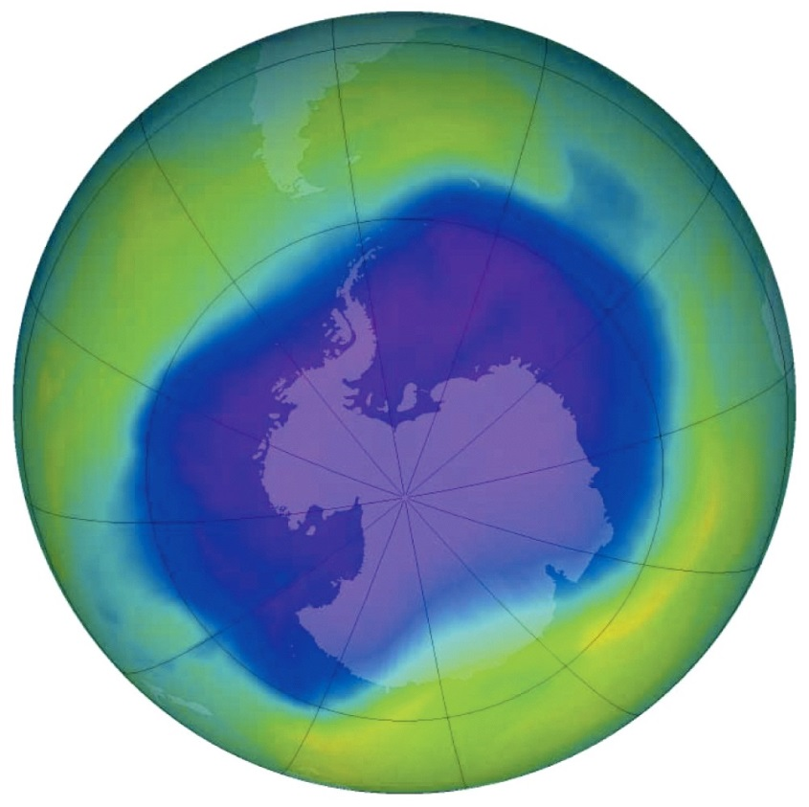
Ozone Depletion in Stratosphere
Ozone thinning/hole
First identified in 1985 over Antarctica
Caused by
human-produced bromine and chlorine containing chemicals
Ex: CFCs

Slide 84
Ozone Depletion in Stratosphere
Hole over Antarctica requires two conditions:
Sunlight just returning to polar region
Circumpolar vortex- a mass of cold air that circulates around the southern polar region
Isolates it from the warmer air in the rest of the planet
Polar stratospheric clouds form
Enables Cl and Br to destroy ozone

Slide 85
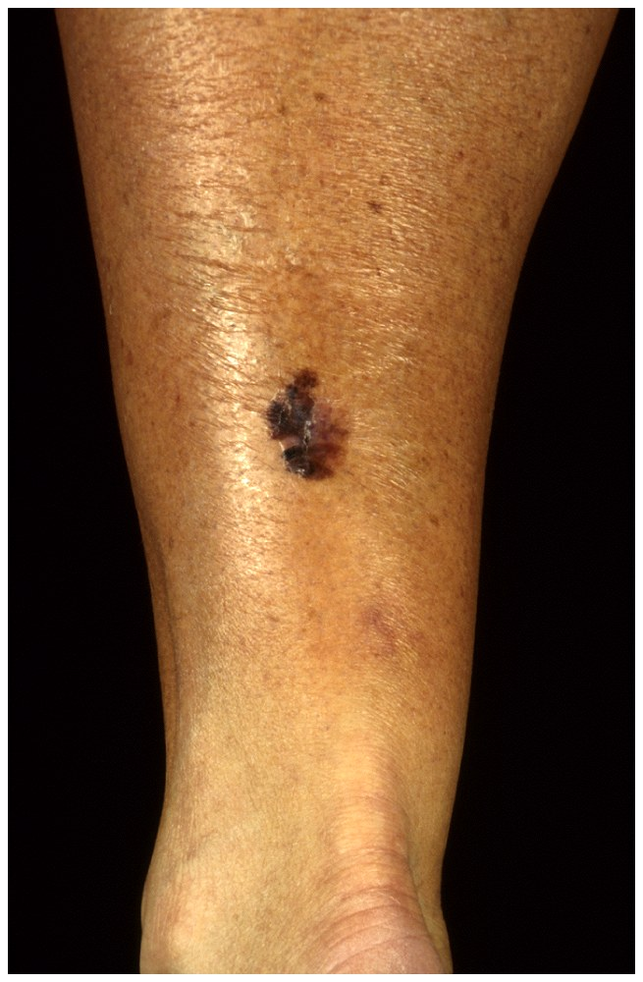
Effects of Ozone Depletion
Higher levels of UV-radiation hitting the earth
Eye cataracts
Skin cancer
Weakened immunity
May disrupt ecosystems
May damage crops and forests

Slide 86
iv Hydrocarbon Compounds
1. Hydrocarbon Chemistry
Hydrocarbon compounds include a large number of chemicals as gases, volatile liquids, semi-volatile substances, and solids.
They contain only hydrogen (H) and C (HCs) and HC
derivatives that contain substances such as O, N, S, or various halogens.
They contain only single bonds are called alkanes or paraffins; straight chained (e.g., CH and ethane (C) branched (e.g., isobutane), and cyclic (e.g., cyclopropane)..
Large molecules contain two or more carbons covalently bonded to each other.

Slide 87
The alkanes or paraffins are unreactive and therefore chemically stable; (n-butane has a relatively long atmospheric lifetime (~5 days).
Hydrocarbons that contain one or more double bonds (alkenes or olefins); the simplest is ethylene (CH).
longer-chained compounds (e.g., propylene and butylene).
Olefinic compounds are very reactive, because double bonds are unstable, as primary reactants in photochemical processes that produce haze and smog. Their atmospheric lifetimes are several hours.
Hydrocarbons; paraffins, olefins, and alkynes, are classified
as aliphatic HCs because of their basic chain structure. Hydrocarbons whose structure is based on the ring structure of benzene (CH) are called aromatic HCs.

Slide 88
Benzene C6H6 , ethyl-benzene, toluene, and xylenes are formulated to produce the fuel additive, (which increases the octane rating of unleaded gasoline.)
Aromatic HCs are commonly found in ambient air, because of their widespread use as solvents and fuel additives
They contain at least three double bonds, aromatic HCs are generally less reactive than olefins. They vary in their reactivity and therefore estimated atmospheric lifetimes (C6H6, ~12 days; toluene, ~2 days; m-xylene, ~7.4 h).
HCs (e.g., m-xylene) are quickly consumed in urban photochemistry, whereas others (e.g., C6H6) are more stable than some of the paraffins.

Slide 89
Aromatic HCs are simple compounds based on a single C6H6 ring.
Benzene rings serve as the basic structural unit of larger, more complex compounds, napthalene (two C6H6 rings) and of polycyclic aromatic hydrocarbons (PAHs).
(PAHs) that are solids under ambient atmospheric conditions as benzo-α-pyrene, which contains five C6H6 rings.
The PAHs are produced in the combustion chemistry of organic fuel and materials and in the elemental C (EC) fraction of atmospheric aerosol. Most PAHs are potential human carcinogens.
Hydrocarbons are described as being saturated with only single bonds; or are unsaturated those with one or more double or triple bonds .

Slide 90
Compounds that contain 1 to 4 C atoms are gases under ambient conditions; those with 5 to 12 C atoms, volatile liquids.
Those with higher C numbers tend to be semi-volatile liquids or solids, or nonvolatile solids.
Hydrocarbon compounds and their derivatives are classified on the basis of their boiling points and volatility.
Very volatile organic compounds (VVOCs) have boiling points that range from 0 to 50–100°C (32 to 122–212°F); VOCs, from 50–100 to 240– 260°C (464 to 500°F); semi-volatile organic compounds (SVOCs), from 240–260 to 380– 400°C (716 to 752°F); and solid organic compounds, >400°C.

Slide 91
Hydrocarbon emissions are regulated by the USEPA.
Because of the low reactivity of CH, HC concentrations in the atmosphere and national emissions estimates are reported as NMHCs.
The USEPA has recently begun to report emission estimates as VOCs (which include both VOCs and VVOCs).
A variety of substances are derived from the basic HC structure. These include, among others, oxygenated and halogenated HCs, both of which represent major atmospheric pollution concerns.
Because they are subject to unique regulatory requirements, halogenated HCs are discussed apart from other NMHCs in this chapter.

Slide 92
2 .Oxyhydrocarbons

Slide 93
3 Nonmethane Hydrocarbons
Sources and Emissions
Emissions of NMHCs and VOCs are regulated in many developed countries because of their role in atmospheric photochemistry.
Anthropogenic sources: mobile and stationary source fuel usage and combustion; petroleum refining; petrochemical manufacturing; industrial, commercial, and individual solvent use; gas and oil production; motor vehicles and gasoline. and biomass burning. emissions of unburned liquefied petroleum gas (LPG) used for heating and cooking.
Emissions associated with gasoline and petroleum-related industries include a variety of paraffinic, olefinic, and aromatic HCs; with natural gas, light paraffins; and with solvents, higher paraffinic and aromatic HCs.

Slide 94
Biogenic Sources: trees and grasslands, and emissions from soils and oceans
Biogenic sources are an order of magnitude higher on a global basis than anthropogenic emissions.
Emissions from
Trees; isoprene and monoterpenes, paraffins and olefins;
Grasslands; light paraffins and higher HCs;
Soils; mainly C2H6
Oceans; light paraffins, olefins, and C9 to C28 paraffins.
Concentrations
Most concentration data are based on measurement of total NMHCs, usually averaged from 6 to 9 A.M. (corresponding to early-morning commuting traffic in urban areas).
Concentrations are determined from flame ionization detector measurements and reported in CH or C equivalents. The air quality standard for this 3-h period is 0.24 ppmv, with most urban concentrations at levels less than this.

Slide 95
These include a large number of short- and long-chained paraffins, a
relatively limited number of olefins, and a variety of aromatic HCs. Para-cymene and isoprene are biogenic in origin.
Acetylene is an indicator of motor vehicle emissions.
Sink Processes
The primary sink process for NMHCs and their oxygenated derivatives:
The oxidative production of alkylperoxy radicals (ROO·) on reaction with OH· or ONO, ROO· is converted to alkoxy radical (RO·), which reacts with O2 to produce aldehydes or, in the case of longer-chained NMHCs, butane, aldehydes, and ketones.
Oxidation of C2H6, a relatively unreactive substance

Slide 96
Ethane oxidation produces CH3CHO, like other aldehydes, reacts more readily with OH· than its NMHC precursor.
As a consequence, CH3CHO reacts with OH· and, by a series of reactions, produces HCHO, which undergoes further oxidation or photodecomposition.
Formaldehyde, CH3CHO, and acetone can photodecompose on absorption of ultraviolet (UV) light in the wavelength range of 330 to 350 nm.
Photodecomposition of HCHO proceeds via either of two pathways. In both cases, photodecomposition produces CO.

