Slide 1

Meteorology
The atmosphere, Air pollution,
and
Global Climate Change
Prof. Maie ElGammal

Slide 2
This course will help you understand:
Composition, structure, and function of the atmosphere
Outdoor air pollution
Stratospheric ozone depletion
Human influences on atmosphere and climate
Effects of climate change

Slide 3
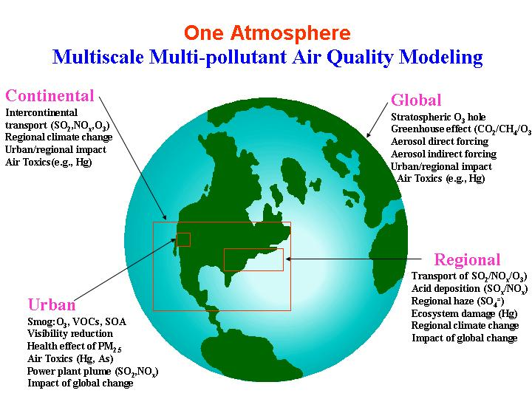

Slide 4
Overview
Meteorological processes that influence air quality
  Sunlight
  Horizontal dispersion
  Vertical mixing
  Transport
  Clouds and precipitation
  Temperature and humidity
Large scale to local scale
Global
Synoptic
Mesoscale
Urban
Neighborhood

Slide 5
To Understand the Atmosphere
Atmosphere
Examine its interfaces
with land/ocean
with space
Sun
nSun
Earth
13,000 km
Is a very thin skin
99% below 50 km (31 miles)
50% below 5.5 km (3.4 miles)
Atmosphere Picture
Energy Flow Solar Input = Output to Space
Space

Slide 6
The Atmosphere
It is maintained in its place - Earth 'gravity- unique to solar system- life
Earth’s atmosphere = the layer of gases that surround the planet
Very thin layer, relative to size of planet
Atmosphere:
  • Absorbs solar radiation
  • Burns up meteors
  • Transports and recycles water, and other chemicals
  • Moderates climate

Slide 7
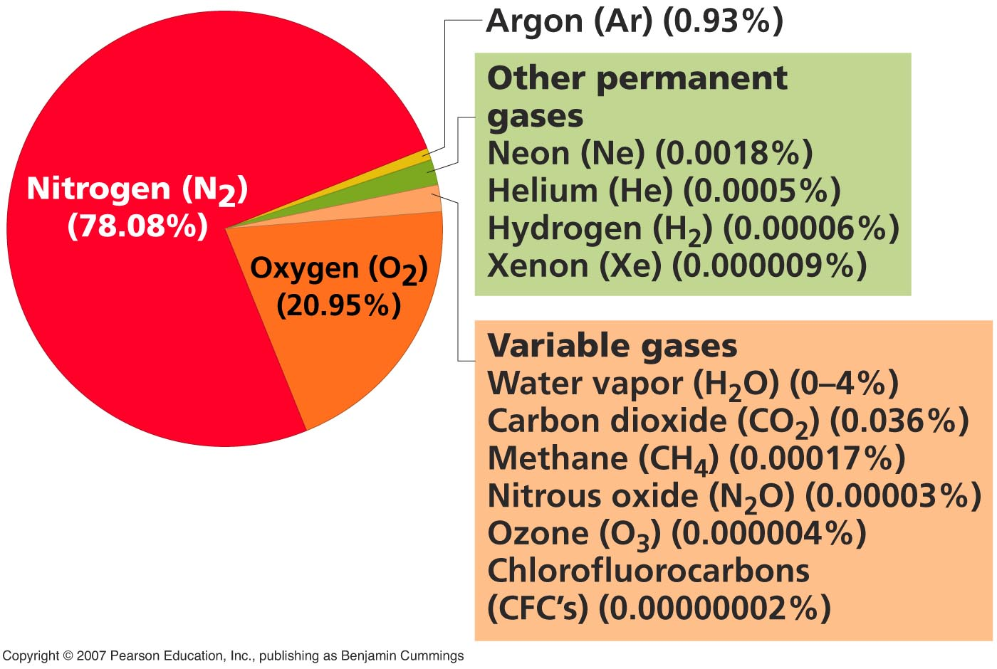
The Atmosphere

Slide 8
Atmosphere Composition
1- CHMICAL COMPOSETIO
Mixture of gases:
A- constant gases
78% nitrogen
21% oxygen
1% argon
B- traces of other gases and variable small amounts of:
water vapor
carbon dioxide
methane
pollutants

Slide 9
B- Trace gases:
Methane (CH4), Carbon Monoxide (CO), Oxides of Nitrogen (NOx), Sulfur dioxide (SO2), Hydrogen Sulfide (H2S) Ammonia (NH3),
B- Trace gases:
Methane (CH₄), Carbon Monoxide (CO), Oxides of Nitrogen (NO_{x}), Sulfur dioxide (SO₂), Hydrogen Sulfide (H₂S) Ammonia (NH₃),
Produced by biological and geological processing:
* Methane (CH₄), Ammonia (NH₃ ),Hydrogen Sulfide biological processing؛(H₂S)
* Methane (CH₄), greenhouse gas, absorbs thermal energy
Produced by biological and geological processing Methane (CH4), Ammonia (NH3 ),Hydrogen Sulfide biological processing؛(H2S)
Methane (CH4), greenhouse gas, absorbs thermal energy

Slide 10
2- PHYSICAL CHARACTERISED
Weather and climate
Weather = a region’s long-term pattern of atmospheric conditions,
local physical properties of the troposphere, including temperature, pressure, wind, humidity, precipitation, cloudiness and other variables
Climate = pattern of atmospheric conditions across large geographic regions over long periods of time (seasons, years, millennia)
“Global climate change = changes in climate on a worldwide scale
Climate changes naturally, and always has, but the recent rapid warming of the planet and its change in atmospheric composition are widely thought due to human activities
Atmosphere is characterized by gases comprise it
Physical phenomena: Solar R, Thermal energy, Density, Pressure
Gravitational Forces Water

Slide 11
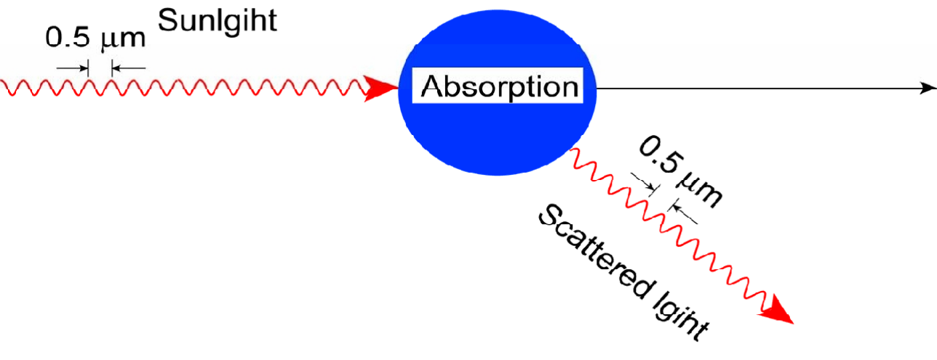
Radiation, atmosphere, and temperature
Light Scattering and Absorption Forcing byAerosols
Direct Radiative
: Absorption
transform to heat
Scattering: redirect the energy
to different directions

Slide 12
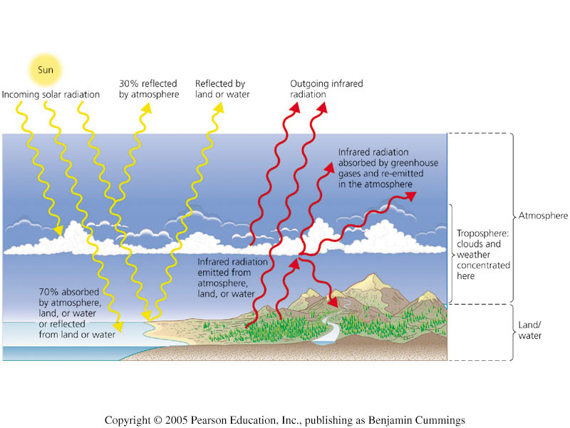
Radiation, atmosphere, and temperature
SUN R. as Black Body Perfect Absorber and Radiating at all λ at Temperature 6000 F
Atmosphere and Earth 'Surface have Enormous Quantity of Electromagnetic E.
T.E Emitted by Sun const= 1.92 cal/cm2/sec
Received by Earth and Atm.
99% of E flux in Spectral R. λ= 0.15- 0.4 μm
50% % of E flux in visible R. λ= 0.4 – 0.7μm green portion of V.R. λ= 0.49 μm
That life process as photosynthesis depend on it

Slide 13
Radiation, atmosphere, and temperature
Earth’s temperature depends on:
How much of the sun’s radiation enters the atmosphere and How much escapes back into space.
Incoming solar radiation is: S.R. Absorbed Short wave
Reflected
1-Absorbed
at the surface by O2, O3, CO2, water vapor, dust, clouds
U.V. absorbed by O2 at λ< 0.18 μm at altitude above 100 km
O3 at λ= 0.2- 0.3μm at altitude below 60 km
5% of S.R. absorbed by Atm. Above 40 km
10- 15% S.R. absorbed by lower Atm. Under clear sky or scattered back to space
80- 85% reaching the ground, however has cloud cover the earth' surface is the prime absorber of S,R. Thus, the troposphere is heated from ground not from sun.

Slide 14
2- Reflected and Scattered
by the atmosphere, or
  by the surface into space
  by particles, cloud droplets and ground
  50% of S.R. reaches the ground under cloudiness conditions
  S.R. is reflected and scattered by cloud droplets and aerosols
  Earth`s Albedo:- Reflection/Scattering of S.R by Atm. Aerosol and ground surface varies depend on angle of incidence of sun`s energy
  Albedo of earth and atmosphere varies with average = 35% due to backscattering associated clouds
  It reflects light that allows us to see Moon and near by Plants in our solar system

Slide 15
  Actually, S.E. is received at earth 'surface is less that Solar constant
  Differences between extraterrestrial S.E. and near earth 'surface due to absorption and backscattering of S.E. by atmosphere
  Molecular as HO2 vapor, CO2 & O3 contain numerous bands absorb
  S.R.:-
  H2O vapor, CO2 absorb in I.R.
  O3 absorb in UV& I.R.
  Thermal R.
  S.R. (short wave) incident on earth' surface and Atm.
  visible light
  absorbed as long wave I.R
  invisible light
Infrared radiation emanating from earth’s heated surface is: emitted into space, or
absorbed by gases and kept in the atmosphere

Slide 16
Radiation, atmosphere, and temperature
Green House Effect
Atmosphere is opaque to λ< 7 and > 14 μm
Atmospheric gases that absorb the emanating radiation are greenhouse gases.
CO2 and H2O absorb > 14 μm (greenhouse effect)
By absorbing and re-emitting this radiation, they warm Earth’s atmosphere and surface, like a greenhouse. This popularly called the greenhouse effect.
transparent to short wave (U.V.) opaque to long wave(I.R.)
The principle of green house construction: glass operates like vapor allowing S.R. pass and blocking reverse R.
Rising concentrations of greenhouse gases in recent decades have resulted in global warming, an increase in Earth’s average surface temperature.

Slide 17
Carbon dioxide increase
Due to:
Burning of fossil fuels: We remove carbon-rich fuels from the ground where they have been stored for millions of years, and combust them in an instant, sending CO₂ into the atmosphere.
Deforestation: Cutting down trees, removing vegetation from the land, decreases the sink for carbon.
Some of the C in plants becomes CO₂ sent into the atmosphere.
Increase of other greenhouse gases
Halocarbon gases (which include CFCs) are powerful greenhouse gases.
Not: But their effects are slowing due to the Montreal Protocol.
Water vapor is the most abundant greenhouse gas. Its future changes, if any, remain uncertain.

Slide 18
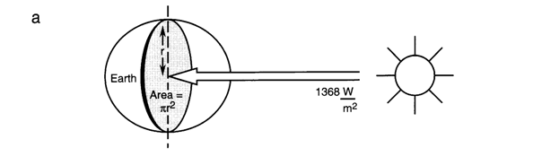
Atmosphere Motion
Constant motion
Occurs in both horizontal and vertical dimension By thermal energy from earth’s surface and air molecules above
Temperature Variation
Atmosphere is transparent, only surface is heated
– Loss by convection + re-radiation
– Shape of atmospheric temperature profile
In the absence of local heating, T decreases with height
SR increase at Equatorial R. & decrease at Polar R.
because of direct function of the angle of inclination of Sun
Though, Equator received most SR, Thermal E does not accumulate, nor increase IR back to space. Rather, thermal E. transferred by air & ocean to polar.
So, Warm current move to Polar R, Cold current move to Equatorial R.
The differential heating of the earth’s surface results in E flows from equator poleward

Slide 19
i.e. Heat transfer occurs as result of:
Evaporation and Condensation
Evaporation of water requires E. absorbed from Atmosphere. and stored in water vapor Condensation, E is released because Evaporation occur near earth's surface & Condensation occur
upper of troposphere. So, Ev./Cond. move from lower R. to higher R.
Conduction
Transferee of heat from earth to atmosphere through conduction by direct physical contact of air and earth
As, particles of air downward decrease, contact with warmer ground and take heat into atmosphere
Convection
Bouncing of warmer air increase and sinking of cold air
Major force in transfer heat for earth to troposphere
A primary factor in movement of air on macroscle
Unequal Distribution of SR on Earth’s atmosphere and Heat Transfer processes cause Temperature Variation and Regional Climate
Changes in earth's inclination to sun that occur over year`s time result in temporal and climatic difference with seasons

Slide 20
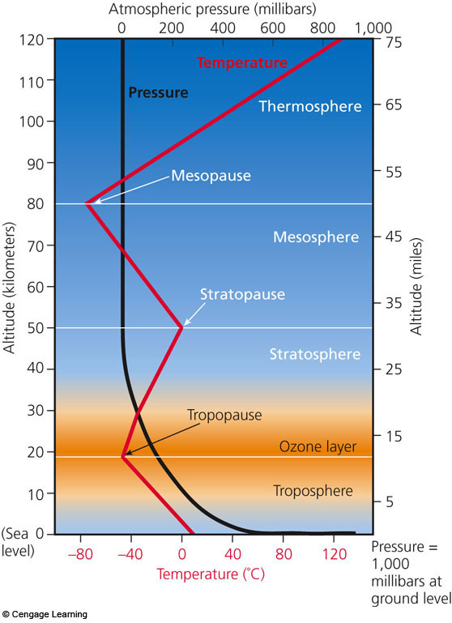
Significant variations in temperature also occur in the vertical dimension that describe various zones
Temperature and other characteristics vary with altitude.
Ozone layer
Tropopause marks boundary between troposphere and stratosphere. Layers don’t mix

Slide 21
Atmospheric layers: consists of several layers:
Troposphere = bottom layer, at Earth’s surface. 10 km (12 km over equator & 8 km over polar) high. Temperature decreases with altitude at average -6,5 C°/km.
Unstable because:
Intense movement of thermal E
Significant temperature differences, day by day, temperature, cloud and precipitation changes occur weather
Tropopause: tope of troposphere and below stratosphere
temperature is isothermal (no change in temperature)
Stratosphere: next layer up (11–50 km).
Temperature increases with altitude to 0C°/km. Contains “ozone layer.” ,high O3 concentration between (25- 40 km) and above 35km efficiency absorbs UV
Stable region, little manifestation (weather), few clouds and winds are primarily horizontal.
Mesosphere: Third layer up (50–90 km). Temperature decreases with altitude. Exosphere: Light molecules (H2 and He) lost to space

Slide 22
Thermosphere = Top layer (90– more than 1000 km). Very thin air; mostly lightweight elements.
No definite upper limit
Contain a minute fraction of atmosphere's mass
Temperature exceed 1000 0C°/km due to absorption of very short wave solar R. by few molecules of N2 & O2
Although, temperature, an object in thermosphere is unlikely to become hot because too few molecules present to transfer their energy to it
Atmosphere is electrically charged at 90- 400km
O2&N2 become photoionized produce electric current
Ionosphere
Reflects AM radio signals back earth nigh time
Following intense solar activity, aurora borealis (northern lights) & aurora australis (southern lights) may occur produced solar storms which emit (protons& electrons) captured by earth`s magnetic field

Slide 23
Atmospheric Density and Pressure
Density
Concentration of molecules (comprise atmosphere) decrease with height
As, molecules become fewer, their mass/ unit volume (density) is exponential:-
9% of mass of atmosphere 12km
99% of mass of atmosphere 33km
Total mass of atmosphere = 5×10¹⁸ kg
As, density decrease with height, atmospheric pressure decrease

Slide 24
Pressure
Force/unite area produced when air molecules in const motion, strike an object, rebound and transferred momentum to it
Amount of momentum transferred is
a function of average kinetic E of air molecules
Proportional absolute temperature
At high temperature, molecules have high kinetic E, thus move more rapidly.
As, they strike an object, more momentum is transferred result the force is greater. i.e pressure is high
An object on earth` surface supports a vertical column of air, this column exerts a force on object equal its weigh
Near sea level, this force (atmospheric P°) at the greatest value
The weigh of atmosphere above it at maximum
At sea level, P= 1,1013x 10⁵ N/m² = 1010 mbar, 760 mmHg

Slide 25
Horizontal and vertical pressure differences occur in troposphere result of changes in thermal conditions
As, Air warms, it expands, density & P decrease
Air cold, density & P increase
Significant P° differences in horizontal dimension occur in both cyclonic & anticyclone air mass system

Slide 26
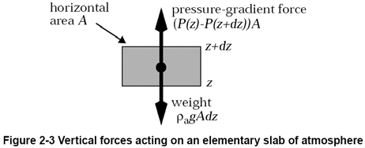
Pressure Variation
Pressure gradient force
Horizontal air movements result from temperature gradients result to density gradients increase & pressure gradients (the force with this pressure gradient force)
The direction of this force is perpendicular to lines of equal pressure (Isobars) from high to low pressure
Regional differences in atmospheric P° indicated by isobars
If isobars are close together, P° gradient force is large and high wind speeds. If isobars are widely spaced (as in high P° system )
pressure gradient force is small & winds are light
Coriolis effect : in large scale (Macroscale), north or south movements, air appears to be deflected from its expected path
Air moving poleward in the (northern hemi) appears to deflected to east
Air moving southward in (southern hemi) appears to deflected to west
This deflection is due to earth 'rotation

Slide 27

High Pressure
Under Stable Condition
Clear Skies , Light Winds , Atmospheric: Stability
Vertical motion of air downward
Horizontal motion of air Is clockwise
Temperature and humidity vary over great area
Any weather change gradual
The dispersion of pollutants are undesirable level
Low Pressure
Under Unstable Condition
Cloudy skies , Gusty winds, Atmospheric: Instability
Vertical motion of air upward
Horizontal motion of air Is counter clockwise
The dispersion of pollutants are minimal

Slide 28
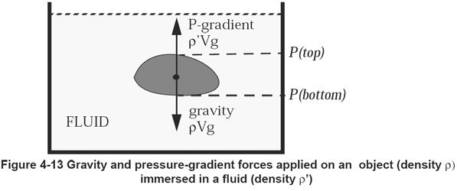
Gravity Is held closely to earth`s surface by gravitational force according to Newton `low
F= G m₁m₂ /r²
m₁m = masses of 2 bodies
G = universal constant of 6.67x 10-11m2/kg2
R = distance between bodies
Gravity: 1- affects 1- vertical air motion
2- planetary air circulation
Because of density changes associated with thermal conditions
2- Play a significant role in removing atmospheric aerosols

Slide 29
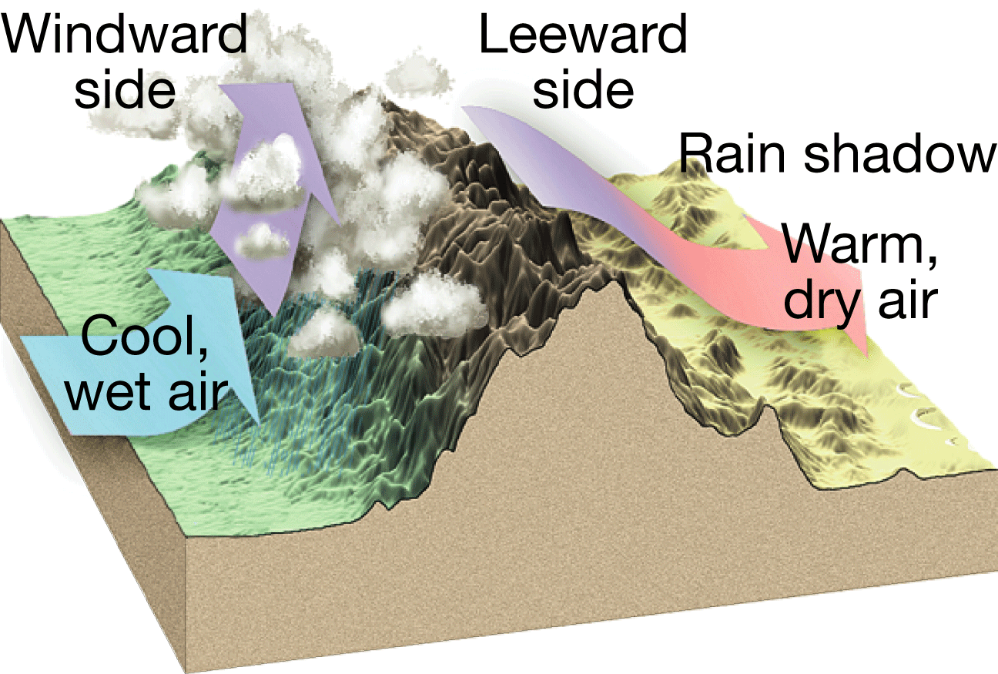
wind

Slide 30
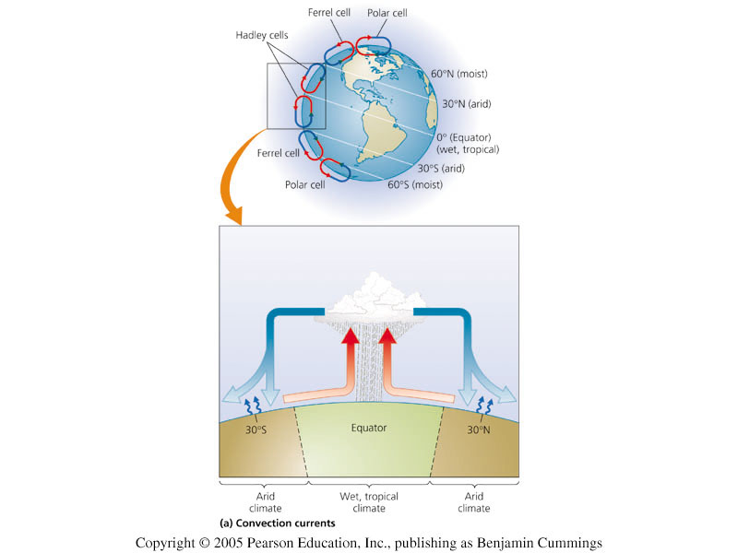
Global convection currents
Hadley cells: air rises at equator, falls at 30º latitude.
Ferrel cells: air falls at 30º, rises at 60º.
Polar cells: air rises at 60º, falls at 90º.
Figure 11.10a

Slide 31
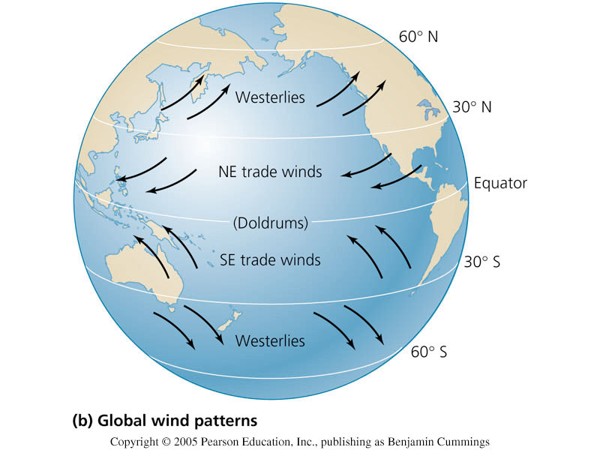
Global wind patterns
Global climate patterns result from:
-Differential heating of Earth’s surface
-Gigantic convection currents called Hadley cells, Ferrel cells, and polar cells
.
These 3 types of cells also influence wind patterns near the ground.
The Coriolis effect (planet’s rotation causes land at the equator to spin more quickly than temperate land) causes north-south winds to appear to be deflected, and to curve.

Slide 32
Air pollution dispersion and modeling

Slide 33
Horizontal dispersion and transport
Synoptic-scale
Winds are driven by large high- and low-pressure systems
Meso- and local scale
- Create stagnation and recirculation
- Local flows are often difficult for weather models to predict but can be predicted by forecasters with knowledge of the area
- Types
Land/sea or lake breeze
Mountain/valley
Terrain forced
Diurnal cycles
Surface vs. boundary layer
- Transport at different vertical levels
- Mixing during the day affects winds

Slide 34
Air Pollution Occurrences
The most obvious factor influencing air pollution is the quantity of contaminants emitted into the atmosphere.
However, when air pollution episodes take place, they are not generally the result of a drastic increase in the output of pollutants; instead, they occur because of changes in certain atmospheric conditions.
Two of the most important atmospheric conditions affecting the dispersion of pollutants are:
  (1) the strength of the wind and
  (2) the stability of the air.

Slide 35
Air Mixing
The direct effect of wind speed is to influence the concentration of pollutants.
Atmospheric stability determines the extent to which vertical motions will mix the pollution with cleaner air above the surface layers.
The vertical distance between Earth's surface and the height to which convectional movements extend is called the mixing depth. Generally, the greater the mixing depth, the better the air quality.

Slide 36
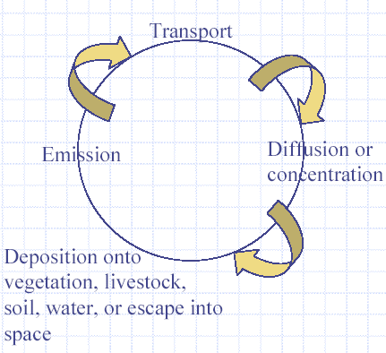
Air Pollutant Cycle

Slide 37
Air pollution dispersion
Mainly follows three laws:
  Mass transfer: pollutants has mass, and models use this mass
  Momentum transfer: depends upon movement of pollutants, advection= flow and wind rose diagram helps in understanding it
  Heat transfer: depends upon lapse rate (change of temperature / increase in height), vertical transport is convective results in heat island
  In case of stack monitoring all these above stated things are important

Slide 38
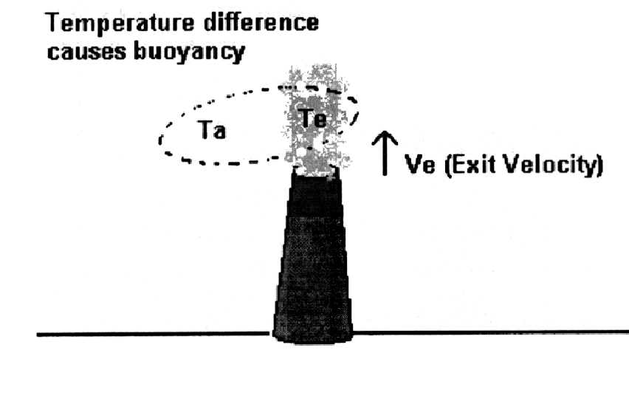
Buoyancy = plume rise

Slide 39
Atmospheric Stability
Important characteristic of atmosphere is ability to resist vertical motion: stability
Affects ability to disperse pollutants
When small volume of air is displaced upward
  Encounters lower pressure
  Expands to lower temperature
  Assume no heat transfers to surrounding atmosphere
  Called adiabatic expansion

Slide 40
Adiabatic Expansion
To determine the change in temp. w/ elevation due to adiabatic expansion:
  Atmosphere considered a stationary column of air in a gravitational field
  Gas is a dry ideal gas
  Ignoring friction and inertial effects
  ( dT/dz)adiabatic perfect gas = - (g M/ Cp)
    T = temperature
    z = vertical distance
    g = acceleration due to gravity
    M = molecular weight of air
    Cp = heat capacity of the gas at constant pressure
( dT/dz)adiabatic perfect gas = -0.0098°C/m or
( dT/dz)adiabatic perfect gas = -5.4°F/ft
Change in Temp. with change in height

Slide 41
Lapse rate
Lapse rate is the negative of temperature gradient
Dry adiabatic lapse rate =
Metric:
Γ = - 1°C/100m or
SI:
Γ = - 5.4°F/1000ft
Important is ability to resist vertical motion: stability
Comparison of Γ to actual environment lapse rate indicates stability of atmosphere
Degree of stability is a measure of the ability of the atmosphere to disperse pollutants

Slide 42
Atmospheric Stability and dispersion
Atmospheric Stability affects dispersion of pollutants
Temperature/elevation relationship principal determinant of atmospheric stability
Stable
  Little vertical mixing
  Pollutants emitted near surface tend to stay there
  Environmental lapse rate is same as the dry adiabatic lapse rate
4 common scenarios
Stability Classes
Developed for use in dispersion models
Stability classified into 6 classes (A – F)
A: strongly unstable
B: moderately unstable
C: slightly unstable
D: neutral
E: slightly stable
F: moderately stable

Slide 43

  Lapse rate
  The temperature of ambient air decreases with increase in altitude
  Lapse rate : he rate of temperature change
  The ambient lapse rate: the temperature gradient of ambient air determined by sending up a balloon equipped thermometer
  (A specific parcel of air) temperature is greater than ambient air tend to rise until its temperature and density = ambient air
  Thus a parcel of artificially heated air ( stack gas) ……. Rise, expands, lighter and cools
  ( the lapse rate without a raising parcel of air ) different from ( the ambient lapse rate )
  Under a adiabatic condition “ without addition or loss of heat”

Slide 44

  (a raising parcel of air) expands until its density = the ambient air , without heat change between the raising parcel and the ambient air
  ( expansion of air) receive heat energy from the earth
  The adiabatic lapse rate : the rate of temperature decrease against altitude under adiabatic condition
  The dry adiabatic lapse rate : dry air temperature adiabatically at – 10 ⁰c / 100 m

Slide 45
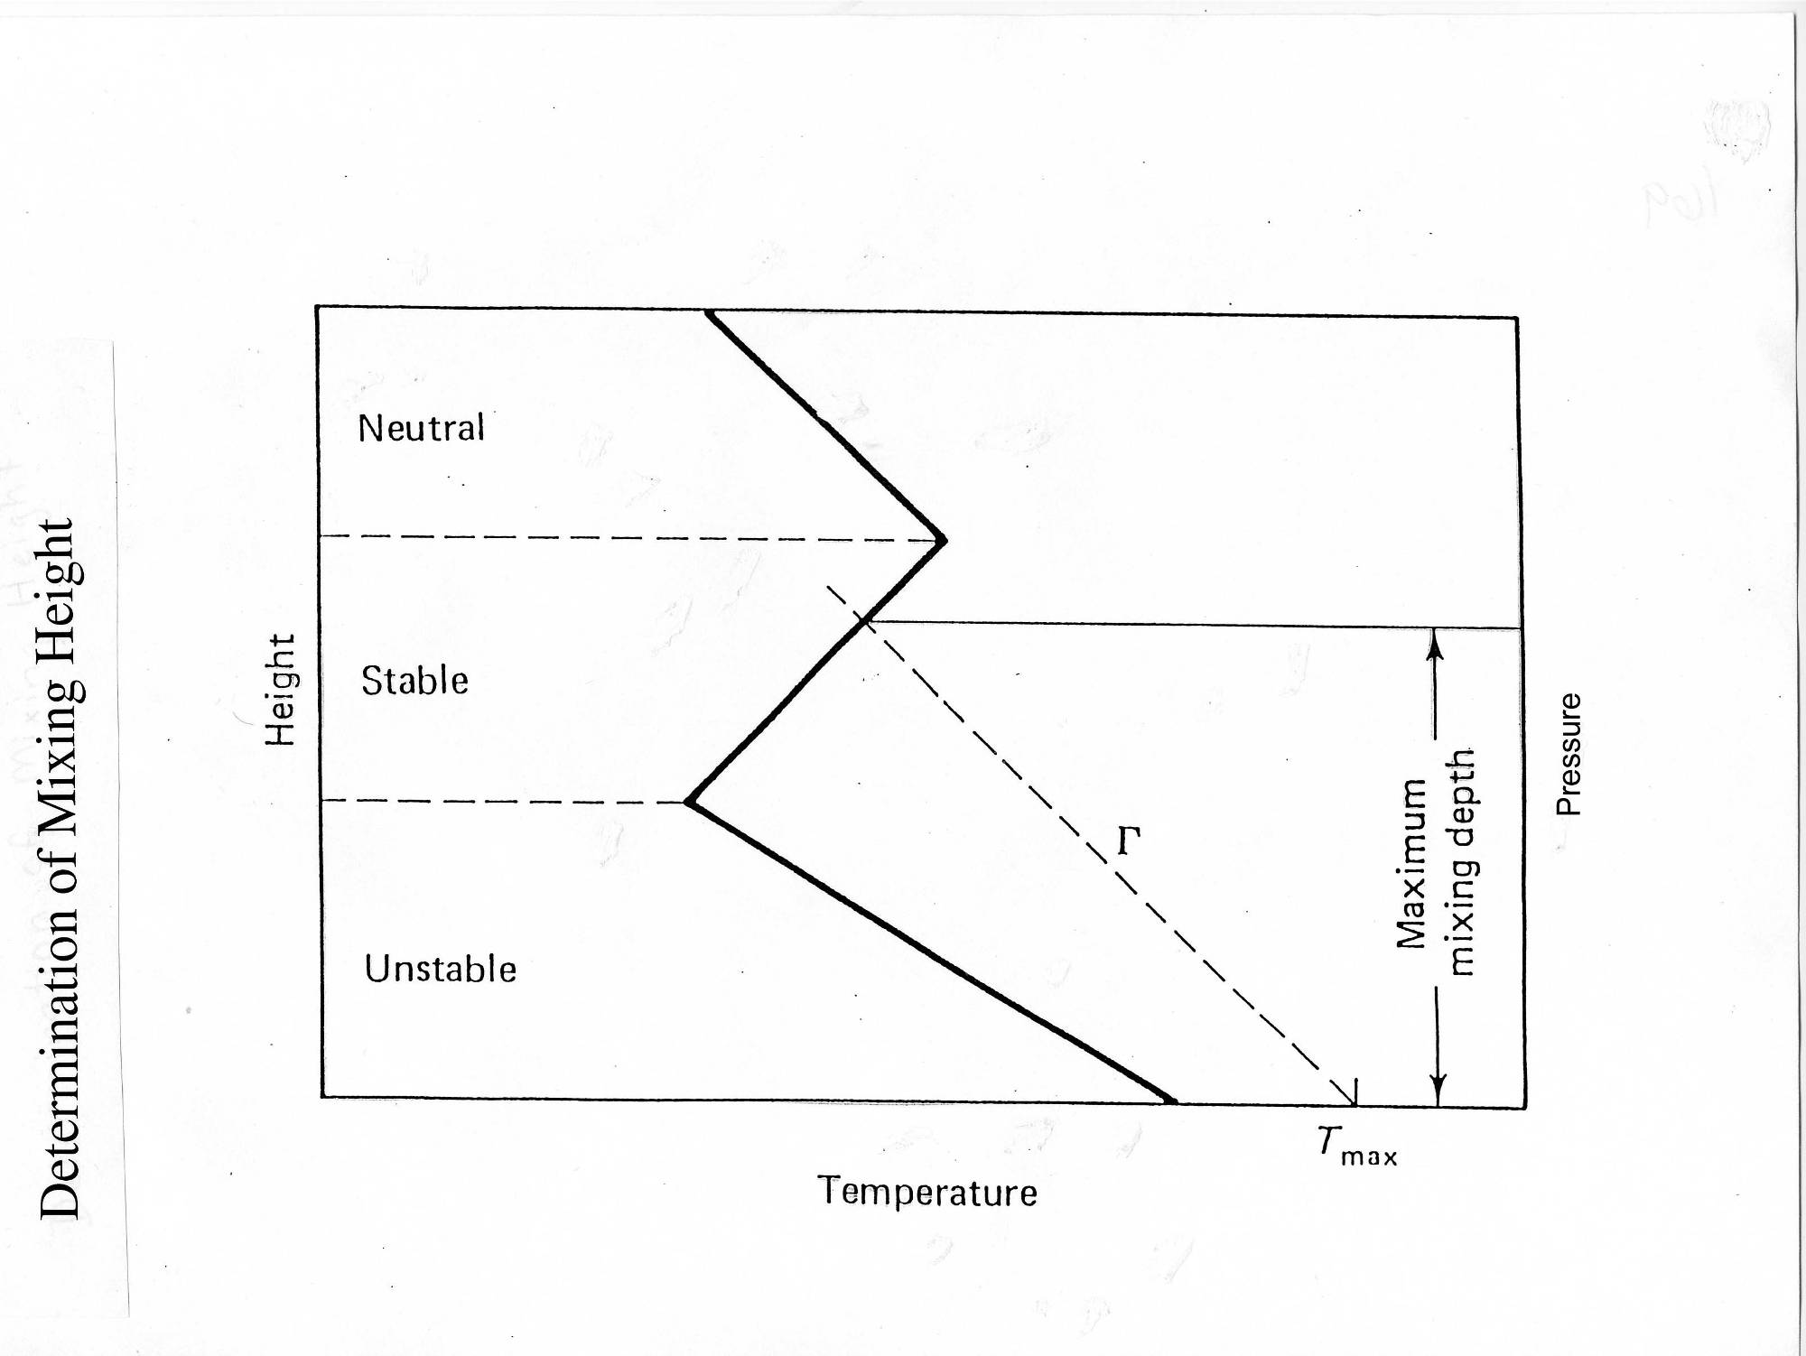
Due to comparison between adiabatic lapse rate (air pollutant / ALR) and environmental lapse rate (ambient air / ELR) results in various stability conditions

Slide 46
The Relation of Environmental Laps Rtes to Stability
DALR
subadiabatic
Inversion
Super adiabatic
Dry adiabatic lapse rate = neutral
Unstable ( Super adiabatic)
A rising parcel of air remains warmer than the ambient air
Since, a parcel continue to accelerate in the direction of the displacement
The ambient lapse rate is super adiabatic
Atmosphere is unstable
Temp. of ambient lapse rate is greater than dry adiabatic
Stable (Sub adiabatic)
A rising parcel of air is colder and denser than ambient
The resultant downward buoyancy form pushes the parcel of air earthward and away from the direction of displacement
The ambient lapse rate is sub adiabatic
Atmosphere is stable
Temp. of ambient lapse rate is less than dry adiabatic

Slide 47
Neutral
Ambient lapse rate equal adiabatic lapse rate
If temp. decrease with height = the cooling rate of parcel
Atmos. has neutral stable

Slide 48
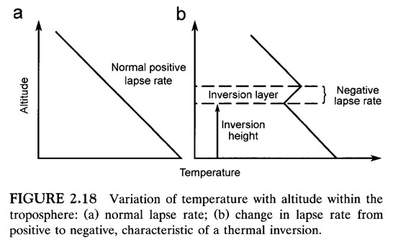
Temperature Inversions
Isothermal : if temp. is constant through a layer of atmosphere
Ambient lapse rate = zero
Atmosphere is stable, dispersion is limited
Inversion layer”: temperature increases with height, if temp of ambient increase rather than decrease
Ambient lapse rate = negative or invert from normal state which air blankets colder air
Atmosphere has high degree of stability

Slide 49
Inversions
Temperature inversions represent a situation in which the atmosphere is very stable and the mixing depth is significantly restricted.
When an inversion exists and winds are light, diffusion is inhibited and high pollution concentrations are to be expected in areas where pollution sources exist.
Surface temperature inversions form because the ground is a more effective radiator than the air above.
Inversions aloft are associated with sinking air that characterizes centers of high air pressure (anticyclones).

Slide 50
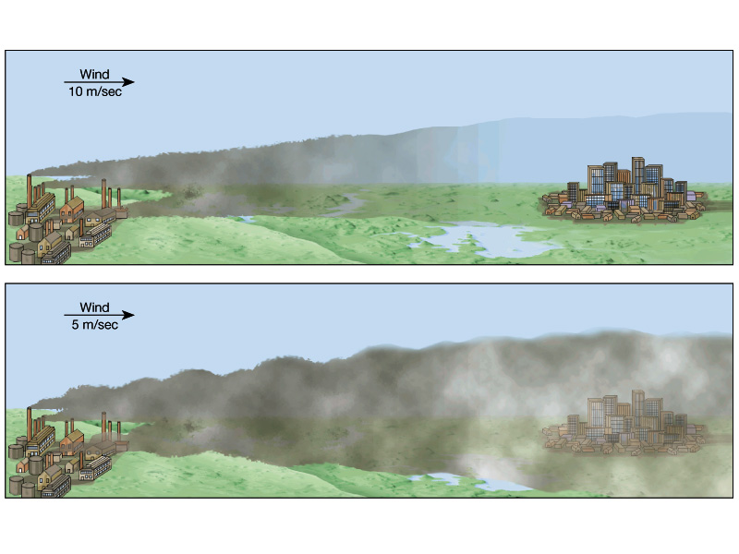
Inversion

Slide 51
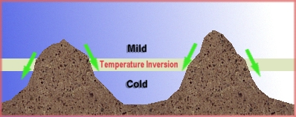

Slide 52
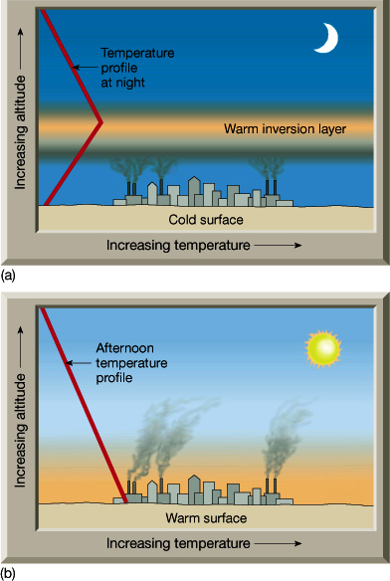
This is an example of a generalized temperature profile for a surface inversion.
Temperature-profile changes in bottom diagram after the sun has heated the surface.

Slide 53
This is an example of a generalized temperature profile for a surface inversion.
Temperature-profile changes in bottom diagram after the sun has heated the surface.

Slide 54
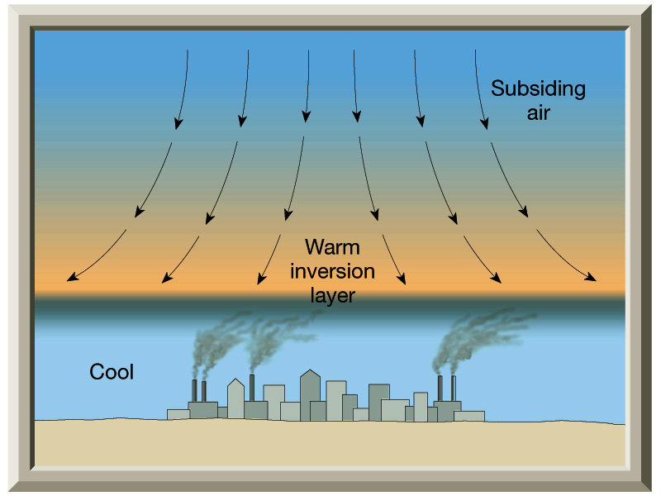
An Inversion Aloft
Types of inversion
1- Irradiation Inversion arising from unequal cooling rates of the earth and the air above the earth; extended a few hundred meters into the friction layers
Nocturnal Phenomenon that breaks up easily with the rays of morning sun
It prompts the formation of the fog and traps gases and particulates, creating concentration of pollutants
Subsidence Inversion associated with high pressure, caused by the sinking motion of air in high pressure
Air circulating around stationary high descends slowly, as air descends, it is compressed and heated forming a blanket of warm air over the cooler air
Thus create inversion prevents the vertical movement of air

Slide 55

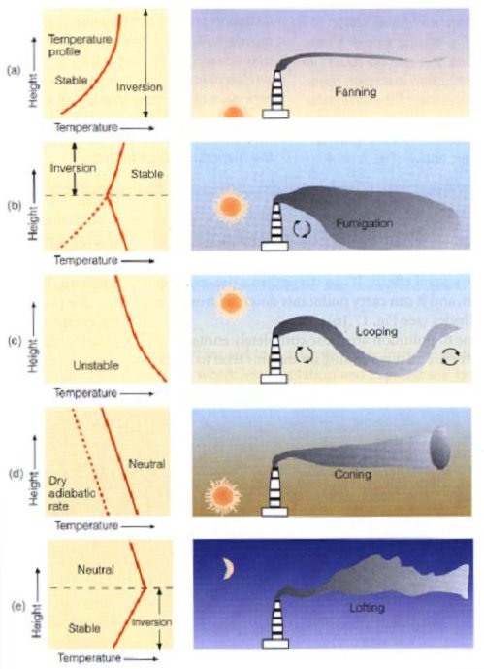
Vertical Temperature Profiles
  Environmental lapse rate (ELR)
  Dry adiabatic lapse rate (DALR)
  If,
  ELR > DALR =sub adiabatic condition, atmosphere is stable.
  ELR >> DALR= Inversion conditions. Very stable atmosphere.
  ELR= DALR= atmosphere is neutral.
  ELR< DALR = super adiabatic condition, atmosphere is unstable.
  Shapes of plumes depends upon atmospheric stability conditions.

Slide 56
The vertical distance between Earth's surface and the height to which convectional movements extend is called the mixing depth. Generally, the greater the mixing depth, the better the air quality.
Maximum mixing depth
The dispersion of pollutants in the lower atmosphere is greatly aided by the convective and turbulent mixing that takes place. The vertical extent to which this mixing takes place depends on the environmental lapse rate which varies diurnally, from season to season and is also affected by topographical features. The depth of the convective mixing layer in which vertical movement of pollutants is possible, is called the maximum mixing depth (MMD).

Slide 57
Plume Characteristics
Plume types are important because they help us understand under what conditions there will be higher concentrations of contaminants at ground level.
As a plume moves downwind of a source, it expands by diffusion in both horizontal and vertical dimensions.
Plumes take forms and behavior patterns that reflect stability conditions in the atmosphere.

Slide 58
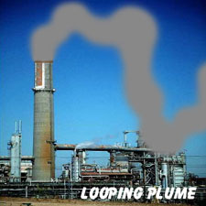
Looping Plume
High degree of convective turbulence
Super adiabatic lapse rate -- strong instabilities
Associated with winds.
There is a significant initial plume rise and a subsequent “looping” motion.
This motion results from portions of the plume being buoyed up by convective rising, with subsequent descending of air.
Upward and downward air motion is considerable. Since eddies that produce this motion are oriented in all directions, significant horizontal dispersion takes place as well.
High probability of high concentrations sporadically at ground level close to stack.
Occurs in unstable atmospheric conditions.

Slide 59
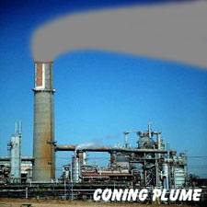
Coning Plume
lapse rates are neutral to isothermal.
Associated with overcast moderate to strong winds.
lapse rates occur on cloudy or windy days or at night.
Pollutants travel fairly long distances before reaching ground level in significant amounts
As such, the atmosphere is slightly unstable to slightly stable.
Atmospheric turbulence is primarily mechanical; turbulent eddies may have different orientations that result in dispersion in a relatively symmetrical pattern.
Occurs in neutral atmospheric conditions

Slide 60
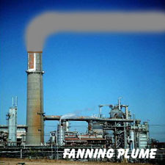
Fanning Plume
Occurs under large negative lapse rate
It is produced under stable conditions in
which the top of a ground-based inversion is well above the stack.
Little turbulence
If plume density is similar to air, travels downwind at same elevation
The plume rises slightly, there being little vertical air movement and dispersion. Horizontal motions, however, are not inhibited.
As a consequence, the plume may be characterized by varying degrees of horizontal spreading.

Slide 61
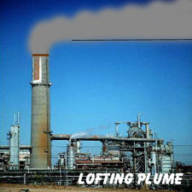
Lofting Plume
A lofting plume may be produced when the atmosphere above a surface inversion is unstable, with the stack above the surface based inversion.
The plume rises upward as its downward movement Is restricted by the inversion beneath it.
Lofting plumes are produced at sunset on clear nights.
Favorable in the sense that fewer impacts at ground level.
Pollutants go up into environment.
Over open terrain.

Slide 62
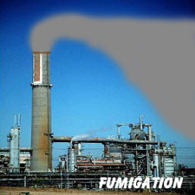
Fumigation
A fumigating plume is produced when a surface based inversion breaks up after sunrise. Pollutants are all coming down to ground level by the downward movement of convective cells. So most dangerous plume.
They are created when atmospheric conditions are stable above the plume and unstable below.
This happens most often after the daylight sun has warmed the atmosphere, which turns a night time fanning plume into fumigation for about a half an hour.
When inversions occur both above and below a smokestack, the plume is trapped; in appearance it is somewhat similar to, but deeper than, a fanning plume.

Slide 63
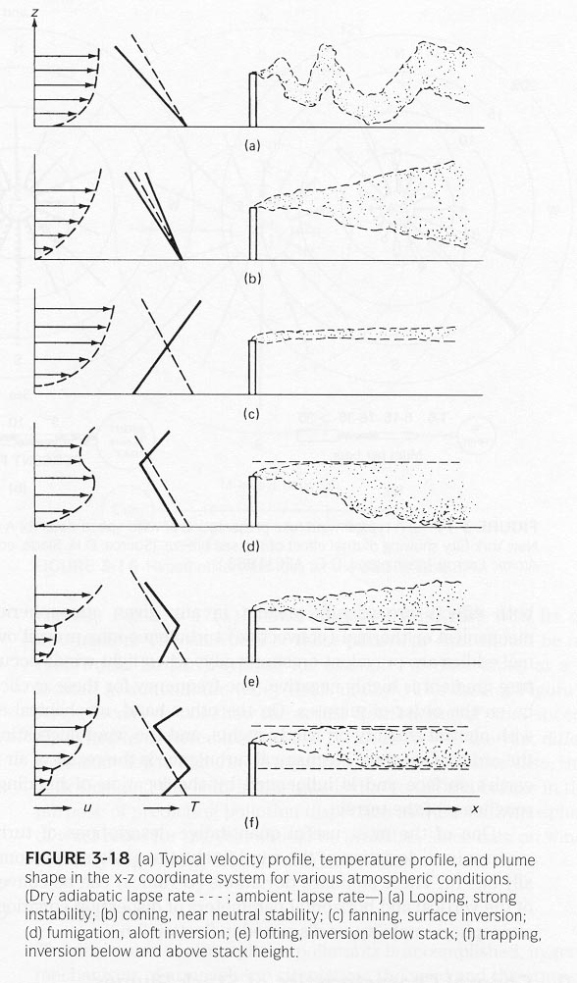

Slide 64
As plumes move downwind, they generally mix with air that is less polluted.
Such mixing occurs as a result of diffusion, advection, displacement, convection, and mechanical turbulence. Consequently, concentrations decrease with downwind distance.
Depending on their height and atmospheric stability, plumes may reach the ground within a few kilometers of a source or may remain airborne for extended distances.
Plumes can be seen because of the presence of light-scattering particles.
Plumes became less and less visible as particle concentrations decrease as a result of dilution.

Slide 65
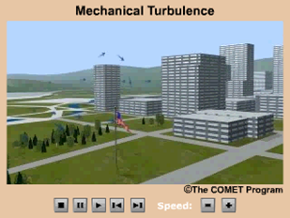
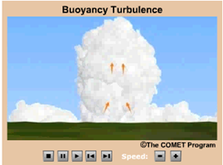
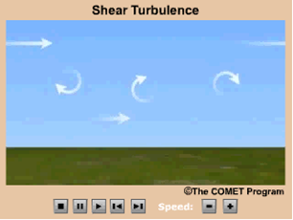
Winds – Dispersion
Disperse pollutants – the spreading of atmospheric constituents
Dispersion is a dilution process
  Molecular diffusion
  Atmospheric turbulence
  Mechanical
  Shear
  Buoyancy (convective)

Slide 66
Winds – Transport
Pollutant transport – movement of pollutants from
one area to another by the wind
Types
  Neighborhood scale: monitor
  to monitor
  Regional scale: city to city
  and state to state
  National scale: country to
  country.
  Global scale: continent to
  continent

Slide 68
Air Motion
Horizontal winds play a significant role in transport and dilution of pollutants
Wind Speed

Slide 69

High pressure ( Anticyclones):
  Anticyclones may significantly affect the dispersion of pollutants over large regions
  Cool air descends from aloft to form a tropical Hadley cell
  This descending is subsiding air produces semi permanent marine high pressure systems major world's major oceans
  The subtropical marine high shift this position toward the poles in summer & the equator in winter
  As the cool air descends , it is warmed adiabatically so that air aloft has a higher temperature than that below
  This results in a subsidence inversion

Slide 70
Water Bodies
Large bodies of water such as lakes and oceans have an important effect on the temperature of an area because the temperature of the water body influences the temperature of the air above it.
Atmospheric Circulation
Global winds are another factor that influences climate because they distribute heat and moisture around Earth.
Humid Tropical Climates
Humid tropical climates are without winters.
Every month in such a climate has a mean temperature above 18ºC. The amount of precipitation can exceed 200 cm per year
Wet Tropical
Wet tropical climates have high temperatures and much annual precipitation

Slide 71
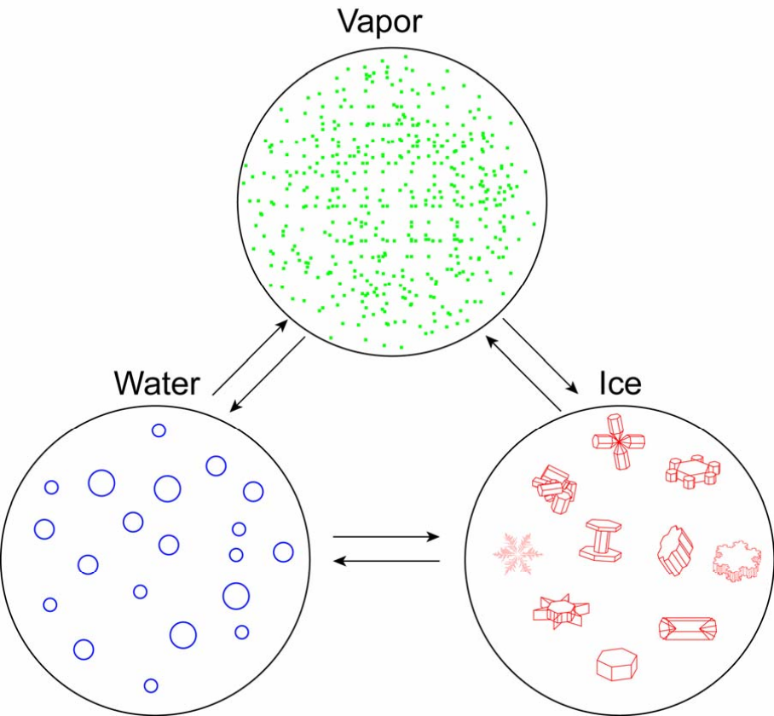
Clouds and Aerosols
Atmospheric water (H₂O) has three thermodynamic phases: may be found in certain cloud
water vapor in molecular form~ 4-10μm)
liquid water droplets in spherical shape (~ 1-20 µm)
ice crystals in various shapes (~ 10-1000 μm. (
Formation of water droplets and ice crystals requires the presence of aerosols as nuclei.
Transformation of H₂O from one phase to another call Weather

Slide 72
Relative Humidity (RH)
 Relative humidity is defined as the ratio of the amount of water vapor in the air to the amount of water vapor that air would hold if it were saturated.
So completely saturated air has a RH of 100% If the air has half as much water vapor as it can hold, the RH is 50%.
Without the presence of aerosols (condensation and ice nuclei), formation of clouds cannot occur at a RH > 400% a condition that is impossible for the Earth’s atmosphere.
With the assistance of aerosols, clouds can form and produce precipitation in an atmosphere with a RH less than 100 %

Slide 73
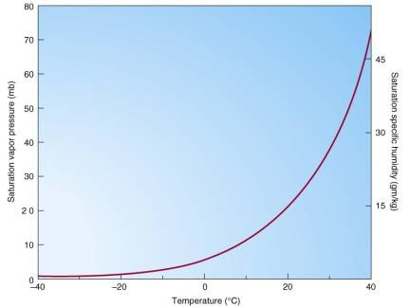
As air becomes cooler, its capacity to hold water in vapor form decreases significantly is known as the Clausius-
Clapeyron relationship.
This means that if air containing water
vapor cools down, it will eventually become saturated with water vapor.
As the air cools
further, enough water vapor
condenses (with the help of aerosols) into droplets to maintain the air at its saturation point.

Slide 74
In the lowest 10 km of the atmosphere temperature decreases with height .
So when warm air rises from the surface, it cools Because of the
Because of the Clausius- Clapeyron relationship, this often means that the air is quickly brought to saturation.
Condensation begins, and clouds formIf the air is especially
buoyant, condensation continues, causing the water droplets to increase
in size.
Eventually the water droplets are so large they begin to coalesce and
fall as precipitation.
For this reason, rising motion is often associated with precipitation.

Slide 75
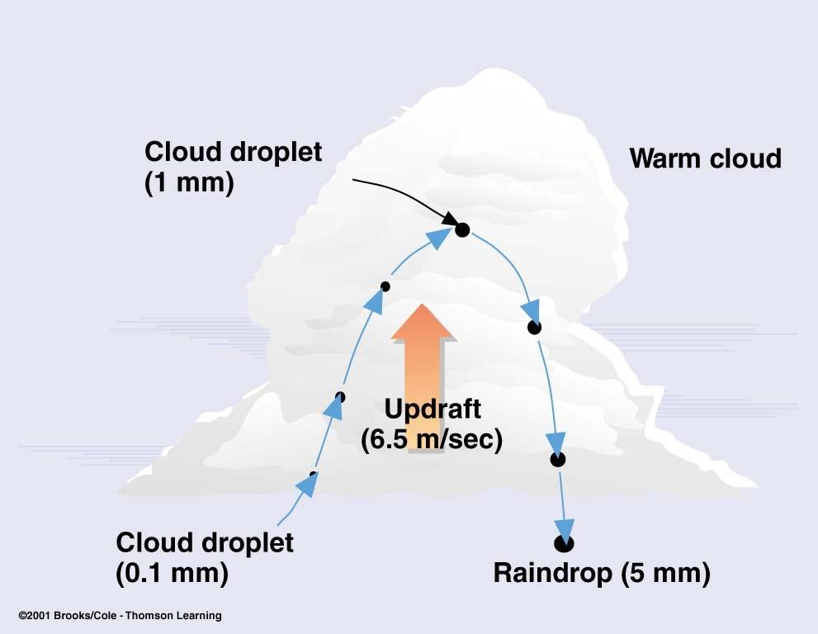
Collision and
coalescence
diffusion

Slide 76
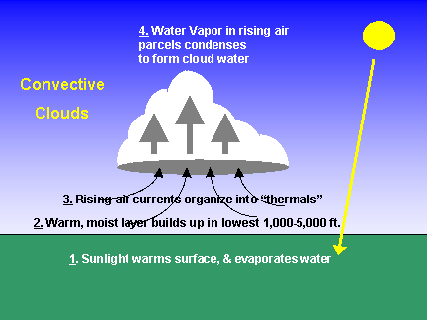
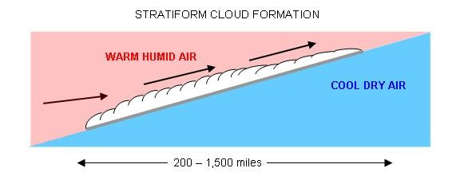
How
do
clouds
form?
Convection
(tropics, midlatitude- summer)
Frontal system

Slide 77
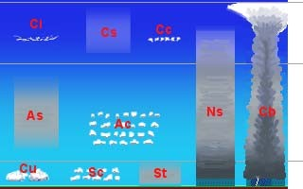
Cloud
Classification
Convective clouds
High clouds
> 6 km
Middle clouds
2-6 km
Low clouds < 2 km

Slide 78
Aerosol-Cloud Interaction (Indirect effect)
Counter Greenhouse warming
Solar albedo effect (first indirect effect):
air pollution Æ more condensation nuclei
(aerosols) Æ competing for water vapor
Æ more smaller droplets formed and
clouds last longer Æ reflect more
sunlight Æ cooling
 Precipitation reduction (second indirect
effect) (because of smaller droplets):
Adding air pollution could alter
atmospheric water cycle.

Slide 79
Climate Radioactive Forcing
(1) Net Flux at TOP* (pristine Atmosphere
(2) Net Flux at TOP* (polluted atmosphere)
Radiative Forcing (W/m²) = (2) Gain of Radiative Flux in Earth- Atmosphere
* generally refer to tropopause

Slide 80
Wind and Dispersion
Wind Speed
Wind Speed increase as volume of air moving increase
Speed of horizontal wind is affected by fraction proportional to surface roughness which determined by topographic features as
Land/sea or lake breeze
Mountain/valley
Terrain forced
Cultivated field/building
Wind Speed over smooth surface (cultivated field/lake) is higher than over rougher surface (Mountain/building)
As surface roughness (urban areas) increase, wind speeds near surface are reduced

Slide 81
Wind Direction
Pollutants dispersion is also affected by Wind direction, if Wind direction increase is constant, the same area will be continuously exposed to high pollutant levels.
On the other hand, Wind direction is constantly shifting, pollutants will be dispersed over a larger area and can over exposed are lower.

Slide 82
Wind direction determines direction of contaminated gases
Wind speed affects plume rise and rate of mixing,
Level of pollutants increase after leaving the source.
Increase wind speed decreases plume rise by bending plume rapidly lead to increase concentration of pollutants.
Increase wind speed lead to increase rate of dilution of plume tending to lower downwind concentration
Topographic conditions effect on wind thus on air quality.

Slide 84
Factors affecting dispersion
Factors affect : transport, dilution and dispersion
Meteorological Conditions
Source Characteristics
Nature of pollutant
Effects of Terrain & Anthropogenic
Meteorological Conditions Influence on Air Quality
Adverse atmospheric conditions in presence air contaminants gives rise to problem of air pollution
By understanding the relation between atmospheric condition and air pollution problem we can minimize the effects

Slide 85
Atmospheric dispersion of air contaminants
General mean air motion result of :
Atmospheric Turbulent velocity fluctuations
Molecular Diffusion due to concentration gradients from plumes.
Aerodynamic characteristics of pollution.
Particles
  Size
  Shape
  Weight
Gaseous & particulates air contaminants are dispersed into ambient air through wind & turbulence

Slide 86
Turbulence
Near the surface of earth, air does not flow smoothly, it flow 3-dimention movement called Turbulence
Turbulence are produced by 2 specific processes:
1- Thermal turbulence
  Results from atmospheric heating
  Causes natural convection currents
  Thermal eddies
2- Mechanical turbulence
  Results from shear wind effects
  Result from air movement over the earth’s surface, influenced by location of buildings and relative roughness of terrain.

Slide 87
  Both type occur in any given atmospheric situation
  Thermal turbulence is dominant on clear, sunny days with light winds
  However, although M. turbulence occurs under a variety of atmospheric condition, it is dominant on windy nights with neutral atmospheric stability
  Although, M. turbulence enhance the dispersion process, the downwash from pollution source may result in high pollution levels immediately downwind

Slide 88
2. Effects of Terrain & Anthropogenic

Slide 89
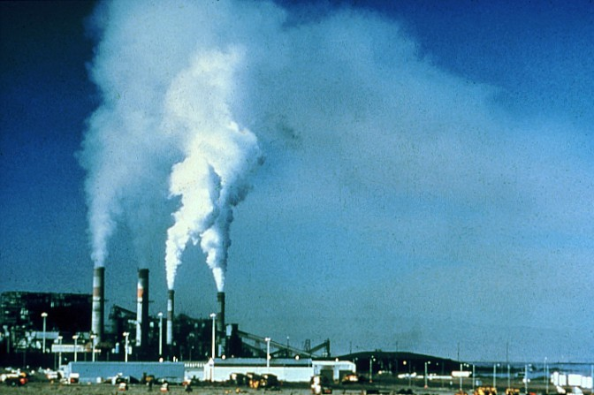
Some observation
reveals that air pollution modifies clouds downwind, becomes brighter, and reduces precipitation

Slide 90
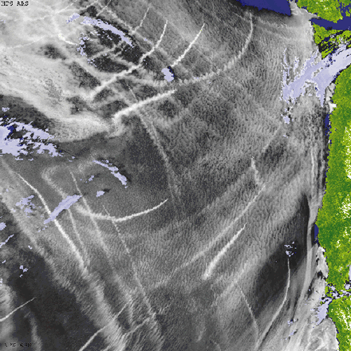
Aerosol modification of
marine stratus clouds. A false color image of ship tracks (white streaks, brighter) in a boundary layer cloud deck (mottled white) offshore from the northwestern United States (green). Cloud-free ocean is dark blue, high- altitude clouds are light blue. CREDIT: PHIL DURKEE/NAVAL
POSTGRADUATE SCHOOL (SATELLITE IMAGE)

Slide 91
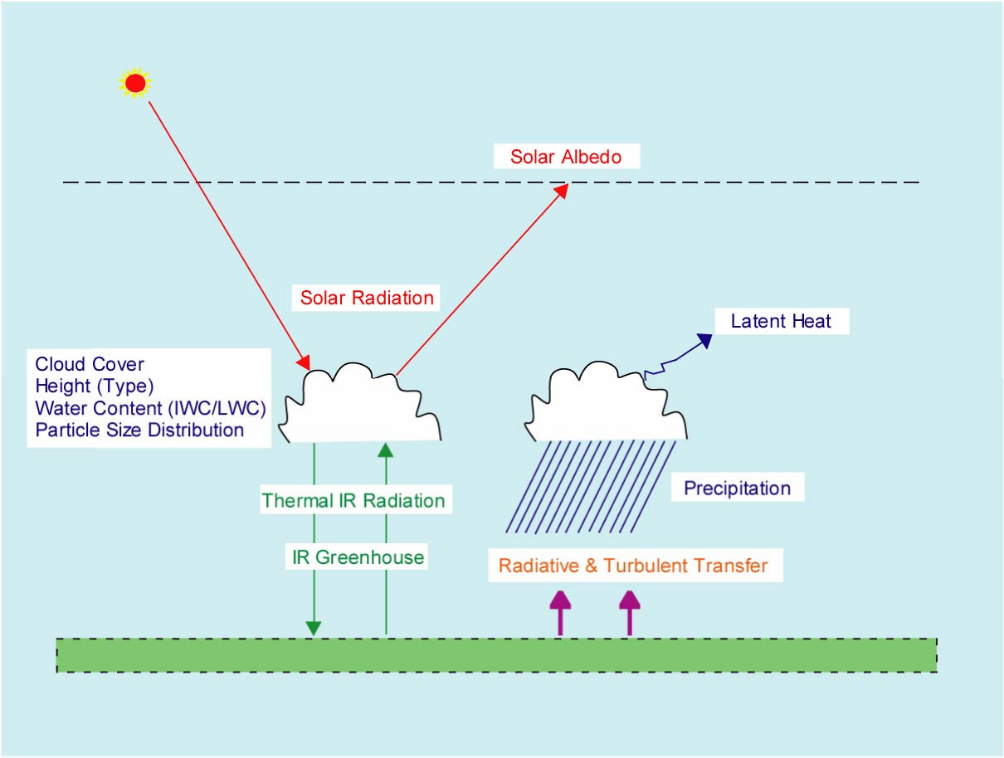
small droplets reflect more sunlight
Smaller droplets reduce

Slide 92
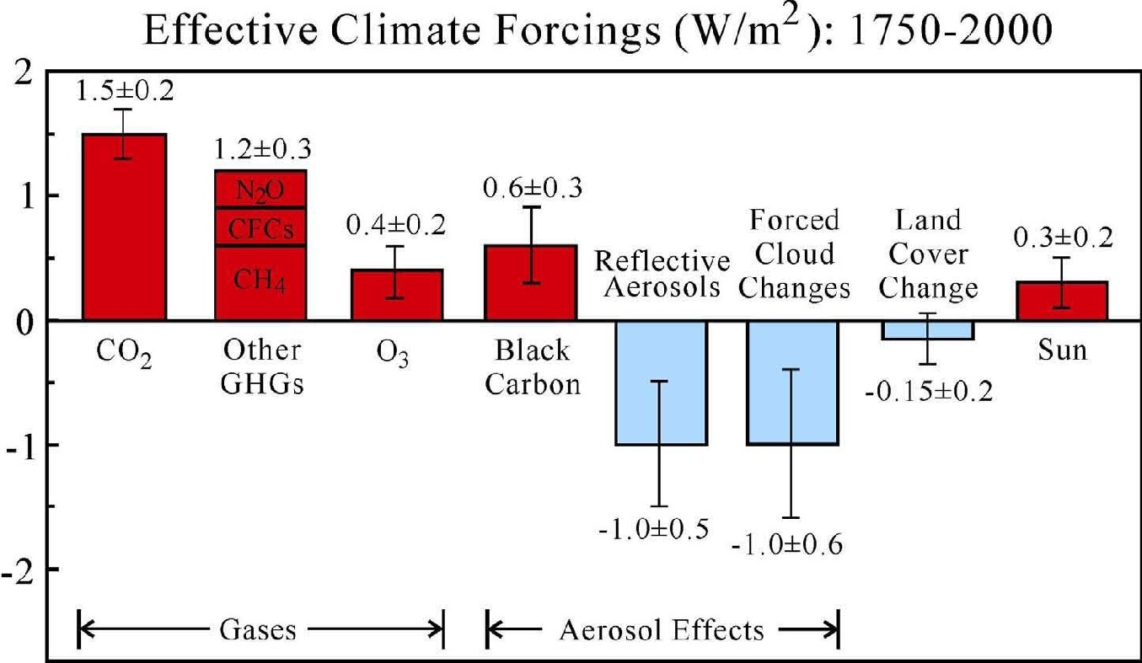
Climate forcing agents in the industrial era. “Effective” forcing accounts for
“efficacy” of the forcing mechanism
Source: Hansen et al., JGR, 110, D18104, 2005.

Slide 94
Summary
Meteorology Associated with Poor AQ
Ridge of High Pressure
Sinking Motion
Warms, Dries, and Stabilizes
Surface High
Creates Temperature Inversion
Clear Skies
Local Flows and/or Light Winds, Possible Transport
Photochemistry
Reduces Vertical Mixing
Stagnation/Recirculation
Poor Air Quality
Notes:
Animate

Slide 95
Summary
Meteorology Associated with Good AQ
Trough of Low Pressure
Rising Motion
Cools, Moistens, and Destabilizes
Surface Low
No Temperature Inversion
Cloudy Skies
Moderate to Strong Winds (Transport)
Reduces Photochemistry
(but may enhance PM_{2.5} chemistry)
Enhances Vertical Mixing
Horizontal Dispersion
Good Air Quality

Slide 96
Air pollution dispersion modeling

Slide 97
What is dispersion modeling
It is an attempt to describe relationship between emission, occurring concentration and deposition
It gives complete analysis of what emission sources have lead to concentration depositions
Mathematical models use analytical and numerical formulations, usually implemented on computers

Slide 98
Why dispersion modeling is required
To predict ambient air concentration which will result from a emission source
To plan and execute air pollution control program considering cost effectiveness
For environmental impact assessment
  Quantify the impact of process improvements
  Evaluating the performance of emission control techniques
  Optimization of stack height, diameter
  Planning the control of air pollution episodes

Slide 100
Atmospheric Chemistry
Emissions Inputs
Numerical Routines
Pollutant Distributions
Meteorological Fields
Emissions Modeling
Effects
Visualization
Meteorological Modeling
Inputs:
Population Roads
Land Use Industry Meteorology
Economics
Inputs:
Topography Observed Meteorology Solar insolation
Controls

Slide 101
Basics of air pollution dispersion models
All air pollution models are based on the simple Material Balance Principles
The general material balance equation for a air pollution model can be written as follows:
Accumulation Rate = (All flow rates in)-(All flow rates out) + (Creation rate) – (Destruction Rate)

Slide 102
Input data required for dispersion models
Meteorological conditions
Emissions parameters
Terrain elevations at the source location and at the receptor location.
Details of obstructions if any

Slide 103
Types of air pollution dispersion models
Box model
Gaussian model
Lagrangian model
Eulerian model
Dense Gas model

Slide 104
Box model (fixed box model)
It is simplest type of model
It assumes the air shed is box shaped
It assumes that air pollution present in the box are homogenously distributed and hence air pollutant concentration is estimated within the air shed
It has very limited ability to accurately predict dispersion of air pollutant over an air shed

Slide 105
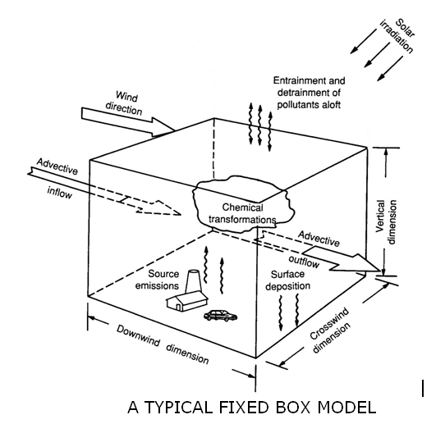

Slide 106
The assumptions indicates it’s a steady state equation. For steady state equations there is zero accumulation rate.
Hence, material balance equation becomes
  0 = (all flow rates in) – (all flow rates out)
Hence concentration of pollutant comes out to be
    c = b+(qL/uH)

Slide 107
Gaussian dispersion model
It is most commonly used model type and one of the oldest
The pollutant follow a normal probability distribution
Used for dispersion of continuous, buoyant air pollutant plume originating from ground level or elevated sources
Primary algorithm used is Generalized Dispersion Equation for a Continuous Point-Source Plume

Slide 108
Gaussian dispersion model
z
¤
Δh = plume rise
h = stack height
Δh
H = effective stack
height
H = h + Δh
H
h
x
C(x,y,z) Downwind at (x,y,z) ?
y

Slide 109
Gaussian dispersion model
z
The contaminated gas stream normally known as plume
For Gaussian plume calculation the plume is assumed to be emitted from a point 0,0,H(eff). Where H(eff) is the effective stack height which is the sum of the physical stack height (hs) and the plume rise Δh
To find out the dispersion of plume by the Gaussian model theory the Plume rise height has to be computed
¤
Δh = plume rise
h = stack height
Δh
H = effective stack
height
H = h + Δh
H
h
x
C(x,y,z) Downwind at (x,y,z) ?
y

Slide 110
Model assumptions
Continuous constant pollutant emissions
Conservation of mass in atmosphere
  No reactions occurring between pollutants
  When pollutants hit ground: reflected, or absorbed
Steady-state meteorological conditions
  Short term assumption
Concentration profiles are represented by Gaussian distribution—bell curve shape

Slide 111
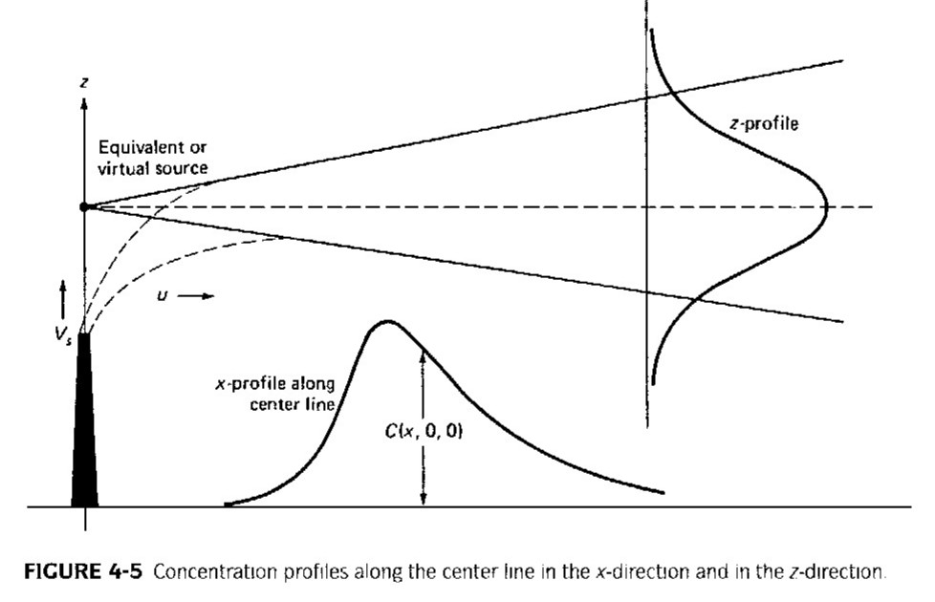
Gaussian Plume Dispersion
One approach: assume each individual plume behaves in Gaussian manner
  Results in concentration profile with bell-shaped curve

Slide 112
u = wind speed
Q = discharge of pollutant
H = h + ∆h where,
x,y = stack location
z = location of interest
σ_{z} and σ_{y} = are functions of atmospheric stability class (measure of turbulence in ambient air)

Slide 113
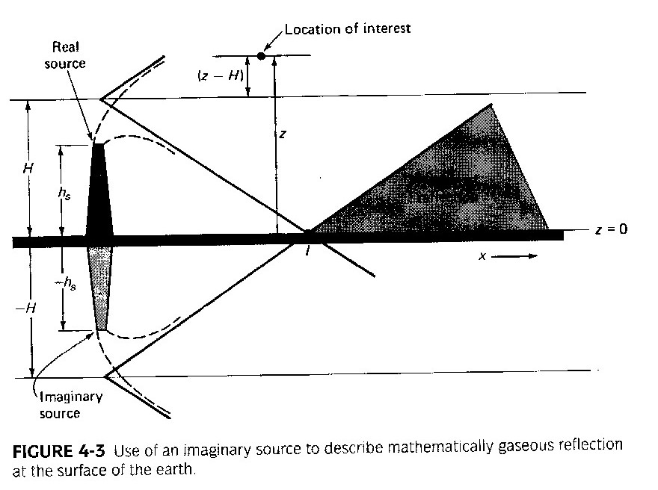

Slide 114
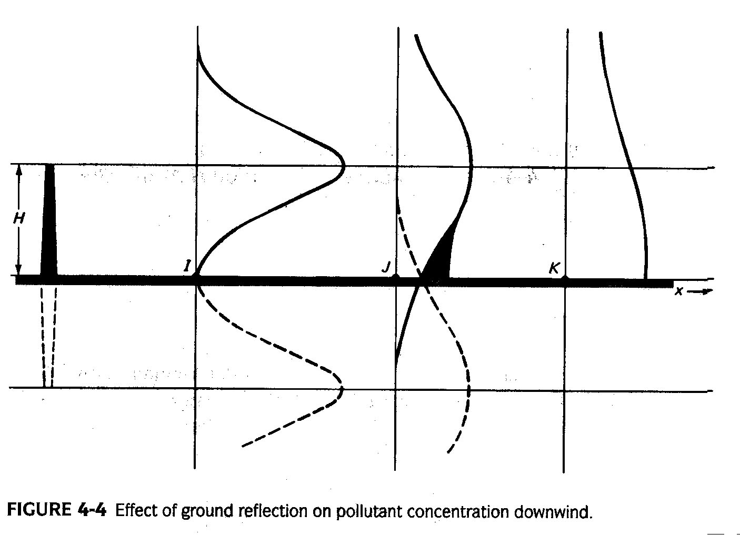

Slide 115
Stack height and plume rise by Holland's equation

Slide 116
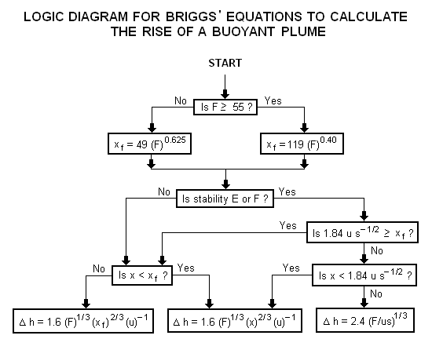
As Gaussians model requires input of H which is pollutant’s plume centerline above ground level which is obtained by Brigg's equation
Here
Δh = plume rise, in m
F = buoyancy factor, in m4s-3
x= downwind distance from plume source, in m.
xf= downwind distance from plume source to point of maximum plume rise, in m.
u= wind speed at actual stack height, in m/s
s = stability parameter, in s-2

Slide 117
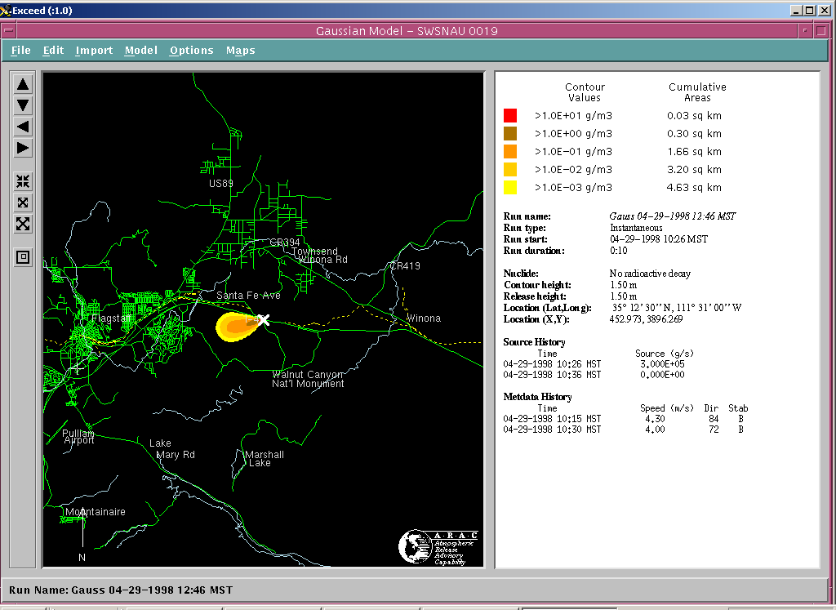
Gaussian model according to a software named screen3

Slide 118
Lagrangian model
a Lagrangian dispersion model mathematically follows pollution plume parcels
The Lagrangian model then calculates the air pollution dispersion by computing the statistics of the trajectories of a large number of the pollution plume parcels
It uses a moving frame of reference as the parcels move from their initial location
It is based on fluid element that follow instantaneous flow

Slide 119
Eulerian model
In this model, chemical species moves in fixed grid
It uses numerical terms to solve equation of mass conservation of pollutant
Its difficult to solve the numerical framework in this model.
Its advantage is well defined 3D formulation which is necessary in some complex regional scale air pollution problems

Slide 120
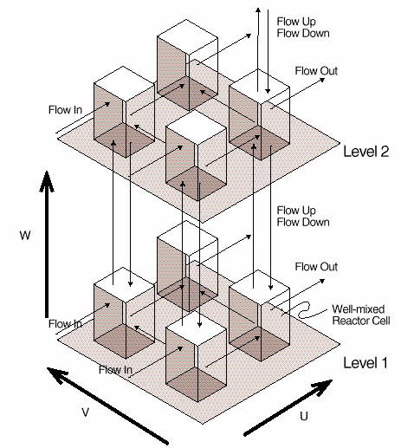
Structure of basic eulerian model

Slide 121
Dense gas models
Dense gas model — Dense gas models are models that simulate the dispersion of dense gas pollution plumes (i.e., pollution plumes that are heavier than air).
The air dispersion models used nowadays are:
ADMS 3
AERMOD
CALPUFF
DISPERSION21
ISC3
MERCURE
NAME
PUFF-PLUME
SIRANE
Some of these models which are mentioned above are described in brief in the following slides.

Slide 122
ADMS 3 (Atmospheric dispersion modeling system) :
  It is an advanced model for calculating atmospheric pollutant emitted continuously (from point, line area volume source) or intermittently (from point source)
AERMOD:
  It is steady state Gaussian plume model for short range about 50kms
  It uses a single wind field to transport emitted species
  A meteorological data preprocessor (AERMET) that accepts surface meteorological data, upper air soundings, and optionally, data from on-site instrument towers.
  A terrain preprocessor (AERMAP) whose main purpose is to provide a physical relationship between terrain features and the behavior of air pollution plumes

Slide 123
CALPUFF:
  It advanced Gaussian puff modeling system
  Used for longer range transport of pollutant and their effect on Federal class I areas
  model is designed to simulate the dispersion of buoyant, puff or continuous point and area pollution sources as well as the dispersion of buoyant, continuous line sources
  model also includes algorithms for handling the effect of downwash by nearby buildings in the path of the pollution plumes

Slide 124
ISC 3 :
  Steady state Gaussian plume model for analyzing pollutant concentration for industrial complex
  This model can account for the following: settling and dry deposition of particles; downwash; point, area, line, and volume sources; plume rise as a function of downwind distance; separation of point sources; and limited terrain adjustment
  ISC3 operates in both long-term and short-term modes

Slide 125
Puff plume:
  PUFF-PLUME is a model used to help predict how air pollution disperses in the atmosphere
  It is a Gaussian atmospheric transport chemical/radionuclide dispersion model that includes wet and dry deposition, real-time input of meteorological observations and forecasts, dose estimates from inhalation and gamma shine (i.e., radiation), and puff or continuous plume dispersion modes

Slide 127
Ozone layer
Ozone layer
Not really a layer, but a region of higher-than-normal ozone concentrations (which are still very low)
~17–30 km altitude
Ozone = O₃—molecule of 3 oxygen atoms
Absorbs ultraviolet (UV) radiation from sun, protecting organisms on surface from radiation damage

Slide 129
T Variation
Atmosphere is transparent, only surface is heated
– Loss by convection + re-radiation
– Shape of atmospheric temperature profile
In the absence of local heating, T decreases with height
• Exceptions: Stratosphere: Chapman Cycle (1930s(
O₂ + hv → 2O
O + O₂ + M → O₃ (+ heat)
O + O₃ → 2O₂
O3 + hv → O + O2 (+ heat)
– Q: what is heat at the molecular level?
• Mesosphere: absorption by N₂, O₂, atoms

Slide 131
Atmospheric (Vertical) Stability II
z z z
T T T
•
Q: which of the following profiles are stable and unstable
– Stable: a small perturbation is damped
– Unstable: a small perturbation is amplified
adiabatic Actual
“Inversion”
10

Slide 140
Thank you

