Slide 1
Depositional Environments Lec. 2 (part 2) Fluvial
DSRG
Dr. EHAB M. ASSAL
Damietta University

Slide 2
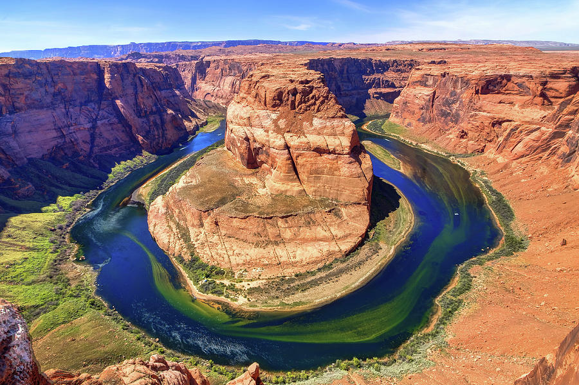
Fluvial Environment

Slide 3
Outline
1
Fluvial system
2
Channel channel pattern
3
Fluvial environment
4
Braided river
5
Meandering river

Slide 4
1. Fluvial system
Fluvial system
Part of a watershed
Drainage basin (= catchment area); contributive network
Provides water and sediment to stream
Adjacent basins separated by divide
Many scales; continental divide
Stages
Young: Mountain regions
Erosional features dominate
Mature
Formation of flood plains and point bars
Depositional features dominate (old, also)
Old: Coastal regions
Rivers coalesce; Channels reduced in size due to division

Slide 5
1. Fluvial system
The wind is an important geomorphic agent wherever it is sufficient to surmount any surface stabilization.
Because of their sensitivity to climatic change, aeolian accumulations have long been used to extract palaeoclimatic information.
Desertification has become prominent today both in science and in public eye because of its impact on human life and as a barometer for changing global climatic conditions e.g. (Mainguet, 1991).

Slide 6
1. Fluvial channel pattern
Channels define rivers
Function of adjustment of channel to changes
Gradient, Cross-section
Controlled by
Sediment load
River characteristics
Amount and nature of discharge

Slide 7
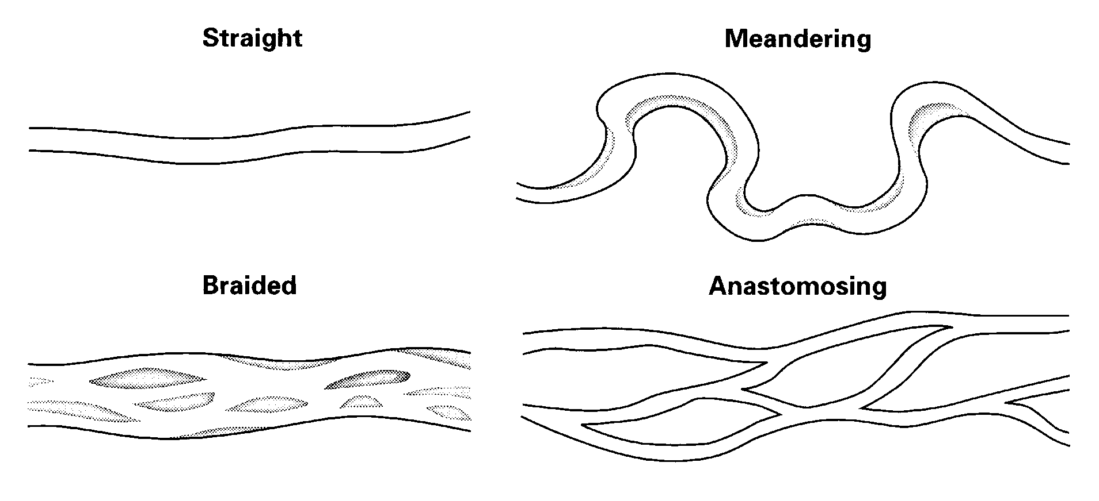
2. Fluvial channel pattern
Channel patterns (fluvial styles) of alluvial rivers are commonly classified as:
Straight rivers
Braided rivers
Meandering rivers
Anastomosing rivers
Types Change! Along length or at flood stage

Slide 8
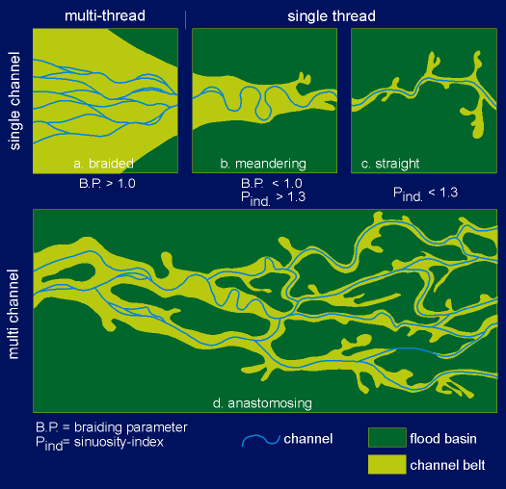
2. Fluvial channel pattern

Slide 9
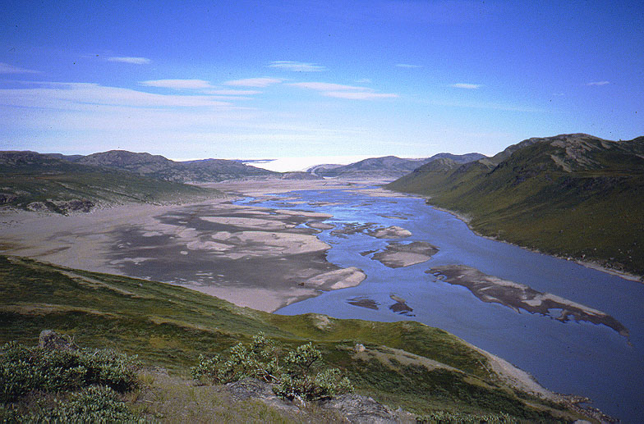
2. Fluvial channel pattern

Slide 10
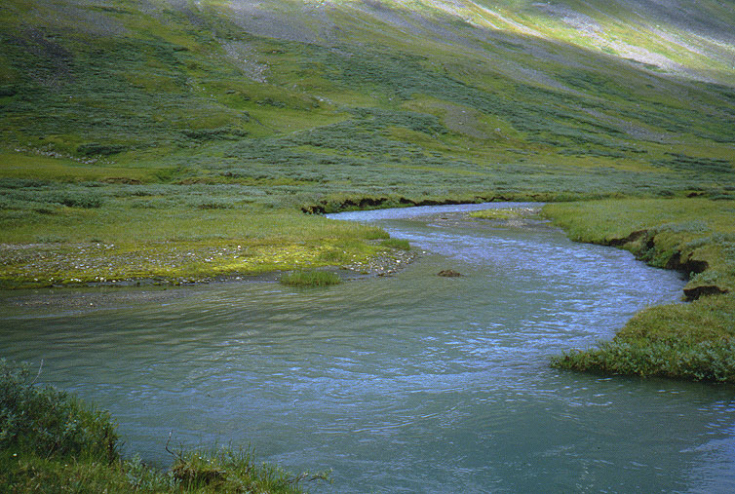
2. Fluvial channel pattern

Slide 11
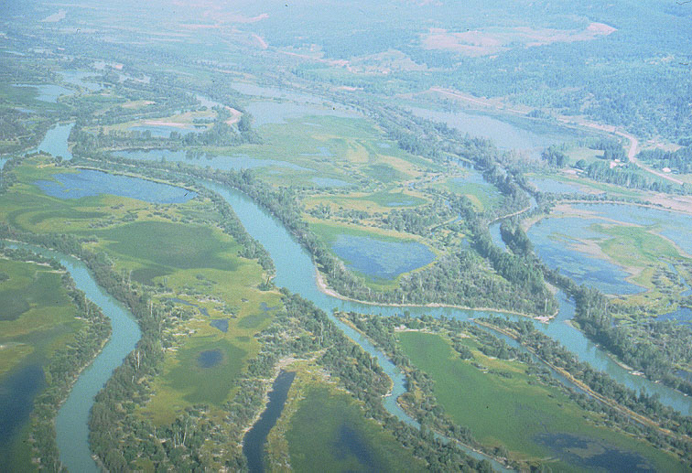
2. Fluvial channel pattern

Slide 12
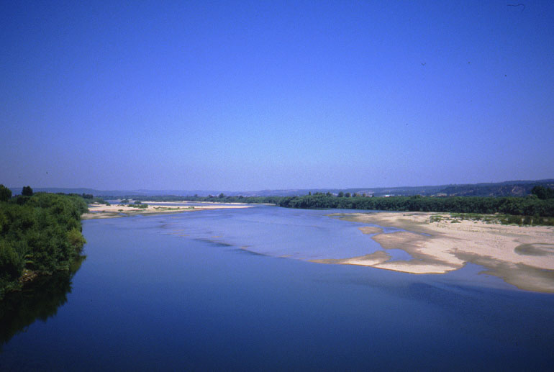
2. Fluvial channel pattern

Slide 13
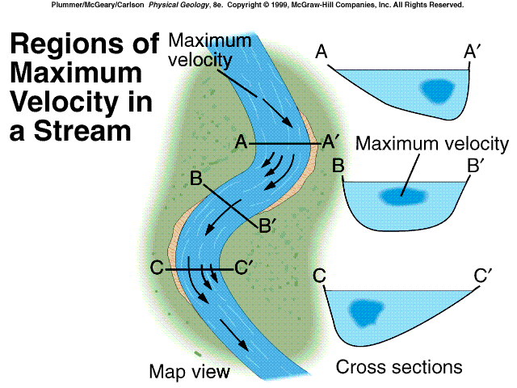
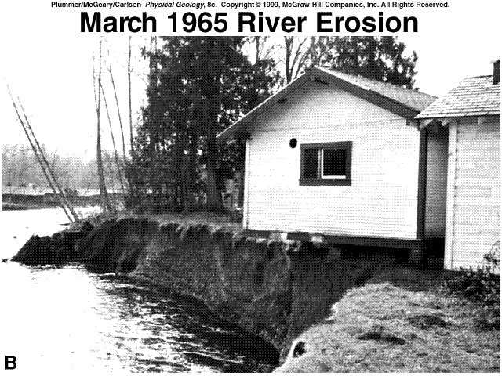
2. Fluvial channel pattern

Slide 14
3. Fluvial environment
Thalweg
Deepest part of channel
Point bars
Built on inside of curve (depositional)
Cut bank
On outside of curve (erosional)
Pools
Deep area opposite to point bar
Riffle
Shallower area (cross-over area)
Levee and Flood Plain
Borders river

Slide 15
3. Fluvial environment
Bars are sandy or gravelly macroforms in channels that are emergent, mostly unvegetated features at low flow stage, and undergo submergence and rapid modification during high discharge
Point bars form on inner banks and typically accrete laterally, commonly resulting in lateral-accretion surfaces; mid-channel or braid bars accrete both laterally and downstream
Bars are always associated with channels; a genetically related bar/bar complex and channel/channel complex is known as a storey

Slide 16
3. Fluvial environment
Lateral accretion involves higher-order bounding surfaces dipping perpendicular to paleoflow direction and associated lower-order bounding surfaces; in the case of downstream accretion higher-order bounding surfaces dip parallel to paleoflow direction
Braided rivers are characterized by a dominance of braid bars exhibiting both lateral and downstream accretion; meandering rivers primarily contain point bars with lateral accretion; in straight (and most anastomosing) rivers bars are commonly almost absent

Slide 17
3. Fluvial environment

Slide 18
3. Fluvial environment
Facies successions in sandy to gravelly channel deposits typically fine upward, from a coarse channel lag, through large-scale to small-scale cross stratified sets (commonly with decreasing set height), and finally overlain by muddy overbank deposits
Facies successions produced by different fluvial styles can be extremely similar!
The geometry and three-dimensional arrangement of architectural elements therefore provides a much better means of inferring fluvial styles from the sedimentary record

Slide 19
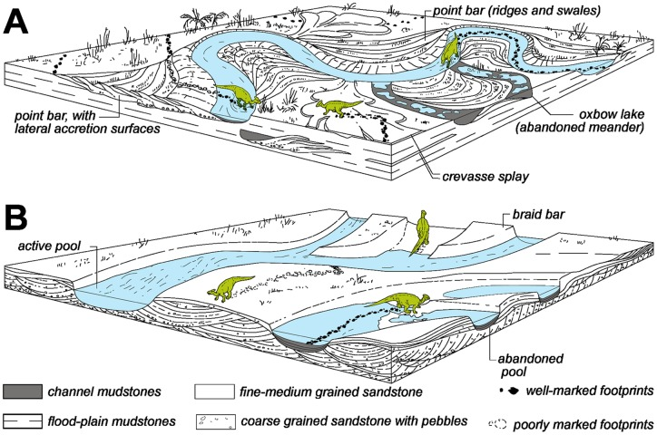
4. Braided river

Slide 20
4. Braided river
Main channel consists of several channels
Bars
Major depositional feature
Often submerged at high flow
Development
Grow downstream and on lateral areas
Often eroded upstream
Stabilized by deposition of fine grains on top + vegetation

Slide 21
4. Braided river
Channel belts consist of channel-bar and channel-fill deposits; the proportion of the two generally decreases markedly from braided rivers to anastomosing rivers
The geometry of a channel belt (width/thickness ratio) is a function of the channel width and the degree of lateral migration.
Residual-channel deposits are predominantly muddy (occasionally organic) deposits that accumulate in an abandoned channel where flow velocities are extremely small

Slide 22
4. Braided river
Successive division and rejoining of flow around islands
Most common in mountain reaches, on alluvial fans and glacial outwash
Requires
high bedload
Steeper gradient (aids in higher bedload)
Relative ease of bank erosion
Grain size
Gravels most common
Can braid fines if discharge is high and banks are weak

Slide 23
4. Braided river

Slide 24
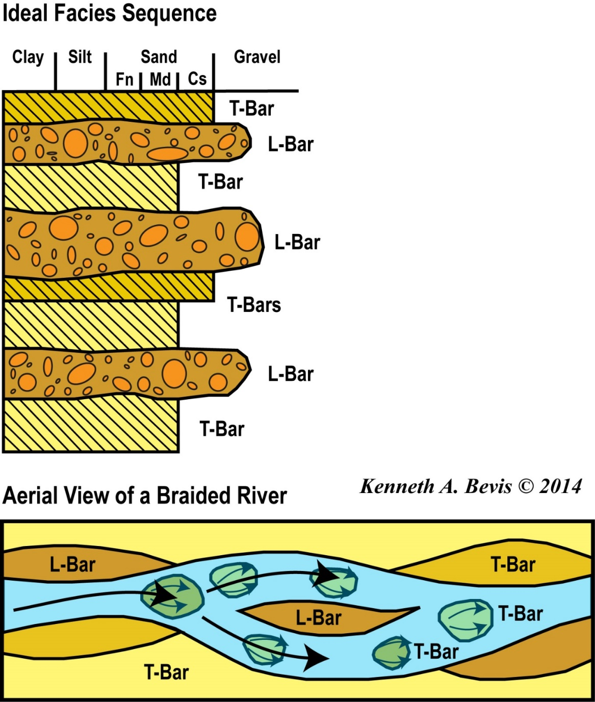
4. Braided river
The braided river facies sequence consists of:
alternating channel L-bars (longitudinal bars) comprised of gravels and T-bars (transverse bars) comprised of cross-bedded sands.
Braided rivers have no true flood plain; channel deposits typically occupy the entire valley floor over time.

Slide 25
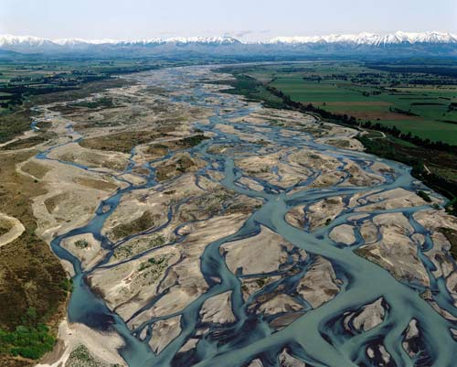
4. Braided river

Slide 26
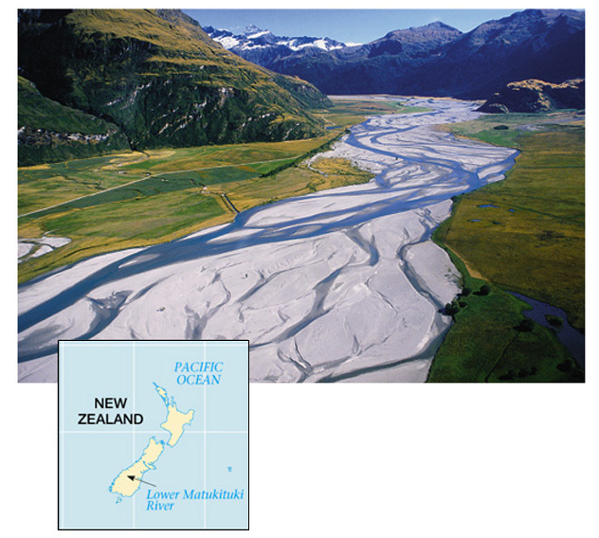
4. Braided River

Slide 27
4. Braided river

Slide 28
5. Meandering river

Slide 29
5. Meandering river
Point bars dominate
Major process of sedimentation in meandering rivers
Usually that which is preserved
Thickness may equal depth of river
Mississippi River= 20-25 m (Fisk, 1944, 1947)
Lateral migration of point bar (and river!) during flooding
But the channel width is maintained (erosion= deposition)
Generally fining upward
Deposition
channel lag at base and mud drape on top
Preservation
Fines at top eroded

Slide 30
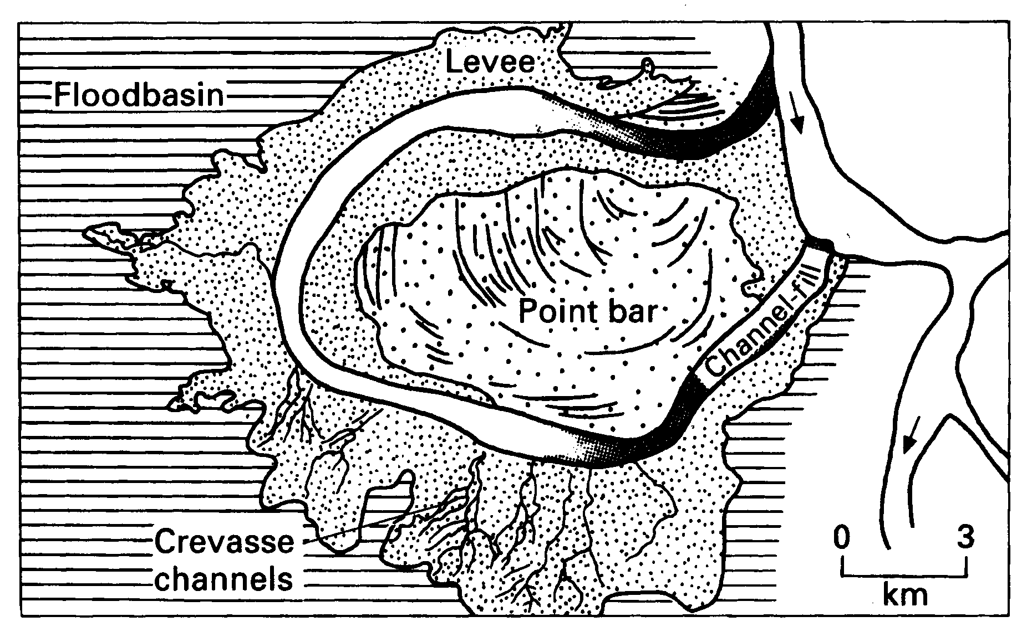
5. Meandering river
Helical circulation leads to meandering
In curves, two flow directions
Strong downstream
greatest at 3, towards the cut bank
Weaker cross-flow at depth
Towards the point bar
When cut bank slumps, material is carried downstream to next point bar

Slide 31
5. Meandering River

Slide 32
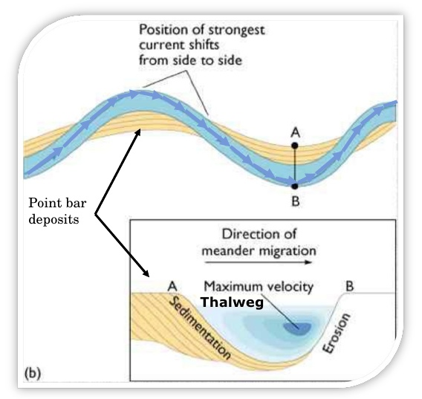
5. Meandering River
Silts, clays
Planar bedding
May be upper - flow
likely it is sediments settling out of suspension as flood wanes
Often interbedded with ripples
Cross-bedding
Ripples and climbing - ripples
Dune common in lower part
Beds ~ 1m
Scour, fill common
Channel lag at base

Slide 33
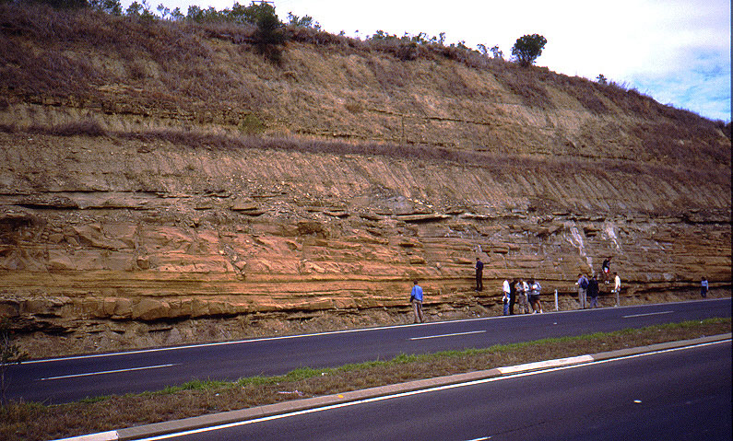
5. Meandering river
Point bar

Slide 34
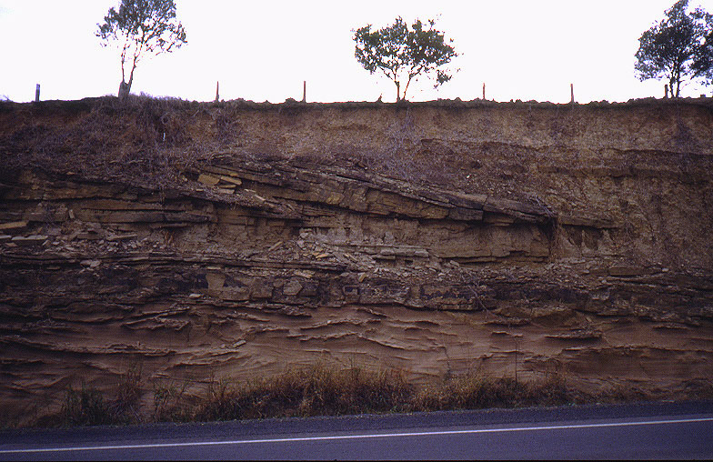
5. Meandering river
Point bar

Slide 35
5. Meandering River
Overbank environments are dominated by fine-grained facies (predominantly muds)
Natural-levee deposits are wedges (‘wings’) of sediment that form adjacent to the channel, dominated by fine sand and silt exhibiting planar stratification or (climbing) ripple cross stratification
Crevasse-splay deposits are usually cones of sandy to silty facies with both coarsening-upward and fining-upward successions, and are formed by small, secondary channels during peak flow
Flood-basin deposits are the most distal facies, consisting entirely of muddy sediments deposited from suspension, and are volumetrically very important (mainly in low-energy fluvial settings)

Slide 36
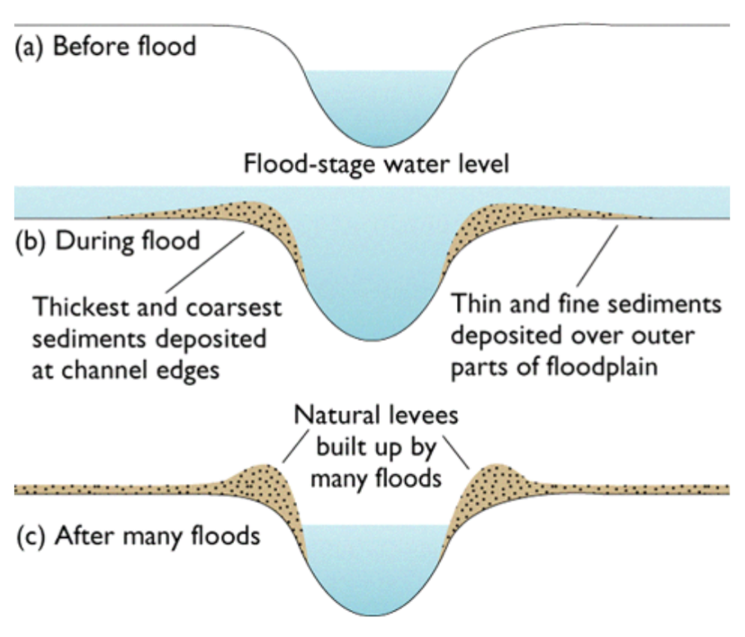
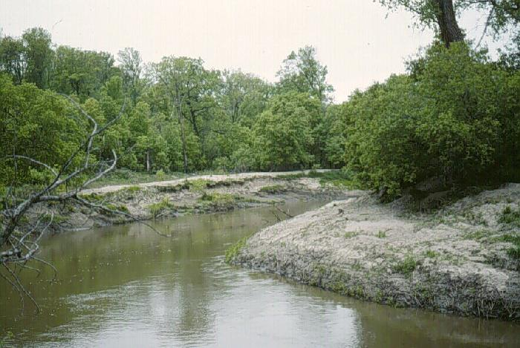
5. Meandering river
Natural levees

Slide 37
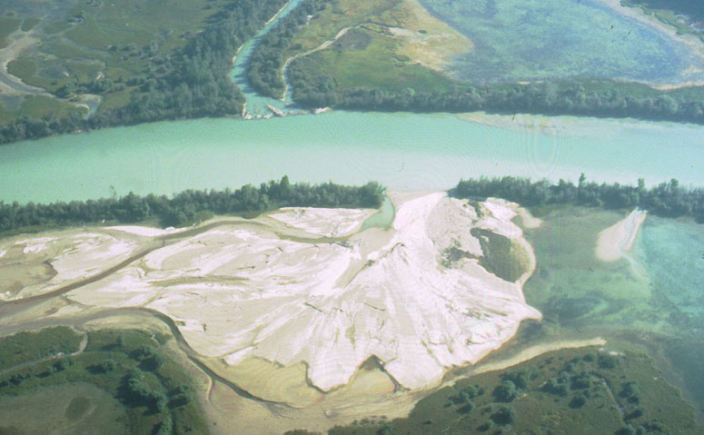
5. Meandering river
Crevasse splay

Slide 38
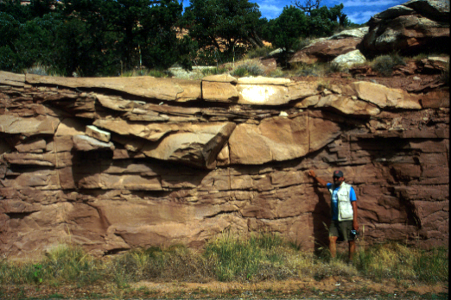
5. Meandering river
Crevasse splay

Slide 39
5. Meandering river
Paleosols (well drained conditions) and occasional peats (poorly drained conditions) occur frequently in overbank environments and are important indicators of variations of clastic aggradation rates and the position relative to active channels (proximal vs. distal)
The pedofacies concept refers to the maturity of a paleosol, irrespective of the specific set of pedogenic processes operating, in the case of floodplains mainly controlled by distance to the active channel
Lacustrine deposits can be important in overbank environments characterized by high water tables, and are also found in distal settings; they are more likely to contain primary sedimentary structures (horizontal lamination) than their frequently bioturbated subaerial counterparts

Slide 40
5. Meandering river
Channel- fill (Oxbows!)
Stream channels that have been abandoned
Cut-off abandonment
Avulsions: sudden abandonment
Very high rate of sedimentation
Meandering can cause if
Chute cut-off: stream shortens its course
Neck- cut off: new channel but between 2 meander loops

Slide 41
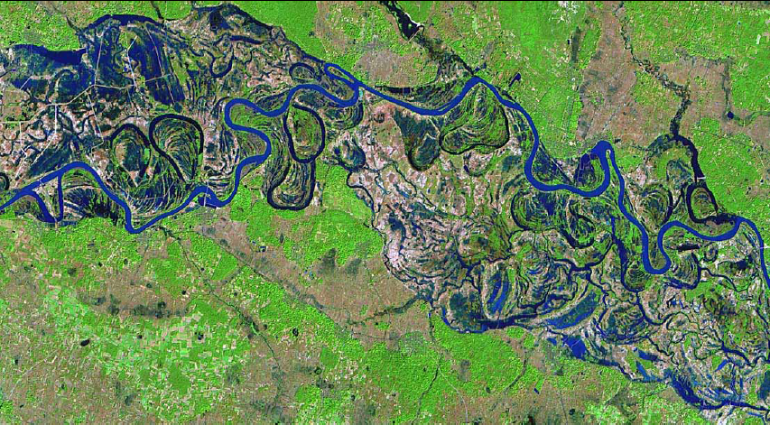
5. Meandering river
Channel- fill (Oxbows!)

Slide 42
5. Meandering river
Channel Avulsion
Avulsion is the sudden diversion of a channel to a new location on the floodplain, leading to the abandonment of a channel belt and the initiation of a new one
Avulsions are the inevitable consequence of the increase of cross-valley slope (typically through a crevasse channel) relative to down-valley slope along the channel, associated with the growth of an alluvial ridge
An avulsion belt constitutes an extensive network of rapidly aggrading, narrow, crevasse-like channels with genetically associated overbank deposits, that may surround the new channel belt

Slide 43
5. Meandering river

Slide 44
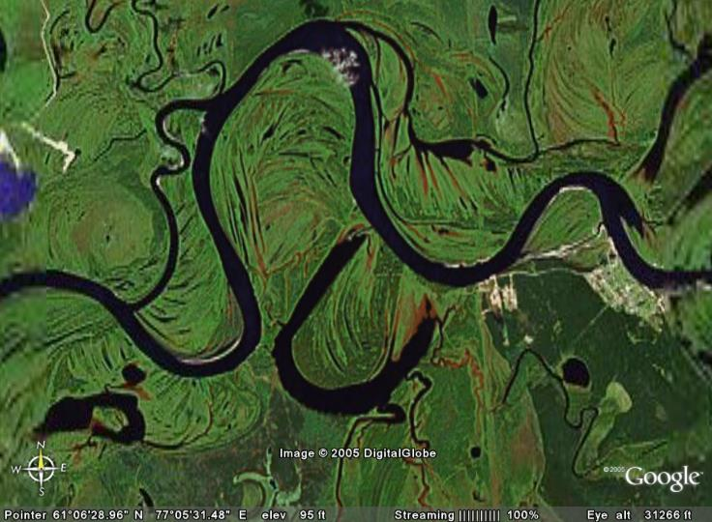
5. Meandering river

Slide 45
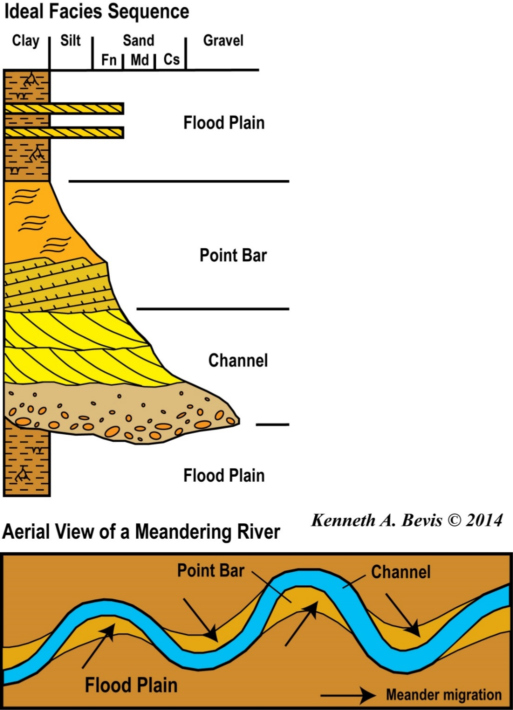
5. Meandering river
The meander river facies sequence consists of:
Distal floodplain mud with roots and desiccation cracks
Proximal floodplain mud with occasional overbank sand.
Ripple x-lamination at upper stage plane bed lamination of upper point bar.
Dune trough x-bedding and upper stage plane bed lamination of low point bar
Coarse grained channel lag deposit.

Slide 46
5. Meandering River

Slide 47
5. Meandering river

Slide 48
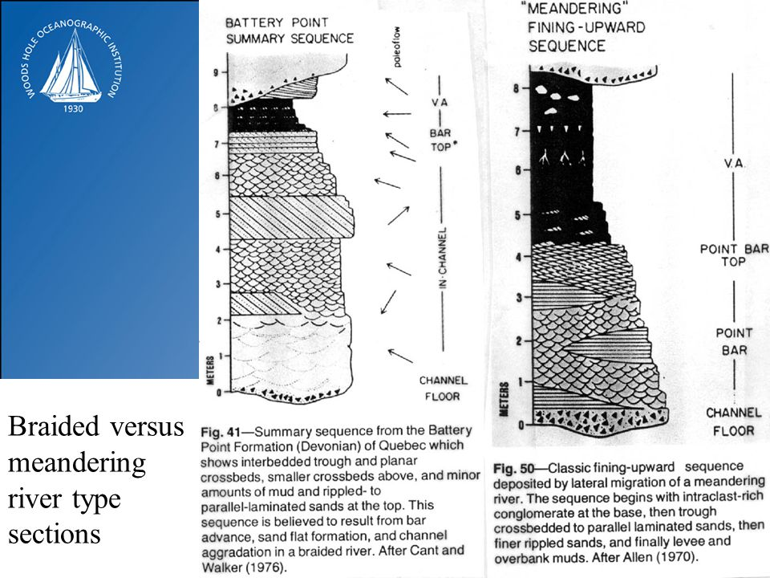
Braided versus meander

Slide 49
Avulsion
Major convection cells
Avulsion is the sudden diversion of a channel to a new location on the floodplain, leading to the abandonment of a channel belt and the initiation of a new one
Avulsions are the inevitable consequence of the increase of cross-valley slope (typically through a crevasse channel) relative to down-valley slope along the channel, associated with the growth of an alluvial ridge
An avulsion belt constitutes an extensive network of rapidly aggrading, narrow, crevasse-like channels with genetically associated overbank deposits, that may surround the new channel belt

Slide 50
Thank You !
DSRG
www.du.edu.eg/faculty/sci

