Slide 1
Depositional Environments Lec. 3 Aeolian
DSRG
Dr. EHAB M. ASSAL
Damietta University

Slide 2
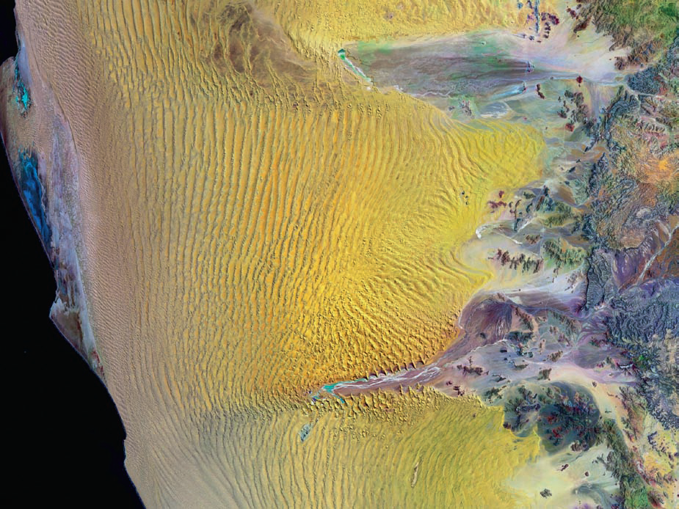
Aeolian Environment
Landsat 7 image of the central Namib Sand Sea, with the Atlantic Ocean to the west and the Great Escarpment to the east.

Slide 3
Introduction
Why aeolian accumulations are important?
The wind is an important geomorphic agent wherever it is sufficient to surmount any surface stabilization.
Because of their sensitivity to climatic change, aeolian accumulations have long been used to extract palaeoclimatic information.
Desertification has become prominent today both in science and in public eye because of its impact on human life and as a barometer for changing global climatic conditions e.g. (Mainguet, 1991).

Slide 4
Introduction
The quantity of atmospheric dust derived from aeolian processes has a series impact on populations in numerous regions.
Aeolian sandstones are important aquifers and contain substantial hydrocarbon reserves as in the Permian Rotliegend if the North Sea area.
A significant part of the recent approach to reservoir characterization and flow modeling is based upon aeolian rocks.
Remote sensing has played a key role in aeolian studies, and these studies have in turn helped to develop remote sensing technology.

Slide 5
Outline
1
Definitions
2
Desert aeolian system
3
Sediment transport
4
Dunes and airflow
5
Loess deposits

Slide 6
1. Definitions
Aeolian deposit is a deposit that forms as a result of the accumulation of wind-driven products of the weathering of solid bedrock or unconsolidated alluvial, lacustrine, marine, or other deposits.

Slide 7
2. Desert aeolian system
Eolian deposits are found primarily in arid regions (sands, loesses), but they also occur in other natural zones. When moving in the wind-sand stream, grains of sand are bounced or rolled.
In a suspended state, dust particles can be lifted by ascending air currents to 3,000–6,000 m and are transported hundreds or thousands of kilometers. When wind energy is not sufficient to transport sand and dust particles, they fall out of the air and accumulate, often in front of orographic barriers. When precipitating from the air, sometimes with rain droplets or snow, dust particles become mixed with marine and continental sediments of varying origin and in such cases do not form independent eolian accumulations.
According to the findings of the Soviet geologist A. P. Lisitsyn, dust particles precipitated from the air constitute 20–75 percent of the oceanic bottom sediments; various salts (for example, carbonate and chloride salts) also precipitate from the air with them. Eolian sand deposits are found along seas and lakes and on river terraces, in addition to deserts. There are eolian sands confined to regions of former continental glaciation.

Slide 8
2. Desert aeolian system
Much of the surface of the Earth is covered with arid (<25 cm/yr. rainfall) and semi arid land (25-50 cm/yr. rainfall).
It is clear from the diagram below that the global distribution of arid and semi arid lands on the Earth is mostly of in the world are located within a belt along the equator, stretching from 30° S to 30° N in latitude.
The distribution of deserts around the equator is the result of climatic conditions created by global wind circulation patterns.

Slide 9
2. Desert aeolian system
Why we get more deserts in the subtropics?
Falling air is cold and dry warm air rise and is moist hits higher altitudes and causes precipitation as it cools

Slide 10
2. Desert aeolian system

Slide 11
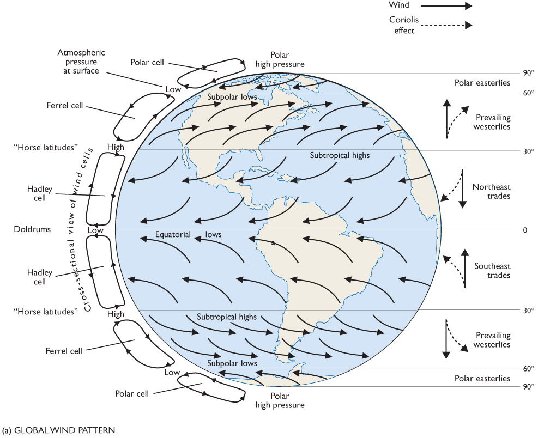
2. Desert aeolian system
Global Wind Pattern

Slide 12
2. Desert aeolian system
Major convection cells
Three major conviction cells are present in each hemisphere
The Hadley cell extends from the Equator to about 30º latitude.
The Ferrel Cell extends from 30º to about 50º latitude.
The Polar Cell extends from 90º to about 50º latitude.
The Coriolis effect causes wind in these cells to bend to the east or west to form the westerlies, easterlies, and the trade winds

Slide 13
2. Desert aeolian system
Global Wind Patterns
The warm moist air at the equator is heated and becomes less dense than the air surrounding it. Equatorial heating is so intense because the angle of inclination of the sun at the equator is 90o. Because of this density difference the air must rise in order to achieve a more stable, equilibrium state. As the air rises, it moves to the north and south, as shown above. After it has become equilibrated at higher elevation it begins to cool and becomes denser than the air around it, in part because of the water vapor it contains. It then begins to flow downward toward the Earth. The rising and falling of air in these patterns creates vertical wind convection cells called Hadley cells. Hadley cells are responsible for much of the arid lands we observe north and south of the Equator, because all of the warm moist air is sucked out of this region and redistributed to the north and south.

Slide 14
2. Desert aeolian system
When air moves north from the equator it begins to drift to the east because the Earth rotates in and eastward direction. The air is not attached to the Earth, and so it is easily deflected. Air moving south from north of the equator towards the equator is deflected to the west by the Coriolis effect, as shown in above. The patterns for the Southern Hemisphere are reversed from those in the Northern Hemisphere. The net effect of these wind patterns is a set of wind currents moving air away from the mid-latitudes towards the equator, called the Northeasterly Trade Winds and Southwesterly Trade Winds. North and south of the mid-latitudes air moves away towards the temperate zones between 30 and 60 latitude north and south. These wind patterns are called the Westerlies. The result of the vertical and horizontal wind patterns, is the stripping of moist air away from the latitudes between the equator and 30° N and 30° S.

Slide 15
2. Desert aeolian system
Desert Distribution
Desert belts
10-30° N and S of equator (Hadley circulation cells)
trades; downwelling cool, dry air
more land, more absoprtion (less if reflective) and shift in circulation
Rain shadows
downwind side of mountain
in US, winds blow W to E
lose moisture over mountains
Far inland
center of continent away from moisture source

Slide 16
2. Desert aeolian system

Slide 17
2. Desert aeolian system
All deserts form because there is little rainfall in the area and the air is dry. There are several ways in which an area can become a desert.
1. Climate Zone Deserts
are simply to be located in the mid-latitude area in which there is little moisture in the air, as discussed earlier. The distribution of climate zone deserts is shown below.

Slide 18
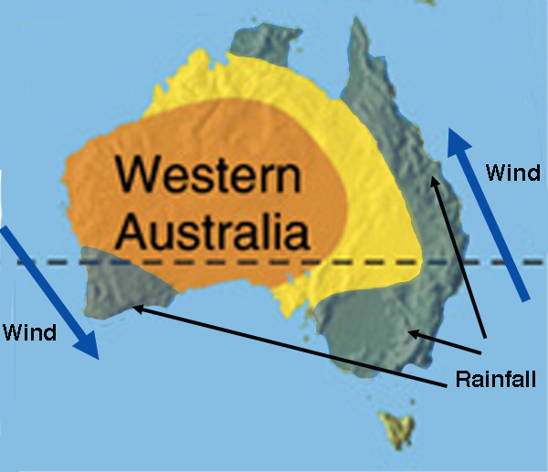
2. Desert aeolian system
2. Continental Isolation Deserts are also form in the center of large land masses. The wind moving onto the continent often loses the moisture it contained as it moved off the ocean by precipitation over the land mass. As the air moves inward less and less moisture is present in the air, because of the precipitation.

Slide 19
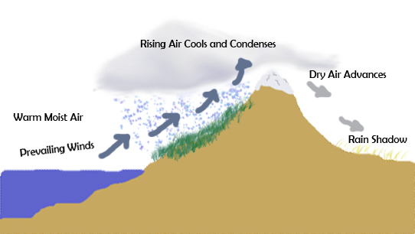
2. Desert aeolian system
3. Rain Shadow Deserts are formed when air moves from the ocean onto the land in a mountainous area, as shown in below. When the moist wind is blown onto the land from the ocean, along a mountainous shoreline, it is forced upward where it cools and expands. The cooling leads to precipitation because the colder air cannot hold as much water vapor as the warm air and it loses the excess through precipitation. If the mountain range is high, most of the water vapor is lost by precipitation along the flanks of the mountain. The now cold dry air is relatively dense as it crosses to the other side of the mountain and it flows downward towards the ground again where it is compressed and heated again.

Slide 20
2. Desert aeolian system
Caption used in the Himalaya article : Composite satellite image of the Himalayan range. The top of the picture is directed towards the north northwest. The Tibetan Plateau is near the centre and the Taklamakan plain is visible as the lighter area near the top.

Slide 21
3. Sediment transport
3 modes of particle movement:
Bedload – continuous/regular contact with the bed
Traction (rolling, sliding)
Saltation
Common for sand, gravel and coarser sediment

Slide 22
3. Sediment transport
3 modes of particle movement:
Suspended Load – Particles held in continuous suspension by fluid turbulence
Upward component of fluid flow overcomes gravitational forces
Finer grain sizes (very fine sand to clay)
“Intermittent suspension” possible

Slide 23
3. Sediment transport
3 modes of particle movement:
Washload – clay-size particles derived from an up-current source, rather than eroded from bed
Large washloads possible even for very low velocities

Slide 24
3. Sediment transport
Grain Transport
Leeder 1999

Slide 25
3. Sediment transport
Types dependent on wind velocity
Traction
Saltation
Suspension
coarse grains
coarse grains
grain collisions aid transport through dispersion
fines (<0.05 mm) are winnowed out and put into suspension
at very high winds, coarser grains are blown
Notes:
Content Layouts

Slide 26
Aeolian deposits

Slide 27
4. Dunes and airflow
Blowout and Pillar Formation
Blowouts are sandy depressions in a sand dune ecosystem (psammosere) caused by the removal of sediments by wind.
Blowouts occur in partially vegetated dunefields or sandhills. A blowout forms when a patch of protective vegetation is lost, allowing strong winds to "blow out" sand and form a depression. Although they generally remain small, blowouts can expand to kilometers in size and up to around 70m in depth

Slide 28
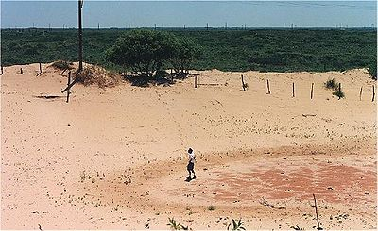
4. Dunes and airflow
Blowout

Slide 29
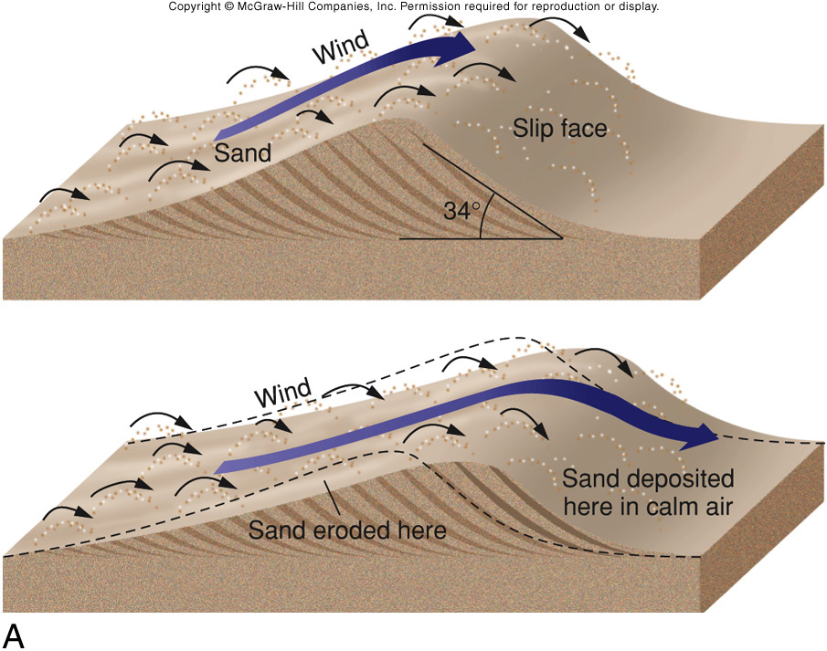
4. Dunes and airflow

Slide 30
4. Dunes and airflow
Dunes
Ripples, dunes
Cross-beds
Draas
HUGE!
λ up to 5.5 km;
h >0.4 km
Controls
as wind V increases, λ lengthens (smear out)
as grain size increases, height goes up (piles up)

Slide 31
4. Dunes and airflow
Dune Types
Classified by patterns formed by slip faces (lee)
Different patterns due to different # wind directions

Slide 32
4. Dunes and airflow
Barchan Dunes form when there is limited sand.
Parabolic Dunes require abundant sand and strong wind!

Slide 33
4. Dunes and airflow
Crescentic
Crescent-shaped mounds are generally wider than they are long. The slipfaces are on the concave sides of the dunes. These dunes form under winds that blow consistently from one direction, and they also are known as barchans, or transverse dunes. Some types of crescentic dunes move more quickly over desert surfaces than any other type of dune. A group of dunes moved more than 100 metres per year between 1954 and 1959 in the China's Ningxia Province, and similar speeds have been recorded in the Western Desert of Egypt. The largest crescentic dunes on Earth, with mean crest-to-crest widths of more than 3 kilometers, are in China's Taklamakan Desert.

Slide 34
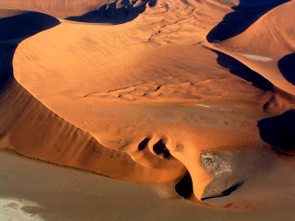
4. Dunes and airflow
Crescentic
Barchan Dune, Namib Desert

Slide 35
4. Dunes and airflow
Linear Dune
Straight or slightly sinuous sand ridges typically much longer than they are wide are known as linear dunes. They may be more than 160 kilometers (99 mi) long. Some linear dunes merge to form Y-shaped compound dunes. Many form in bidirectional wind regimes. The long axes of these dunes extend in the resultant direction of sand movement.

Slide 36
4. Dunes and airflow
Dome Dune
Oval or circular mounds that generally lack a slipface, dome dunes are rare, and these occur at the far upwind margins of sand seas.

Slide 37
4. Dunes and airflow
Parabolic Dune
U-shaped mounds of sand with convex noses trailed by elongated arms are parabolic dunes. These dunes are formed from blowout dunes where the erosion of vegetated sand leads to a U-shaped depression. The elongated arms are held in place by vegetation; the largest arm known on Earth reaches 12 km. Sometimes these dunes are called U-shaped, blowout, or hairpin dunes, and they are well known in coastal deserts. Unlike crescent shaped dunes, their crests point upwind. The bulk of the sand in the dune migrates forward.
In plan view, these are U-shaped or V-shaped mounds of well-sorted, very fine to medium sand with elongated arms that extend upwind behind the central part of the dune. There are slip faces that often occur on the outer side of the nose and on the outer slopes of the arms.

Slide 38
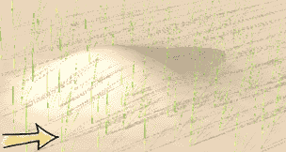
4. Dunes and airflow
Parabolic Dune

Slide 39
4. Dunes and airflow
Parabolic Dune

Slide 40
4. Dunes and airflow
Longitudinal (Seif) Dune
Longitudinal dunes (also called Seif dunes, after the Arabic word for "sword"), elongate parallel to the prevailing wind, possibly caused by a larger dune having its smaller sides blown away.
Seif dunes are sharp-crested and are common in the Sahara. They range up to 300 m (980 ft) in height and 300 km (190 mi) in length. In the southern third of the Arabian Peninsula, a region called the Empty Quarter because of its total lack of population, a vast erg called Rub al Khali contains seif dunes that stretch for almost 200 km and reach heights of over 300 m.
Seif dunes are thought to develop from barchans if a change of the usual wind direction occurs. The new wind direction will lead to the development of a new wing and the over development of one of the original wings. If the prevailing wind then becomes dominant for a lengthy period of time the dune will revert to its barchan form, with one exaggerated wing. Should the strong wind then return the exaggerated wing will further extend so that eventually it will be supplied with sand when the prevailing wind returns.

Slide 41
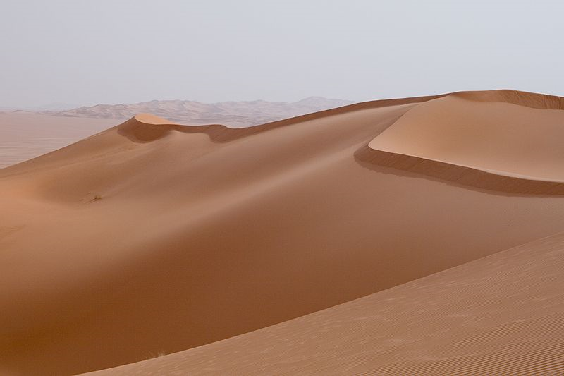
4. Dunes and airflow
Longitudinal (Seif) Dune

Slide 42
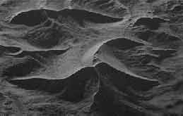
4. Dunes and airflow
Star Dune
Radially symmetrical, star dunes are pyramidal sand mounds with slipfaces on three or more arms that radiate from the high center of the mound. They tend to accumulate in areas with multidirectional wind regimes. Star dunes grow upward rather than laterally. They dominate the Grand Erg Oriental of the Sahara. In other deserts, they occur around the margins of the sand seas, particularly near topographic barriers. In the southeast Badain Jaran Desert of China, the star dunes are up to 500 metres tall and may be the tallest dunes on Earth.

Slide 43
4. Dunes and airflow
Reversing Dunes
Complex dune: Dune 7 in the Namib desert, one of the tallest in the world.
Occurring wherever winds periodically reverse direction, reversing dunes are varieties of any of the above shapes. These dunes typically have major and minor slipfaces oriented in opposite directions.

Slide 44
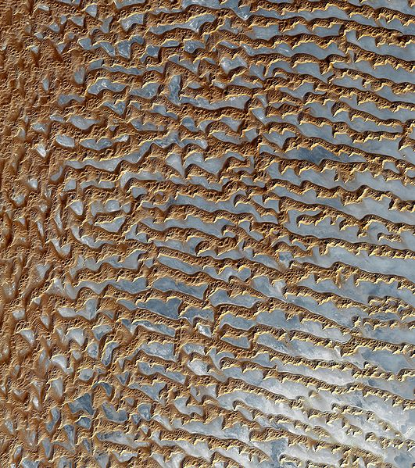
4. Dunes and airflow
Image of sand dunes in Rub' al Khali, Arabia's "empty quarter". Acquired by the Advanced Spaceborne Thermal Emission and Reflection Radiometer, or ASTER, aboard NASA's Terra Earth-orbiting satellite

Slide 45
4. Dunes and airflow
Erg Chebbi,
Morocco, Africa

Slide 46
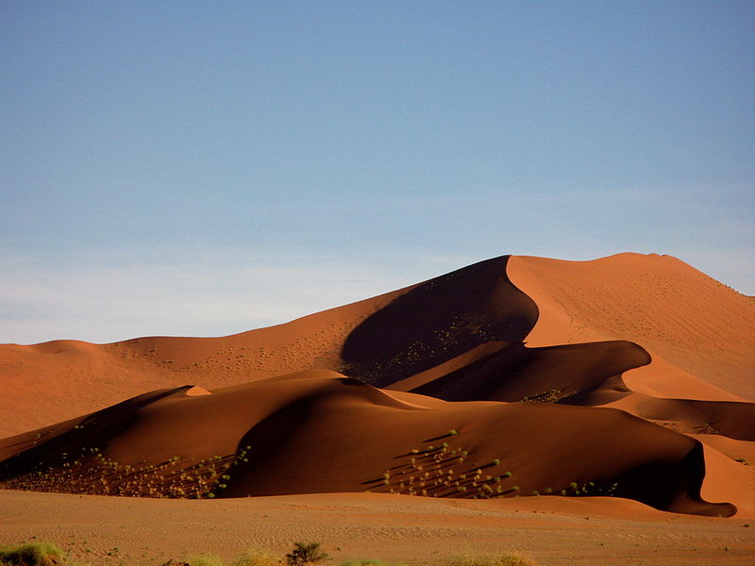
4. Dunes and airflow
Sand dune Sossusvlei Namibia.

Slide 47
4. Dunes and airflow
Avalanche deposits on a crest of the Kelso Dunes, California.

Slide 48
4. Dunes and airflow

Slide 49
4. Dunes and airflow
Ripples
amplitude = .01 – 100 cm, up to 20 cm apart
size fnc. (wind V, particle size, ripple type)
** most formed by bombardment of saltating grains and associated creep
impact ripples

Slide 50
4. Dunes and airflow
Dunes
Dune height and spacing are regular
Described by power function
D_{h}=cD_{s}^{n}
Dh
dune H
Ds
spacing
N
function of sand supply, wind speed
C
constant

Slide 51
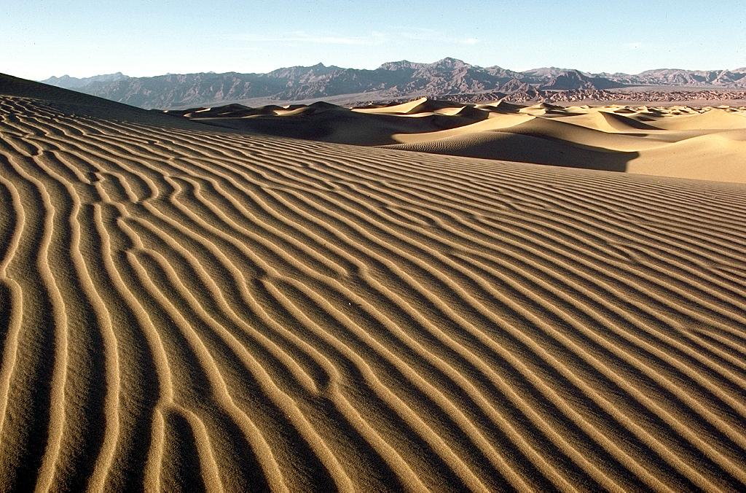
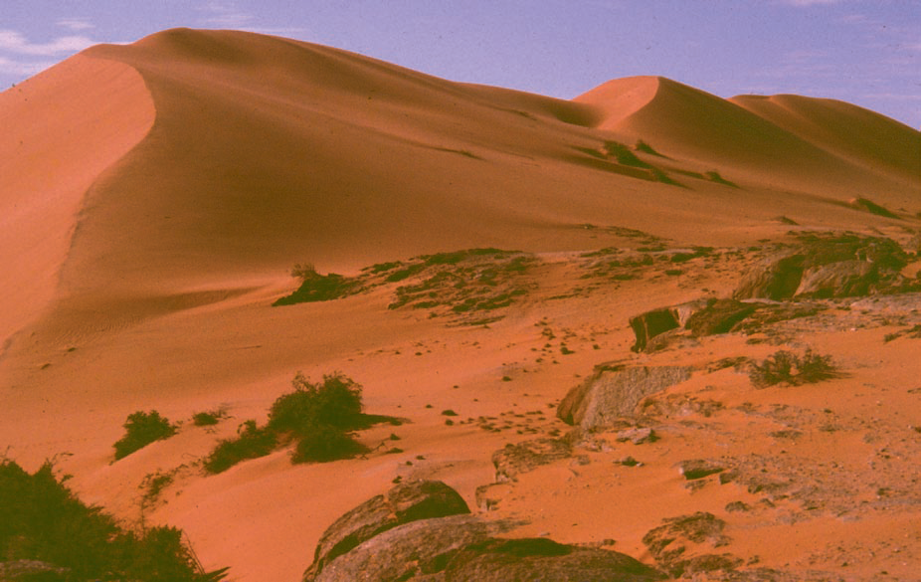
4. Dunes and airflow

Slide 52
4. Dunes and airflow
Interdune Areas
Deflation
low sand accumulation
Lags
Deposition
Dry or Wet

Slide 53
4. Dunes and airflow
Interdune Areas
Dry
Ripples formed from sands avalanching off dunes
Poor sorting
gently dipping layers with poor structure
Bioturbated
WET
water accumulates and traps silts/ clays
look for evidence of terrestrial life
Tracks
Diatoms
gastropods, etc.
Evaporites
when lake dries up, can get evaporates
Gypsum
mudcracks, other evidence of dessication

Slide 54
5. Loess deposits
Loess
is an aeolian sediment formed by the accumulation of wind-blown silt and lesser and variable amounts of sand and clay that are loosely cemented by calcium carbonate. It is usually homogeneous and highly porous and is traversed by vertical capillaries that permit the sediment to fracture and form vertical bluffs.
Yellowish-buff unstratified silt, sometimes calcareous, well sorted, with a modal grain size in the range 0.02-0.5 mm, and with pronounced vertical structure.
Loess often stands in either steep or vertical faces. Because the grains are angular, loess will often stand in banks for many years without slumping. This soil has a characteristic called vertical cleavage which makes it easily excavated to form cave dwellings, a popular method of making human habitations in some parts of China. Loess will erode very readily.

Slide 55
5. Loess deposits
Loess Formation
Glacial loess
Glacial loess is derived from the floodplains of glacial braided rivers that carried large volumes of glacial meltwater and sediments from the annual melting of continental icesheets and mountain icecaps during the summer. During the fall and winter, when melting of the icesheets and icecaps ceased, the flow of meltwater down these rivers either ceased or was greatly reduced. As a consequence, large parts of the formerly submerged and unvegetated floodplains of these braided rivers dried out and were exposed to the wind. Because these floodplains consist of sediment containing a high content of glacially ground flour-like silt and clay, they were highly susceptible to winnowing of their silts and clays by the wind. Once entrained by the wind, particles were then deposited downwind. The loess deposits found along both sides of the Mississippi River Alluvial Valley are a classic example of glacial loess.

Slide 56
5. Loess deposits
Loess Formation
Non-glacial loess
Non-glacial loess can originate from deserts, dune fields, playa lakes, and volcanic ash.
Some types of nonglacial loess are:
Volcanic loess in Ecuador and Argentina.
Tropical loess in Argentina, Brazil and Uruguay.
Gypsum loess in Spain.
Trade wind loess in Venezuela and Brazil
Anticyclonic loess in Argentina.
The thick Chinese loess deposits are non-glacial loess having been blown in from deserts in northern China. The loess covering the Great Plains of Nebraska, Kansas, and Colorado is non-glacial desert loess. Non-glacial desert loess is also found in Australia and Africa

Slide 57
5. Loess deposits
Dust stringers coming out of the Andes to the Pacific

Slide 58
5. Loess deposits
Loess
Chinese loess
Principal (continuous) sources are the Tibetan plateau and Chinese deserts
Thick deposits that continue over 3 Myrs
Soil units are developed during times when loess flux decreased (but not stopped).
Chronology
Luminescence, ¹⁴C, ash
¹⁰Be and magnetic susceptibility
Atmospheric 10Be and a measurement of the magnetization
Climate
¹⁰Be and mag. Susceptibility correlate with ¹⁸O record

Slide 59
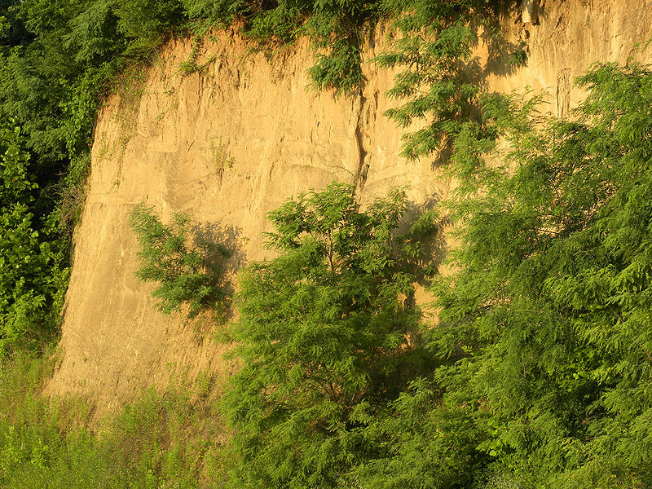
5. Loess deposits
Loess deposit exposed in a bluff (Vicksburg, Mississippi). (Wikipedia)

Slide 60
5. Loess deposits
Loess deposits in northern Patagonia, Argentina. (from Wikipedia)

Slide 61
Thank You !
DSRG
www.du.edu.eg/faculty/sci

