Slide 1
Depositional Environments Lec. 4 (part 2) Estuaries
DSRG
Dr. EHAB M. ASSAL
Damietta University

Slide 2
Paralic Environments

Slide 3
Boggs (2006), p.308.

Slide 4
Microtidal coasts
Under microtidal conditions wave action can maintain a barrier system that can be more or less continuous for tens of kilometres.
Exchange of water between the lagoon and the sea may be very limited, occurring through widely spaced inlets and as seepage through the barrier.
Coarse sedimentation in the lagoon will be largely restricted to washovers that occur during storms.
There is a strong likelihood of the lagoon waters becoming either brackish or hypersaline, depending upon the prevailing climate.

Slide 5
Mesotidal coasts
With the increased tidal range of mesotidal conditions, more exchange of water between the lagoon and the sea is required, resulting in more inlets forming, breaking up the barrier into a series of islands.
These inlets are the pathways for the tidal flows and the currents within them can be strong enough to redistribute sediment.
On the lagoon side of the barrier sediment washed through the channel is deposited in a flood-tidal delta.
Ebb-tidal deltas form on the seaward margin of the tidal channel as water flows out of the lagoon when the tide recedes.

Slide 6
Macrotidal coasts
Coasts that have high tidal ranges do not develop barrier systems because the ebb and flood tidal currents are a stronger control on the distribution of sediment than wave action.
A depositional coast in a macrotidal setting will be characterized by areas of intertidal mudflats that are covered at high tide and exposed at low tide.
Water flooding over these areas with the rising tide spreads out and loses energy quickly: only suspended load is carried across the tidal flats, and this is deposited when the water becomes still at high tide.

Slide 7
Estuaries
An estuary is the marine-influenced portion of a drowned valley.
A drowned valley is the seaward portion of a river valley that becomes flooded with seawater when there is a relative rise in sea level (a transgression). They are regions of mixing of fresh and seawater.
Sediment supply to the estuary is from both river and marine sources, and the processes that transport and deposit this sediment are a combination of river and wave and/or tidal processes.
An estuary is different from a delta because in an estuary all the sedimentation occurs within the drowned valley, whereas deltas are progradational bodies of sediment that build out into the marine environment.
A stretch of river near the mouth that does not have a marine influence would
not be considered to be an estuary.

Slide 8
Wave-dominated estuaries
An estuary developed
in an area with a small tidal range
and strong wave energy will typically have
three divisions:
the bay-head delta,
the central lagoon
the beach barrier.
Distribution of depositional settings
in a wave-dominated estuary.

Slide 9
Wave-dominated estuaries
Bay-head delta
The bay-head delta is the zone where fluvial processes are dominant.
As the river flow enters the central lagoon it decelerates and sediment is deposited.
The form and processes of a bay-head delta will be those of a river- dominated delta because the tidal effect is minimal and the barrier protects the central lagoon from strong wave energy.
A coarsening-up, progradational succession will be formed, with channel and overbank facies building out over sands deposited at the channel mouth, which in turn overlies fine-grained deposits of the central lagoon.

Slide 10
Wave-dominated estuaries
Central lagoon
The lowest energy part of the estuarine system is the central lagoon, where the river
flow rapidly decreases and the wave energy is mainly concentrated at the barrier bar.
The central lagoon is therefore a region of fine-grained deposition, often rich in organic material, similar to normal lagoonal conditions.
When the central lagoon becomes filled with sediment it becomes a region of salt-water marshes crossed by channels.
In wave-dominated estuaries, parts of the lagoon that receive influxes of sand may be areas where wave-ripples form and these may also be draped with mud.

Slide 11
Wave-dominated estuaries
Beach barrier
The outer part of a wave-dominated estuary is a zone where wave action reworks marine sediment (bioclastic material and other sediment reworked by longshore drift) to form a barrier.
The characteristics of the barrier will be the same as those found along clastic coasts.
An inlet allows the exchange of water between the sea and the central lagoon, and if there is any tidal current, a flood-tidal delta of marine-derived sediment

Slide 12
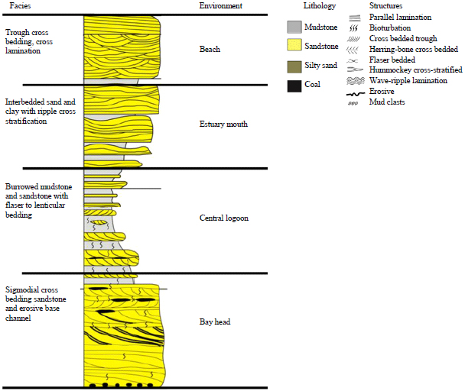
Wave-dominated estuaries
Successions in wave-dominated estuaries
The sedimentary succession deposited in the estuary will reflect the three divisions of the system, although they may not all occur in a single vertical succession.
The relative thicknesses of each will depend on the balance between fluvial and marine supply of sediment: if fluvial supply is greatest, the bay-head delta facies will dominate, whereas the barrier deposits will be more important if the marine supply is higher.

Slide 13
Tide-dominated estuaries
Tidal processes may dominate in mesotidal and macrotidal
coastal regimes where tidal current energy exceeds wave energy at the estuary mouth.
The funnel shape of an estuary tends to increase the flood-tidal current strength, but decreases to zero at the tidal limit, the landward extent of tidal effects in an estuary. The river flow strength decreases as it interacts with the tidal forces that are dominant.
Three areas of deposition can be identified:
tidal channel deposits,
tidal flats
Tidal sand bars

Slide 14
Tide-dominated estuaries
Tidal channels
In the inner part of the estuary where the river channel is influenced by
tidal processes, the low-gradient channel commonly adopts a meandering form.
Point bars form on the inner banks of meander bends in the same way as purely fluvial systems, but the tidal effects mean that there are considerable fluctuations in the strength of the flow during different stages of the tidal cycle: when a strong ebb tide and the river act together, the combined current may transport sand, but a strong flood tide may completely counteract the river flow, resulting in standing water, which allows deposition from suspension.
The deposits in the point bar are therefore heterolithic, that is, they consist of more than one grain size, in this case alternating layers of sand and mud

Slide 15
Tide-dominated estuaries
Tidal flat
Adjacent to the channels and all along the sides of the estuary there are tidal flat areas that are variably covered with seawater at high tide and subaerially exposed at low tide.
These are typically vegetated salt marsh areas cut by tidal creeks that act as the conduits for water flow during the tidal cycles.
The processes and products of deposition in these settings are the same as found in macrotidal settings.

Slide 16
Tide-dominated estuaries
Tidal sand bar
The outer part of a tide-dominated estuary is the zone of strongest tidal currents, which transport and deposit both fluvially derived sediment and material brought in from the sea.
In macrotidal regions the currents will be strong enough to cause local scouring and to move both sand and gravel: bioclastic debris is common amongst the gravelly detritus deposited as a lag on the channel floor.
Dune bedforms are created and migrate with the tidal currents to generate cross-bedded sandstone beds.
Evidence for tidal conditions in these beds may include mud drapes,
reactivation surfaces and herringbone cross-stratification

Slide 17
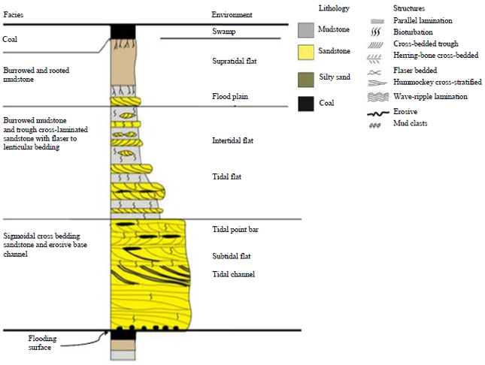
Tide-dominated estuaries
Facies Model
A succession formed in a tide-dominated estuary will consist of a combination of tidal channel, tidal flat and tidal bar deposits.
The base of a tidal channel is marked by a scour and lag, and will typically be followed by a fining-upwards succession of cross- bedded sands, which may show mud drapes, inclined heterolithic stratification.
Channel and bar deposits may also show bi- directional palaeocurrent indicators. Muddy tidal flat deposits rich in organic material may contain sandy sediment deposited within tidal creeks, at the highest tides and during storms.

Slide 18
Tide-dominated estuaries
Recognition of estuarine deposits
There are many features in common between the deposits of deltas and estuaries in the stratigraphic record.
Both are sedimentary bodies formed at the interface between marine and continental environments and consequently display evidence of physical, chemical and biological processes that are active in both settings (e.g. an association of beds containing a marine shelly fauna with other units containing rootlets).
The key difference is that a delta is a progradational sediment body, that is, it builds out into the sea and will show a coarsening-up succession produced by this progradation.
In contrast, estuaries are mainly aggradational, building up within a drowned river channel. The base of an estuarine succession is therefore commonly an erosion surface scoured at the mouth of the river, for example, in response to sea level fall.

Slide 19
Tide-dominated estuaries
Recognition of estuarine deposits
It may be difficult to distinguish between the deposits of a tidal estuary and a tide- dominated delta if there is limited information and it is difficult to establish whether the succession is aggradational and valley-filling or progradational.

Slide 20
Tide-dominated estuaries
Beach/barrier systems
lithology – sand and conglomerate
mineralogy – mature quartz sands and shelly sands
texture – well sorted, well rounded clasts
bed geometry – elongate lenses
sedimentary structures – low-angle stratification and wave reworking
palaeocurrents – mainly wave-formed structures
fossils – robust shelly debris
colour – not diagnostic
facies associations – may be associated with coastal plain, lagoonal or shallow-marine facies

Slide 21
Tide-dominated estuaries
Lagoon
lithology – mainly mud with some sand
mineralogy – variable
texture – fine-grained, moderately to poorly sorted
bed geometry – thinly bedded mud with thin sheets and lenses of sand
sedimentary structures – may be laminated and wave rippled
palaeocurrents – rare, not diagnostic
fossils – often monospecific assemblages of hypersaline or brackish tolerant organisms
colour – may be dark due to anaerobic conditions
facies associations – may be associated with coastal plain or beach barrier deposits

Slide 22
Tide-dominated estuaries
Tidal channel systems
lithology – mud, sand and less commonly conglomerate
mineralogy – variable
texture – may be well sorted in high energy settings
bed geometry – lenses with erosional bases
sedimentary structures – cross-bedding and cross lamination and inclined heterolithic stratification
palaeocurrents – bimodal in tidal estuaries
fossils – shallow marine
colour – not diagnostic
facies associations – may be overlain by fluvial,
shallow marine, continental or delta facies.

Slide 23
Tide-dominated estuaries
Tidal mudflats
lithology – mud and sand
mineralogy – clay and shelly sand
texture – fine-grained, not diagnostic
bed geometry – tabular muds with thin sheets and lenses of sand
sedimentary structures – ripple cross- amination and flaser/lenticular bedding
palaeocurrents – bimodal in tidal estuaries

Slide 24
Thank You !
DSRG
www.mans.edu.eg/FacSciD

