Slide 1
Depositional Environments Carbonate depositional environments
DSRG
Dr. EHAB M. ASSAL
Damietta University

Slide 2
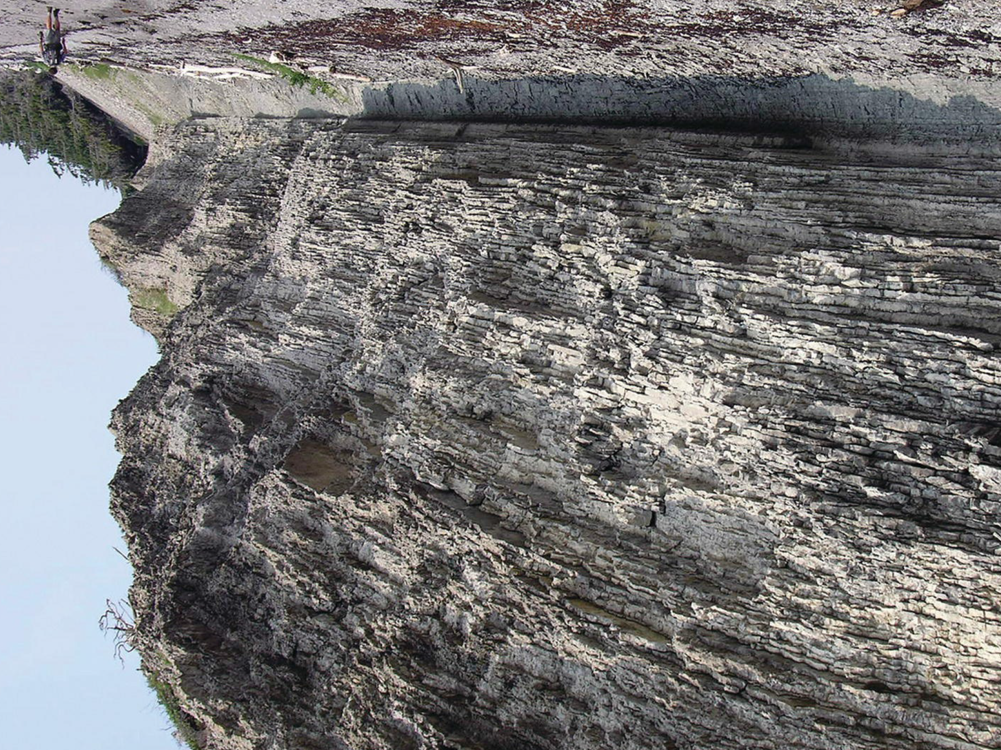
Carbonate depositional environments
Frontispiece Cliff of Upper Ordovician carbonate storm deposits, Anticosti Island, Québec,
Canada, person for scale at left.

Slide 3
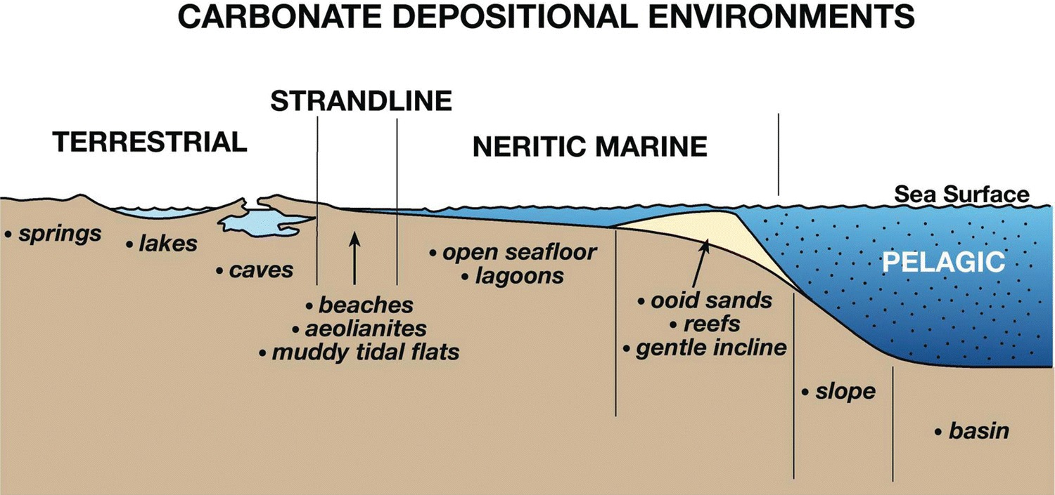
Carbonate depositional environments
A simplified cross-section of the suite of sedimentary environments encountered in carbonate depositional systems.

Slide 4
Carbonate depositional environments
Carbonate depositional systems occur on land, across shallow marine settings, and onto the deep sea or basin floor.
1. Terrestrial systems
2. Strandline systems
3. Marine systems

Slide 5
Carbonate depositional environments
Terrestrial systems
Carbonate rocks occur in a variety of terrestrial settings, with the most important being: (1) lakes, marshes, and soils; (2) caves; and (3) springs. Like their marine cousins, however,
water is always involved, carbonate saturation states are important, and organisms are generally participating in one way or another. This part of the book concentrates on lake, lake margin, and spring depositional systems.

Slide 6
Carbonate depositional environments
1. Lakes and marshes
Limestones and dolostones generated in these environments are by far the most extensive and economically important terrestrial accumulations.
Deposits form in freshwater or saltwater lakes under a variety of climate regimens, ranging from environments that are highly vegetated in humid regions to evaporitic in arid areas.
Lacustrine carbonates such as those in the Caspian Sea and Great Salt Lake rival many marine basins in size and stratigraphic thickness.
Palustrine carbonates are mostly shallow freshwater deposits that have undergone extensive pedogenic modification, particularly in swamps and marshes

Slide 7
Carbonate depositional environments
2. Springs
Calcareous spring deposits develop wherever carbonate-charged subsurface waters emerge at the surface of the Earth.
Circulated at various depths within the crust, spring waters range from cold (<10 °C) to boiling (100 °C), from acidic (in some cases with pH<1) to alkaline (pH>8), and can contain many different dissolved solids at highly variable concentrations.
Carbonate spring deposits are widespread, with the precipitation of calcite, aragonite, or both (and even dolomite in rare examples) being influenced by local climate.
Microbes typically play a critical formative role in this style of carbonate precipitation.

Slide 8
Carbonate depositional environments
Strandline systems
1. Muddy tidal flats
These low-energy peritidal depositional systems are widespread in time and space.
They occur along protected shorelines and form by the combined action of daily tides and cyclonic storms, the latter sweeping muddy waters onto the flats. Sequences comprise stacked subtidal, intertidal, and supratidal deposits.
The character of such cycles is a function of local climate and the nature of the adjacent subtidal environments.
Many such sequences can be stacked on one another to form impressive successions of rocks.

Slide 9
Carbonate depositional environments
Strandline systems
2. Beaches and aeolianites
Beaches are generally adjacent to grainy high-energy shelf systems.
They are best developed on open shelves and on inner ramps where waves and swells sweep unimpeded onshore.
These deposits have the same general attributes as siliciclastic beaches.
One important difference, especially in the tropics, is the presence of carbonate beachrock layers in the intertidal zone.

Slide 10
Carbonate depositional environments
Marine systems
1. Open seafloor
This can be the widest and most areally extensive of all depositional systems.
The deposits are known as subtidal and, in the past, have formed vast shallow illuminated ocean floors (epeiric seas).
Under normal marine salinities, this environment is a prolific carbonate factory. Muddy sediments formed in a protected lagoon.
They occur as epifaunal, infaunal and binding, boring and burrowing, constructing and destructing, autotrophs
and heterotrophs.

Slide 11
Carbonate depositional environments
2. Shelf edge
It effectively forms the boundary between the open ocean and the shallow-water shelf or lagoon.
Reefs, sand shoals, or both characterize this zone in tropical systems.
The shelf edge in cool-water systems is generally devoid of reefs because ocean conditions preclude the growth of corals and other reef-forming organisms.
The shelf edge or margin on these temperate shelves is generally deep with a gradually increasing gradient into the slope proper.

Slide 12
Carbonate depositional environments
3. Slopes
Carbonate slopes pass from shallow to deep water and have inclines that range from <1° to >30° to subvertical.
They are the middle- and outer-ramp environment and the generally steep slope between the shallow rimmed platform margin and basin.
Deposition takes place either on the slope proper or sediment sweeps across the slope to accumulate at the base of slope along the basin margin.
The deposits are a combination of pelagic carbonate fallout and sediment gravity flows.

Slide 13
Carbonate depositional environments
3. Slopes
Carbonate slopes pass from shallow to deep water and have inclines that range from <1° to >30° to subvertical.
They are the middle- and outer-ramp environment and the generally steep slope between the shallow rimmed platform margin and basin.
Deposition takes place either on the slope proper or sediment sweeps across the slope to accumulate at the base of slope along the basin margin.
The deposits are a combination of pelagic carbonate fallout and sediment gravity flows.

Slide 14
Carbonate depositional environments
4. Pelagic carbonates
These deep-water systems comprise fine-grained sediment and the skeletons of calcareous plankton.
Deposition also takes place via the fallout of mud generated by storms on the platform or ramp and swept out to sea.
Such deposits are rare in the Paleozoic because there were no calcareous plankton, but are prolific in post-Jurassic sediments.

Slide 15
Depositional Environments Lec. 9 Lacustrine Carbonates
DSRG
Dr. EHAB M. ASSAL
Damietta University

Slide 16
Lacustrine carbonates

Slide 17
Outline
1
Modern lakes
2
Controls on lake sedimentation
3
Lake sedimentation
4
Lacustrine microbialites
5
Classification of ancient lake deposits

Slide 18
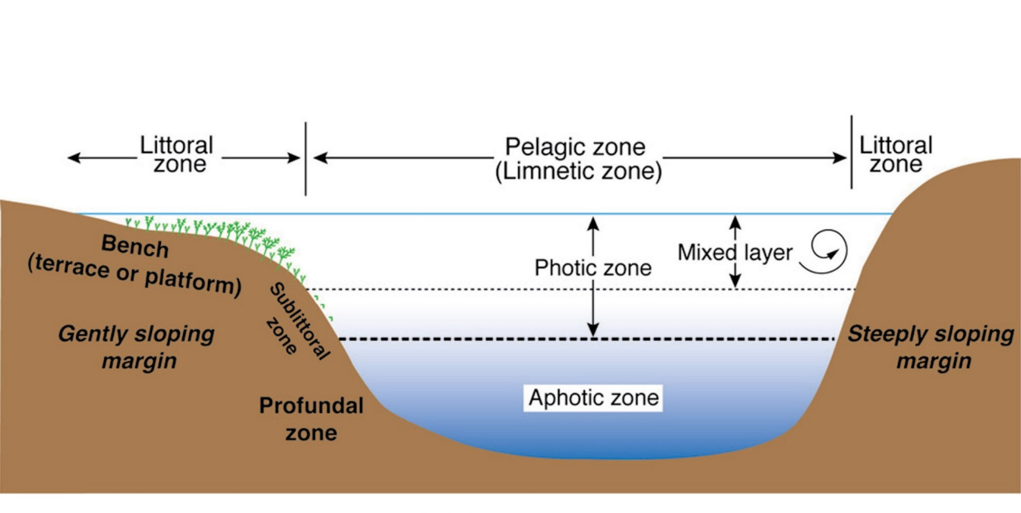
Modern lakes
The lake environment is divided into the littoral, sublittoral, profundal, and pelagic zones.
Zonation of lakes. from Renaut and Gierlowski-Kordesch (2010).

Slide 19
Modern lakes
The littoral zone encompasses the shallow water around the lake margin.
The profundal zone is the deep, aphotic part of the lake where little or no light penetrates.
The littoral zone in many lakes is characterized by a shallow-water “bench” or “terrace” that extends out from the shoreline.
The sublittoral zone refers to the transition region between the littoral zone and the deeper, profundal part of the lake.
The pelagic zone is the water column above the profundal zone.

Slide 20
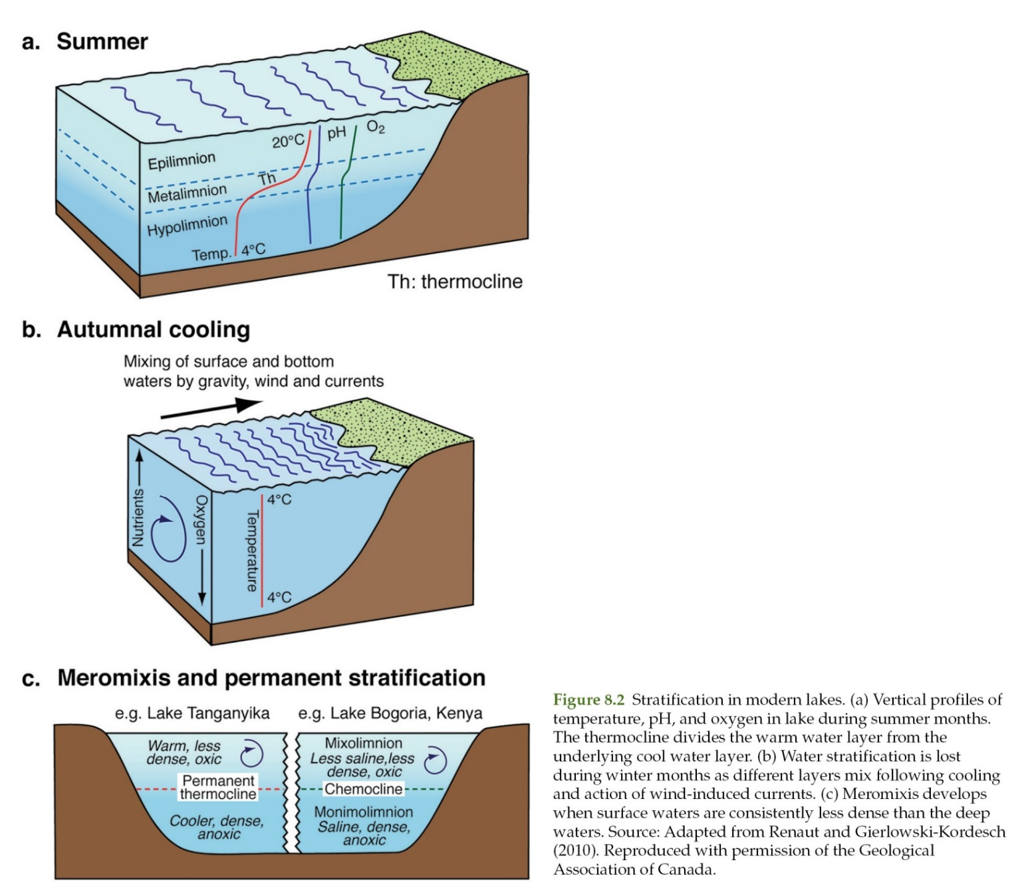
Modern lakes

Slide 21
Controls on lake sedimentation
Carbonate sedimentation in lakes is determined by the interplay between different extrinsic and intrinsic parameters. The main extrinsic factors are climate and tectonics, whereas the dominant intrinsic factors are hydrology, sediment sources, and lake stratification and mixing.
Hydrology
Climate
Sediment input
Lake stratification and mixing

Slide 22
Controls on lake sedimentation
Hydrology
Irrespective of location, lake hydrology is linked to the local climate and tectonics because these factors control the large-scale water input and hydrology of the region.
Water enters a lake via precipitation (rain, snow), surface runoff, groundwater seepage, or sub-lacustrine springs.
Critically, these waters are also responsible for bringing carbonates into the lake as bedload, as suspended load, or in solution.
The potential for carbonate sedimentation is high when the bedrock around a lake is limestone or dolostone, but low if the bedrock is noncarbonated rock (e.g., siliciclastic sedimentary rocks and most igneous and metamorphic rocks).

Slide 23
Controls on lake sedimentation
Hydrology
Large amounts of carbonate can be introduced into lakes via subaqueous springs.
As in any depositional setting, water movement can have a major impact on the manner in which the carbonate sediments form, accumulate, and are redistributed.
Unlike marine settings, lakes are tideless and hence do not experience a regular short-term rise and fall in water level.
This lack of tides could partly explain why the stratification of lake waters is not disturbed on a more frequent and regular basis.
Waves and currents are instead largely wind-driven with wave amplitude and current strength being dependent on the size and orientation of the lake relative to the wind direction.

Slide 24
Controls on lake sedimentation
Climate
Lakes with carbonate sediments are not restricted to specific climatic zones. Lacustrine carbonates are, for example, well known from Antarctica, Australia, Africa, and northern Canada.
Climate is important because rainfall and temperature control the net water balance by determining water input via precipitation and water loss via evaporation.
Climate can also influence carbonate sedimentation by dictating periods of biogenic activity (e.g., planktonic blooms), seasonal variance in calcite and aragonite precipitation, and varve development.

Slide 25
Controls on lake sedimentation
Sediment input
Lacustrine sediments are various mixtures of precipitated minerals, detrital material, and biological components. Abiogenic mineral precipitation is controlled by the composition of the water, whereas the biogenic components are intimately related to the resident biota.
Abiogenic precipitates include a diverse range of Ca-, Mg-, Mn-, Ba-, Sr-, Fe-, and Nacarbonates. There are at least 33 different carbonate minerals known from lacustrine deposits.

Slide 26
Controls on lake sedimentation
Sediment input
The diversity of these precipitated minerals reflects the chemical diversity of lake waters.
Although calcium carbonate (aragonite, calcite) and magnesium carbonates (magnesite, hydromagnesite) are the most common precipitates (Figure 8.4), dolomite is also found in many lake sediments.
Precipitation of the carbonate minerals takes place when the waters become supersaturated due to evaporation, cooling, or CO2 degassing.
Degassing is generally restricted to the shallow parts of the lake and surface waters.

Slide 27
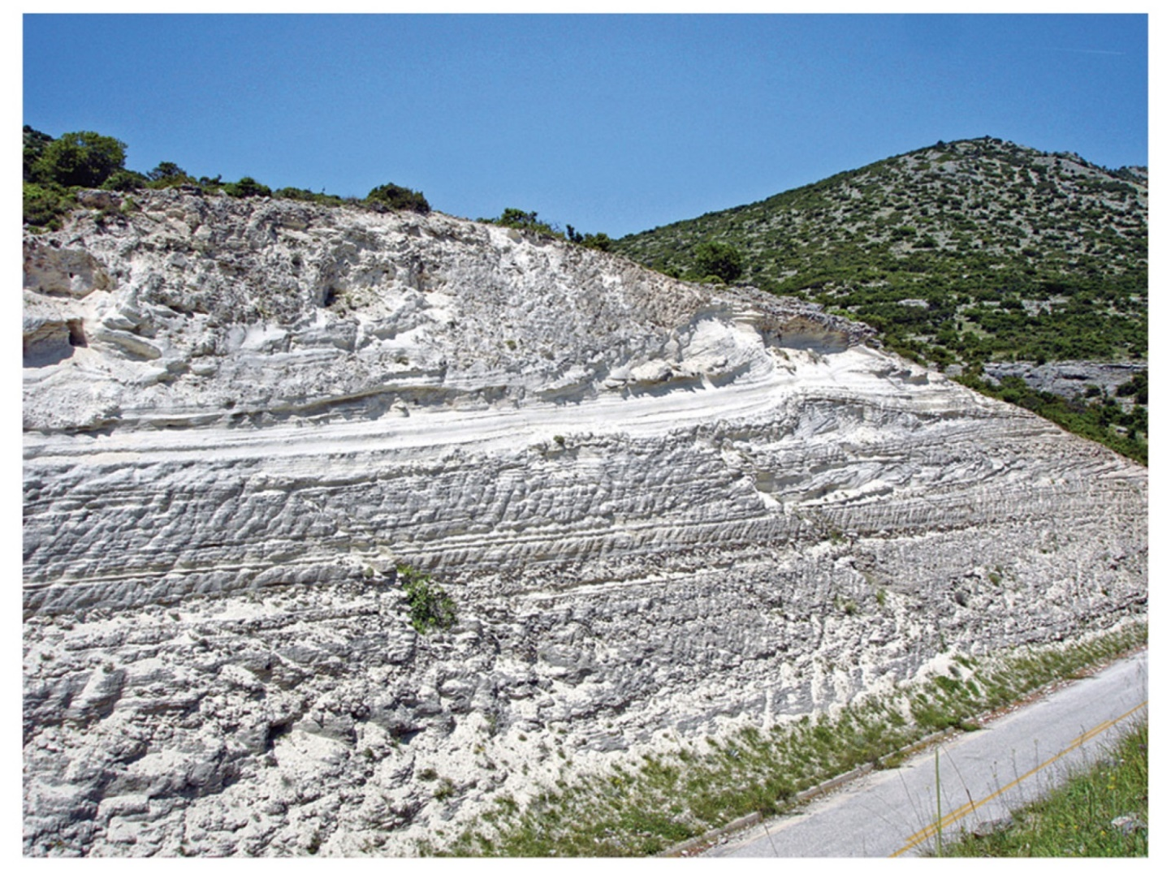
Controls on lake sedimentation
Figure 8.4 Succession of Miocene lacustrine carbonates formed largely of hydromagnesite and magnesite, marginal facies of the Kozani Basin, Greece. Outcrop: ~10 m high.

Slide 28
Controls on lake sedimentation
Lake stratification and mixing
Lake stratification, which is controlled by the heating and cooling of surface waters, has a significant impact on the sediments that form and develop in the lake.
Bottom waters in the aphotic zone of stratified lakes are isolated from the atmosphere and so rapidly become oxygen depleted through bacterial activity.
This creates dysoxic or anoxic conditions that preclude habitation by most organisms, but promote preservation of organic matter.

Slide 29
Controls on lake sedimentation
Lake stratification and mixing
Other consequences of stratification and mixing include:
recycling of nutrient elements (N, P) from the bottom waters to surface waters that typically stimulate planktic productivity;
cooling or warming of bottom and surface waters, which can curtail or promote carbonate formation and biological activity; and
renewed oxygenation of bottom waters, that can lead to mineral precipitation (e.g., Fe and Mn minerals) and promote sediment bioturbation by benthic organisms.

Slide 30
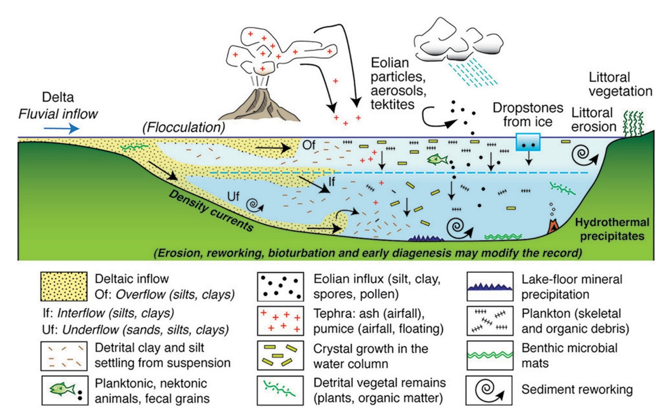
Controls on lake sedimentation
Potential sources of sediment in the central, open parts of lakes.
Source: Adapted from Renaut and Gierlowski-Kordesch (2010)

Slide 31
Lake sedimentation
Lake sediments are usually separated into a shoreline facies and a lake centre facies.
Shoreline facies
The development of carbonate deposits along the shoreline depends on how much carbonate is delivered by inflowing waters.
Benches commonly form along steep lake margins, whereas ramps are associated with low-gradient shorelines.
Irrespective of the lake floor configuration, sedimentation in this littoral zone is largely dictated by hydrodynamics.

Slide 32
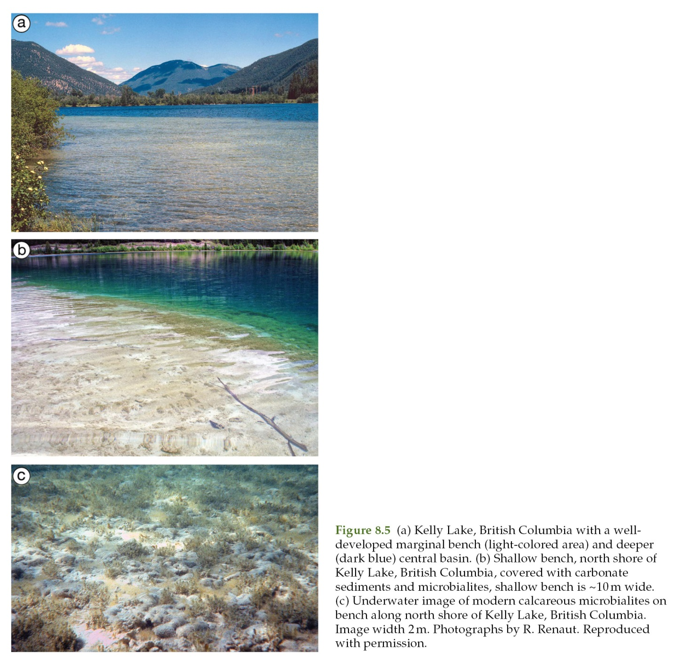
Lake sedimentation

Slide 33
Lake sedimentation
Low-energy carbonate benches (Previous slide) are usually covered with marl (>50% carbonate mud) and carbonate sand with the constituents coming from: (1) the breakdown of ostracods, bivalves, and gastropods shells; (2) sand and mud precipitation associated with charophytes; or (3) bio-induced carbonate mud that precipitates in the water column.
With ample sunlight, charophytes form dense carpets that cover the lower bench and slope.
Oncoids (a) and stromatolites (b, c) can be abundant in shallow, nearshore waters. Strandline facies include beachrock, palustrine marshes, sand shoals and beaches, marl and micrite benches, marl and micrite ramps, or microbialites and microbial bioherms.

Slide 34
Lake sedimentation
Oncoids (a) and stromatolites (b, c) can be abundant in shallow, nearshore waters.
Stromatolites growing along shoreline area of Clifton Lake, Australia. Foreground width 10 m
Underwater view of margin of a growing stromatolite, Clifton Lake, Australia. Image width 50 cm.

Slide 35
Lake sedimentation
Strandline facies include beachrock, palustrine marshes, sand shoals and beaches, marl and micrite benches, marl and micrite ramps, or microbialites and microbial bioherms.
Beachrock:
This limestone forms as sheets of lithified sediment that accumulated as older deposits along the shoreline, cemented by calcite and aragonite (Figure 8.7).
Beachrock typically develops with the lowering of lake levels and is usually associated with the input of groundwater along the lake margins.

Slide 36
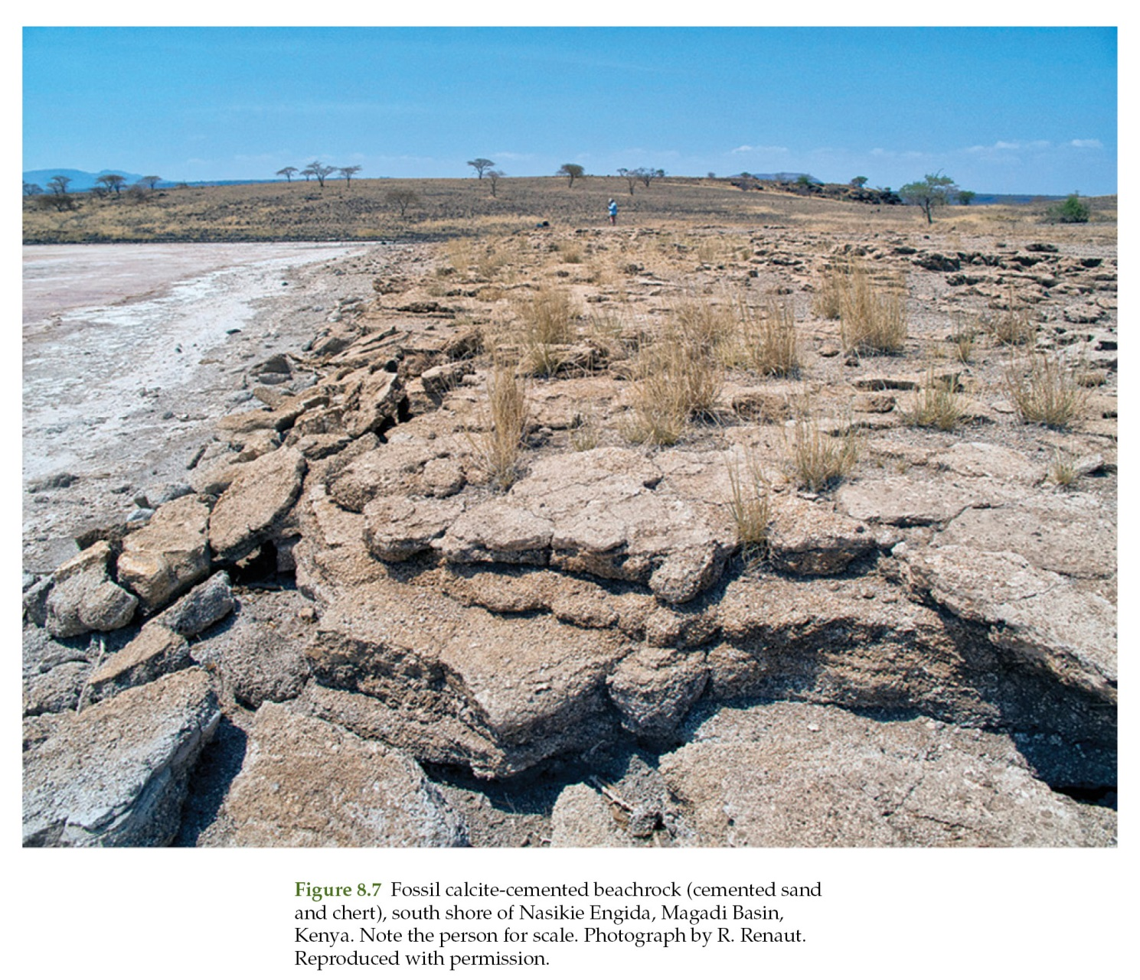
Lake sedimentation

Slide 37
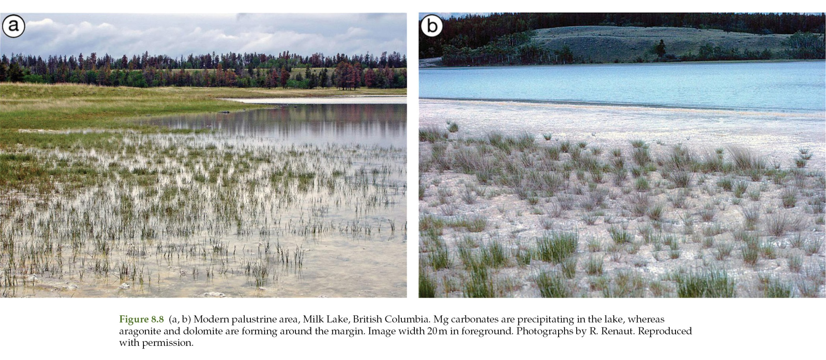
Lake sedimentation
Palustrine marsh:
These marshes, found around lake margins, are subject to highly variable environmental conditions (Figure 8.8).

Slide 38
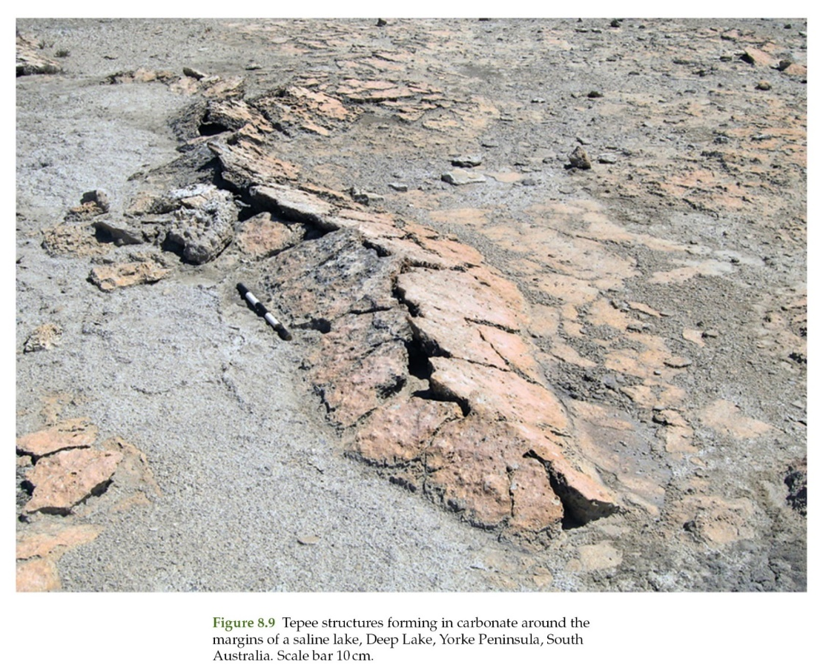
Lake sedimentation
Palustrine marsh:
Deposits are muddy and include pedoturbation (disturbance of the soil by burrowing animals), various diagenetic fabrics that develop as a result of subaerial exposure (e.g., teepee structures - Figure 8.9) brecciation, rhizoliths, sparmicrite, and peats and coals.

Slide 39
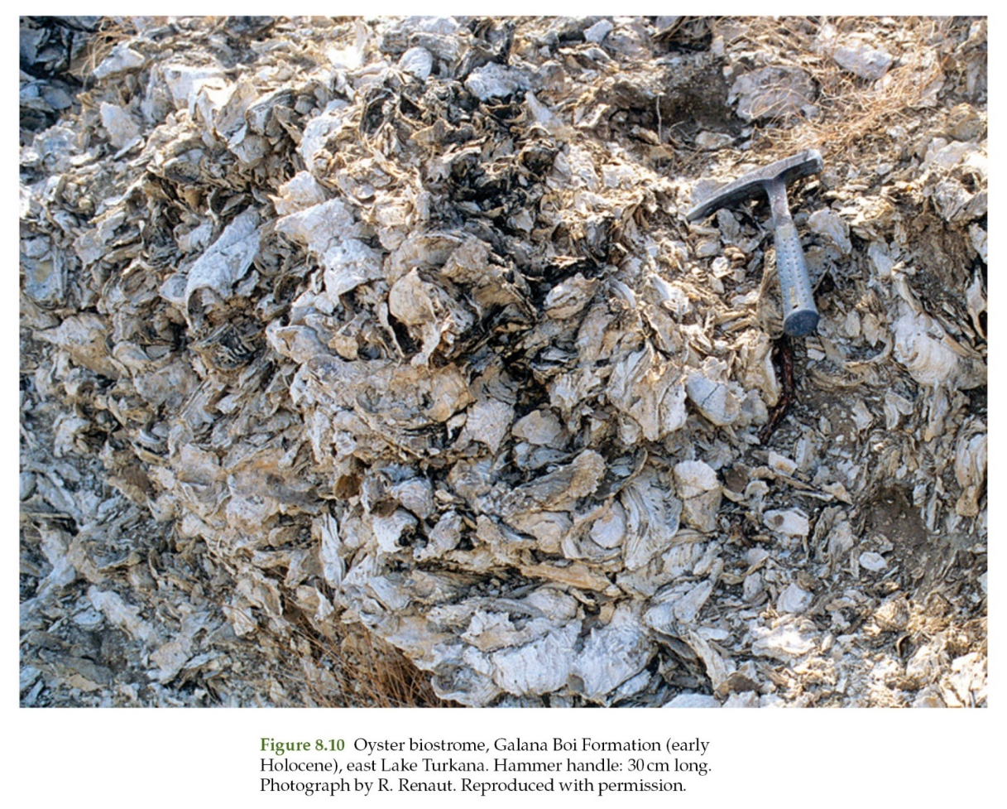
Lake sedimentation
Shoals and beaches:
Coarse-grained ooids or biofragments and exhibit ripple cross-laminations or low-angle cross-stratification. Shell coquinas can be composed of ostracods, bivalves (Figure 8.10), and gastropods.

Slide 40
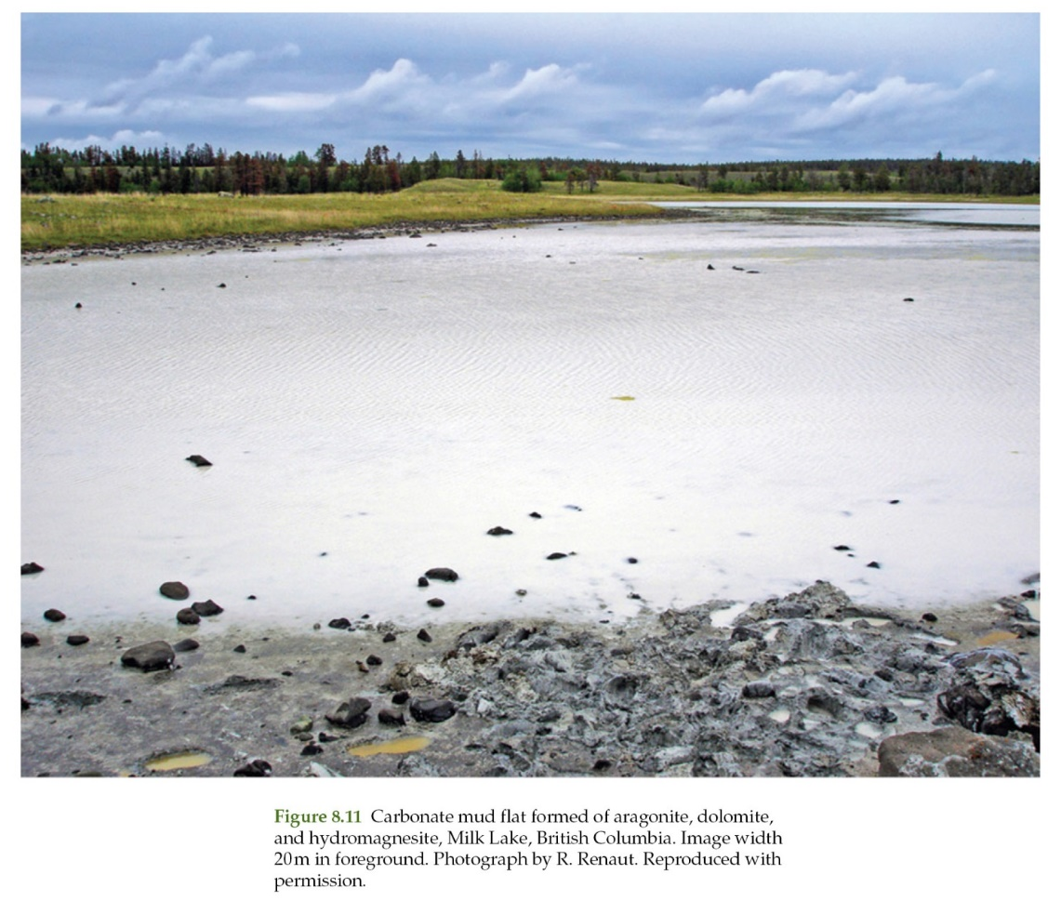
Lake sedimentation
Marl-micrite benches:
Sediments are predominantly fine-grained marls and silts with grains derived from charophytes, mollusks, ostracods, and plant material (Figure 8.11).
Oncoids, ooids, and microbialites can be numerous, whereas bioturbation is ubiquitous.
Sediment gravity flow deposits including turbidites are common on slopes.

Slide 41
Lake sedimentation
Marl-micrite ramps:
Typical sediments include structureless fine-grained carbonates, silts, and sands with associated biofragments, local coquinas, ooids, oncoids, charophytes, intraclasts, and plant material; microbialites are locally conspicuous.

Slide 42
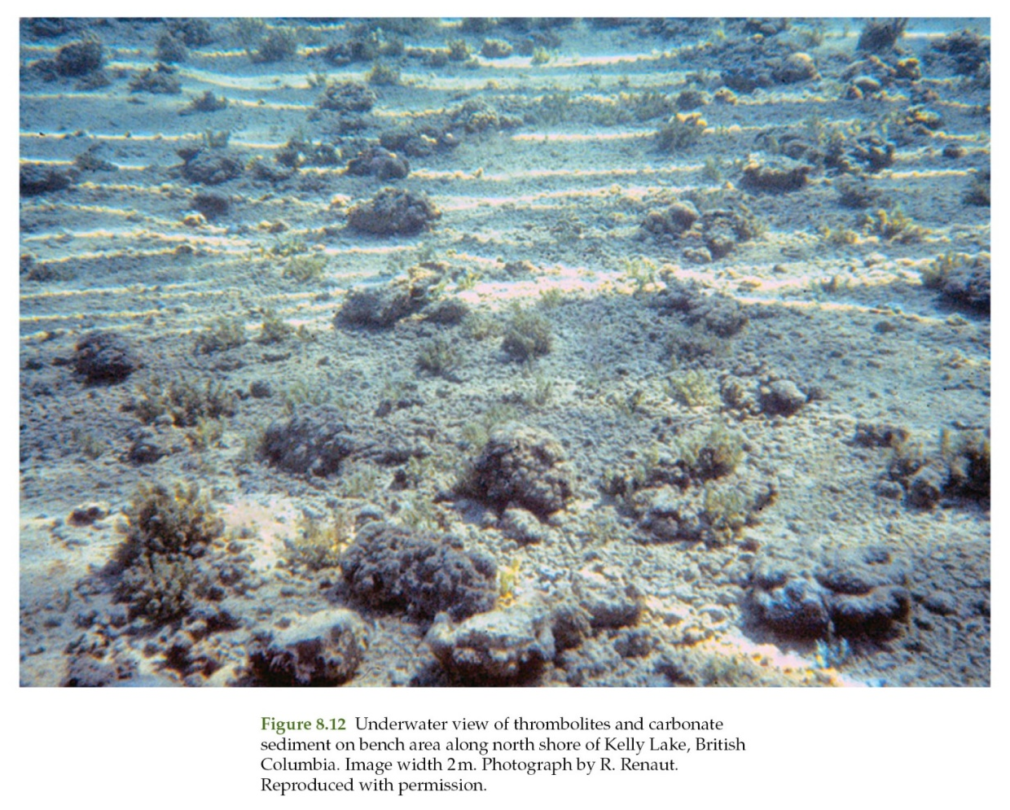
Lake sedimentation
Microbialites-bioherms:
Microbial buildups constructed by algae and bacteria can be up to decimeters in scale and sub-hemispherical, domal, bushy, columnar, or crust-like in morphology (Figure 8.12).

Slide 43
Lake sedimentation
Lake center and pelagic environments
The central parts of perennial lake floors, beyond the influence of shoreline processes, are usually covered with allochthonous or autochthonous fine-grained sediment. Water depth exerts a critical control over sediment generation and accumulation. All of the lake floor in shallow lacustrine systems can lie within the photic zone with plants covering the entire sediment surface. The sediment floor in deep lakes will lie below the photic zone where dark and even anoxic conditions can prevail.

Slide 44
Lake sedimentation
Lake center and pelagic environments
The combination of low water temperature and low oxygen levels in some lakes can lead to carbonate undersaturation and dissolution.
Deep lake sediments come from many different sources, including
(1) skeletal grains derived from ostracods, bivalves, gastropods, or charophyte debris;
(2) detrital grains from the catchment area; and
(3) bio-induced calcite and aragonite precipitation.
The precipitation of aragonite as opposed to calcite is largely determined by:
(1) ambient water temperature;
(2) Mg: Ca ratio of the water;
(3) dissolved organic matter; and
(4) carbonate supersaturation levels.

Slide 45
Lake sedimentation
Lake center and pelagic environments
Limestone facies of lake center and pelagic environments are structureless, laminated, and transported.
Massive (structureless) limestones:
These deposits include mudstones, wackestones, grainstones, and marlstones that may or may not contain scattered fossils.
The structureless nature of the limestones is generally attributed to bioturbation, where oxygenated waters allow an active infauna to burrow the sediments.

Slide 46
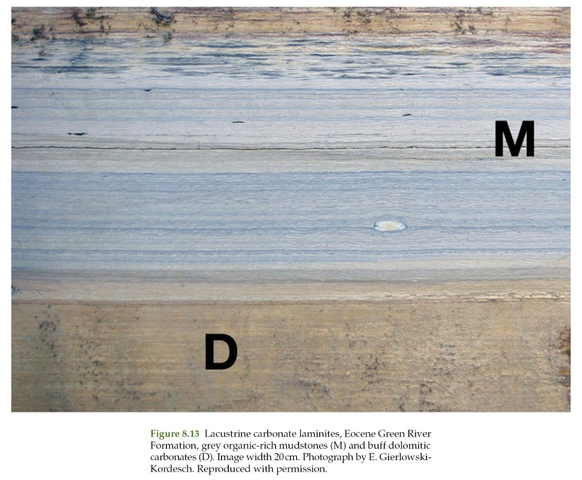
Lake sedimentation
Lake center and pelagic environments
Laminated limestones:
These finely layered carbonates, with laminae of variable thickness and lateral extent, generally form from sediments that settle out of suspension (Figure 8.13).
Laminations develop where there are temporal variations in the amount of sediment input and where the sediments, once deposited, remain largely undisturbed.

Slide 47
Lake sedimentation
Lake center and pelagic environments
Temporal variations in many lakes are seasonal with distinct differences between the summer and winter deposition. Terms used to describe these types of deposit include:
(1) varves, which represent summer and winter couplets, that form on an annual basis in glacial lakes;
(2) non-glacial varves that form in all other lakes; and
(3) rhythmites or couplets of alternating composition that form over unknown time frames.
Rhythmite laminae can be variable because they accumulate in response to both seasonal changes and other nonpredictable variations in lake sedimentation.

Slide 48
Lake sedimentation
Lake center and pelagic environments
As such, care must be taken in the interpretation of such deposits because they can accumulate in response to:
(1) seasonal changes in runoff patterns;
(2) seasonal changes in water temperature and stratification that can control nutrient and saturation levels with respect to specific minerals;
(3) seasonal changes in salinity; and
(4) monsoons in tropical areas that affect rainfall and wind direction and intensity.

Slide 49
Lacustrine microbialites
Lacustrine microbialites, including stromatolites and thrombolites, are found throughout the world including the ice-covered lakes of Antarctica, the highly alkaline lakes in East Africa, the high-altitude lakes at elevations of 4000 m in the Andes, the hypersaline lakes in western Australia, and commonly in “normal” freshwater lakes.
These microbialites are various in size, morphology, and areal extent. It has been estimated, for example, that microbialite bioherms cover ~1000 km2 in the Great Salt Lake.
Enormous tower-like microbialites up to 40 m high have developed in water more than 100 m in Lake Van in eastern Anatolia, Turkey.
Elsewhere, much smaller but numerous lacustrine stromatolites are restricted to the shallow photic zone.

Slide 50
Lacustrine microbialites
Microbialites are developed in lakes, as in the ocean due to the absence of grazing organisms, which is generally attributed to high salinity.
This microbialites also grow in brackish water lakes (Lake Clifton) and freshwater lakes.
Stromatolites growing along shoreline area of Clifton Lake, Australia. Foreground width 10 m
Underwater view of margin of a growing stromatolite, Clifton Lake, Australia. Image width 50 cm.

Slide 51
Lacustrine microbialites
Lakes with microbialites are located in limestone terrains, and the groundwater is rich in calcium bicarbonate. Nutrient levels are also important because they dictate the nature of the lake microbiota.
Low nutrient levels, for example, can be responsible for the lack of grazers that curtail the growth and spread of microbialites.
Lacustrine microbialites generally have poorly developed laminae; overall, thrombolites rather than stromatolites seem to be the most common types.
Thrombolitic buildups are up to 30 m wide and 5 km long in Lake Clifton in Western Australia are formed largely of the aragonite that is precipitated in association with the filamentous cyanobacterium Scytonema.

Slide 52
Lacustrine microbialites
Large mounds and towers can develop around sites where groundwater vents feed into the lake. This precipitation is usually triggered by fluids supersaturated with respect to calcite or carbonate as a result of CO2 degassing, bacterial mediation, or mixing of fluids of spring and lake waters that have significantly different compositions.

Slide 53
Classification of ancient lake deposits
Ancient lake successions are classified on the basis of their sequence-stratigraphy that in turn hinges on the balance between sediment supply, water supply, basin-sill height (spillpoint), and basin-floor depth.
The tectonic setting is critical because it controls the temporal development of accommodation (basin shape and depth), sediment input from the surrounding area, and local drainage patterns.
Evaporation rate, precipitation rate, and sediment supply are mostly influenced by regional climate.
Using these factors, lake deposits are classified as: (1) underfilled; (2) balancedfilled; and (3) overfilled, with each type being characterized by well-known lithological successions that are characterized by facies architectures, fossils, and geochemical parameters.

Slide 54
Classification of ancient lake deposits
Ancient lake successions are classified on the basis of their sequence-stratigraphy that in turn hinges on the balance between sediment supply, water supply, basin-sill height (spillpoint), and basin-floor depth.
The tectonic setting is critical because it controls the temporal development of accommodation (basin shape and depth), sediment input from the surrounding area, and local drainage patterns.
Evaporation rate, precipitation rate, and sediment supply are mostly influenced by regional climate.
Using these factors, lake deposits are classified as: (1) underfilled; (2) balancedfilled; and (3) overfilled, with each type being characterized by well-known lithological successions that are characterized by facies architectures, fossils, and geochemical parameters.

Slide 55
Classification of ancient lake deposits
(1) Underfilled lake basins develop where water and sediment supplies are very low compared to the available accommodation.
Drainage is closed, lakes are short-lived, and the position of the shoreline fluctuates frequently.
Lowstand facies include evaporites, mudflat deposits with desiccation features, paleosols, and aeolianites.
Highstand facies, which are common in many perennial saline lakes, can include laminites, carbonates, evaporites, sublittoral organic-rich mudstones, microbial bioherms, stromatolites, and beach deposits in the littoral zone.
The biota in these lakes is generally limited by the high lake water salinity. Some of these lakes have a ring of peripheral mudflats around the lake center where evaporites are precipitating.

Slide 56
Classification of ancient lake deposits
(1) Underfilled lake
The mudflat precipitates, which can include calcite, Mg-calcite, aragonite, and dolomite, precipitate when lake level is high and the brines are diluted, or during lowstand situations as a result of seepage and evaporation.
Drying of the muds typically leads to the formation of intraclasts. Carbonate sediments composed of calcite, aragonite, hydromagnesite, or dolomite will accumulate in shallow lakes if the water never reaches saturation with respect to any of the evaporite minerals.
Examples:
Green River Formation (Eocene) in Wyoming
Pleistocene–Holocene deposits associated with Lake Bogoria in the Kenyan Rift Valley
interior lakes in British Columbia, Canada

Slide 57
Classification of ancient lake deposits
(2) Balanced-fill lake basins, which are intermediate in style between underfilled and overfilled basins.
The many different carbonate deposits include grainstones, ooids, wackestones, mudstones, and microbialites.
The production of carbonate sediment in these lakes is closely tied to lake levels.
Carbonates precipitate during lowstand periods when the lake level is below the outlet sill and salinities increase during
evaporation.
Carbonate precipitation will cease when lake levels are high and waters overflow the lake sills and become undersaturated with respect to Ca.
Green River, Wyoming

Slide 58
Classification of ancient lake deposits
(3) Overfilled lake basins develop when the water and sediment supplies > low rate of accommodation creation and the watershed remains open.
Carbonates are generally rare because the water remains undersaturated with respect to the carbonate minerals.
Carbonates can develop in lakes that lie in catchment basins formed of carbonate or volcanic rocks or both. The influx of siliciclastic sediment is low and Ca saturation is attained relatively easily.
Carbonate sediments on the marginal benches and ramps include charophytic sands, oncoids, microbialites, skeletal sands, and ooids.

Slide 59
Classification of ancient lake deposits
Carbonate precipitation in larger lakes is bio-induced by plankton and can lead to the production of varves (e.g., Lake Zürich).
Climate is important because waters in cold regions will not achieve Ca saturation.
Examples:
Kelly Lake (British Columbia)
Green Lake (USA)
Lake Zürich (Switzerland)

Slide 60
Thank You !
DSRG
www.du.edu.eg/faculty/sci

