Slide 1
Depositional Environments Lec. 12 Deep-water carbonates
DSRG
Dr. EHAB M. ASSAL
Damietta University

Slide 2
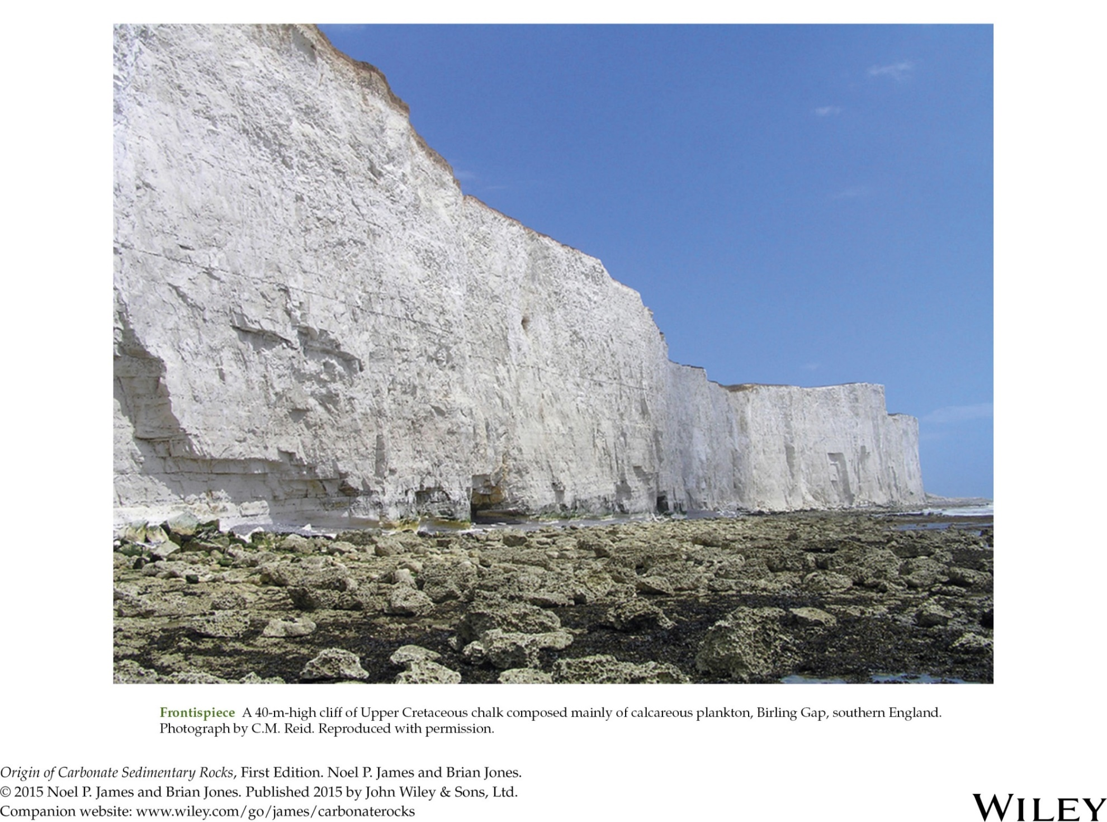
Deep-water carbonates

Slide 3
Outline
1
Universal controls
2
Depositional controls
3
Old pelagic sediments
4
Young pelagic sediments
5
The pelagic factory
6
Chalk

Slide 4
Introduction
Pelagic carbonate (Frontispiece, Figure 17.1) accumulates largely below depths of ~200 m and is usually uniform over large areas.
The modern deep open benthic carbonate factory produces sediment at a very slow rate because, in this twilight to perpetually dark and relatively cold environment, there are no algae or ooids, just sparse benthic invertebrates and skeletons of nektic animals.
Any carbonate sediments that accumulate here must come from the neritic zone via sediment or from the planktic factory in the shallow part of the overlying water column.

Slide 5
Introduction
Pelagic carbonate (Frontispiece) accumulates largely below depths of ~200 m and is usually uniform over large areas.
The modern deep open benthic carbonate factory produces sediment at a very slow rate because, in this twilight to perpetually dark and relatively cold environment, there are no algae or ooids, just sparse benthic invertebrates and skeletons of nektic animals.
Any carbonate sediments that accumulate here must come from the neritic zone via sediment or from the planktic factory in the shallow part of the overlying water column.
These rocks are commonly called the basinal carbonate facies. They are important as source rocks and reservoir rocks for hydrocarbons.

Slide 6
Universal controls
Global tectonics
Depositional environments for basinal carbonate facies (Figure 1.8) are either:
(1) cratonic, on continental crust (Cratonic locations are varied, but in general are epeiric seas, intracratonic basins and seaways, or continental margins).
(2) oceanic, in the deep sea far removed from land, generally on oceanic crust (Oceanic settings range from abyssal plains to continental borderlands, volcanic seamounts, aseismic ridges, submerged plateaus, and mid-ocean ridges).

Slide 7
Universal controls
Cratonic pelagic carbonate sedimentary rocks are generally well preserved as part of continental successions. In contrast, the oldest in-place oceanic pelagic carbonates are Late Jurassic.
All Precambrian and Paleozoic and many younger pelagic carbonate successions are only preserved in tectonically complex areas of collisional and accretionary orogens.

Slide 8
Universal controls
Global sea level
Deep ocean basins can be repositories of pelagic sediment at any time, but cratons are depocenters only when sea level is exceptionally high such as during the Phanerozoic (e.g., Ordovician–Mississippian and Jurassic–Eocene).
The Phanerozoic history of pelagic sedimentation can therefore be divided into old deepwater pelagic carbonate deposits and young deepwater pelagic carbonate deposits (Figure).

Slide 9
Universal controls
Evolutionary biology
The most important event in the history of pelagic sedimentation was the evolution of calcareous plankton in the middle Mesozoic. This event changed the nature of pelagic carbonate sedimentation forever.
Precambrian pelagic carbonates might have formed in early oceans from highly carbonate-saturated seawater.
Paleozoic pelagic deposits (Figure 17.3), the “old” pelagic carbonates, consist of condensed limestone sequences with shales or cherts and only accessory nektic and benthic macrofossils.
By contrast, Mesozoic and younger pelagic carbonates are dominated by calcareous plankton. These microfossils are, for example, responsible for the widespread chalk deposits of the late Phanerozoic.

Slide 10
Universal controls

Slide 11
Depositional controls
Dissolution
Accumulation of calcareous sediment on the seafloor is a balance between the rate of supply versus the rate of dissolution.
A major control on the preservation of pelagic carbonate is the location and depth of the carbonate compensation depth (CCD) and aragonite compensation depth (ACD).
Dissolution is a function of many variables including decreased temperature, increased hydrostatic pressure, and increased CO2 content of the water with increasing depth.
Even below these depths, dissolution may not occur immediately because most grains have organic coatings or are held in organic-rich fecal pellets.

Slide 12
Depositional controls
Dissolution
In the modern world, below the CCD where organic coatings have disappeared, there is no carbonate and the seafloor is covered with red clay and biosiliceous ooze.
The deep-ocean hills that protrude up above the CCD today are mantled with white pelagic carbonate and have been called the “snow-capped mountains of the deep sea”, with the snow being the white carbonate sediment.
The lysocline, the depth where dissolution begins, is much shallower.
The positions of the CCD and ACD have varied in space and time. They are mostly affected by nutrient concentrations in the surface waters, which determine the rate of biogenic carbonate production and thus sediment supply, and the degree of undersaturation of the deep water.

Slide 13
Depositional controls
Dissolution
These controls are also affected by water temperature and salinity that are, in turn, controlled by plate tectonics.
Dissolution is also affected by the rate of organic matter breakdown, which releases CO₂.
Deep water loses oxygen and becomes more CO₂ rich with increasing age because of biological consumption and organic matter decomposition.
Older deep ocean waters that have been circulating for a long time, on the order of 1500 years, are therefore more chemically aggressive.
The CCD also shallows close to continental margins where the input of organic matter is high and CO₂ levels are increased.

Slide 14
Depositional controls
Submarine currents
The deep seafloor lies below the effects of tides and surface waves. The importance of internal waves is poorly understood but carbonate particles can be winnowed and sorted by other seafloor currents to produce grainy pelagic sediment.
During icehouse times and periods of invigorated oceanic circulation, bottom currents are highly active and can remove sediment, resulting in hiatuses in the form of hardgrounds or iron manganese nodules.
Contour currents along continental margins are particularly important in this regard.
Today, contour currents along the eastern margin of the north Atlantic have velocities of 15–35 cm s–1, and are easily capable of eroding, sorting, and transporting finegrained pelagic sediment.
Seafloor erosion can be significant even during greenhouse times and associated high sea levels (Figure 17.4).

Slide 15
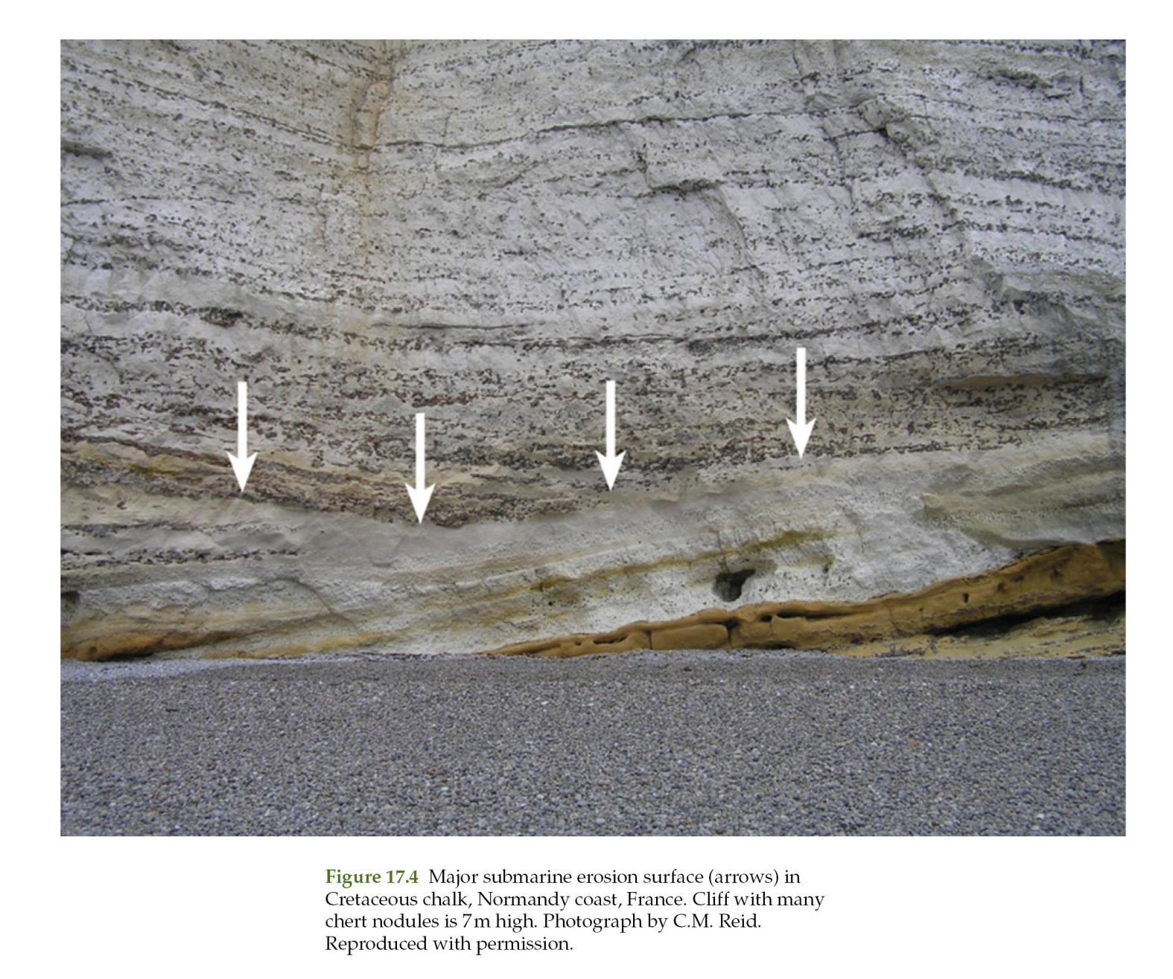
Depositional controls

Slide 16
Universal attributes
Phanerozoic pelagic carbonates are characterized by the following general attributes:
1. the presence of planktic or nektic macrofossil remains;
2. fine-grained, well-bedded sediments of great lateral extent with gradual lateral facies changes;
3. sediment with numerous fecal pellets, small-scale laminations, or centimeter- to meter thick rhythms (e.g., chalk-marl cycles);
4. numerous carbonate nodules in otherwise argillaceous or marly sediments that formed through early synsedimentary lithification and subsequent pressure solution;
5. condensed sections (thin successions accumulating over long periods) that were deposited

Slide 17
Universal attributes
5. condensed sections (thin successions accumulating over long periods) that were deposited at slow rates and punctuated by numerous depositional breaks, typically in the form of multiple hardground horizons that mark submarine lithification events associated with hiatuses;
6. ripple marks but no large-scale bedforms;
7. burrow assemblages dominated by ichnogenera such as Helminthoidea, Paleodictyon, and Chondrites in deep-water facies and Thalassinoides and Chondrites in shallow-water settings; and
8. mineral-encrusted (glauconite, Mn-Fe oxides, phosphate) burrow linings and hardgrounds.

Slide 18
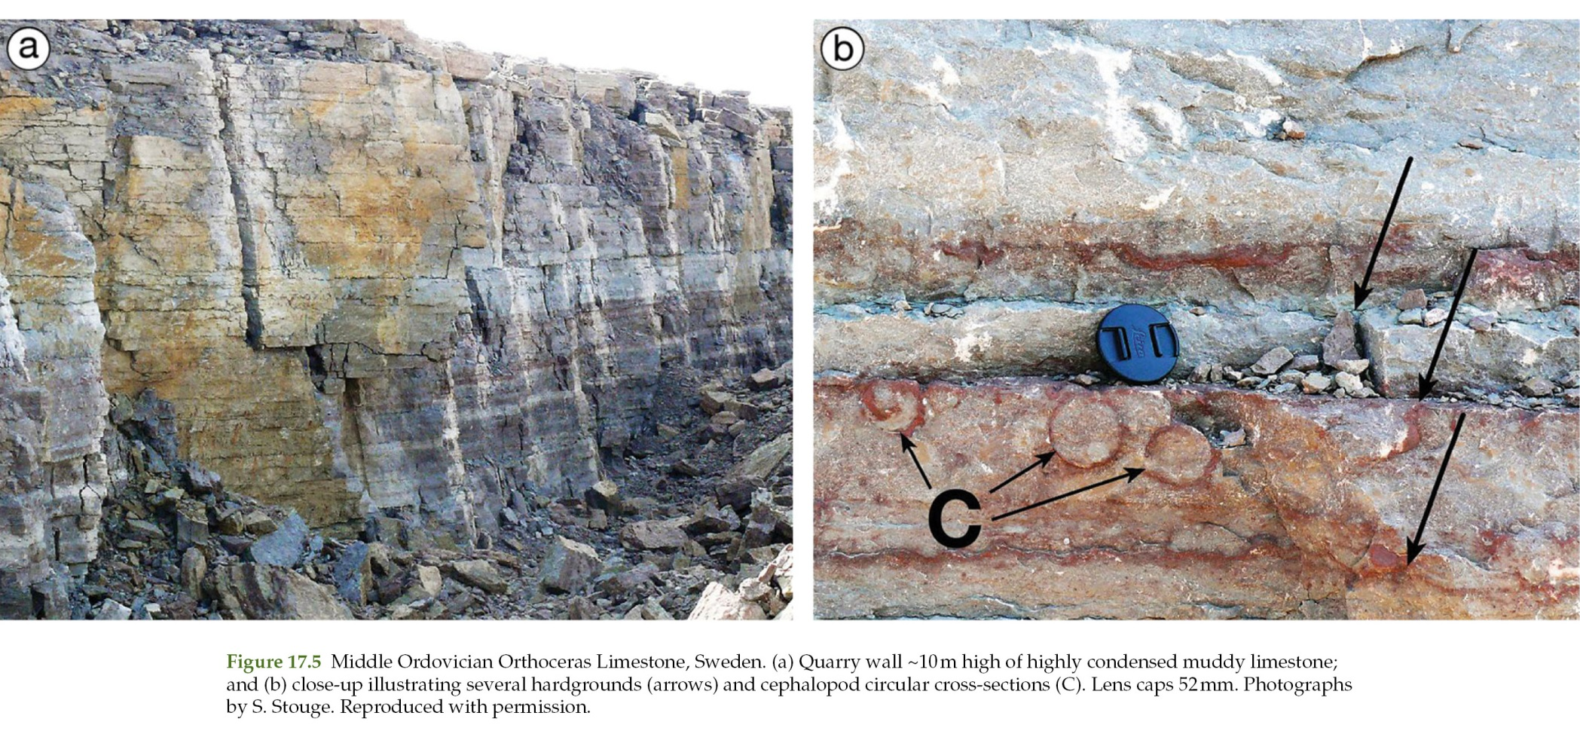
The reef mosaic

Slide 19
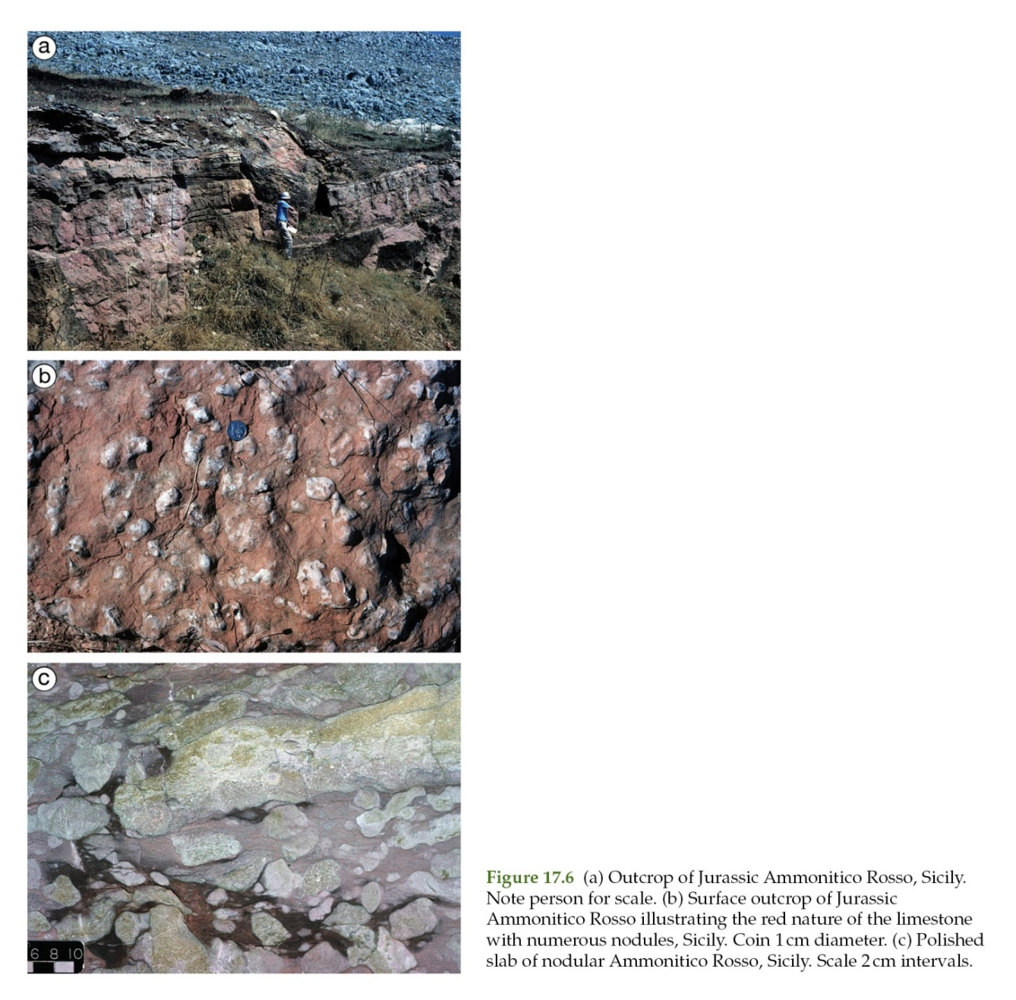
The reef mosaic

Slide 20
The pelagic factory
Biogenic production
Calcareous and non-calcareous plankton are the base of the pelagic food chain. Whereas only calcareous plankton produce mineralized sediment, both types of plankton are food for heterozoans such as fish, crustaceans, mollusks, and other nektic animals.
Planktic productivity is dependent upon nutrients, water temperature, light, and salinity, all of which vary with latitude, climate, and water circulation.
Both organic productivity and carbonate productivity are highest in areas of upwelling along continental margins, equatorial regions, and at places where oceanic currents diverge (Figure 17.7).
Most calcareous plankton production today is in warm surface waters at low latitudes. Siliceous plankton are concentrated in, but not confined to, cooler surface waters and areas of higher trophic resources.

Slide 21
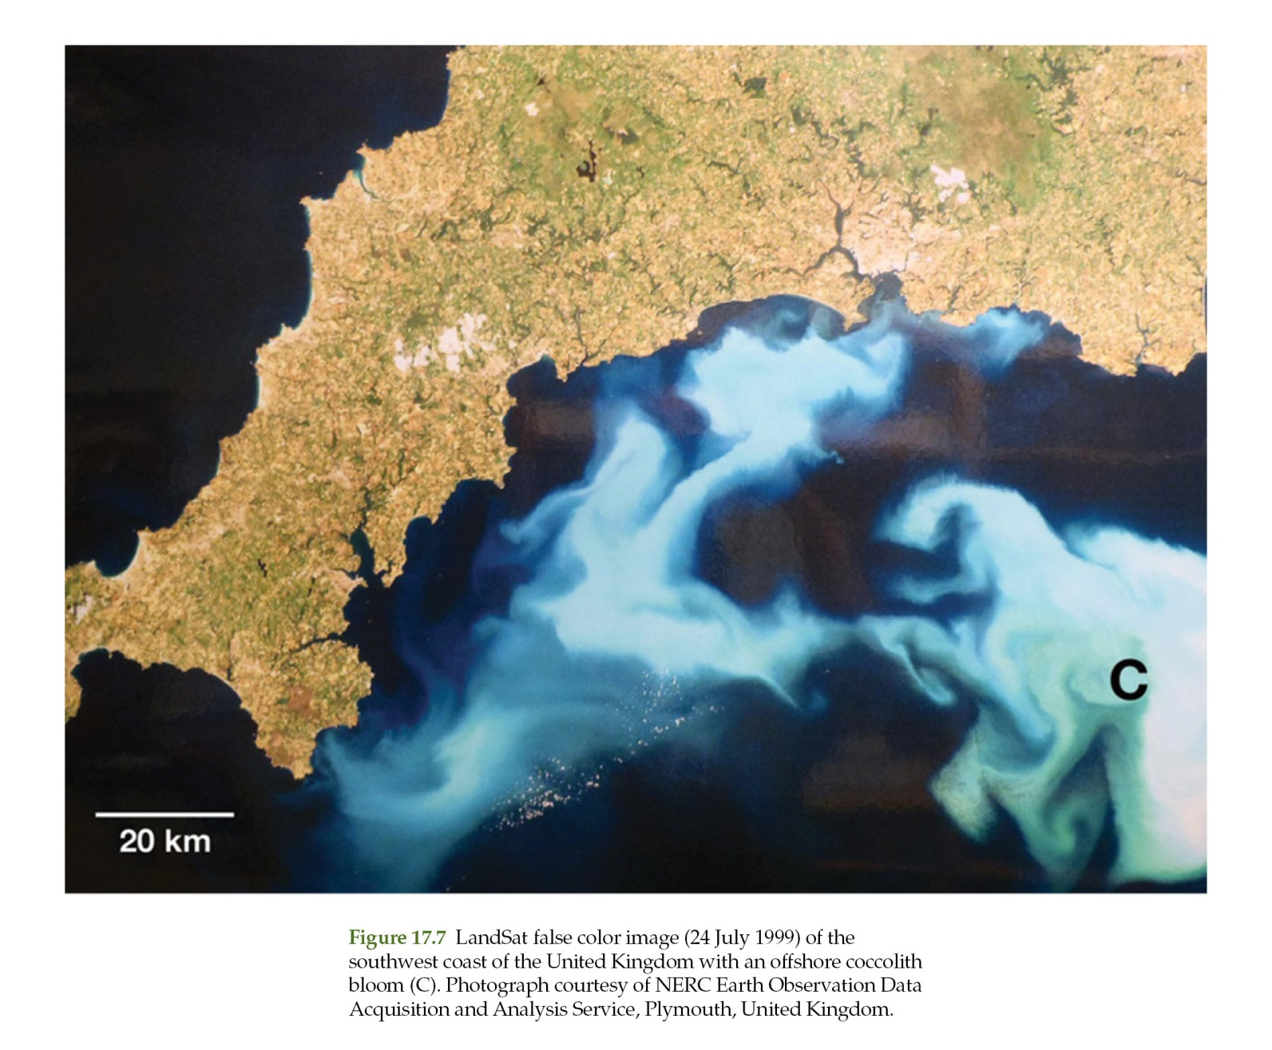
The pelagic factory

Slide 22
The pelagic factory
Biogenic production
Today, the community of planktic organisms in near-surface waters today comprises the autotrophic coccolithophorids and diatoms and the heterotrophic planktic foraminifers, pteropods, and radiolarians.
The yellow-green “golden” unicellular algae known as coccolithophoridae produce spherical tests (microscopic skeletons) 10–100 μm in diameter (coccospheres) that are formed of platelets 2–20 μm wide (coccoliths) (Next Fig. a).
Coccoliths are plentiful, with 50,000–500,000 L–1 of seawater.
The less numerous but conspicuous pteropods are conical planktic gastropods up to a few millimeters long.
The skeletons of calcareous plankton sink to the deep seafloor at various rates. Planktic foraminifers >50–60 μm in size (Next Fig. b) take only a few days to sink, whereas
nannofossils such as coccoliths that are ~5 μm in size take, on average, 100 years.

Slide 23
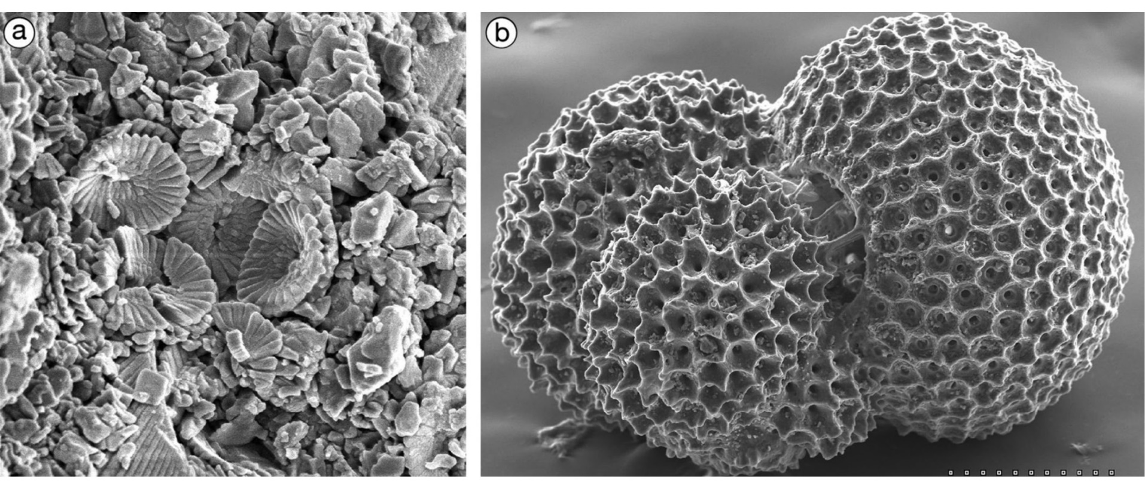
The pelagic factory
Biogenic production
(a) Cretaceous chalk composed almost entirely of coccolith fragments, subsurface Cuba. Image width 9 μm.
(b) SEM image of the planktic foraminifer Globigerinoides ruber. Image width 300 μm.

Slide 24
The pelagic factory
Calcareous ooze
The most widespread and voluminous pelagic sediment in the modern ocean is biogenic ooze, a deposit of pelagic sediment of which at least 30% is skeletal.
Early sailors who dredged this fine-grained, soft, soupy sediment from the deep seafloor worldwide coined the word “ooze.”
The sediment grain size is polymodal, with peaks at
0.5 μm (calcite laths from disintegrated coccoliths),
1–5 μm (whole coccolith plates),
5–20 μm (larger coccoliths, coccospheres, comminuted foraminifers, and other skeletal fragments),
25–64 μm (whole foraminifers), and
>64 μm (foraminifers, bivalve prisms, and other macrofossil fragments).

Slide 25
The pelagic factory
Calcareous ooze
The critical point in terms of subsequent diagenesis is that the dominant components, planktic foraminifers and coccoliths, are formed of LMC.
In contrast, the pteropods are composed of aragonite, and are therefore more soluble and generally only seen in shallow tropical waters above the ACD.

Slide 26
The pelagic factory
Dilution of pelagic sediment
The slow accumulation rate of pelagic carbonate means that the deposit can be easily diluted by siliciclastic sediment (Figure 17.9).
Dilution depends upon several factors such as the rate of pelagic fallout, distance from land, depth below sea level, local bathymetry, climate, and wind direction.
Most of these controls affect the introduction of fine siliciclastics into the system via a variety of fluvial processes.
Aeolian dust is also an important source of fine terrigenous sediment because it can be dispersed over such a wide area.
Pelagic carbonates adjacent to platforms and ramps are both diluted by and interbedded with resedimented neritic carbonates.

Slide 27
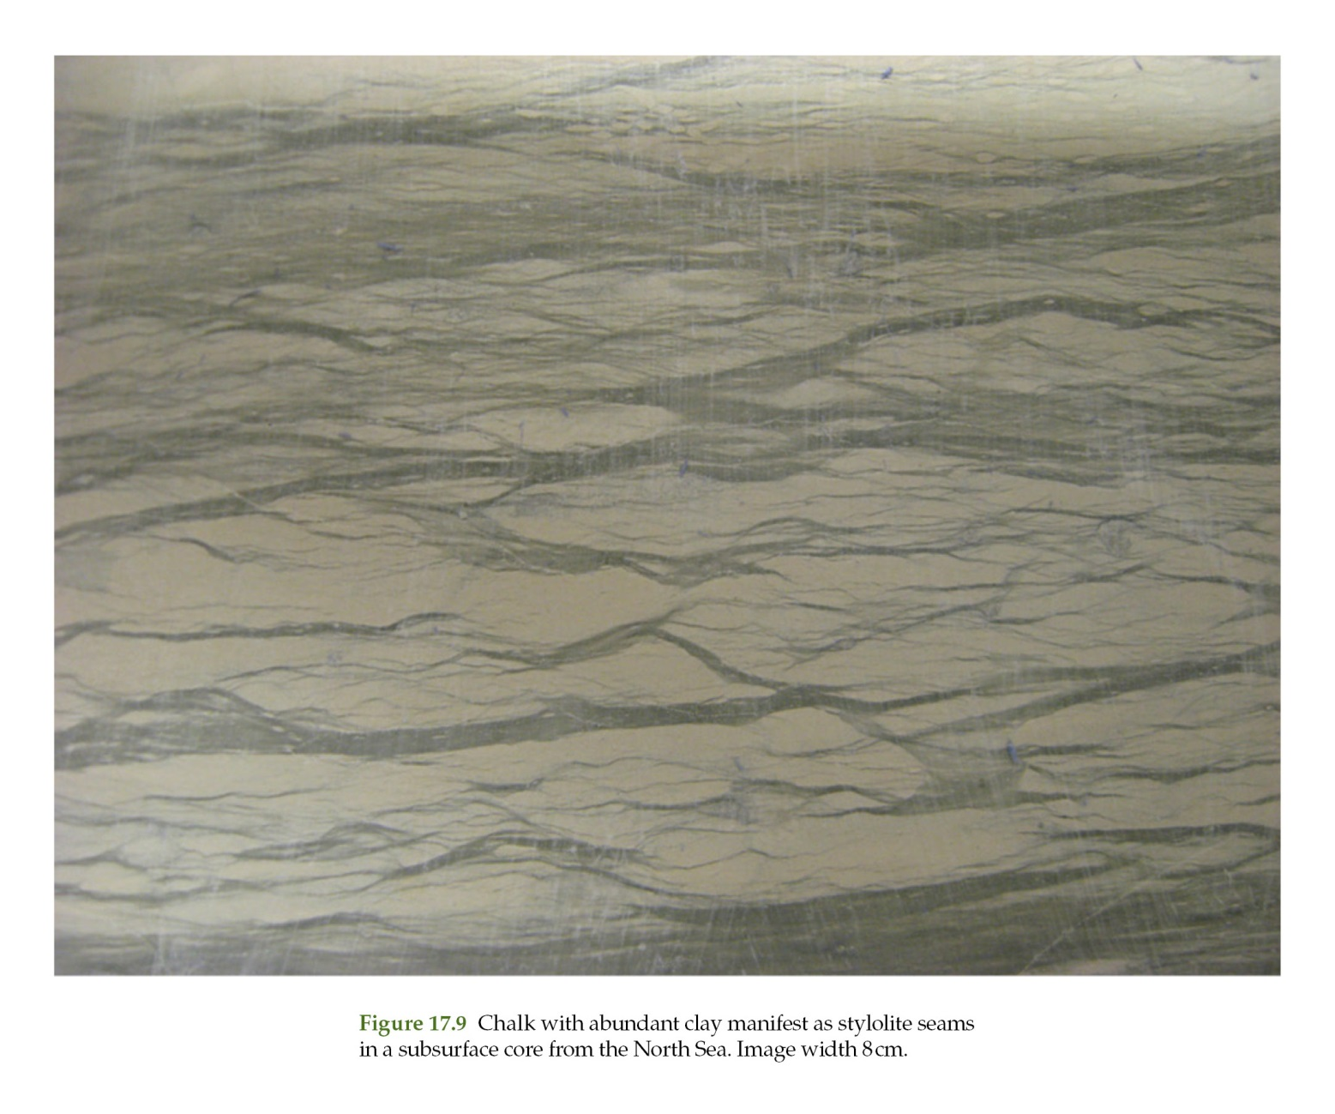
The pelagic factory

Slide 28
Chalk
The most impressive sedimentary deposit of the late Mesozoic–Cenozoic is chalk (next silde), from which the Cretaceous period gets its name.
Chalk is pelagic carbonate sediment that is predominantly Late Cretaceous in age and is present across large cratonic areas of North America and Europe.
Chalk accumulated during a greenhouse time when global sea level was 200–300 m higher than it is today.

Slide 29
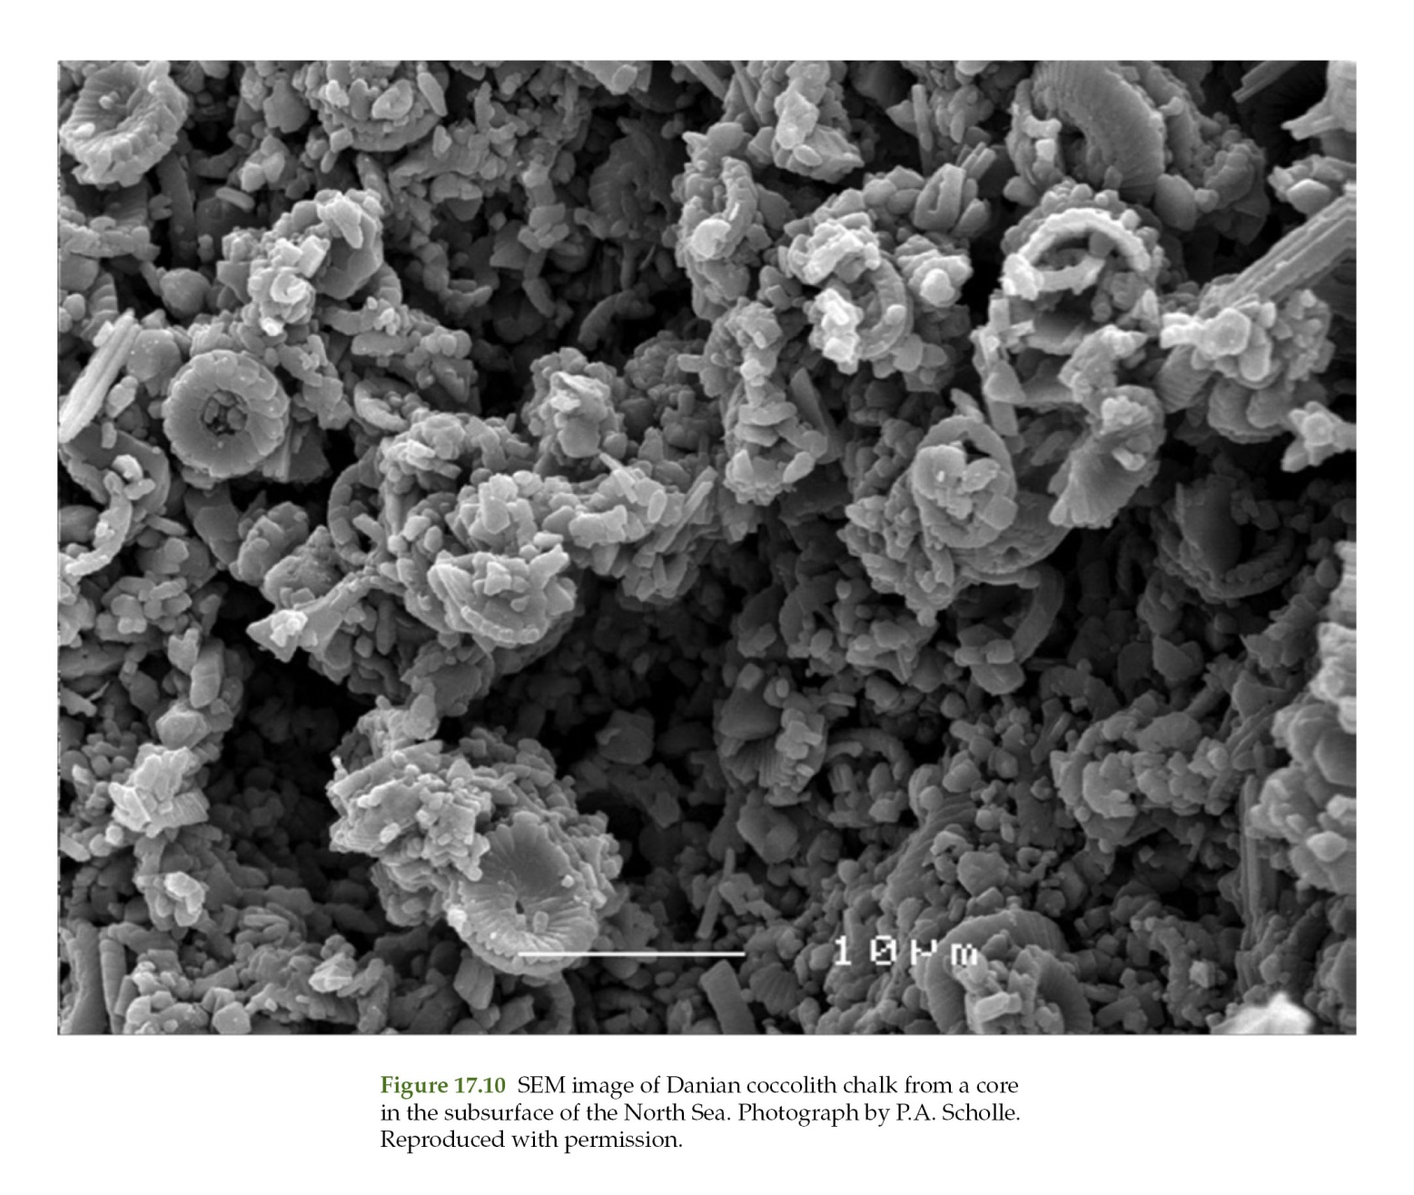
Chalk

Slide 30
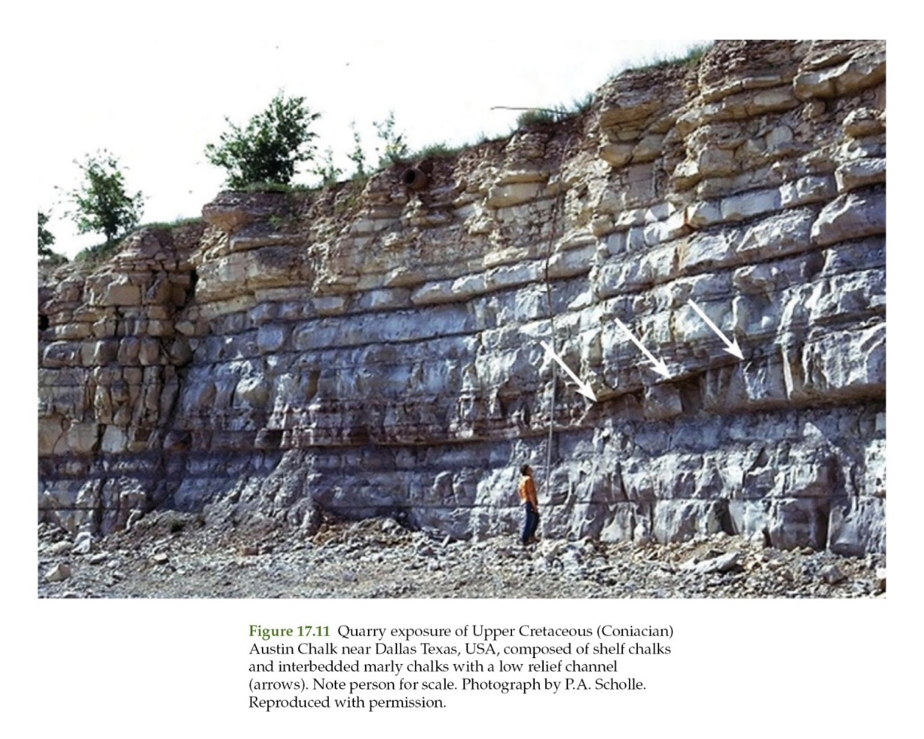
Chalk
North America
Pelagic carbonates in North America (Figure 17.11) are restricted to the elongate, north–south Western Interior Seaway and, to a lesser extent, the Eastern Seaboard of the continent.

Slide 31
Chalk
North America
Their distribution in the Seaway was largely controlled by the influx of fluvial terrigenous sediment, especially from the rising Cordillera to the west.
The influx of fresh water is also thought to have stressed the marine biota because the diversity of all organisms is relatively low.
The macrobiota is mostly mollusks; there is a conspicuous lack of burrowers and hence excellent preservation of sedimentary structures, especially laminations.
Hardgrounds are not well developed.
Water depths were on the order of a few hundred meters.
Lowstands are represented by siliciclastic sediments, especially shales.

Slide 32
Chalk
Europe
Pelagic carbonates (Figure 17.12) accumulated over large areas of Europe, largely because there was little terrigenous input due to a somewhat arid climate.
Successions are thicker than those in North America (generally ~200 m) and are up to 1000 m thick in the North Sea Basin.
The ocean was more normal marine than in the Interior Seaway of North America, and there was a more diverse microbiota and macrobiota; the latter being dominated by siliceous sponges, brachiopods, mollusks, bryozoans, and echinoderms with lesser amounts of pelagic ammonites, belemnites, and crinoids.

Slide 33
Chalk
Europe
Shallow facies included a significant benthic fauna of echinoids, bivalves, sponges, brachiopods, and bryozoans. The sediments are intensively burrowed and contain much more chert (from sponges) (Figure 17.12) than the North American sediments.
The carbonates also pass laterally into more diverse marginal-marine carbonate facies including greensands, phosphatic chalks, hardgrounds, and shelly chalks.
Lowstand deposits are typically hardground omission surfaces. Spiculitic diagenetic chert (flint) is a hallmark of the chalk (Figure 17.12) with many burrows replaced by chert nodules.

Slide 34
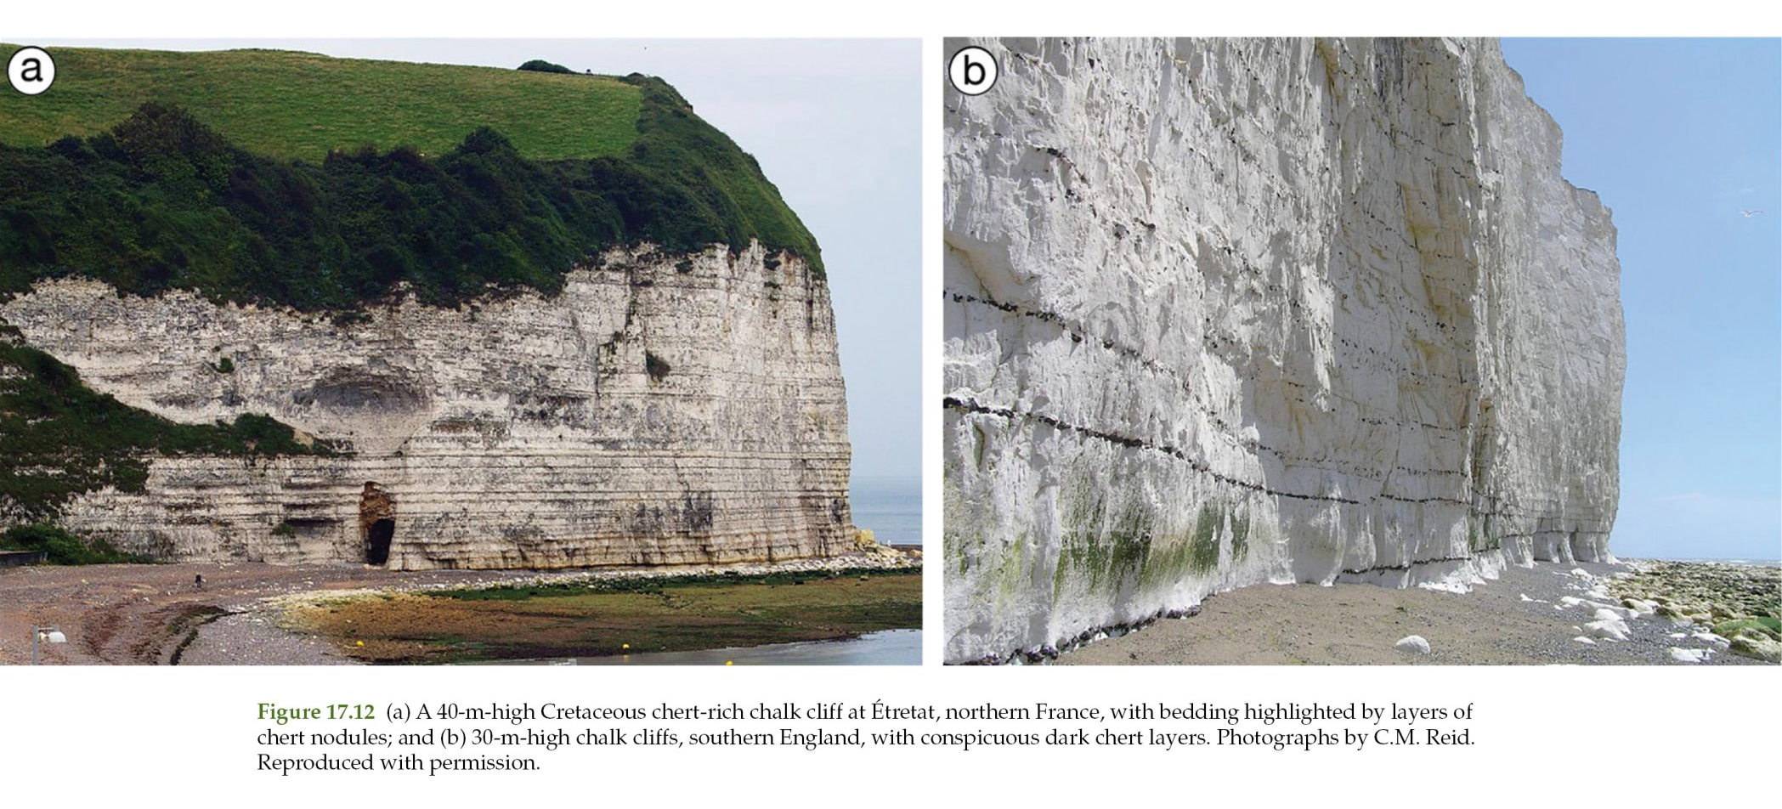
Chalk

Slide 35
Sedimentation rates
Sedimentation rates
The accumulation rates of Mesozoic–Cenozoic pelagic sediments (uncompacted) were on the order of ~30 mm ky–1.
In the North Sea Basin they ranged from 150 to 250 mm ky–1.

Slide 36
Sedimentation rates
Diagenesis
Diagenesis has been intensively investigated in the chalk because of its importance as a hydrocarbon reservoir. Much of the chalk is weakly lithified and has a very high microporosity.
Alteration is nevertheless present in the form of conspicuous well-cemented and nodular layers.
The softness of the chalk is thought to be due to:
(1) the dominantly LMC original mineralogy of the particles, with no aragonite to supply cement; and
(2) the nature of the burial fluids that were of marine origin; there was no dissolution and cement precipitation from meteoric waters as with other limestones.
Another factor is that they may not have been buried very deeply.

Slide 37
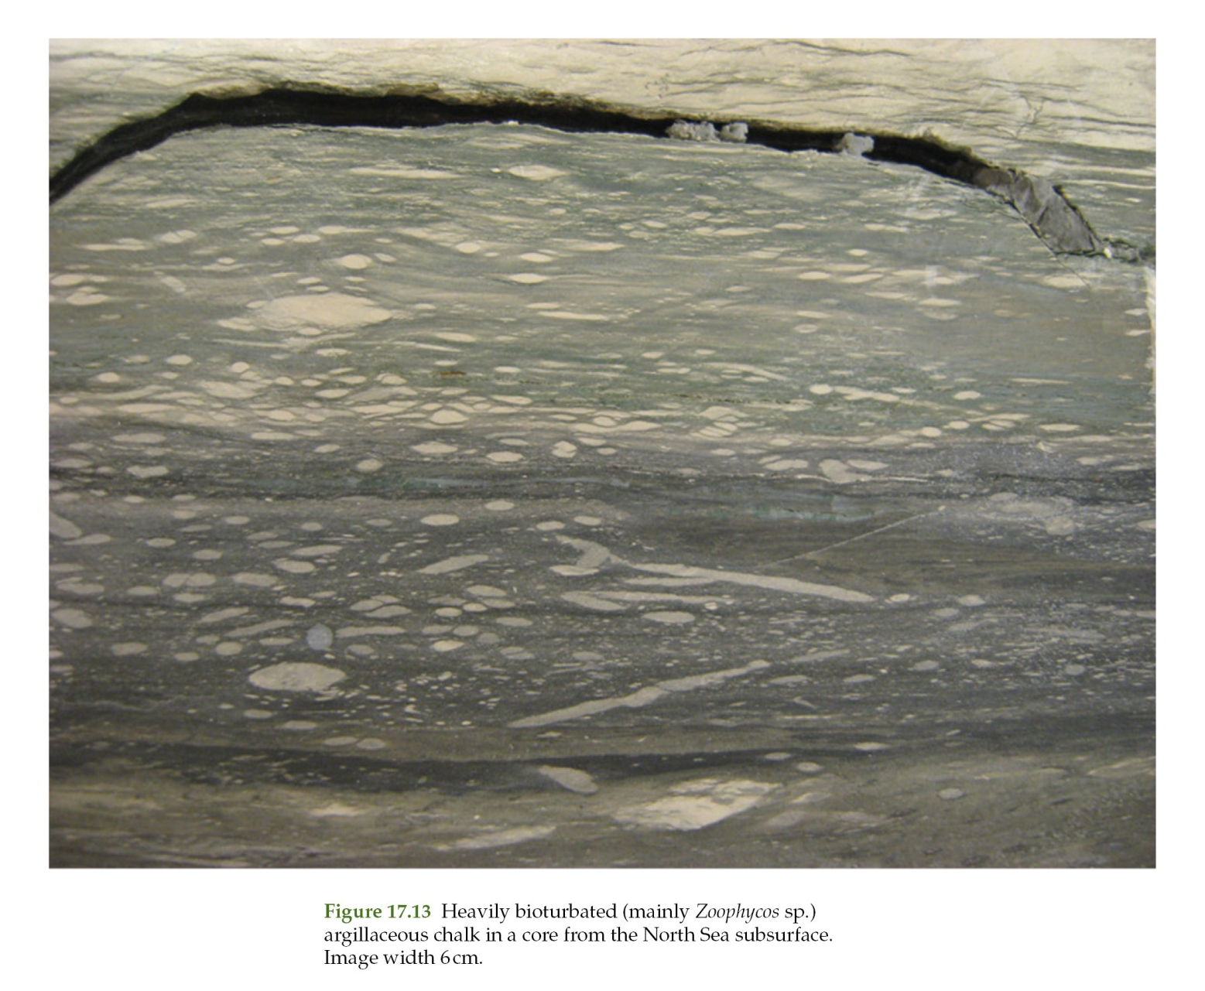
Sedimentation rates

Slide 38
Sedimentation rates
Seafloor lithification in the form of hardgrounds (Figure 17.14) was important because it led to the formation of subsurface aquicludes in otherwise porous stratigraphic sections.
Cementation was principally by dHMC, aragonite, glauconite, and phosphate. There was a recurring progression of cementation associated with burrows:
(1) burrow fillings were lithified; and then (2) lithification expanded to form calcareous nodules. In some situations, the nodules were then winnowed out to form clasts.
Given their relatively simple composition, the diagenetic transformation of many pelagic sediments can be predicted and modeled.
This is especially important when considering such sediments as potential petroleum reservoirs.

Slide 39
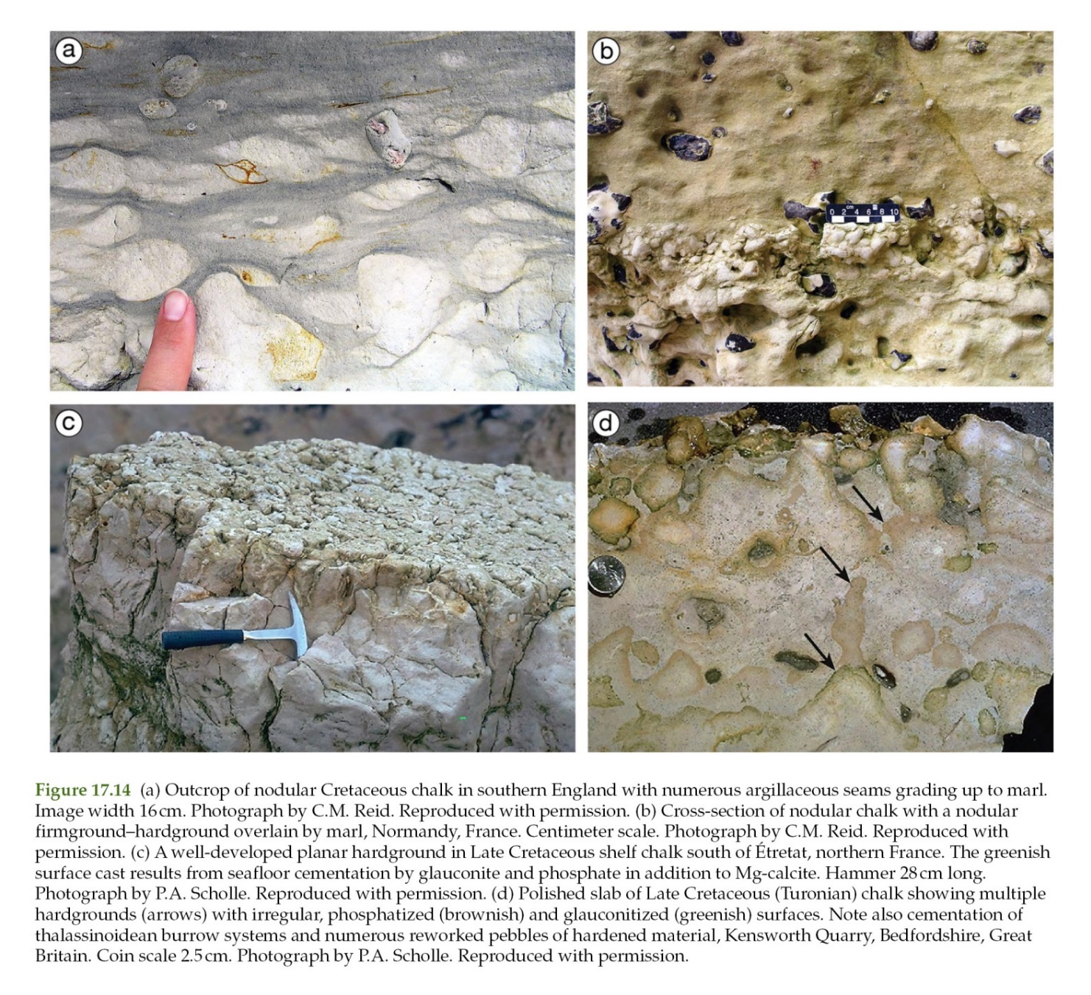
Chalk

Slide 40
Thank You !
DSRG
www.du.edu.eg/faculty/sci

